Slide 1
ML Model Performance
Bias-Variance Tradeoff
Underfitting, Overfitting, Bias & Variance

Slide 2
ML Model Performance
Goal: Build a model that generalizes well to unseen data
Performance measured by metrics like accuracy, precision, recall, RMSE
Trade-off between underfitting and overfitting

Slide 3
Underfitting
Model is too simple, fails to capture patterns
High training error & high test error
Example: Using linear model for non-linear data

Slide 4
Overfitting
Model is too complex, memorizes training data
Low training error but high test error
Example: Very deep decision tree without pruning

Slide 5
Bias and Variance
Bias: Error due to wrong assumptions in the model
High bias → Underfitting
Variance: Error due to sensitivity to training data
High variance → Overfitting

Slide 6
Bias-Variance Tradeoff
Increasing model complexity reduces bias but increases variance
Goal: Find the optimal complexity for minimal test error
Regularization techniques help balance bias and variance

Slide 7
Visual Diagrams
Diagram 1: Underfitting vs Overfitting curves
Diagram 2: Bias-Variance Tradeoff curve
Diagram 3: Model Complexity vs Error

Slide 8
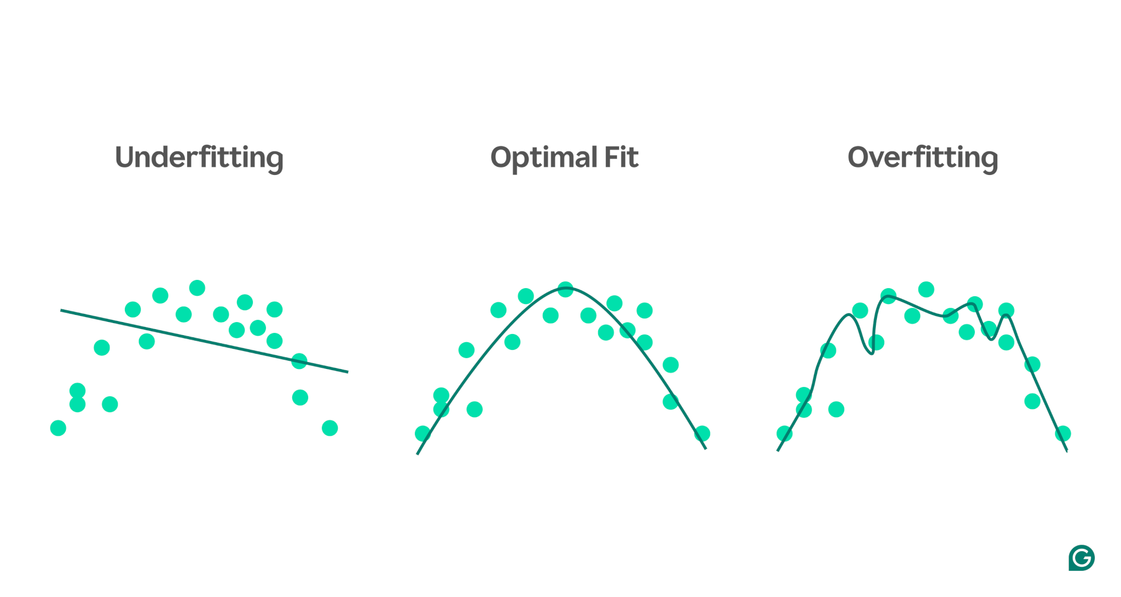
Underfitting vs Overfitting curves
Figure Source: https://www.grammarly.com/blog/ai/what-is-underfitting/

Slide 9
Causes of underfitting
Model architecture is too simple.
Poor feature selection
Insufficient training data
Not enough training
If both the training and validation loss are high and remain close to each other throughout the training process, it means the model is underperforming on both datasets.
This indicates that the model is not capturing enough information from the data to make accurate predictions, which points to underfitting.

Slide 10
Causes of Overfitting
High variance and low bias.
The model is too complex.
The size of the training data.

Slide 11
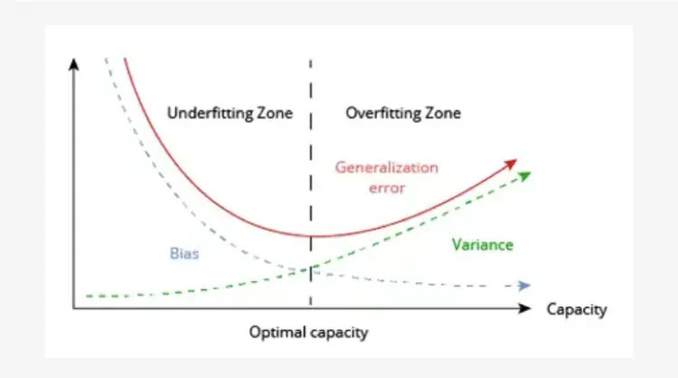
Bias-Variance Trade-off
Error
Model Complexity

