Slide 1
Support Vector Machines

Slide 2
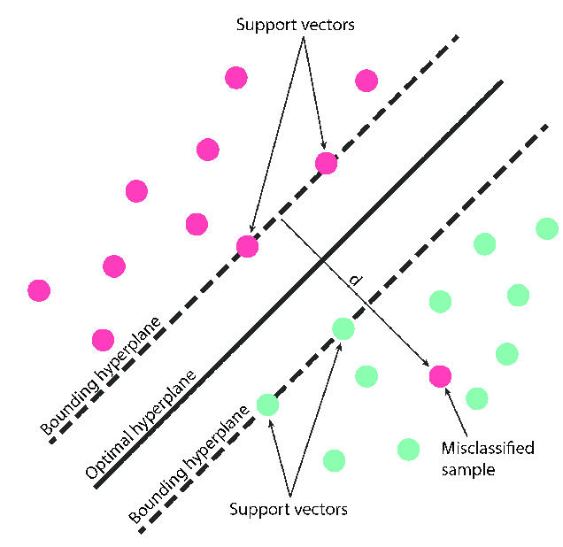
Support Vector Machine Classifier
A Support Vector Machine (SVM) classifier is a supervised machine learning algorithm that finds an optimal hyperplane to separate data into different classes.
The core idea is to find the hyperplane that has the largest possible margin—the distance between the hyperplane and the closest data points of each class.

Slide 3
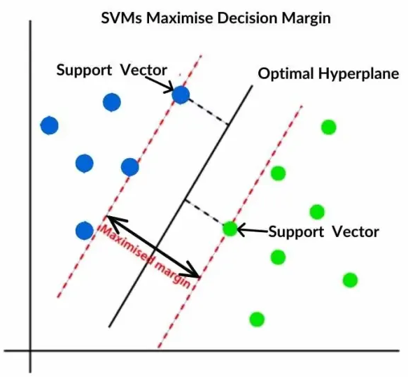
Key Points
Hyperplane: In a 2D space, a hyperplane is simply a line. In a 3D space, it's a plane. In spaces with more than three dimensions, it's a hyperplane. It serves as the decision boundary that separates the data points of one class from another.
Support Vectors: These are the data points closest to the hyperplane. They're the most critical points
because they "support" and define the position and orientation of the hyperplane. Removing any other
data points won't affect the hyperplane, but moving or removing a support vector will.
Margin: The margin is the distance between the hyperplane and the support vectors. The goal of
an SVM is to maximize this margin. A larger margin generally leads to better generalization, meaning
the model is more likely to correctly classify new, unseen data.

Slide 4
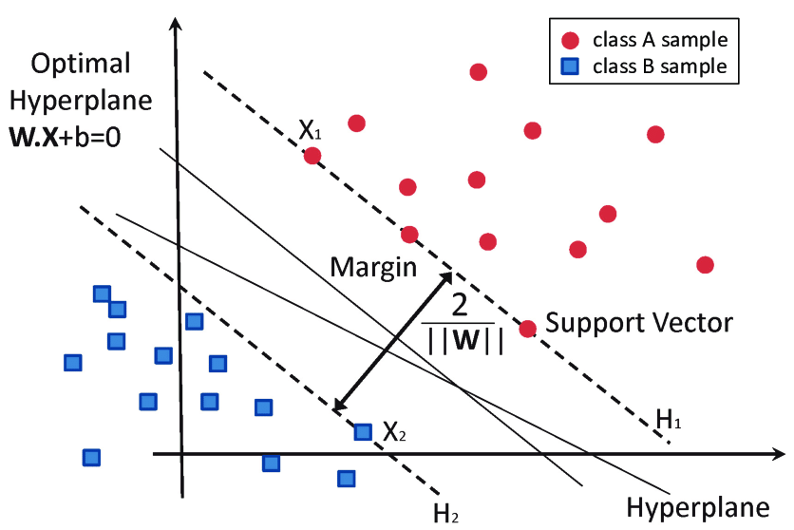
Linear Classification
For data that is linearly separable (meaning a single straight line or plane can divide the classes), the SVM algorithm works as follows:
The algorithm identifies multiple possible hyperplanes that could separate the data.
It then selects the single best hyperplane—the one that maximizes the distance to the nearest data points of each class. This is known as the maximum-margin hyperplane.
The data points that lie on the margin boundaries are the support vectors. The SVM classifier is entirely defined by these vectors and the maximum margin they create.

Slide 5
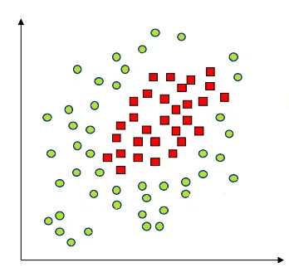

Non-linear Classification (The Kernel Trick)
Many real-world datasets aren't linearly separable. In these cases, a simple straight line can't effectively separate the classes. This is where the kernel trick comes in.
The kernel trick transforms the data from its original, low-dimensional space into a new, higher-dimensional space.
In this new, higher-dimensional space, the data that was once intertwined and non-separable becomes linearly separable.
The SVM then finds a linear hyperplane in this higher-dimensional space to separate the classes. This hyperplane, when mapped back to the original space, appears as a complex, non-linear boundary.
Common kernel functions include the Radial Basis Function (RBF), polynomial, and sigmoid kernels. The choice of kernel depends on the dataset and problem.

Slide 6
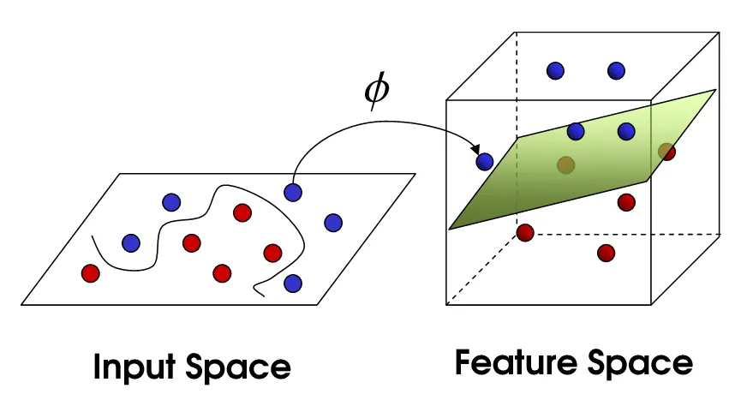
Kernel Trick
If the data is not linearly separable in the original, or input, space then we apply transformations to the data, which map the data from the original space into a higher dimensional feature space.
The goal is that after the transformation to the higher dimensional space, the classes are now linearly separable in this higher dimensional feature space.
We can then fit a decision boundary to separate the classes and make predictions. The decision boundary will be a hyperplane in this higher dimensional space.

Slide 7
Hyper Parameters in SVM
C (Regularization Parameter): This parameter controls the trade-off between maximizing the margin and minimizing misclassification. A small C value creates a wider margin but allows for more misclassifications, making the model more robust to outliers. A large C value results in a narrower margin but penalizes misclassifications more heavily, which can lead to overfitting if the data is noisy.
Gamma: For non-linear kernels like the RBF, the gamma parameter defines how much influence a single training example has. Low gamma means a large influence, leading to a wider, smoother decision boundary. High gamma means a small influence, creating a more complex boundary that might overfit the training data.

Slide 8
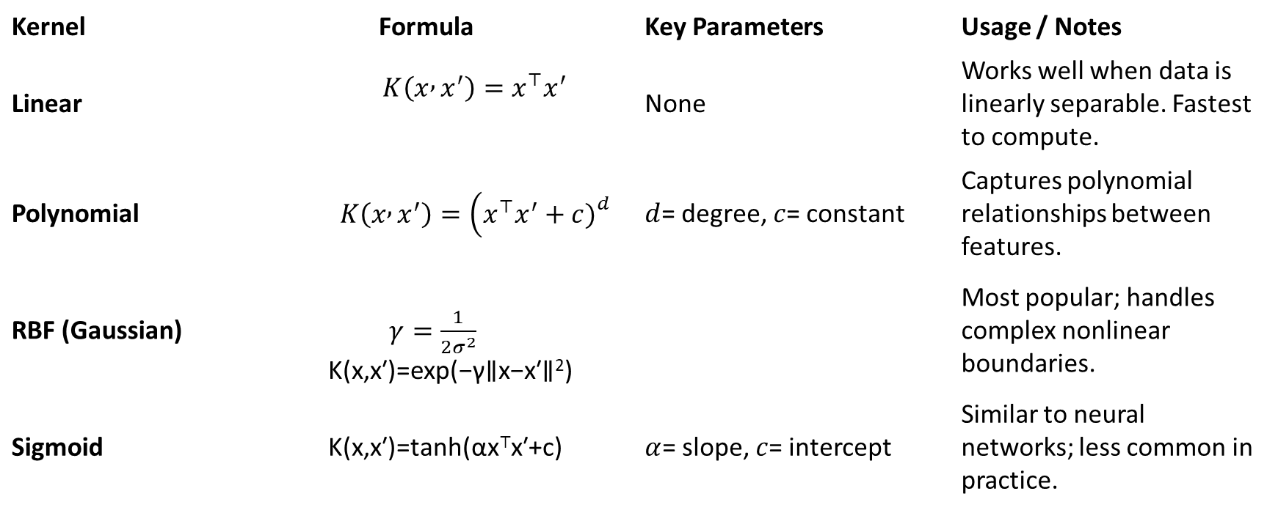
Kernel Functions in SVM
Kernel | Formula | Key Parameters | Usage / Notes
Linear | $$K\left(x , x^{′}\right)=x^{⊤}x^{′}$$ | None | Works well when data is linearly separable. Fastest to compute.
Polynomial | $$K\left(x , x^{′}\right)=\left(x^{⊤}x^{′}+c{\left.)\right.}^{d}\right.$$ | $d$= degree, $c$= constant | Captures polynomial relationships between features.
RBF (Gaussian) | $γ=\frac{1}{2σ^{2}}$ K(x,x′)=exp(−γ∥x−x′∥²) |  | Most popular; handles complex nonlinear boundaries.
Sigmoid | K(x,x′)=tanh(αx⊤x′+c) | $α$= slope, $c$= intercept | Similar to neural networks; less common in practice.

