Slide 1
Artificial Neural Networks
Deep Learning

Slide 2
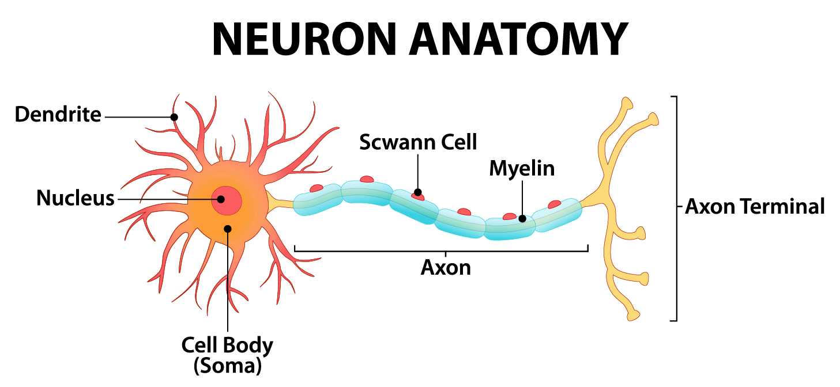
Communication in Human Brain
The human brain has around 86 billion neurons (nerve cells). Each neuron is like a tiny processing unit that communicates with others.
Neuron can be perceived as a "receiver, processor, and sender of information.
Neurons communicate using electrical impulses called action potentials through axons.
The more often two neurons fire together, the stronger their connection (synaptic weight) becomes.

Slide 3
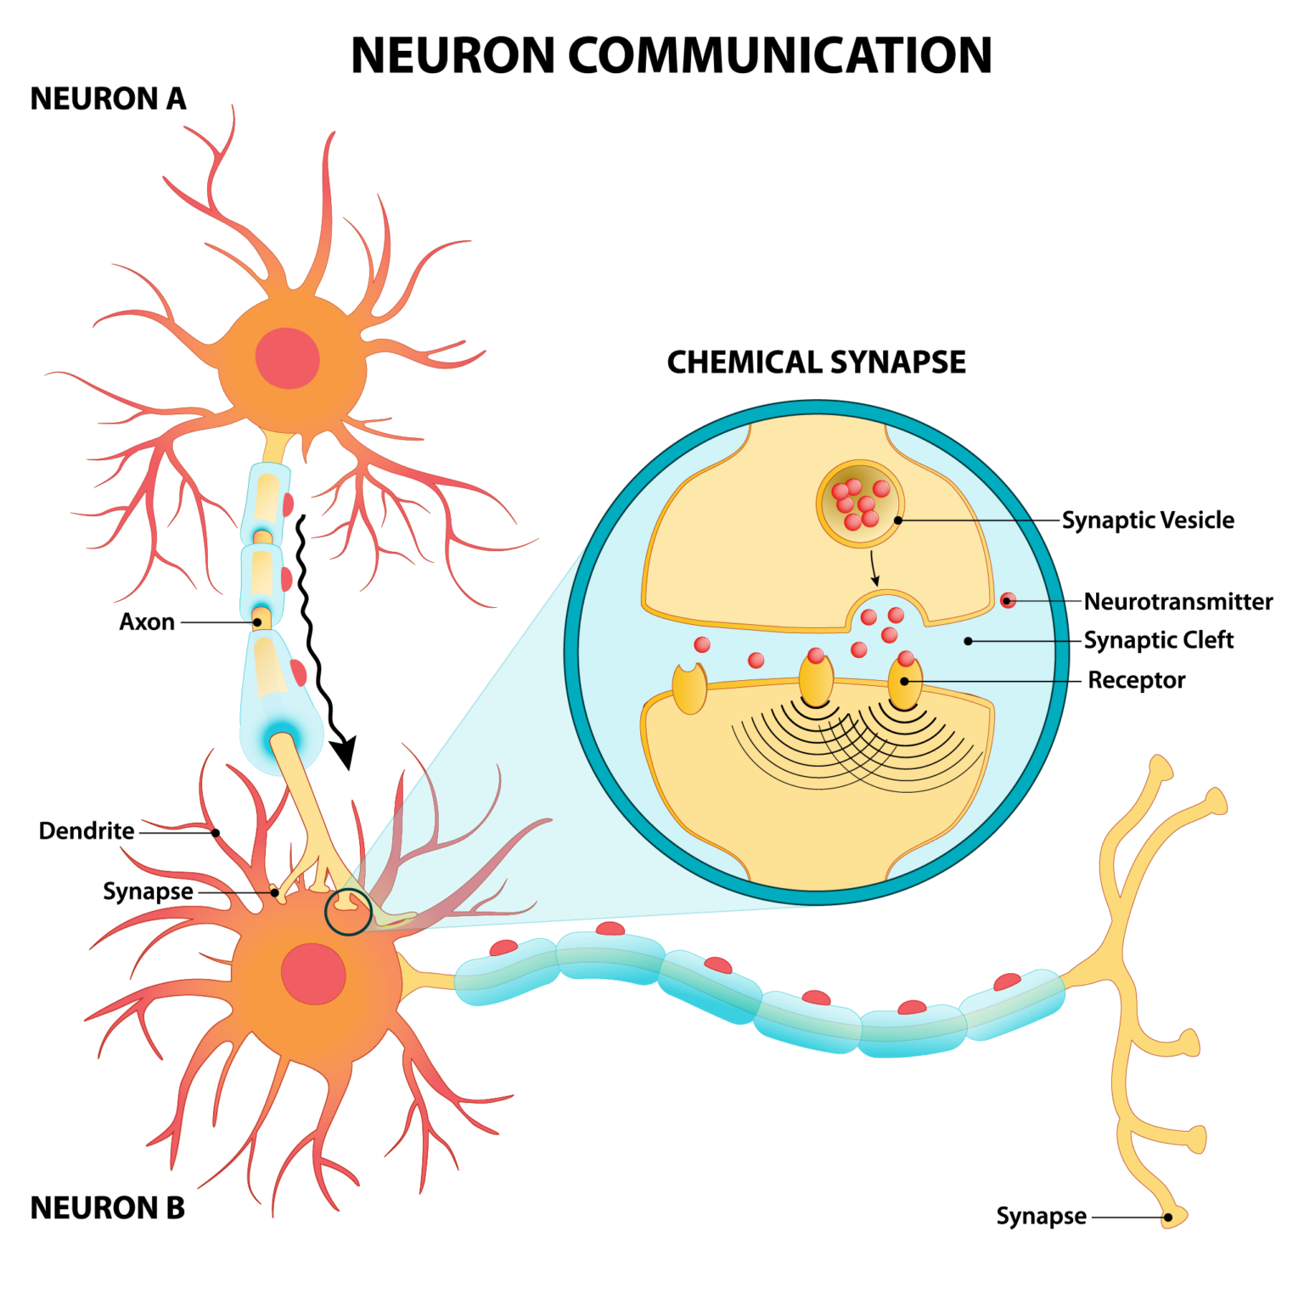
Communication in Human Brain
The junction where two neurons meet is called a synapse and is where intercell communication takes place.
Neurons communicate with one another through action potentials (changes in a neuron’s electric potential) and neurotransmitters
Essentially, synapses convert an electrical signal (the action potential) into a chemical signal (the neurotransmitters) and then back into an electrical signal once it meets the next neuron.

Slide 4
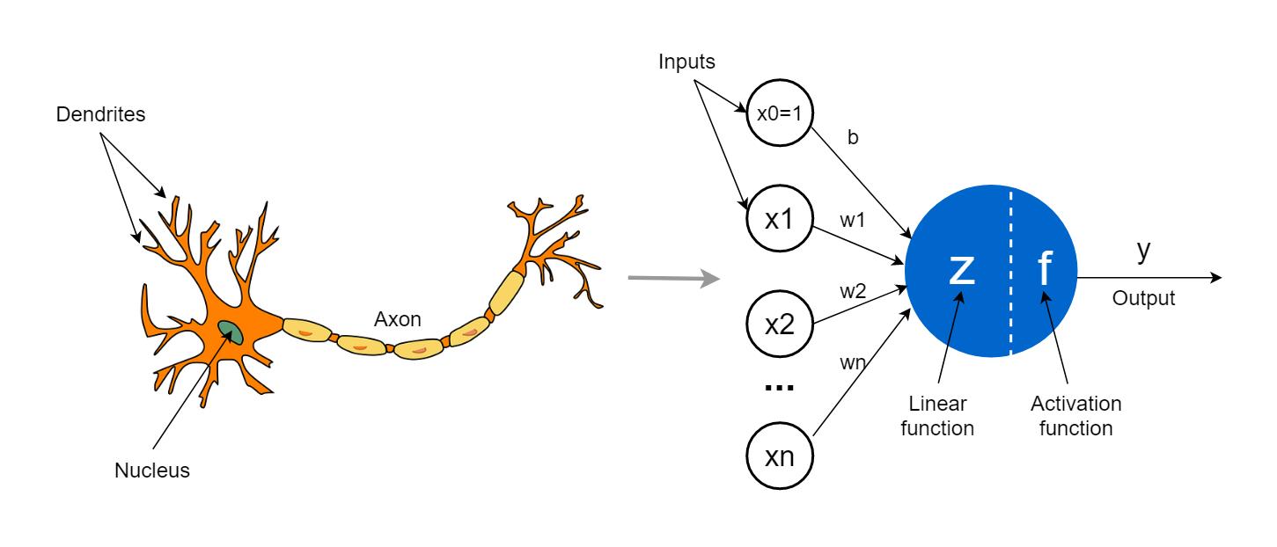
Artificial Neurons(Perceptrons)
An artificial neuron is a mathematical function inspired by how a biological neuron processes signals.
Just like dendrites receive signals, an artificial neuron receives input values

Slide 5
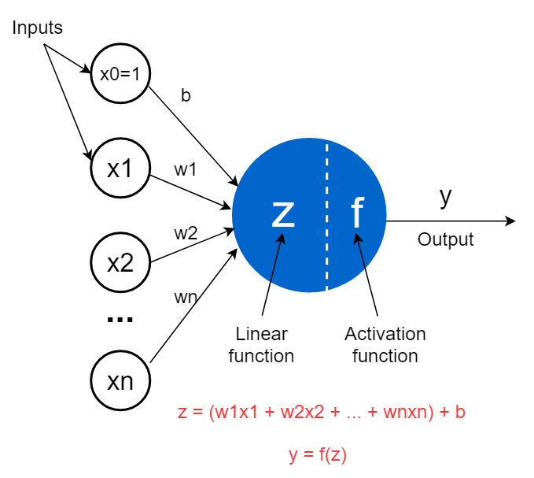
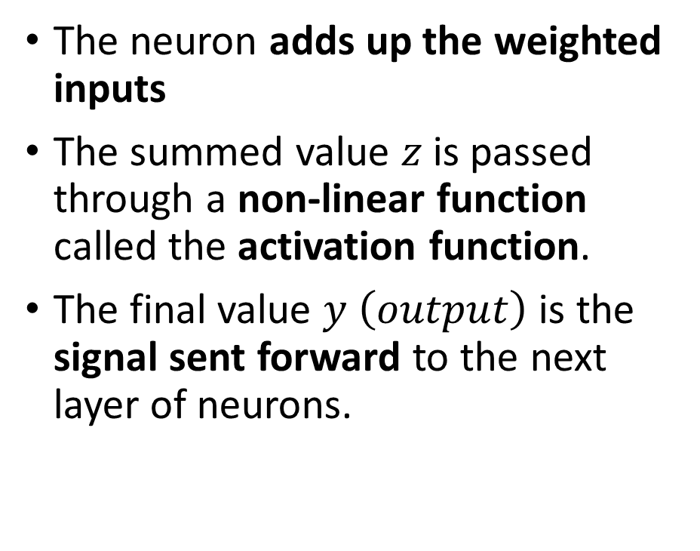
Artificial Neurons
The neuron adds up the weighted inputs
The summed value $z$is passed through a non-linear function called the activation function.
The final value $y \left(output\right)$ is the signal sent forward to the next layer of neurons.

Slide 6
Artificial Neural Network
The b is called the bias term or bias unit that also takes a numerical value. It is added to the weighted sum of inputs.
The purpose of including a bias term is to shift the activation function of each perceptron to not get a zero value.
In other words, if all x1, x2, …, xn inputs are 0, the z is equal to the value of bias.
You can also think of the above z function as a linear regression model in which weights are known as coefficients and the bias term is known as the intercept

Slide 7
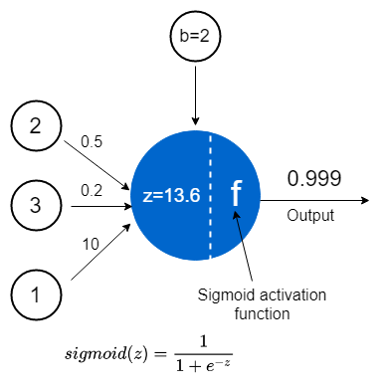
Artificial Neural Network
https://towardsdatascience.com/the-concept-of-artificial-neurons-perceptrons-in-neural-networks-fab22249cbfc/

Slide 8
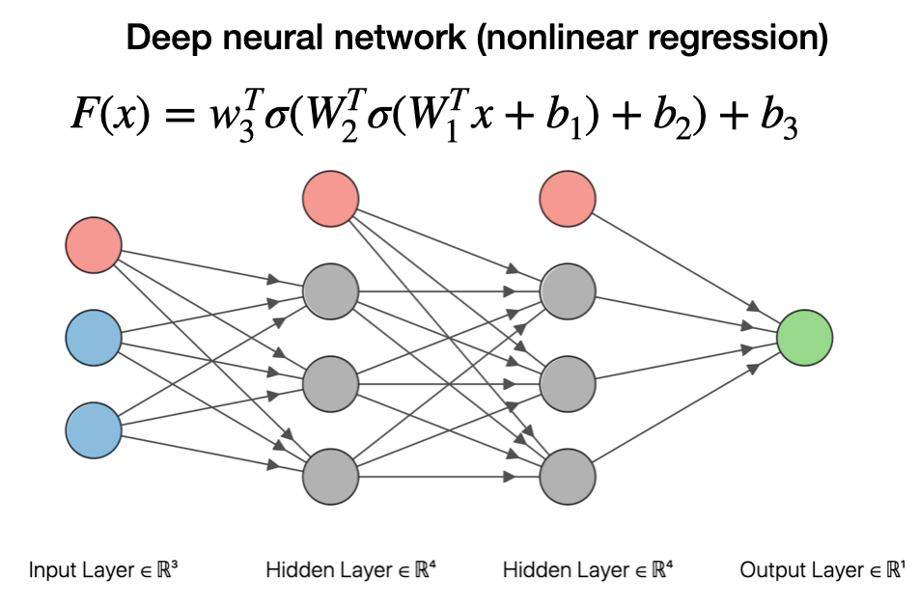
Artificial Neural Network (Regression)
https://joshuagoings.com/2020/05/05/neural-network/

Slide 9
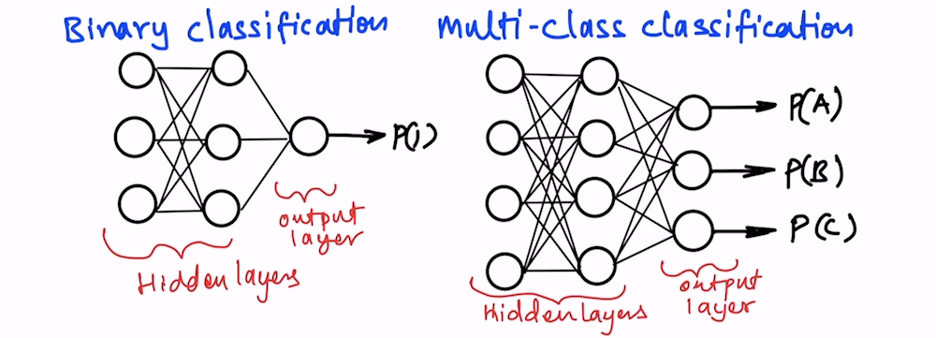
Artificial Neural Network (Classification)
https://thinkingneuron.com/how-to-use-artificial-neural-networks-for-classification-in-python/

Slide 10
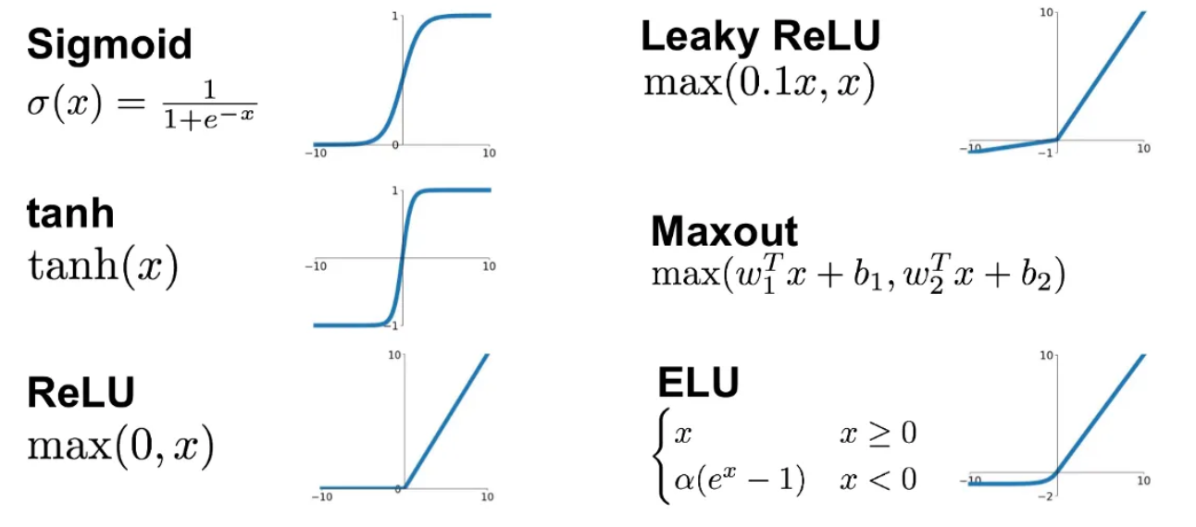
Activation Functions
https://medium.datadriveninvestor.com/types-of-activation-functions-in-deep-learning-e7c2a48d3242

Slide 11

Activation | Formula | Range | Strengths ✅ | Drawbacks ❌ | Typical Use
Sigmoid | $$f\left(x\right)=\frac{1}{1+e^{−x}}$$ | (0, 1) | - Smooth, differentiable- Interpretable as probability | - Vanishing gradients (saturates at extremes)- Not zero-centered (slows learning)- Expensive computation | Output layer in binary classification
Tanh |  | (-1, 1) | - Zero-centered- Stronger gradients than sigmoid- Better for hidden layers than sigmoid | - Still suffers vanishing gradients at extremes | Hidden layers in RNNs (older architectures)
ReLU |  | [0, ∞) | - Simple & efficient- Sparse activations (many zeros)- Avoids vanishing gradient (for +ve side) | - Dying ReLU problem (neurons stuck at 0)- Not zero-centered | Default choice for hidden layers in modern DNNs
Leaky ReLU | $f\left(x\right)=x$if $x>0$, else $αx$($α≈0.01$) | (-∞, ∞) | - Fixes dying ReLU problem- Keeps small gradient for negative side | - Slightly more computation than ReLU- Choice of $α$is arbitrary | Hidden layers where dying ReLU is a concern
ELU (Exponential Linear Unit) | $f\left(x\right)=x$if $x>0$, else $α\left(e^{x}−1\right)$ | (-α, ∞) | - Negative values smooth (helps mean shift toward 0)- Avoids dying ReLU- Better convergence sometimes | - More computationally expensive (exp function)- Choice of $α$matters | Hidden layers in deep CNNs (alternative to ReLU)
Maxout | , $i=1..k$ | (-∞, ∞) | - Very flexible (generalizes ReLU & Leaky ReLU)- Approximates any convex piecewise-linear function- Works well with Dropout | - More parameters (multiple weight sets)- Higher computation cost- Less common in practice now | Hidden layers (when expressive power is needed, esp. with Dropout)

Slide 12
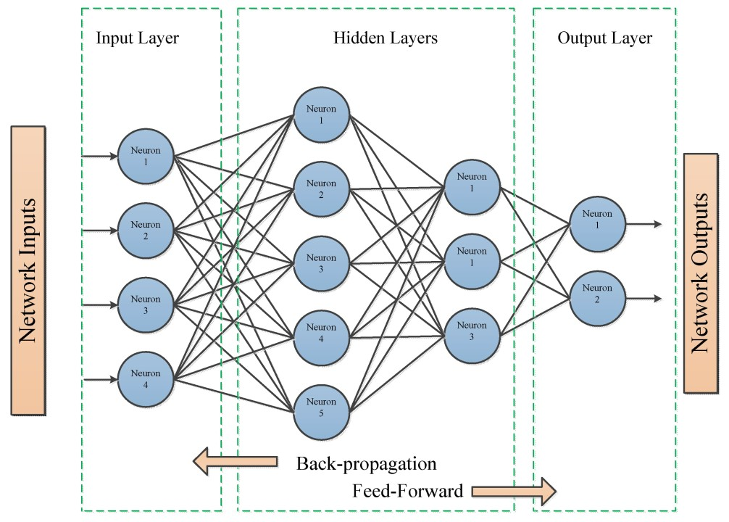
Back Propagation in Neural Networks
https://www.linkedin.com/pulse/feedforward-vs-backpropagation-ann-saffronedge1/

Slide 13
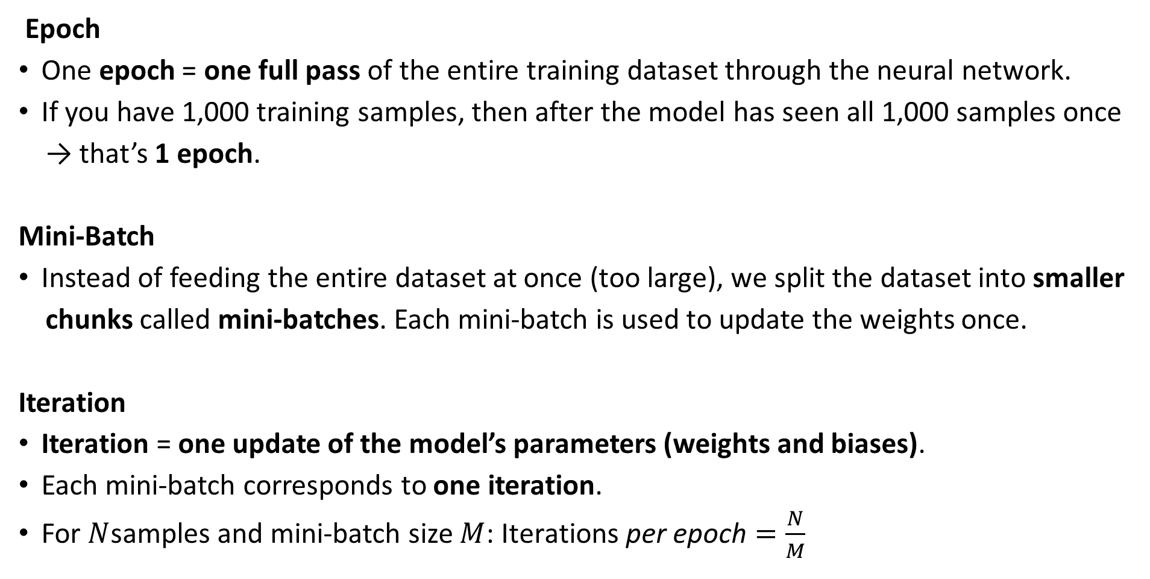
Training in Neural Networks
Epoch
One epoch = one full pass of the entire training dataset through the neural network.
If you have 1,000 training samples, then after the model has seen all 1,000 samples once
→ that’s 1 epoch.
Mini-Batch
Instead of feeding the entire dataset at once (too large), we split the dataset into smaller
chunks called mini-batches. Each mini-batch is used to update the weights once.
Iteration
Iteration = one update of the model’s parameters (weights and biases).
Each mini-batch corresponds to one iteration.
For $N$samples and mini-batch size $M$: $\text{Iterations} \text{per} \text{epoch}=\frac{N}{M}$

Slide 14
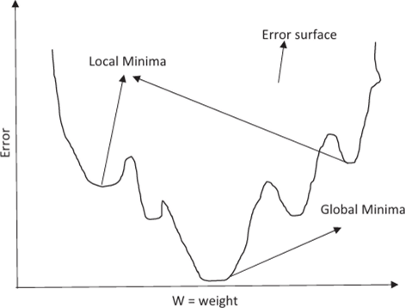
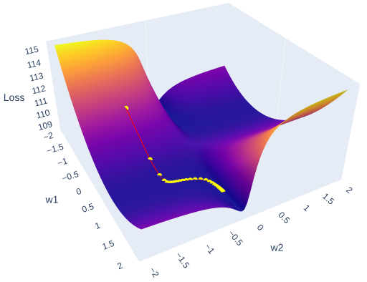
Gradient Descent Algorithm
https://ebrary.net/190741/engineering/propagation
https://towardsdatascience.com/whats-inside-a-neural-network-799daf235463/

