Slide 1
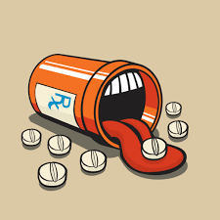
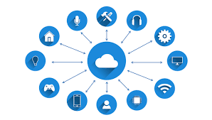
ACI NATIONAL HACKATHON
ADVANCED MEDICAL PILL BOX USING IOT AND ANDROID FOR TUBERCULOSIS PATIENTS

Slide 2
SOFTWARE AND HARDWARE REQUIRED
Software : Arduino,MIT APP INVENTOR 2(a very effective tool for creating powerful apps)
Hardware: Arduino Uno(ATMEGA328), Bluetooth HC-05,GSM module,vibration sensor,accelerometer,SD card reader,RTC(Real time clock).

Slide 3
WHAT IS TUBERCULOSIS?
Before discussing the problem statement tuberculosis should be known ,Tuberculosis is potentially serious infectious bacterial disease that mainly affects the lungs. IT IS CAUSED BY A BACTERIA NAMED TUBERCULOSIS BACTERIA. MAIN SYMPTOMS INCLUDE PAIN in CHEST,LOSS OF WEIGHT,LOSS OF MUSCULAR STRENGTH,NAUSEA,HIGH FEVER,SHORTNess of breath etc…….

Slide 4
PROBLEM STATEMENT
In India,every year on a average 10-15 lakh people fall prey to tuberculosis every year. Medication of tuberculosis is almost 18-24 months. Out of these, 55%-60% people stop their medication at the half way stage leading to dangerous side effects. These people hire caretakers to prevent this. Our project deals with a very efficient way to make sure that the caretakers provide medicines to patients on time making sure that the medication is not stopped.

Slide 5
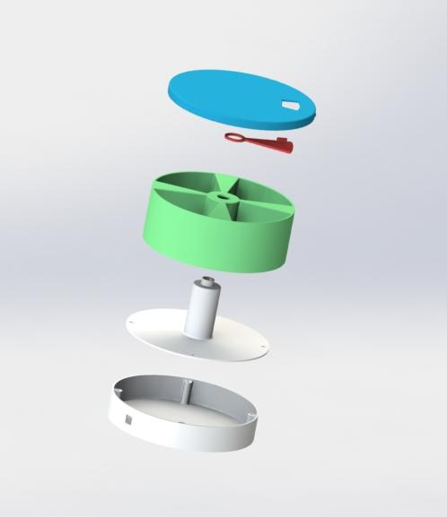
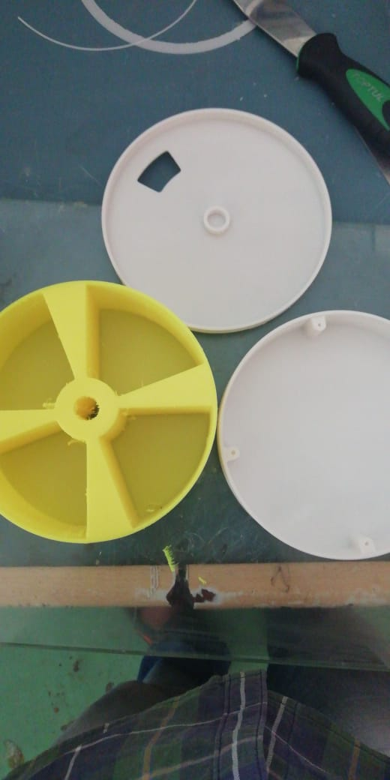
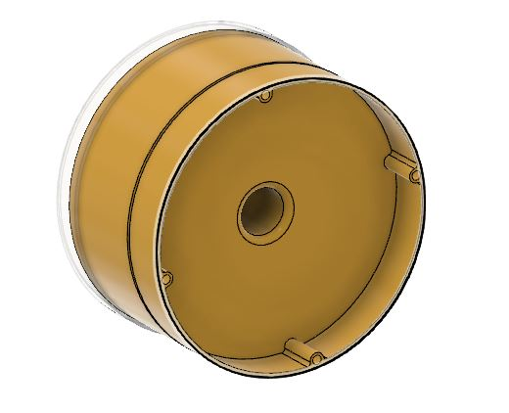
MEDICINE PILL BOX
Our project includes a medical pill box consisting of 4 compartments each with 100 pills capacity and a provision for storing the Arduino Circuit.

Slide 6
WORKING MECHANISM
To make this box work to it’s potential , We create a android app using MIT APP INVENTOR that can control and deliver data to arduino via BLUETOOTH(HC-05 module)
The data given by the caretaker in the application include
PHONE NUMBER
COMPARTMENT NUMBER
NO OF PILLS TO BE TAKEN/DAY
TIME
NO OF PILLS INITIALLY KEPT IN THE COMPARTMENT

Slide 7
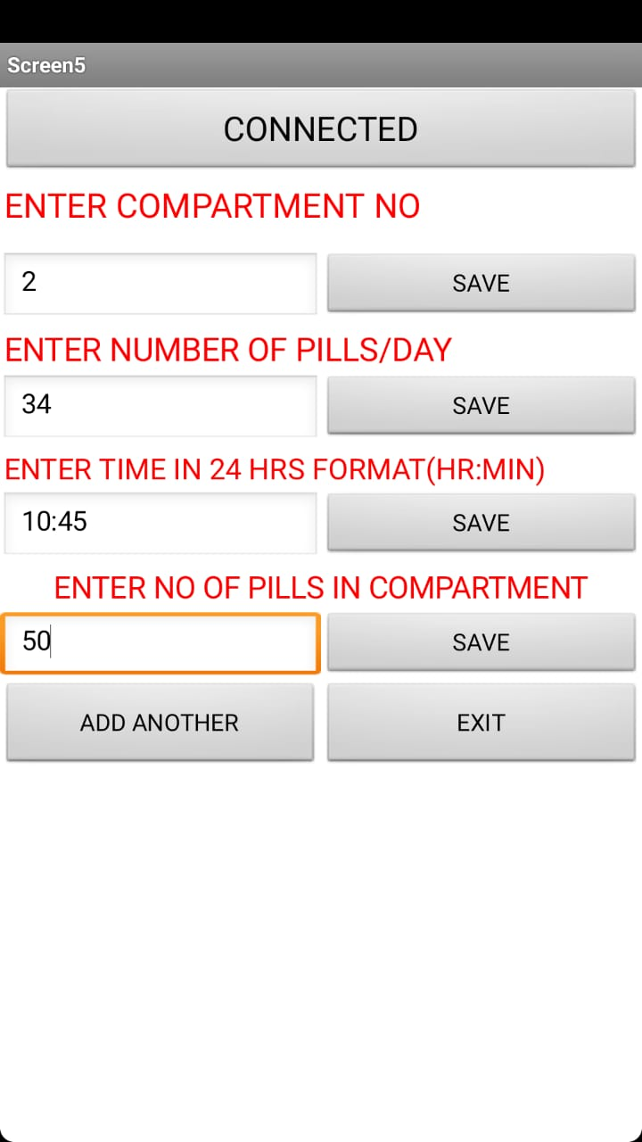
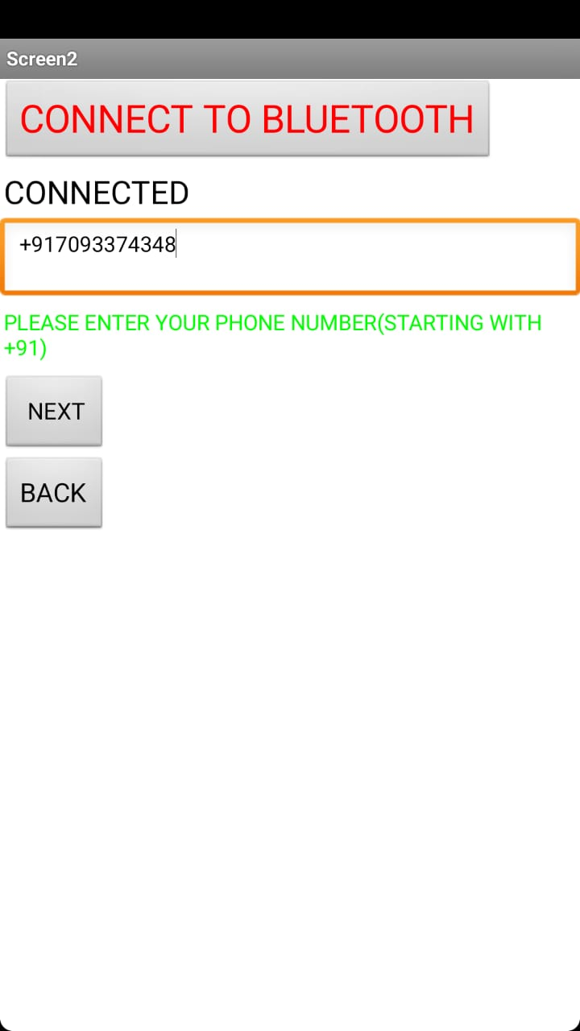
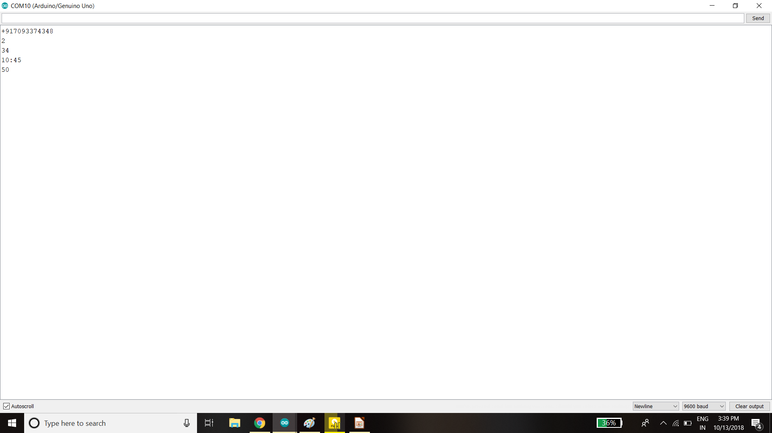
APP LAYOUT

Slide 8
STORING DATA
After getting the data through the android app,We store the data in the sd card using the sd card module.To remind the caretakers of the pills and their specific compartments ,the Time input given by the caretaker is compared with the RTC and based on this the caretaker gets a call or message using GSM module. The vibration motor makes sure to read the number of vibrations when each pill is taken. The accelerometer makes sure that the caretaker makes sure to get pills from the right compartment by checking the orientation angle.If the angle deviates then required then the buzzor will ring making that the caretaker is looking for the wrong compartment and warns through a message.

Slide 9
MAKING VIDEO(REFERENCE)

Slide 10
THANK YOU

