Slide 1
Welcome to STA 199
Lecture 0 Chris Hallstrom

Slide 2
Hello world!

Slide 3
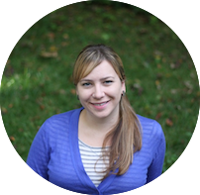
Meet the prof
Dr. Mine Çetinkaya-Rundel
Professor of the Practice
Old Chem 213

Slide 4
Meet the course team
Mary Knox (Course coordinator)
Betsy Bersson (Head TA)
Chris Oswald
Jasmine Wang
Mert Bildirici
Will Tirone
Krish Bansal
Caitrin Murphy
Avery Hodges
Jon Campbell
Foxx Hart
Netra MittalAlexa Fahrer
Devin Johnson
Konnie Huang
Li Fan
Kelly Huang
Leah Johnson
Lisa Zhang
Miles King
Noah Obuya

Slide 5
Meet each other!

Slide 6
Meet data science
Data science is an exciting discipline that allows you to turn raw data into understanding, insight, and knowledge.
We’re going to learn to do this in a tidy way – more on that later!
This is a course on introduction to data science, with an emphasis on statistical thinking.

Slide 7
Software

Slide 8
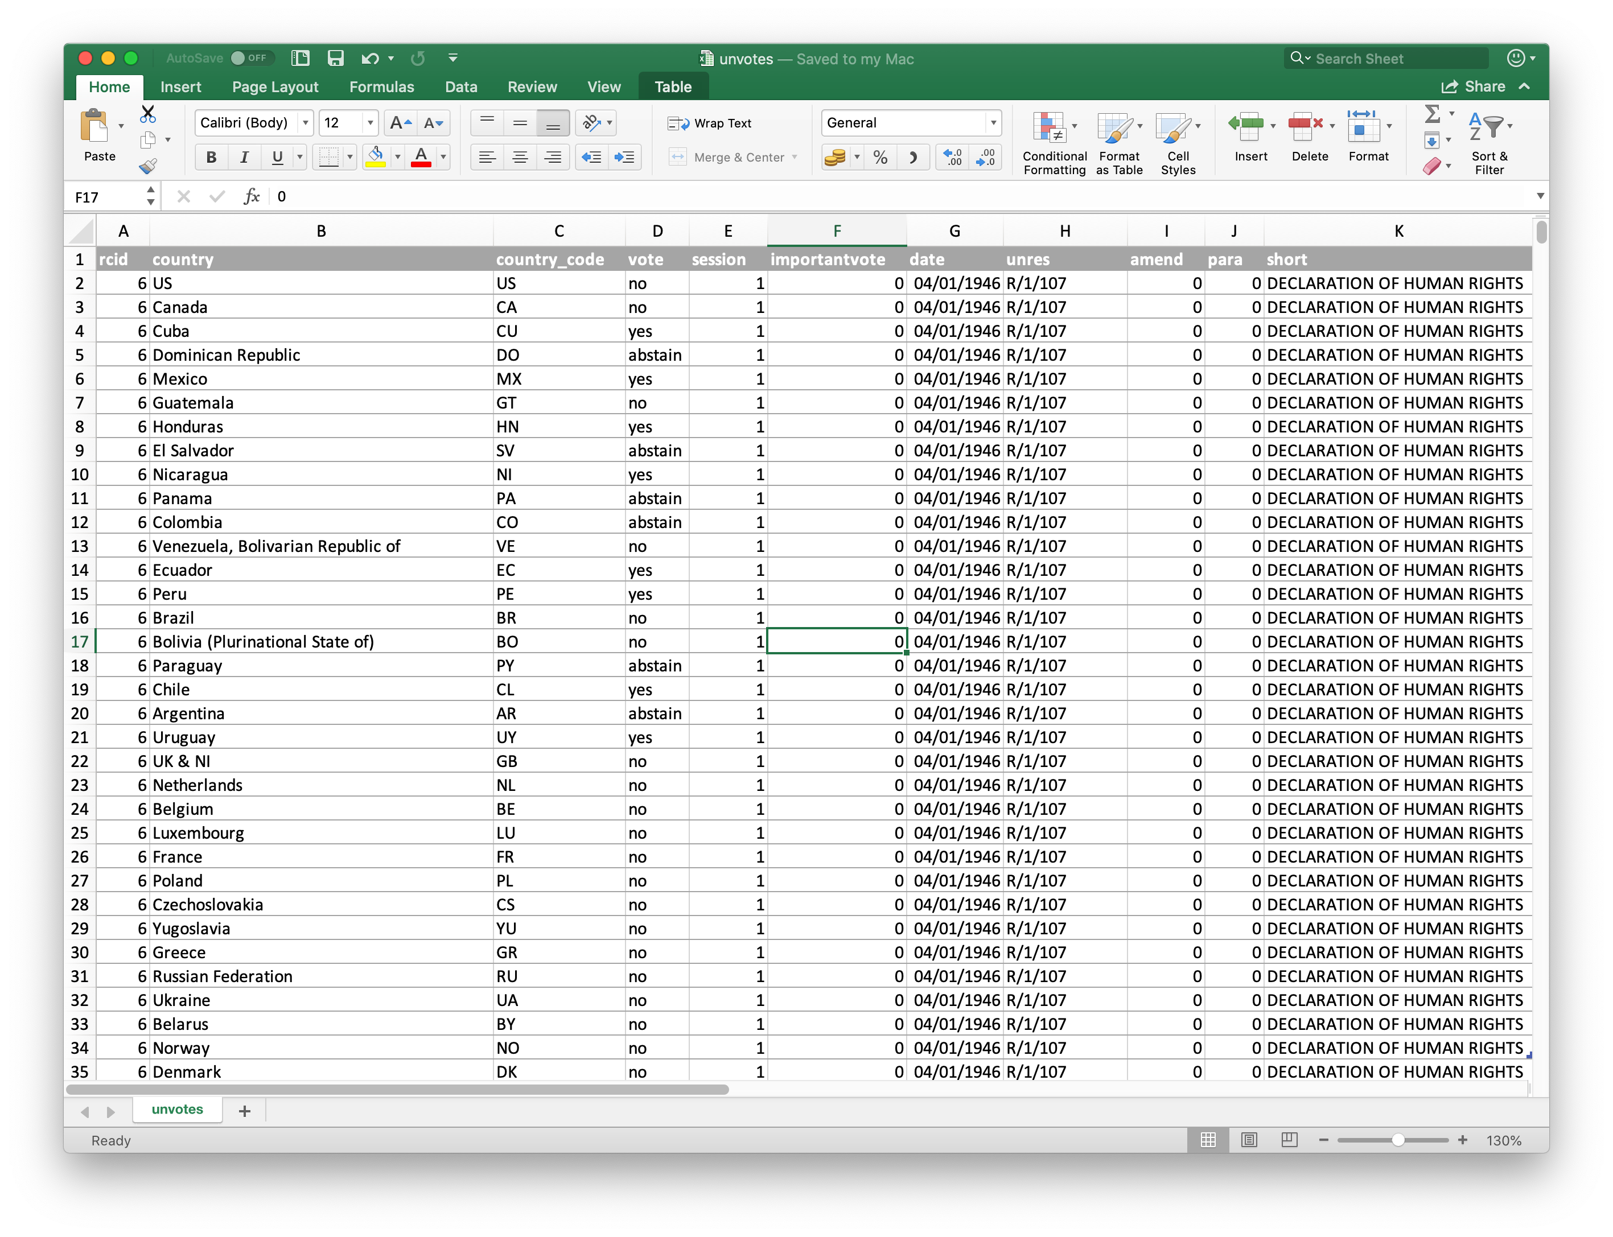
Excel - not…

Slide 9
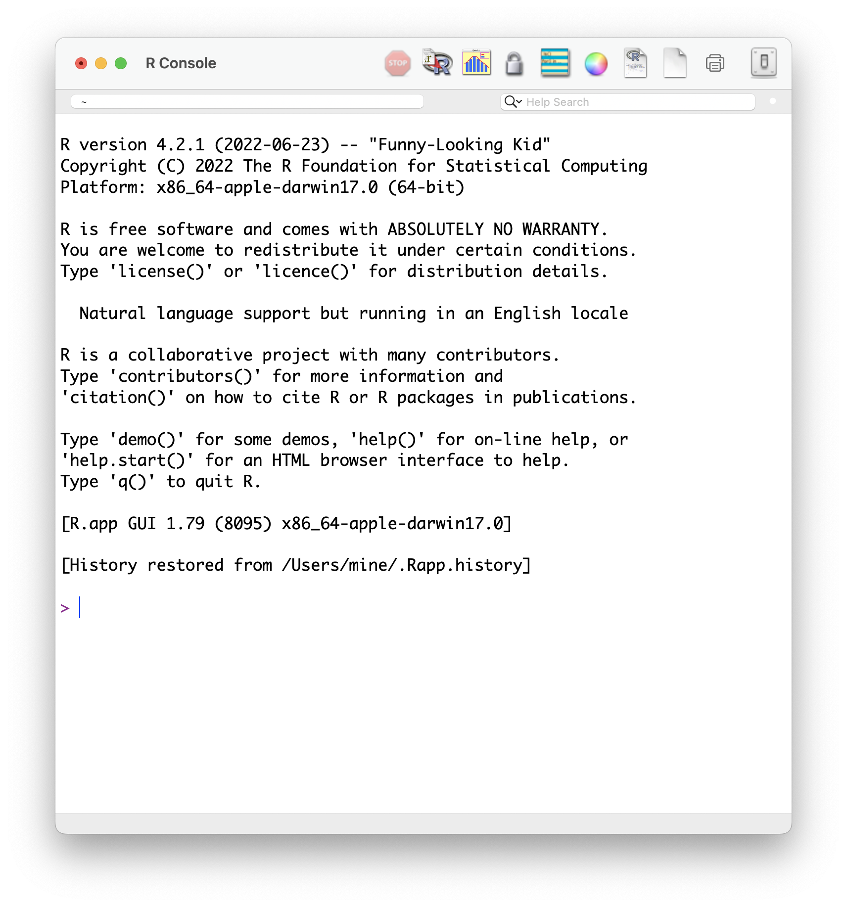
R

Slide 10
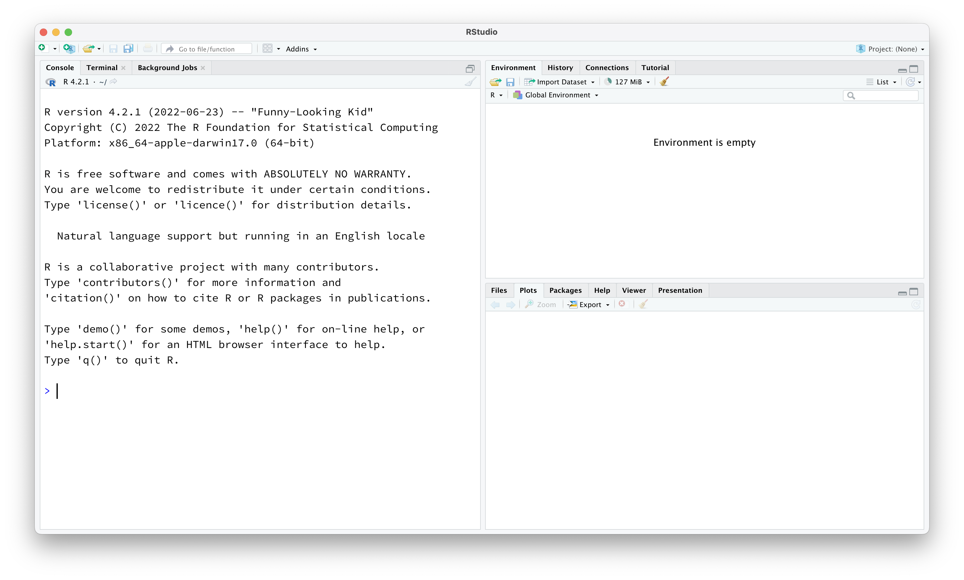
RStudio

Slide 11
Data science life cycle

Slide 12
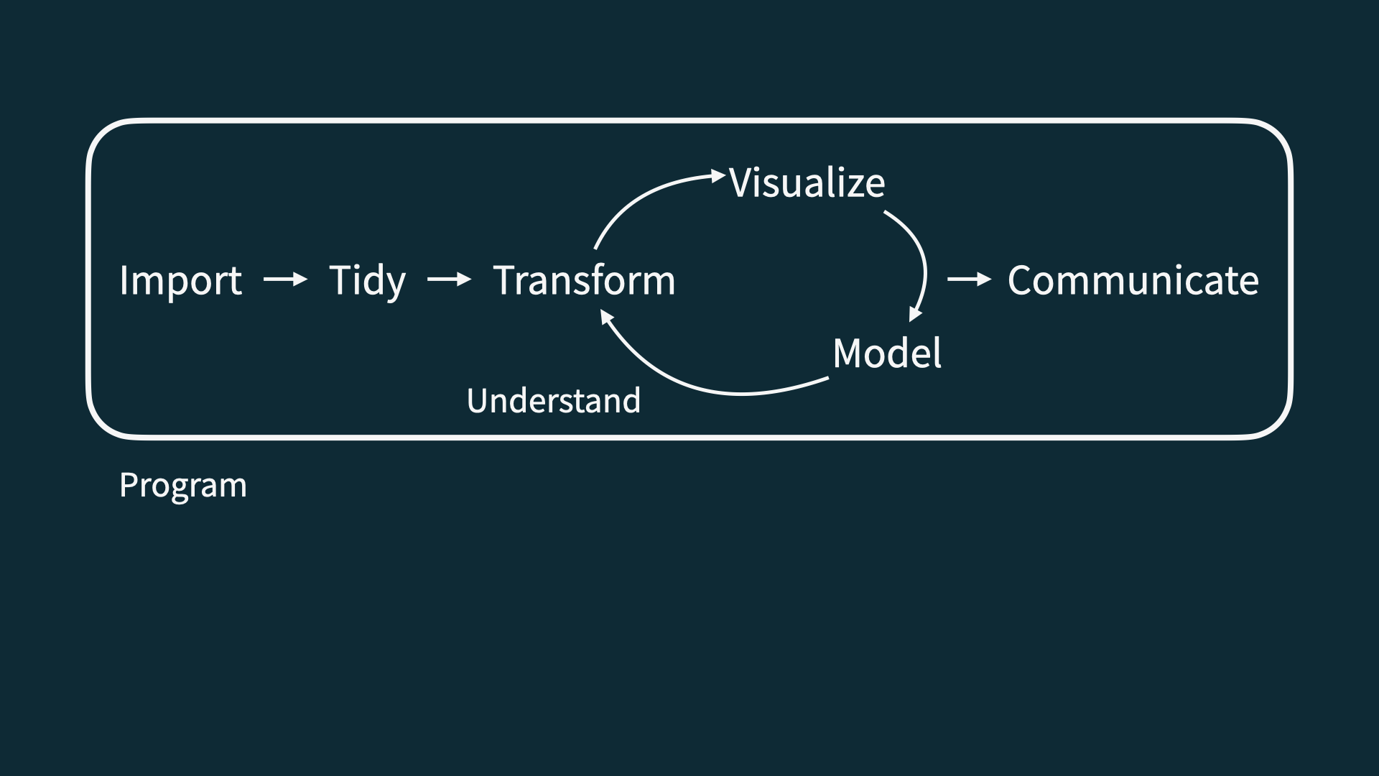
Data science life cycle

Slide 13
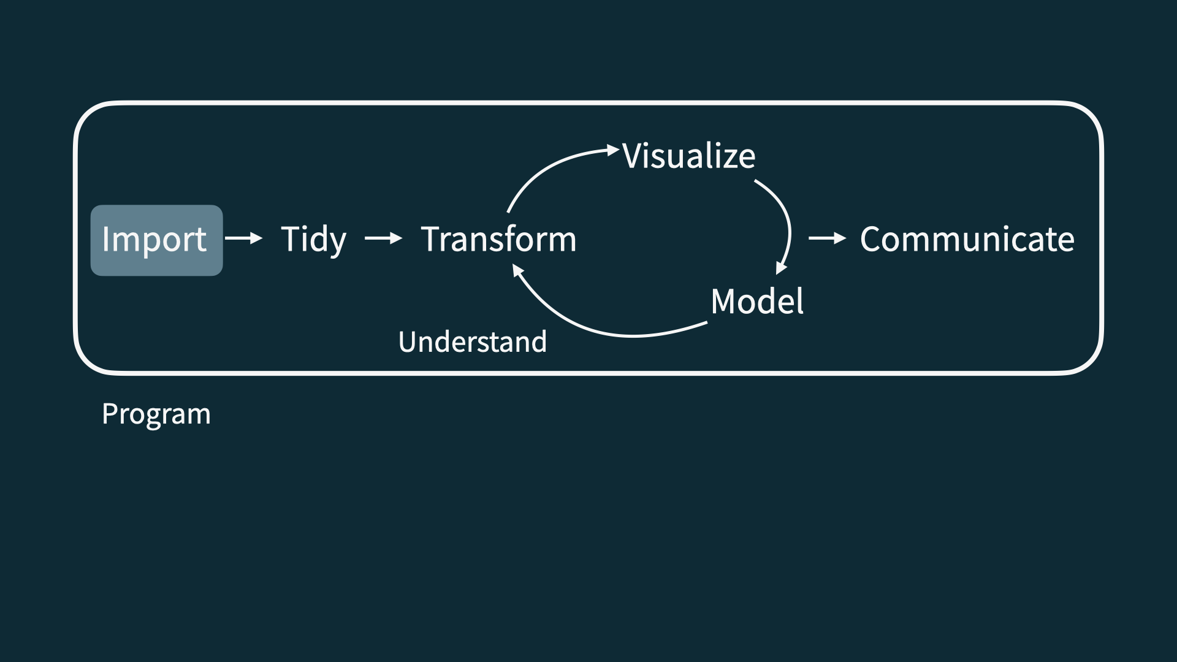
Import

Slide 14
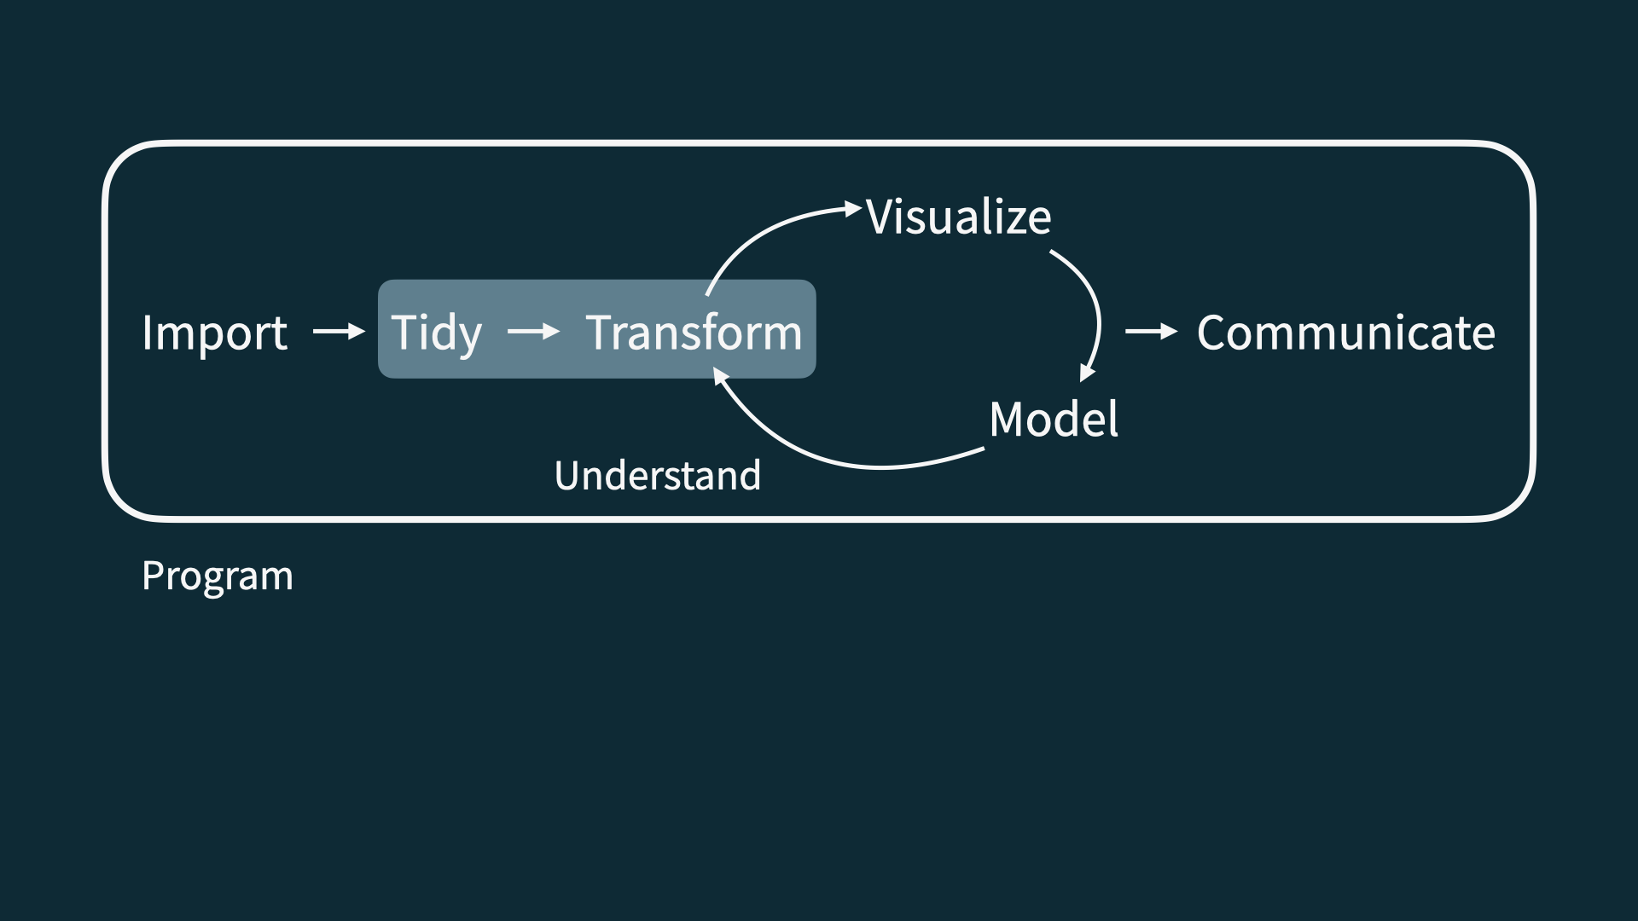
Tidy + transform

Slide 15
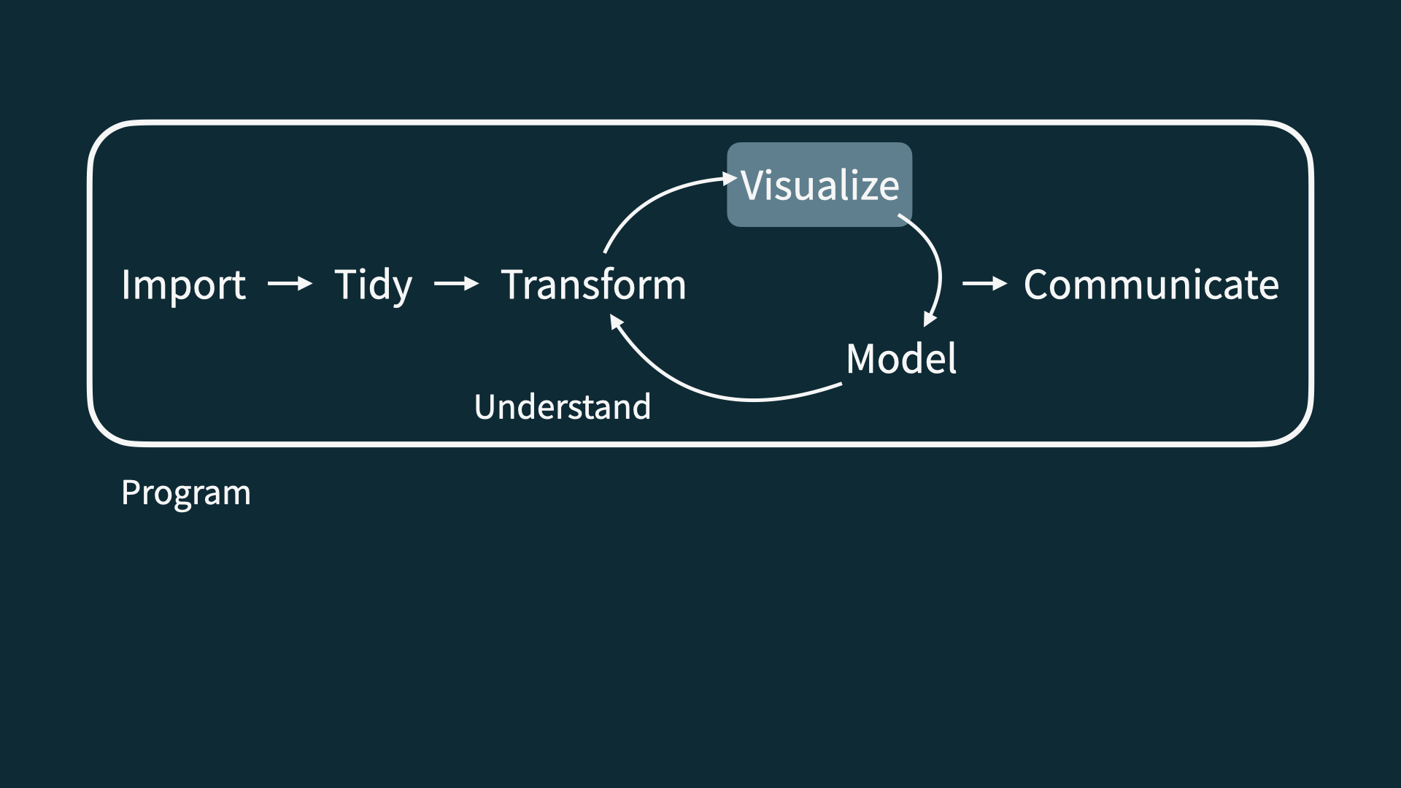
Visualize

Slide 16
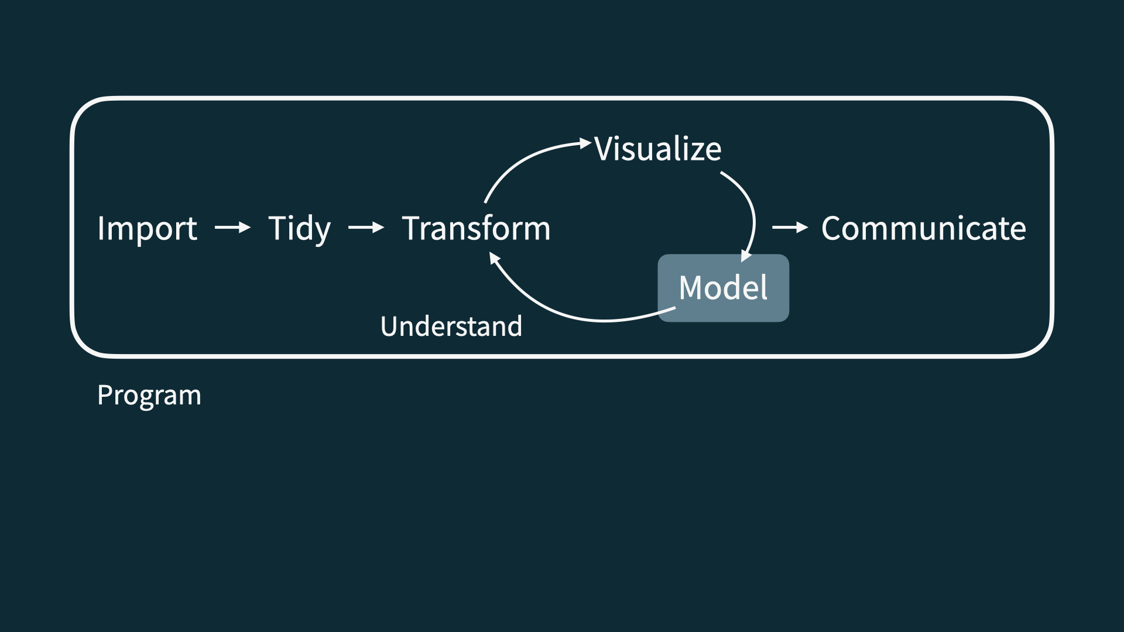
Model

Slide 17
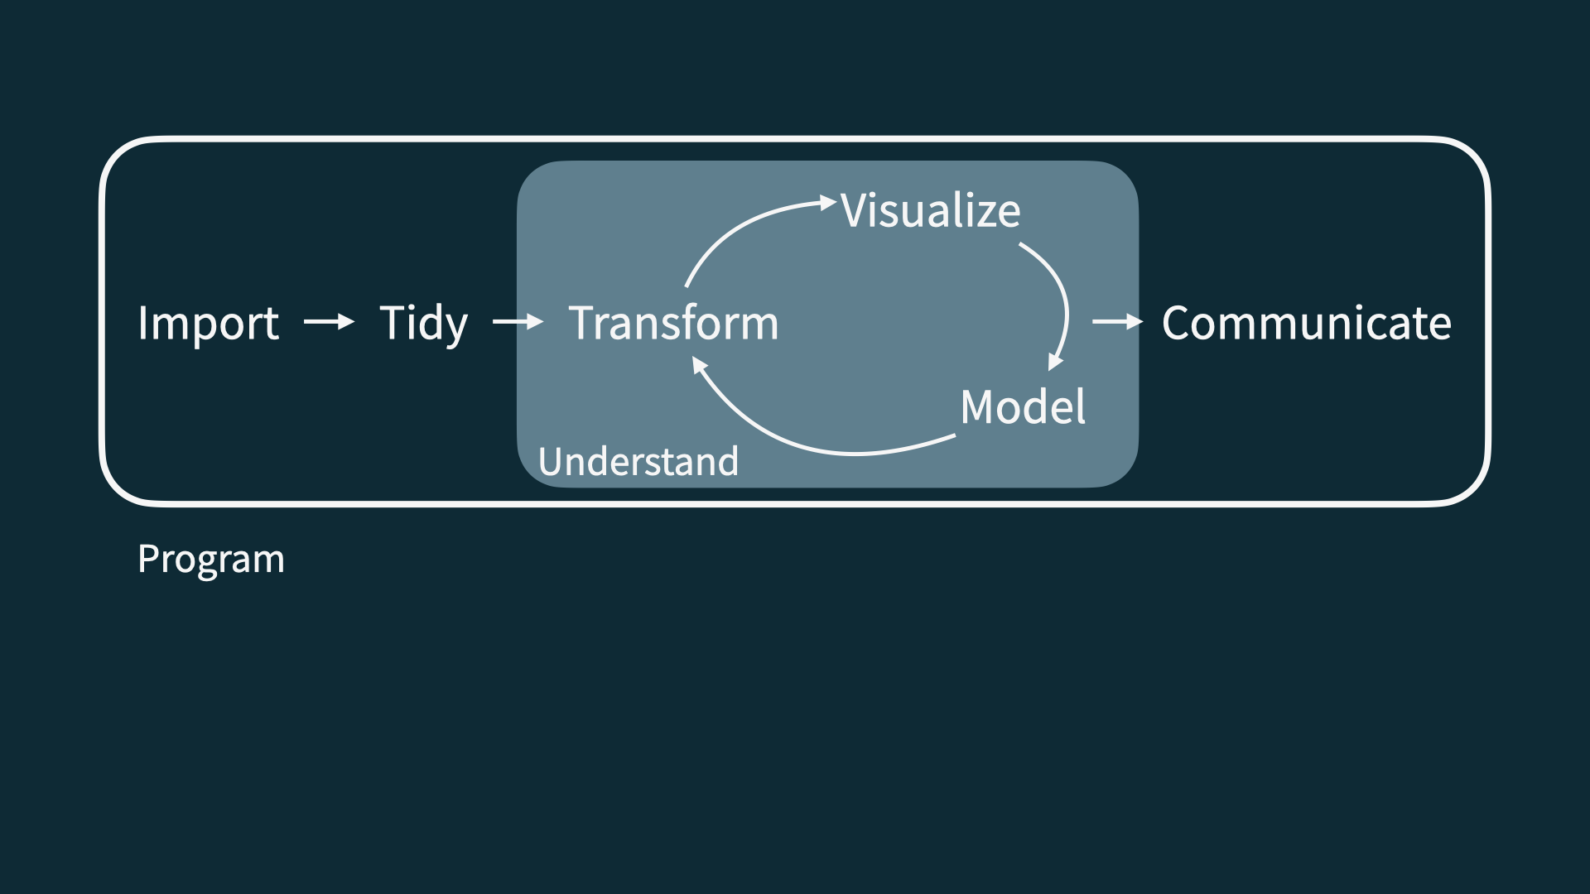
Understand

Slide 18
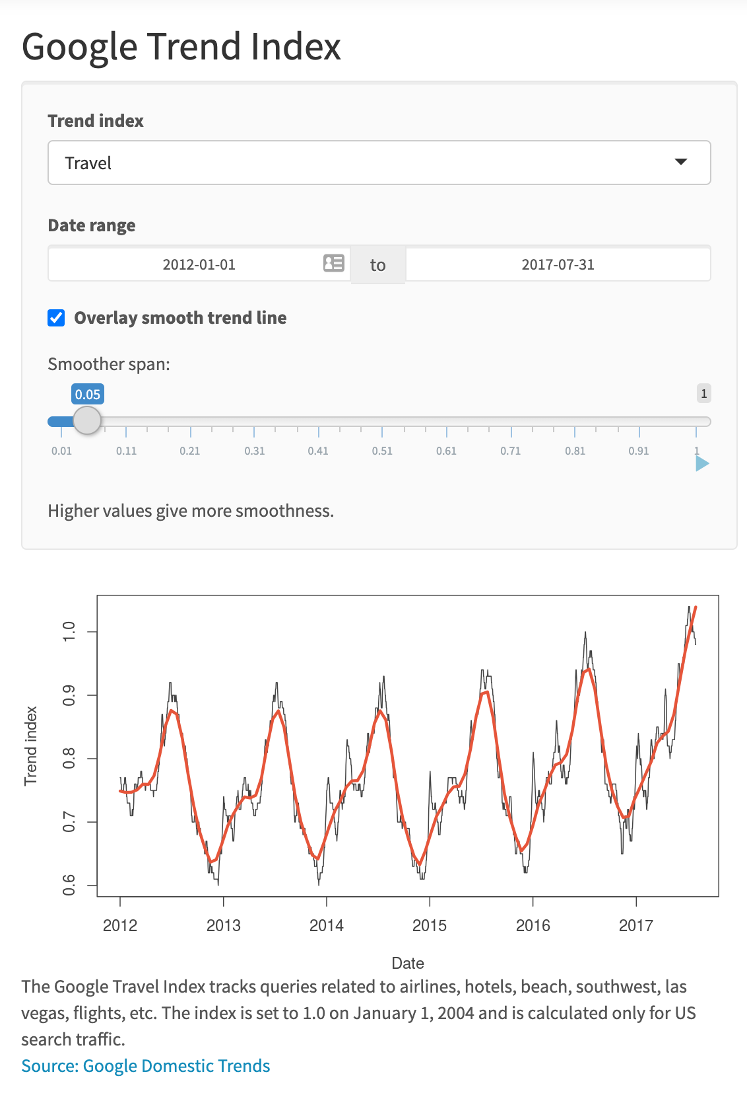

Slide 19
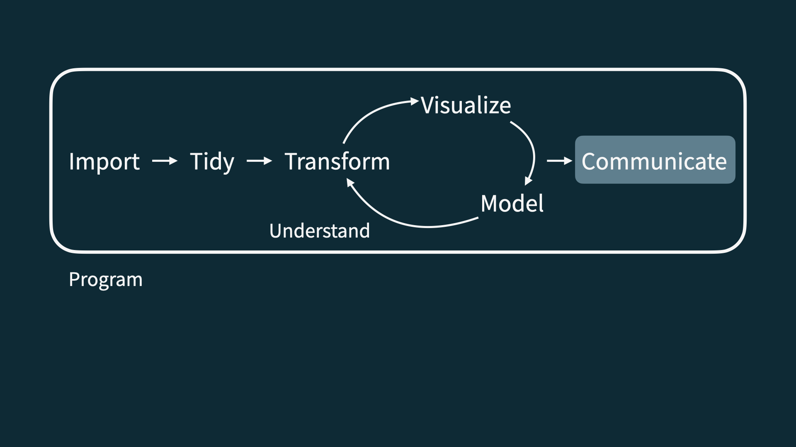
Communicate

Slide 20
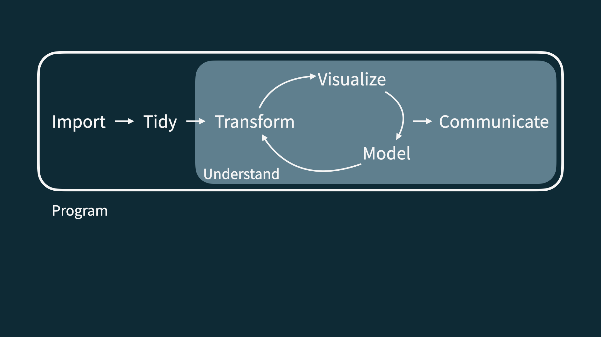
Understand + communicate

Slide 21
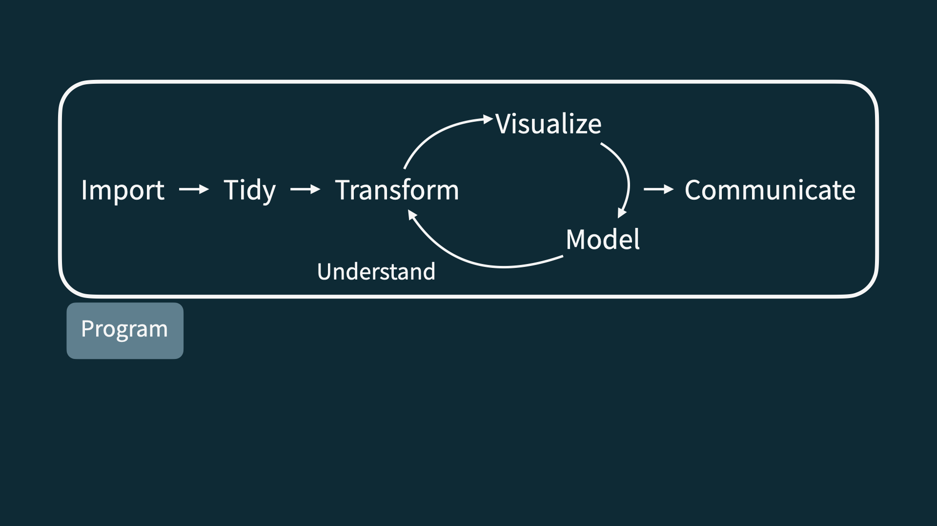
Program

Slide 22
Let’s dive in!

Slide 23
Application exercise
Or more like demo for today…
📋 github.com/sta199-s24/ae-00-unvotes

Slide 24
Course overview

Slide 25
Homepage
https://sta199-s24.github.io
All course materials
Links to Canvas, GitHub, RStudio containers, etc.

Slide 26
Course toolkit
All linked from the course website:
GitHub organization: github.com/sta199-s24
RStudio containers: cmgr.oit.duke.edu/containers
Communication: Ed Discussion
Assignment submission and feedback: Gradescope

Slide 27
Activities
Introduce new content and prepare for lectures by watching the videos and completing the readings
Attend and actively participate in lectures and labs, office hours, team meetings
Practice applying statistical concepts and computing with application exercises during lecture, graded for completion
Put together what you’ve learned to analyze real-world data
Lab assignments x 7
Exams x 2
Term project presented in the last lab session

Slide 28
Exams
Two exams, each 20%
Each exam comprised of two parts:
In class: 75 minute in-class exam. Closed book, one sheet of notes (“cheat sheet”, no larger than 8 1/2 x 11, both sides, must be prepared by you) – 70% of the grade
Take home: The take home portion will follow from the in class exam and focus on the analysis of a dataset introduced in the take home exam – 30% of the grade
Caution
Exam dates cannot be changed and no make-up exams will be given. If you can’t take the exams on these dates, you should drop this class.

Slide 29
Project
Dataset of your choice, method of your choice
Teamwork
Presentation and write-up
Presentations in the last lab
Interim deadlines, peer review on content, peer evaluation for team contribution
Some lab sessions allocated to working on projects, doing peer review, getting feedback from TAs
Caution
Final presentation date cannot be changed. If you can’t present on that date, you should drop this class. You must complete the project to pass this class.

Slide 30
Teams
Assigned by me
Project
Peer evaluation during teamwork and after completion
Expectations and roles
Everyone is expected to contribute equal effort
Everyone is expected to understand all code turned in
Individual contribution evaluated by peer evaluation, commits, etc.

Slide 31
Grading
Category | Percentage
Labs | 35%
Project | 20%
Exam 1 | 20%
Exam 2 | 20%
Application Exercises | 5%

Slide 32
No specific points allocated to attendance, but attendance will be recorded periodically throughout the semester, and this information will be used as “extra credit” if you’re in between two grades and a minor bump would help.
See course syllabus for how the final letter grade will be determined.

Slide 33
Support
Attend office hours
Ask and answer questions on the discussion forum
Reserve email for questions on personal matters and/or grades
Read the course support page

Slide 34
Announcements
Posted on Canvas (Announcements tool) and sent via email, be sure to check both regularly
I’ll assume that you’ve read an announcement by the next “business” day
I’ll (try my best to) send a weekly update announcement each Friday, outlining the plan for the following week and reminding you what you need to do to prepare, practice, and perform

Slide 35
Diversity + inclusion
It is my intent that students from all diverse backgrounds and perspectives be well-served by this course, that students’ learning needs be addressed both in and out of class, and that the diversity that the students bring to this class be viewed as a resource, strength and benefit.
Please let me know your preferred name and pronouns on the Getting to know you survey.
If you feel like your performance in the class is being impacted by your experiences outside of class, please don’t hesitate to come and talk with me. I want to be a resource for you. If you prefer to speak with someone outside of the course, your advisors, and deans are excellent resources.
I (like many people) am still in the process of learning about diverse perspectives and identities. If something was said in class (by anyone) that made you feel uncomfortable, please talk to me about it.

Slide 36
Accessibility
The Student Disability Access Office (SDAO) is available to ensure that students are able to engage with their courses and related assignments.
I am committed to making all course materials accessible and I’m always learning how to do this better. If any course component is not accessible to you in any way, please don’t hesitate to let me know.

Slide 37
Course policies

Slide 38
Late work, waivers, regrades policy
We have policies!
Read about them on the course syllabus and refer back to them when you need it

Slide 39
Academic integrity
To uphold the Duke Community Standard:
I will not lie, cheat, or steal in my academic endeavors;
I will conduct myself honorably in all my endeavors; and
I will act if the Standard is compromised.

Slide 40
Wrap up

Slide 41
This week’s tasks
Complete Lab 0
Computational setup
Getting to know you survey
Read the syllabus
Start readings for next week

Slide 42
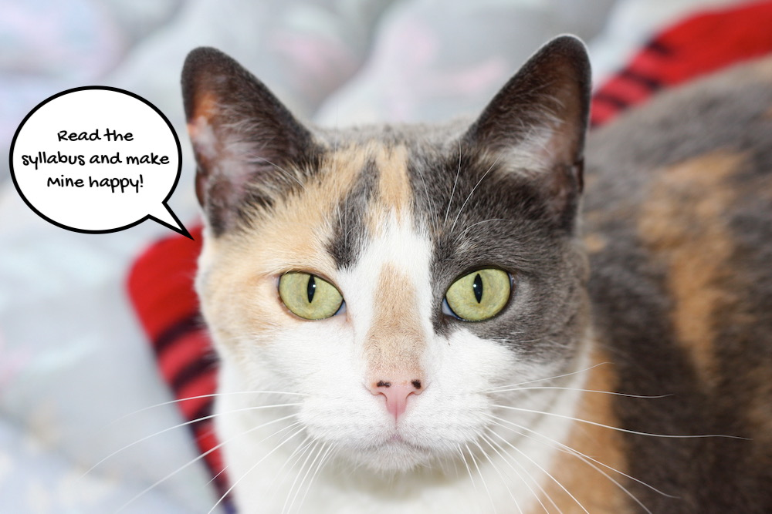
Midori says…

