Slide 1
Data analysis in 6 minutes
A tale in three acts

Slide 2
Plot Summary
With broad access to log records from across a large network, our intrepid hero solves mysteries and answers eternal questions about activities on the hosts and across the network.
At least that was what was supposed to happen. This is REALLY the story of how everything went downhill from there.
A tale in three acts.

Slide 3
ACT ONE: call to dataVenture
In a land far, far away deep in a secret government laboratory known only as Los Alamos National Lab was hidden away a seemingly perfect trove of data. 90 days of:
Computer (host) logs
Network (traffic) logs
https://csr.lanl.gov/data/2017.html

Slide 4
Legend described the data as rich and fruitful
Network | Hosts
Time | Time
Duration | UserName
SrcDevice | DomainName
DstDevice | EventID
Protocol | FailureReason
SrcPort | LogHost
DstPort | LogonType
SrcPackets | LogonTypeDescription
DstPackets | ProcessName
SrcBytes
DstBytes

Slide 5
What could go wrong?
“A hero ventures forth from the world of common day into a region of supernatural wonder: fabulous forces are there encountered and a decisive victory is won: the hero comes back from this mysterious adventure with the power to bestow boons on his fellow man.”
- Joseph Campbell

Slide 6
Six Minutes of Data…
Our hero discovered… 90 days of data, and soon learned that for every day there were… two sacred text, the network text and the host text
Network text: 8.48 GB of data
Host text: 9.01 GB
GitHub file size limit... 100 MB so... we looked at:
a six minute subset of sacred texts limited to only ONE day
Network: 47.3 MB
Host: 99.9 MB

Slide 7
ACT Two: ORDEALS in Exploration
The hero in this journey was heavy laden with exploratory data analysis (EDA).
His EDA covered a lot of ground…
Describing the data in the sacred texts
Translating the sacred works (nulls, duplicates, sorts, counts, and more)
Understanding the truth behind the words of the data gods
Ultimately to find… the sacred texts were incomplete

Slide 8
Failure One: A lack of time
When does Host EventID rear its ugly head?
When does Network Device appear in the holy writ?
What ports are reflected most prominently in the data gods’ prophecies?
Sadly, the hero had not collected enough of the sacred texts
The hero had not yet acquired the mystical clock of understanding

Slide 9
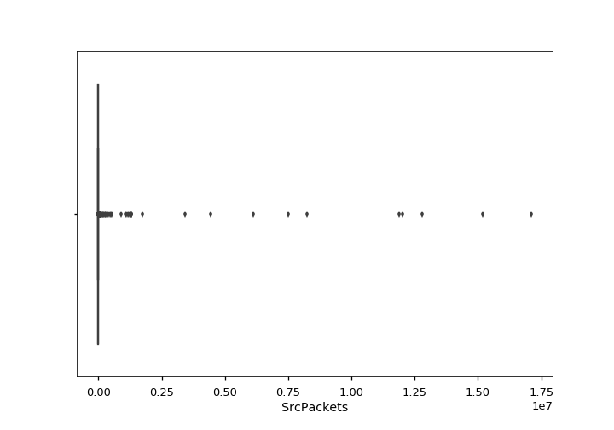
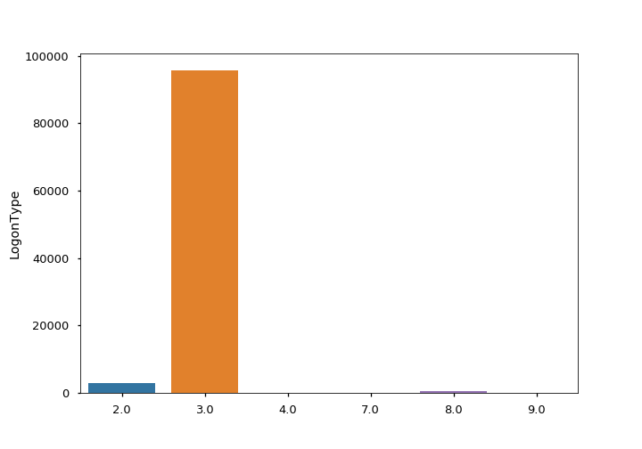
FAILURE TWO: No light in the darkness
Are there outliers in the data?
What shows up most frequently?
Our hero sketched diagrams in the mud, in the dark
Our knew aught about trees nor logs

Slide 10
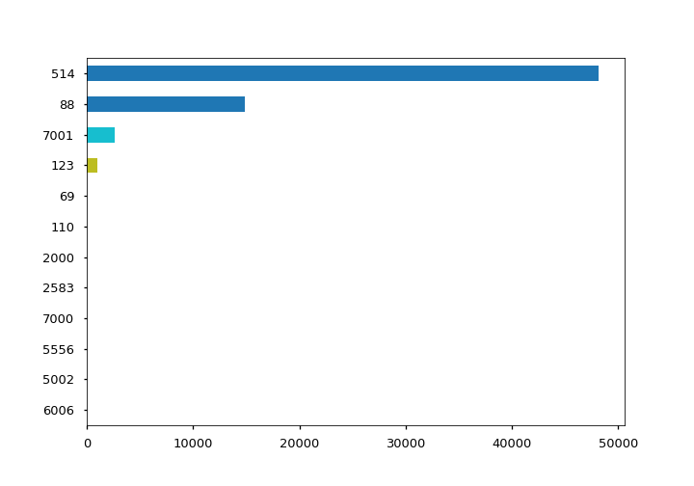
Eventual “Success”: The Reward, Scene I
Despite the trials, tribulations and suffering
Our Hero’s adventure led to growth,
excitement and dare we say… FUN in
three scenes.
Does the enemy listen at any given port?
https://isc.sans.org/services.html

Slide 11
Eventual “Success”: The Reward, Scene II
Do adventurers cross domains?
UserName | DomainName | Frequency Count
AppService | Domain001 Domain002 Domain005 EnterpriseAppServer | 30764 966 35 2838
EnterpriseAppServer$ | Domain001 Domain003 | 6104 1
User031784 | Domain001 Domain002 | 52 52
User564015 | Domain001 Domain002 | 13 3
User706736 | Comp307946 Domain001 Domain002 | 8 2 2

Slide 12
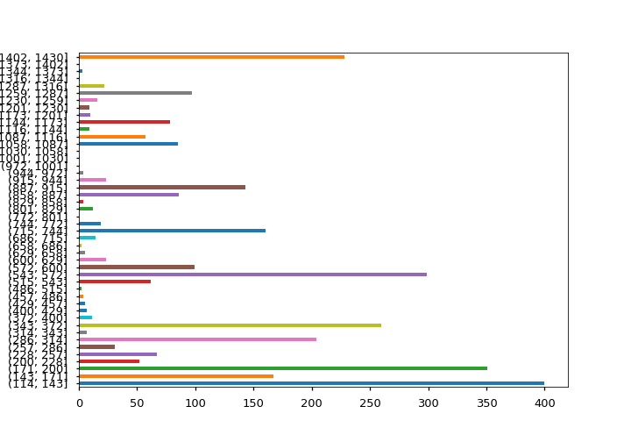
Eventual “Success”: The Reward, Scene III
Do oracles speak equally to all?

Slide 13
ACT THREE: what now?
Visit the marketplace… to buy the proper tools
Sell off unneeded goods…

Slide 14
Epilogue
Thank you to:
my fellow classmates for sharing your knowledge, your ideas and especially your questions in the chat
michael and jillian for your mentorship
especially to chris for your time and expertise in teaching the class

