Slide 1
Progress Presentation
Caroline & Peter

Slide 2
Detecting post-it note
-Initial HSV guess is given
-We detect the green square by eroding and calculating moments
-We adjust the HSV guess and sensitivities based on the pixels near the found center
-In later iterations, we also crop the original image to what we have found

Slide 3
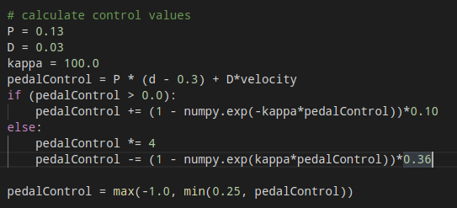
Calculating errors
1. Distance to post-it note from polynomial fit
2. Calculate horizontal deviation from center
3. Use the two to calculate angle

Slide 4
Issues
1. Green post-it is difficult to find again
2. Relative velocity calculation

