Slide 1
WASP Summmer School
Group 10 – Chris and Martin

Slide 2
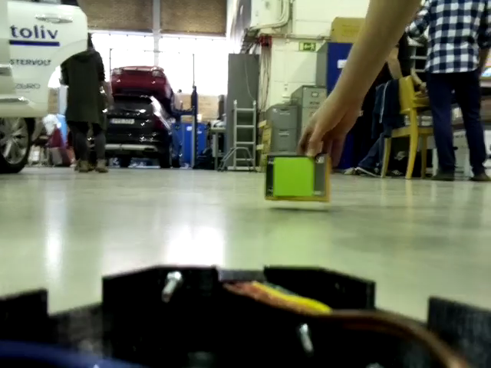
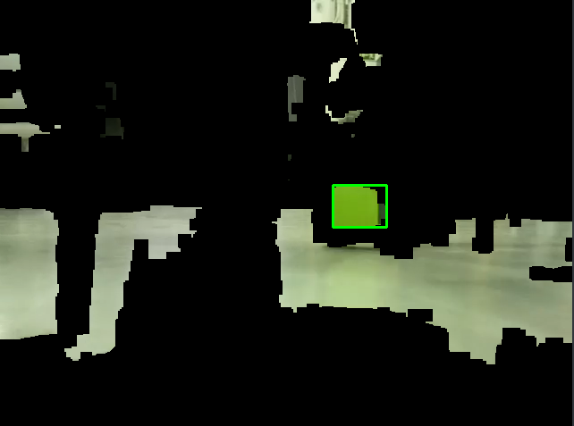
Camera
White balance correction (removed due to execution time)
RGB to HSV color space
Histogram equalization (CLAHE) of S and V channel
Color filter in HSV space
Erosion

Slide 3
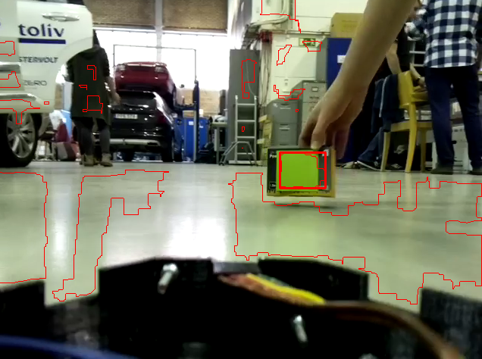
Camera
Contour finding
Filtering of contours based on area, rectangular shape, aspect ratio
Target distance is calculated from contour height
Target direction is calculated from contour center

Slide 4
Ultra-sound sensors
Collision avoidance – the car reverses iff an object appears in front and the rear is free

Slide 5
Control
PD-controller for speed
P-controller for steering

