Slide 1
WASP Summer School 2018
Abdo, Johan and Marcus

Slide 2
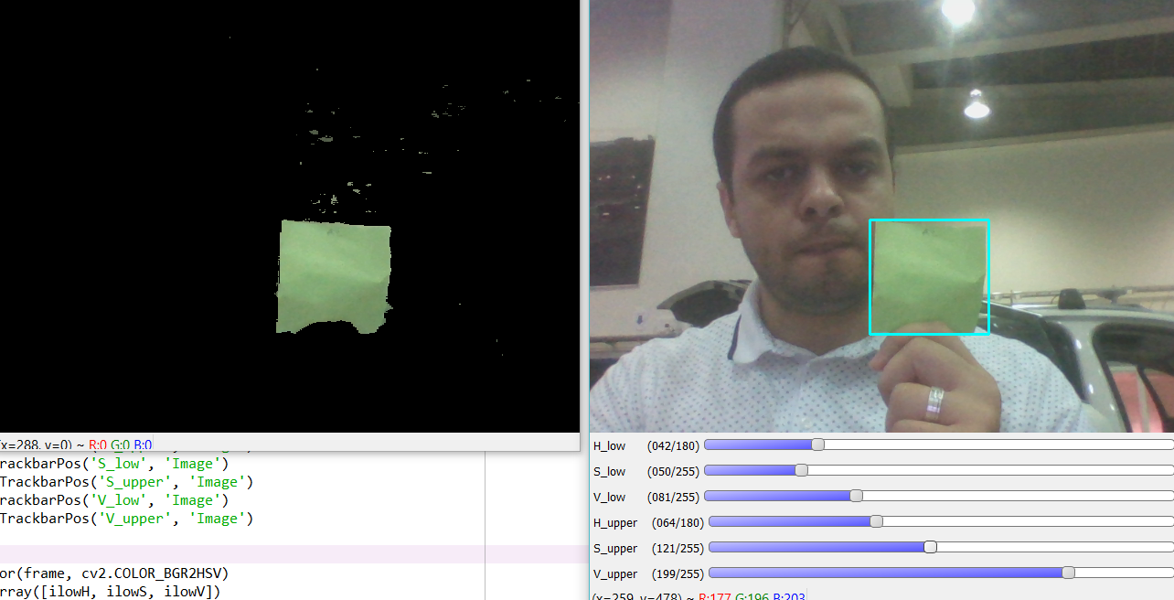
Day 2
HSV color detector.

Slide 3
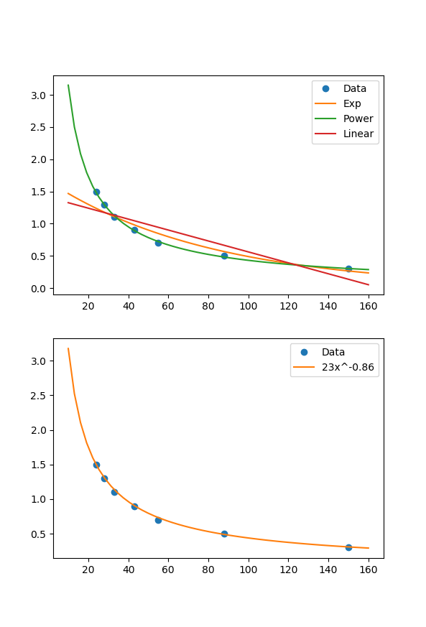
Day 2
P-Controller for the steering angle based on the center of the detected bounding box.
PD-Controller based on an approximated ratio between BB height and distance to the sticky note in meters.

Slide 4

Day 2
Demo.

Slide 5
Day 3
LBP cascaded detector.

Slide 6
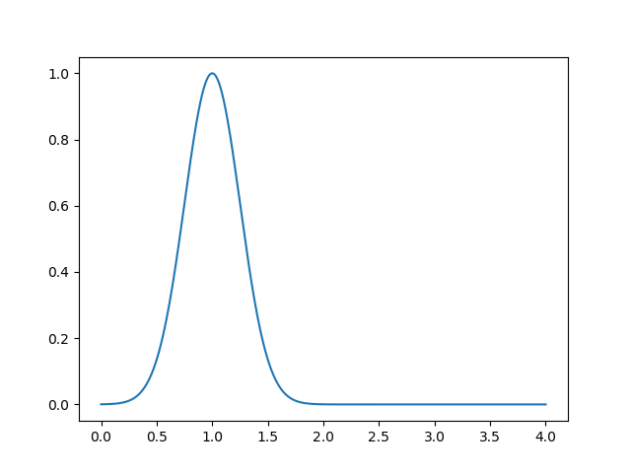
Day 3
Image and US sensor fusion for distance estimation.

Slide 7
Day 3
Demo.

Slide 8




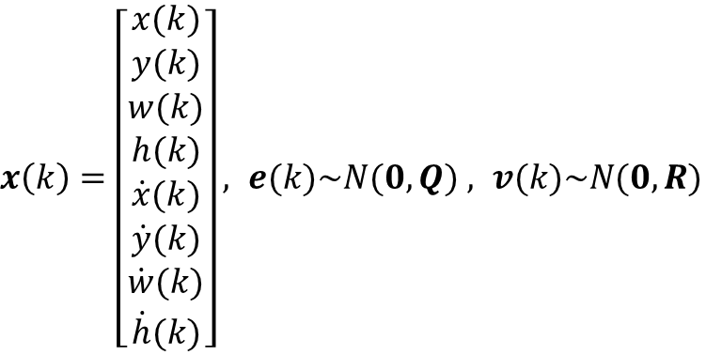




Day 4
Kalman filtering for robust frame tracking
States and noise
$$w(k)$$
$x\left(k\right)=\left[\begin{matrix}\begin{matrix}x(k) \\ y(k)\end{matrix} \\ \begin{matrix}w(k) \\ h(k) \\ \dot{x}(k)\end{matrix} \\ \begin{matrix}\dot{y}(k) \\ \dot{w}(k) \\ \dot{h}(k)\end{matrix}\end{matrix}\right], e(k)\sim N(0,Q)$ $, v(k)\sim N(0,R)$
$$h(k)$$
$$x(k)$$
$$y(k)$$
System dynamics – double integrator model
$$x\left(k+1\right)=Ax\left(k\right)+e(k)$$
$$A= \left[\begin{matrix}I_{4} & hI_{4} \\ 0_{4} & I_{4}\end{matrix}\right]$$
$$y\left(k\right)=Cx\left(k\right)+v(k)$$
$$C=\left[\begin{matrix}I_{4} & 0_{4}\end{matrix}\right]$$

Slide 9
Day 4
Kalman predictions in Green.
Cascade detections in Red.

