Slide 1



COVID-19
DETECTION SYSTEM

Slide 2
INTRODUCTION
Coronavirus disease 2019 (COVID-19) is an infectious disease caused by severe acute respiratory syndrome coronavirus 2 (SARS-CoV-2). It was first identified in December 2019 in Wuhan, China. It was declared as a Pandemic by WHO on March 11, 2020. COVID attacks respiratory system, causes severe illness. There is an ongoing increase in the number of cases day-by-day across the globe. To get protected from COVID one should wear masks, maintain social distance and sanitize thoroughly is essential.
Tissues with sparse material, such as lungs which are full of air, do not absorb the X-rays and appear black in the image. Dense tissues such as bones absorb X-rays and appear white in the image.
COVID-19 test kits are in short supply and they can't be manufactured fast enough, which is an unprecedented situation and there is a need to rely on other diagnosis measures like exploring X-ray images as doctors frequently use X-rays and CT scans to diagnose pneumonia, lung inflammation, and/or enlarged lymph nodes. Since COVID-19 attacks the epithelial cells that line our respiratory tract, we can go for X-rays to analyse the patient’s health. A drawback in it is that X-ray analysis requires a radiology expert and takes significant time for a patient which is precious when people are sick around the world. Therefore, developing an automated detection system is required to save medical professionals valuable time and assist radiological experts in making better clinical decisions.

Slide 3
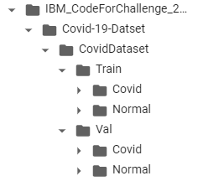
abstract
X-ray images are given in jpeg, jpg file formats. Folder structure contains Train and Test folders. Each folder is segregated into Covid and Normal folders as shown below. Train contains 224 images and Test contains 60 images.
Computer Vision plays a vital role in medical area like radiology and have used to automate analysis to detect COVID on given X-ray images and assist radiology experts to make better clinical decisions.
Using the given data sets we have built a Deep learning CNN model to detect COVID.
Keywords: COVID-19 Detection, Computer Vision, Deep Learning.

Slide 4
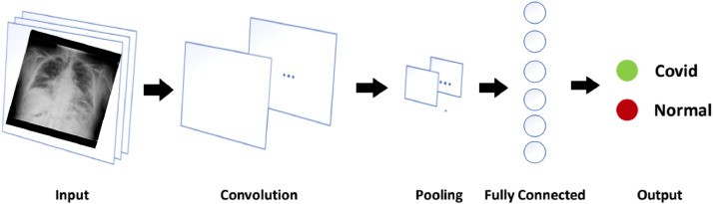
approach
Initially a Convolutional Neural Network was build to train the images with pooling, dropout, flatten and dense layers.
Secondly results were predicted as 0 and 1 for the given train images. {'Covid': 0, 'Normal': 1}
Finally labelling on image were done as “COVID” or “NORMAL” based on the predicted classes.

Slide 5
Preprocessing and augmentation
Here first step in pre-processing was to,
Generate batches of tensor image data with real-time data augmentation. The data will be looped over (in batches).
Take the path to a directory & generate batches of augmented data.
While Augmentation was done as follows:
For Training images were rotated to 15 degrees, rescaled to 1./255, sheared with intensity of 0.2,zoomed to 0.2,flipped horizontally, points outside the boundaries of the input are filled in the mode 'nearest', width and height shifted to 0.1
Test images were rescaled to 1./255

Slide 6
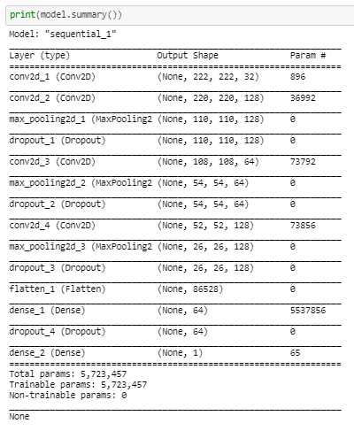
Summary of MODEL

Slide 7
Model compilation
Adam is an optimization algorithm that can be used to update network weights iterative based in training data. Adam is a popular algorithm in the field of deep learning because it achieves good results faster.
Binary Cross Entropy computes the cross-entropy loss between true labels and predicted labels. Use this cross-entropy loss when there are only two label classes (assumed to be 0 and 1).
Accuracy measures how many observations, both positive and negative, were correctly classified.

Slide 8
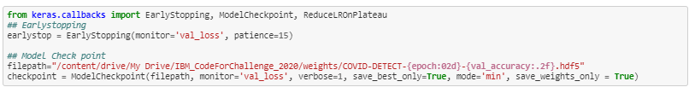
CALL BACKS
A callback is an object that can perform actions at various stages of training (e.g. at the start or end of an epoch, before or after a single batch, etc).
Early Stopping stops training when a monitored metric has stopped improving
Model Checkpoint save the Keras model or model weights at some frequency

Slide 9
Fit model
Model had been fitted on data yielded batch-by-batch by a Python generator. (deprecated)
Parameters:
Number of Epochs=30
Steps per epoch =10

Slide 10
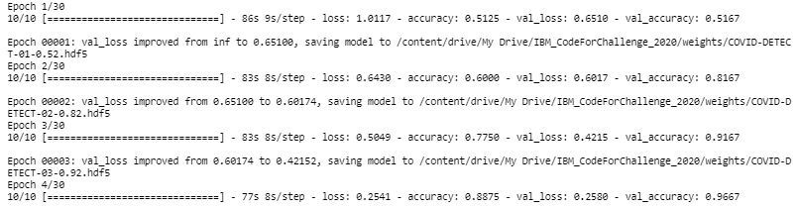
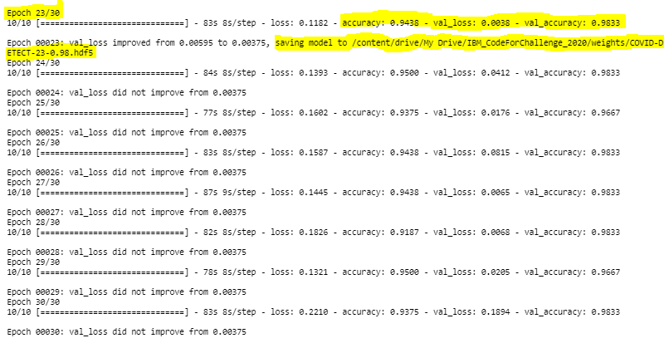
Fit model

Slide 11
CALCULATED METRICS
Network Model | Training Accuracy (%) | Training Loss | Validation Accuracy (%) | Validation Loss
CNN | 94.38 | 0.1182 | 98.33 | 0.0038

Slide 12
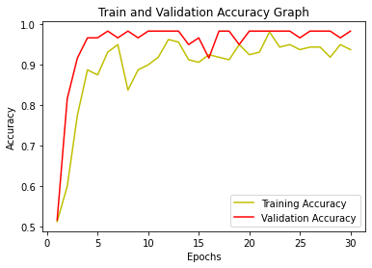
Plot ACCURACY

Slide 13
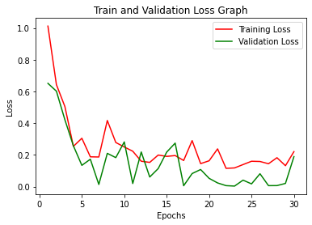
Plot LOSS

Slide 14
PREDICT TEST X-RAY IMAGES
Load
Load the image in PIL format.
Convert
Convert into numpy array and expand the shape.
Generate
Generate predictions on input array. If result= 0 then label the prediction variable as “COVID-19” else label the prediction variable as “NORMAL” for result=1.
Set
Set the prediction variable as title on top of image for better visualization.

Slide 15
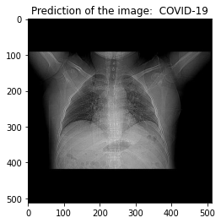
VISUALIZE PREDICT X-RAY IMAGES

Slide 16
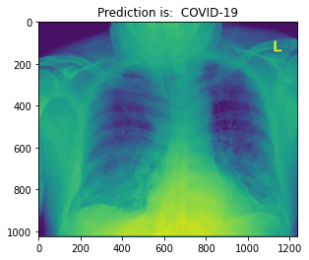
VISUALIZE PREDICT X-RAY IMAGES

Slide 17
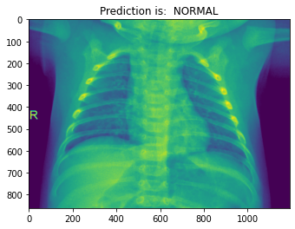
VISUALIZE PREDICT X-RAY IMAGES

Slide 18
THANKS!!

