Slide 1



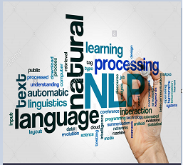
Document summarization using Natural language processing

Slide 2
Team DETAILS
TEAM NAME: SUMMARIZERS
TEAM:
SURYA TEJA CHALLAPALLI
AKHIL KANIKE
IMTIAZ AHMED
MENTOR:
MURALIDHAR KONIJETI

Slide 3
INTRODUCTION
“I don’t want a full detail, just give me a summary of the context !!”
We may often found ourselves in this situation when we have no time to read the long paragraphs. Manually converting the detail to a summarized version is time taking, since it requires a lot of analysis to do. This is where "Document/Text Summarization" comes into picture and avoids manual intervention.

Slide 4
abstract
The datasets we have used here are different news articles published by New York Times, Breitbart, CNN, Business Insider, The Atlantic, Fox News, Talking Points Memo, Buzzfeed News, National Review, New York Post, The Guardian, NPR, Reuters, Vox, and The Washington Post.,
Given 3 CSV documents articles1, articles2, articles3.
articles1.csv - 50,000 news articles (1-50,000)
articles2.csv - 49,999 news articles (50,001-100,00)
articles3.csv - Articles 100,001+

Slide 5
objective
Our goal is to design a system which can generate summary for large text and plot word cloud art using Deep Learning/NLP techniques.

Slide 6
Solution approach
Solution | Tools & Deep Learning Libraries
Document/Text Summarization https://infygit.ad.infosys.com/ghack2020/summarizers | Python, Jupyter Notebook, Google Colab/Amazon Sage Maker, nltk, TF-IDF, K-Means Clustering

Slide 7
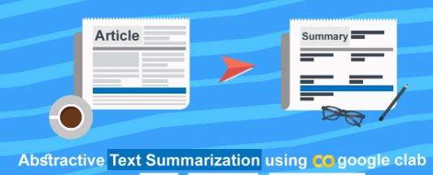
abstractive Summarization methods
Read Document
Preprocessing or Cleaning
Generate Summaries and plot Word Cloud Art on articles
Searching requests and finding similar articles using TF-IDF algorithm
Cluster Bag of Words and predict closest cluster for the passed sentence using K-Means algorithm.

Slide 8
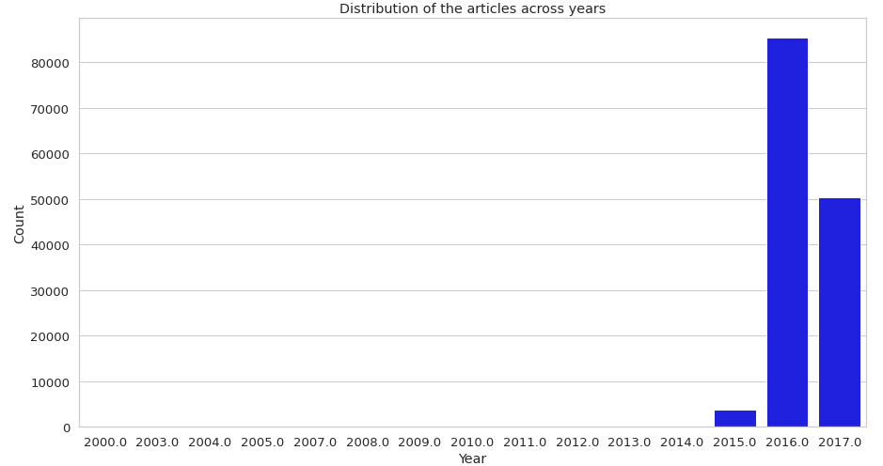
Distribution plot for articles across years

Slide 9
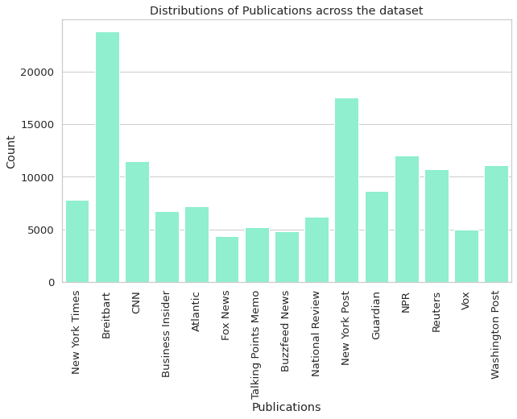
Distribution plot for publications

Slide 10
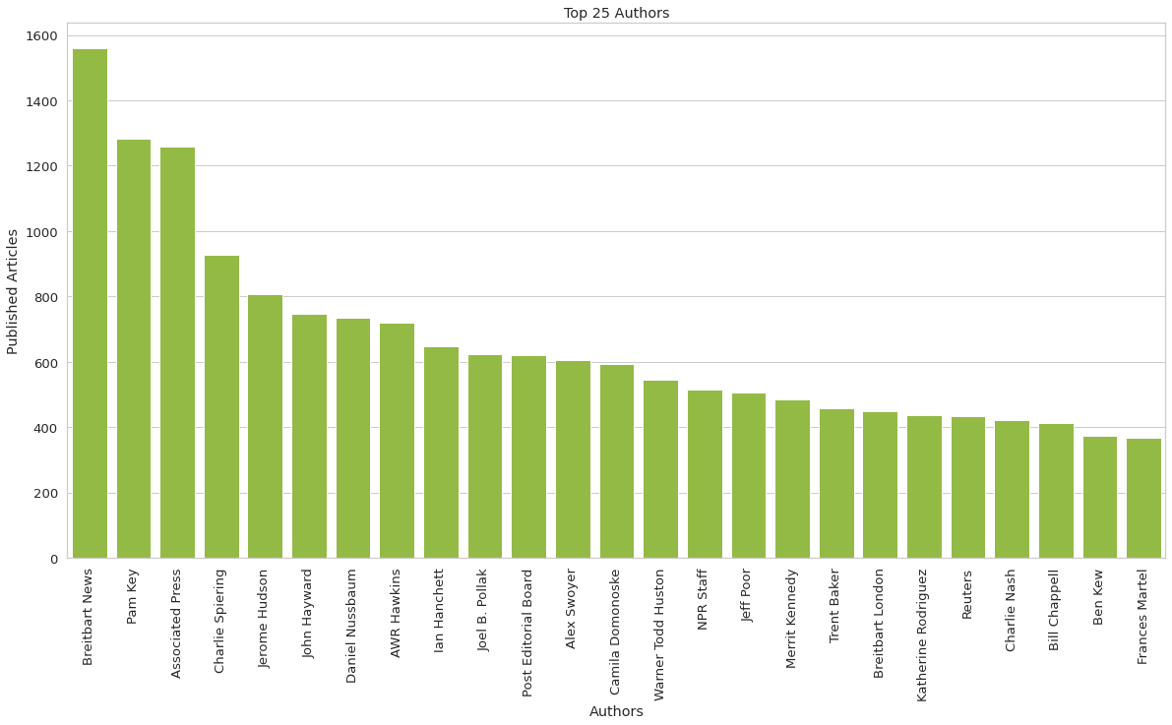
PLOT FOR Authors vs articles

Slide 11
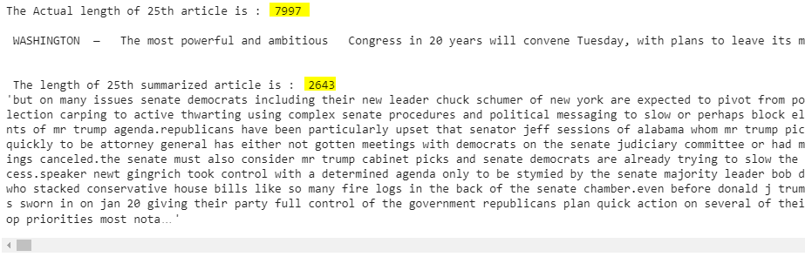
Generate summaries

Slide 12
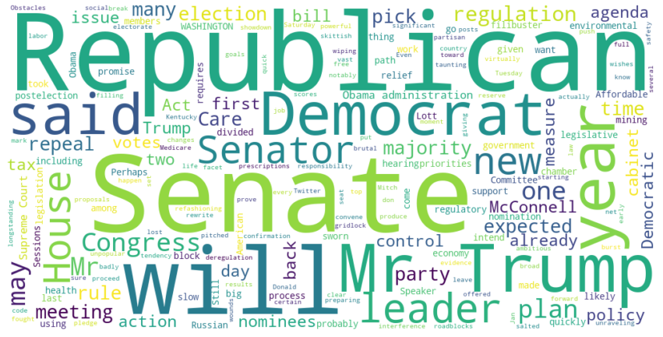
Word cloud art of article on trump

Slide 13
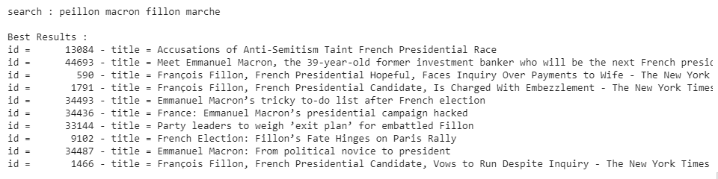
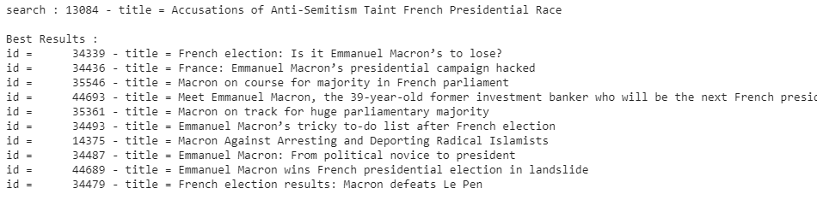
Search for request and find similar articles using tf-idf

Slide 14
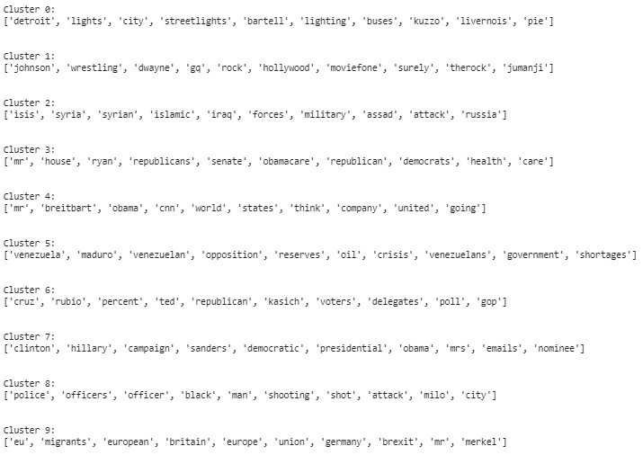
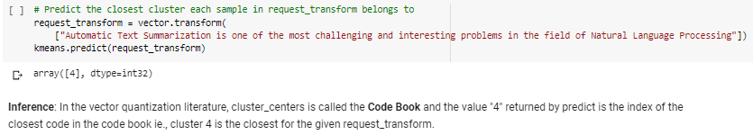
Cluster bag of words and predict closer cluster using k-means

Slide 15
THANKS!!

