Slide 1
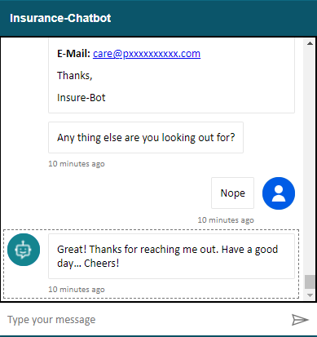
INSURE-YOU THE INSURANCE CHATBOT

Slide 2
AZURE BOT SERVICES
Build bots quickly and easily
Deploy across channels and languages
Scale securely with centralized management
Improve your bots over time

Slide 3
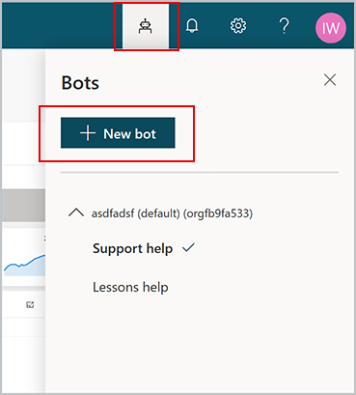
BOT CREATION

Slide 4
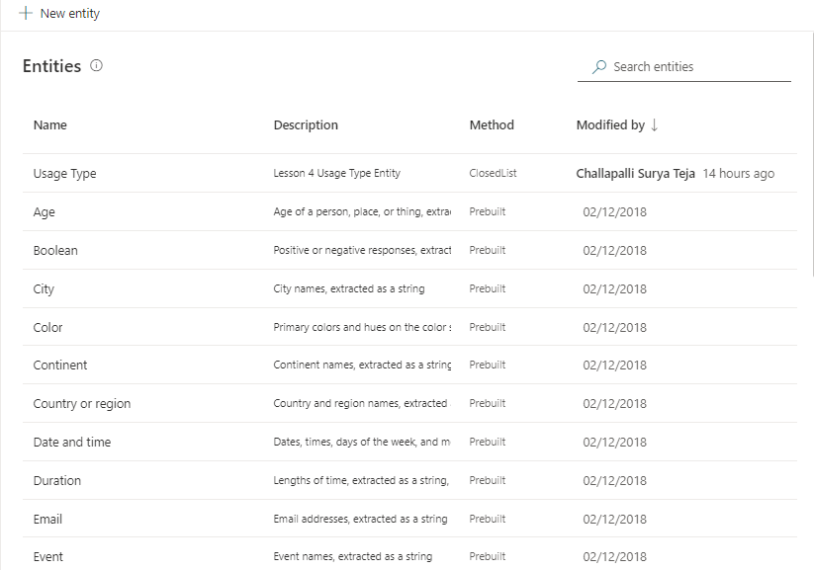
entities
An entity can be viewed as an information unit that represents a certain type of a real-world subject, like a phone number, zip code, city, or even a person's name.
Types of Entities:
Pre-built
Regex

Slide 5
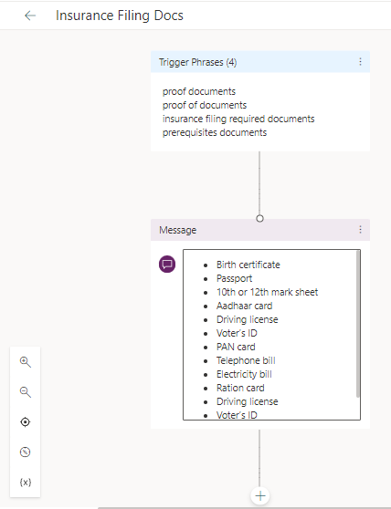
TOPICs
A topic defines a how a bot conversation plays out.
Topic components:
Trigger phrases
Conversation nodes.
Topic takes Phrases/Keywords as Input and shows the relevant output defined by business.
For eg., Topic: Insurance Filing docs, requires phrases such as “prerequisite documents” that user in general give in chat, the bot will understand these phrases and will generate the business output that satisfies the user ie., List of proof documents in this case.

Slide 6
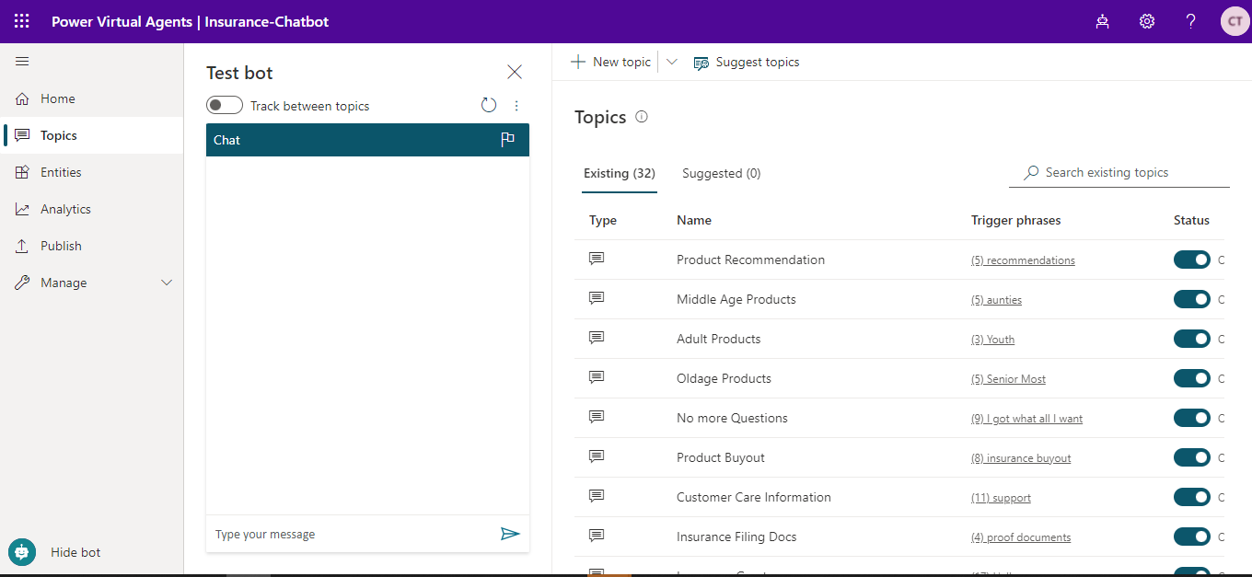
TOPICS list created

Slide 7
DIALOG FLOW TESTING SAMPLE OUTPUT

Slide 8
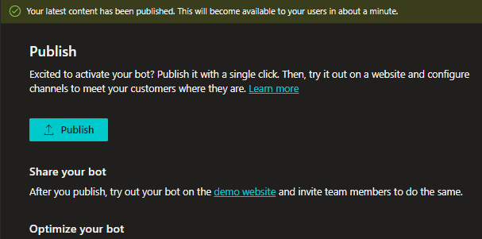
PUBLISH BOT
https://web.powerva.microsoft.com/environments/Default-7f16c8b3-f0ef-45a1-aa81-9d5c90cb8ba5/bots/fe4f43ee-81ec-46c2-aefc-e7ad26779934/publish

Slide 9
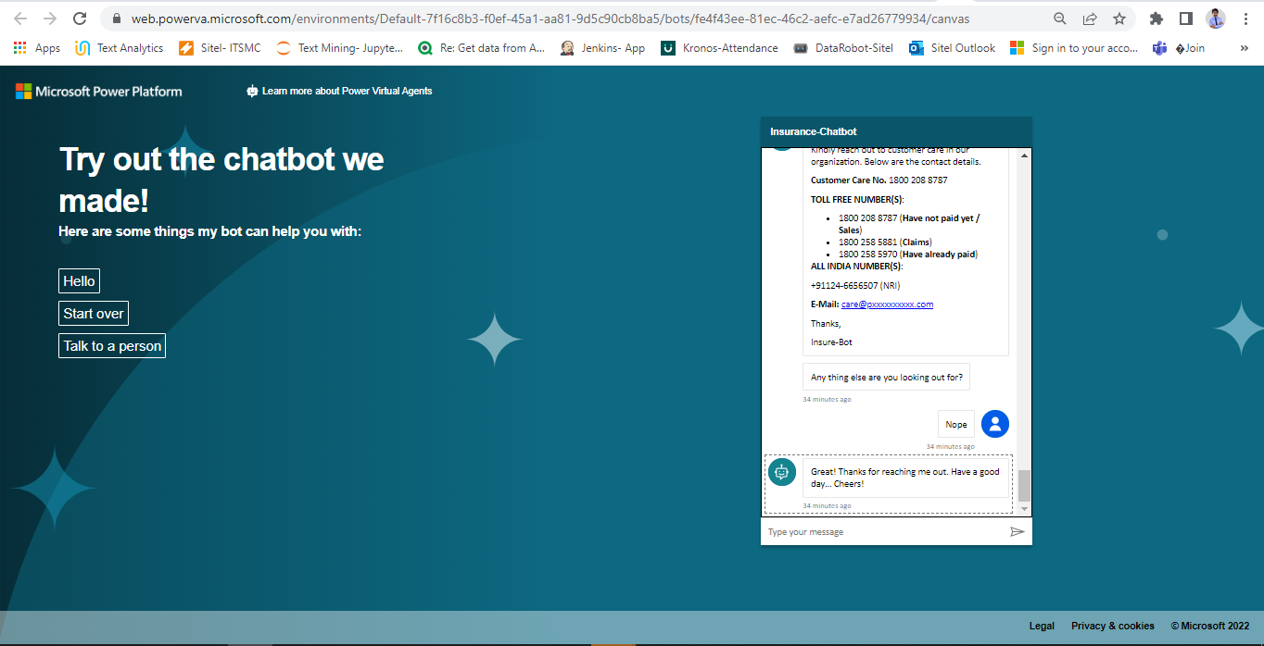
INSURE-YOU BOT WEBSITE
https://web.powerva.microsoft.com/environments/Default-7f16c8b3-f0ef-45a1-aa81-9d5c90cb8ba5/bots/fe4f43ee-81ec-46c2-aefc-e7ad26779934/canvas

Slide 10
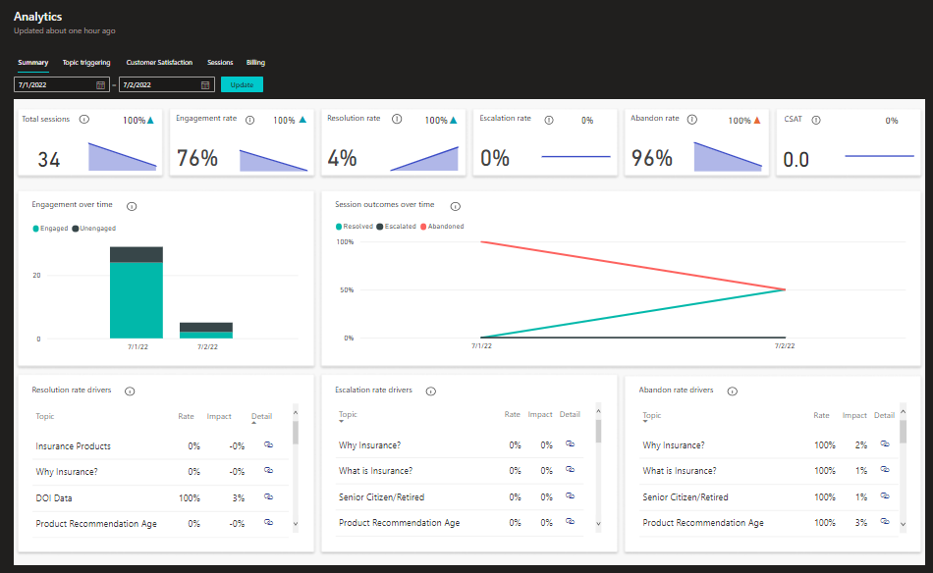
BOT PERFORMANCE ANALYTICS

Slide 11
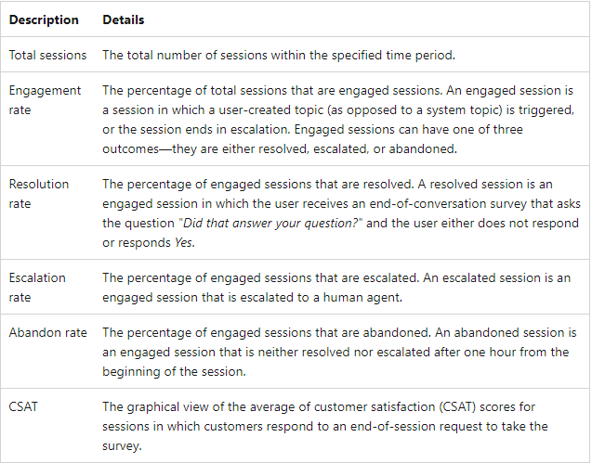
KEY PERFORMANCE INDICATORS

Slide 12
END CREDITS
AUTHOR: SURYA TEJA CHALLAPALLI
BOT NAME: INSURE-YOU (INSURANCE BOT)
BOT FUNCTIONALITY: INSURANCE INFORMATIVE SERVICES, USER ONBOARDING, BOT ANALYTICS, PRODUCT RECOMMENDATION
TECHNOLOGY USED: AZURE BOT SERVICE, VIRTUAL AGENT
TECHNOLOGY STACK: NLP, REGEX, KEYWORD EXTRACTION, DIALOGFLOW

Slide 13
THANKS

