Slide 1
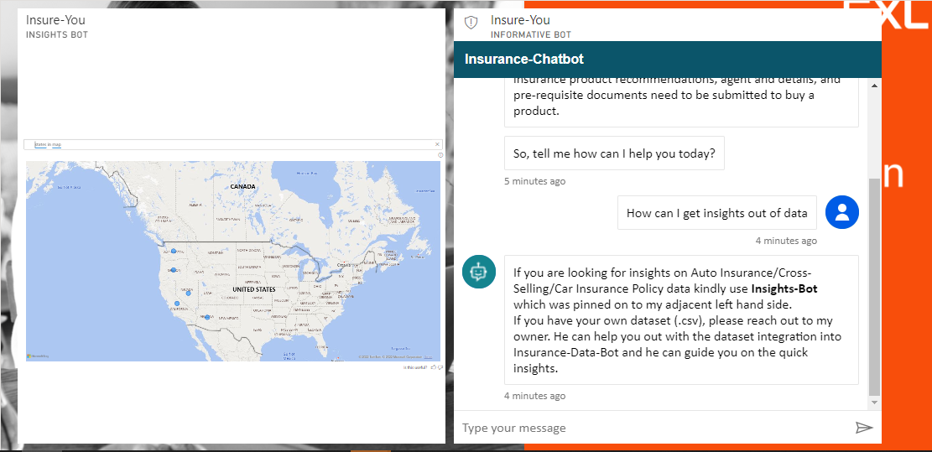
INSURE-YOU A SMART BOT FOR INSURANCE

Slide 2
INTRODUCTION
Insure-You is a powerful Chatbot with Augmented Intelligence, initially developed using Azure IOT services and later has been integrated to Power-BI tool with Q & A utility. It was developed in order to achieve the objective of being informative towards the user and being a bot that can infer insights out of any given specific Insurance dataset. Following are some of the capabilities of our bot,
Able to answer few FAQ’s on Insurance domain knowledge based on the user defined keywords and also it can provide the Wikipedia page link of Insurance knowledge base.
Able to recommend certain insurance products based on the category that user falls in terms of age level.
Able to redirect user to organization link where he/she starts filing application on his own and then redirects the user to policy executive/agents for further process.
Also it can provide some general information like how many days the application process will take, what are the documents customer care will request to process the application, additional available insurance products, insurance companies with which the organization tie up.
Able to aggregate the data and show the results , visualize the raw data/aggregate results to user in different charts like bar, scatter, pie, geographical map, word cloud, tree map etc.,

Slide 3
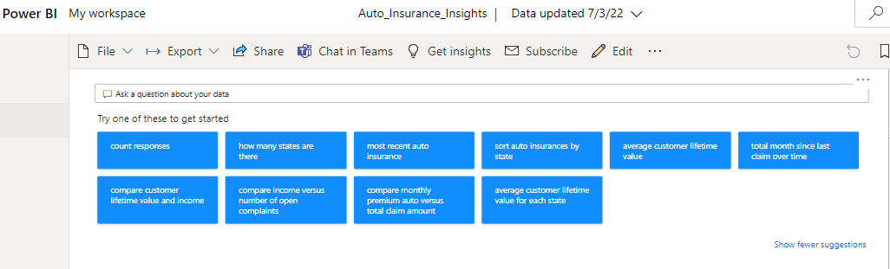
POWERBI - q & a
Q&A utility has an inbuilt NLP (Natural Language Processing) feature that is capable of extracting the user intent out of his/her question on the data points and ends up with the visualization results on face front where any user can gain insights out the visuals.
Below are some of the advanced features available in Q & A utility.
Autocomplete
Red/Blue/Orange underlines
Suggestions for some customer FAQ’s
Pinned Utility to any existing Report/Dashboard
Form Report/Visualization from data points.

Slide 4
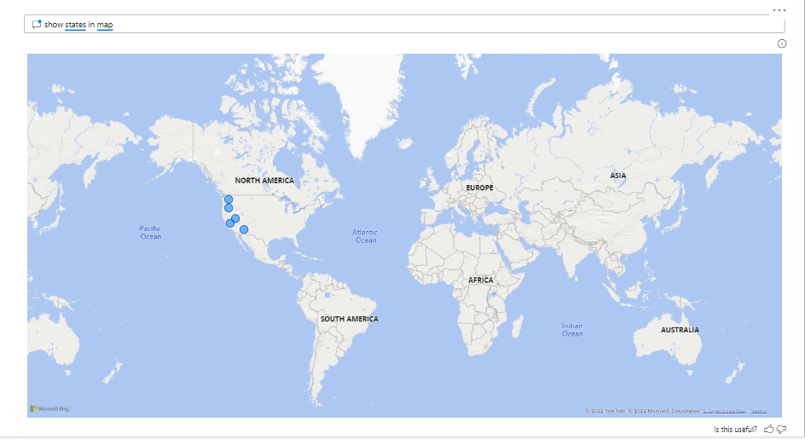
q & a VISUALS
Eg., User text is “show states in map”

Slide 5
AZURE BOT SERVICES
Azure Bot Service provides an integrated development environment for bot building. Its integration with Power Virtual Agents, a fully hosted low-code platform, enables developers of all technical abilities build conversational AI bots.
Build bots quickly and easily
No code needed
Deploy across channels
Scale securely with centralized management
Improve your bots over time by monitoring performance

Slide 6
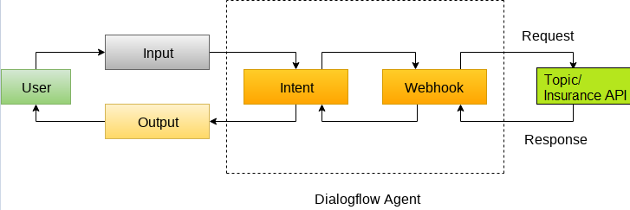
VIRTUAL AGENT DIALOG FLOW
Dialog-flow is a natural language understanding platform that makes it easy to design and integrate a conversational user interface into your mobile app, web application, device, bot, interactive voice response system, and so on.

Slide 7
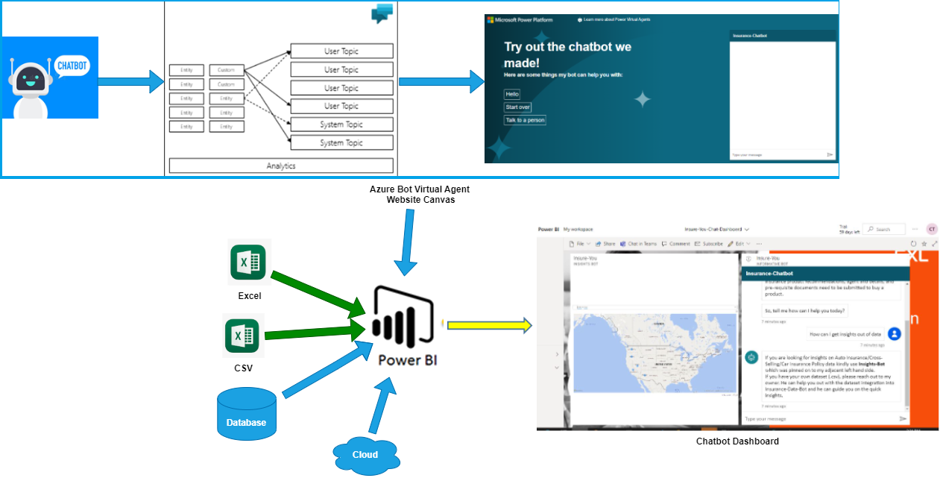
PROJECT ARCHITECTURE

Slide 8
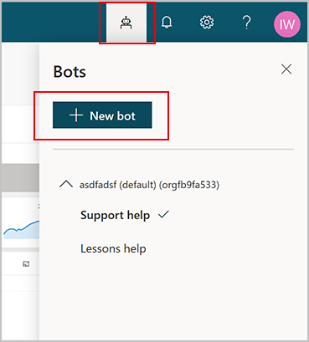
BOT CREATION (VIRTUAL AGENT)

Slide 9
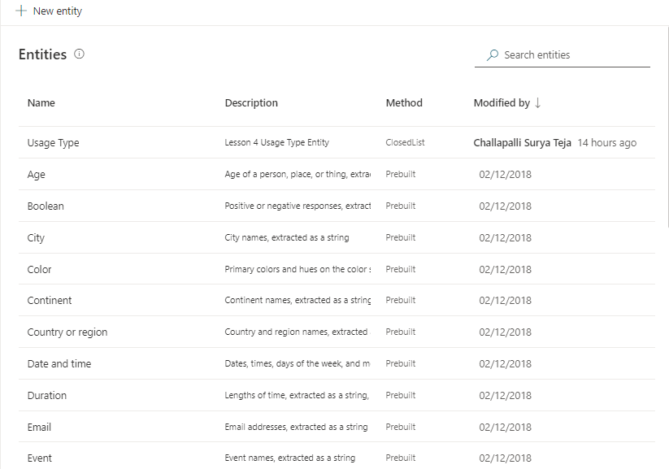
entities
An entity can be viewed as an information unit that represents a certain type of a real-world subject, like a phone number, zip code, city, or even a person's name.
Types of Entities:
Pre-built
Regex

Slide 10
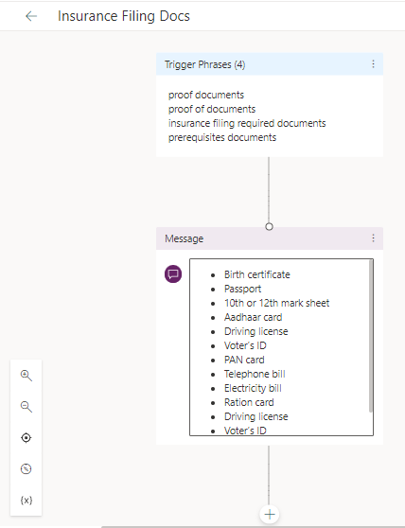
TOPICs
A topic defines a how a bot conversation plays out.
Topic components:
Trigger phrases
Conversation nodes.
Topic takes Phrases/Keywords as Input and shows the relevant output defined by business.
For eg., Topic: Insurance Filing docs, requires phrases such as “prerequisite documents” that user in general give in chat, the bot will understand these phrases and will generate the business output that satisfies the user ie., List of proof documents in this case.

Slide 11
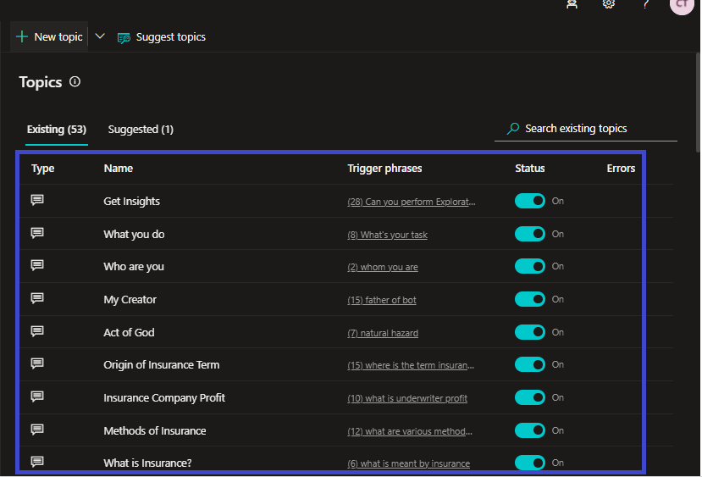
Created TOPICS

Slide 12
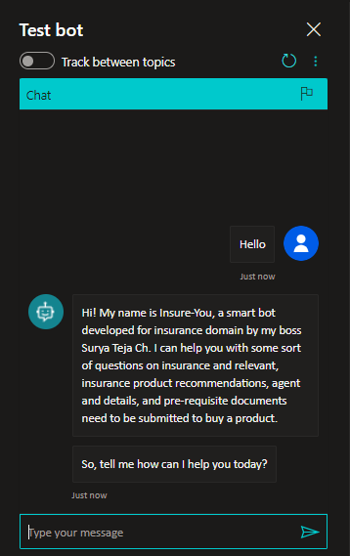
BOT FUNCTIONAL testing

Slide 13
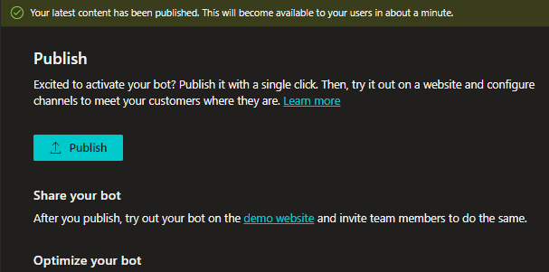
PUBLISH BOT
https://web.powerva.microsoft.com/environments/Default-7f16c8b3-f0ef-45a1-aa81-9d5c90cb8ba5/bots/fe4f43ee-81ec-46c2-aefc-e7ad26779934/publish

Slide 14
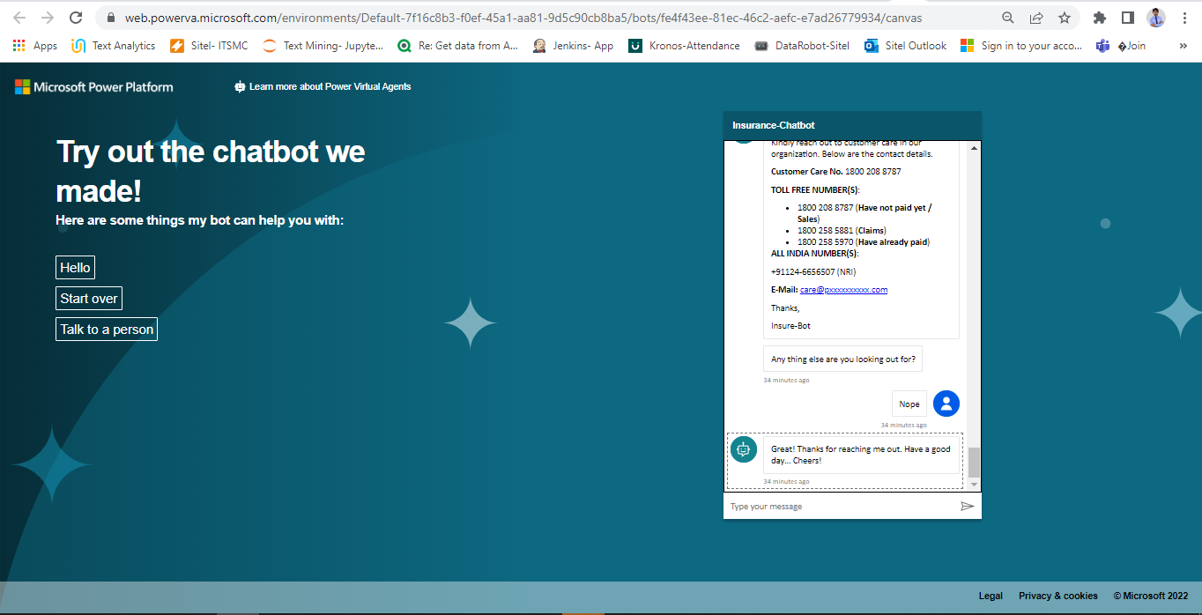
INSURE-YOU BOT WEBSITE
https://web.powerva.microsoft.com/environments/Default-7f16c8b3-f0ef-45a1-aa81-9d5c90cb8ba5/bots/fe4f43ee-81ec-46c2-aefc-e7ad26779934/canvas

Slide 15
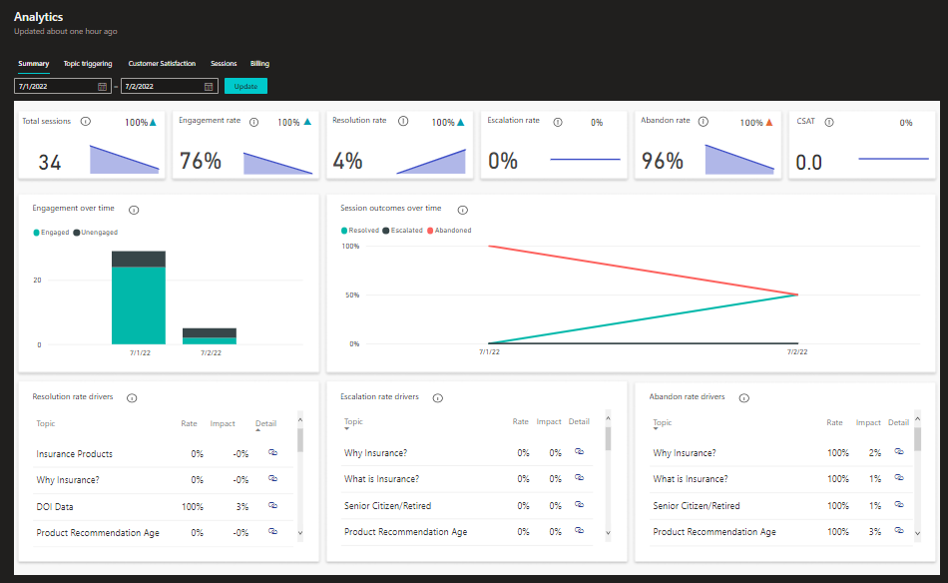
BOT PERFORMANCE ANALYTICS

Slide 16
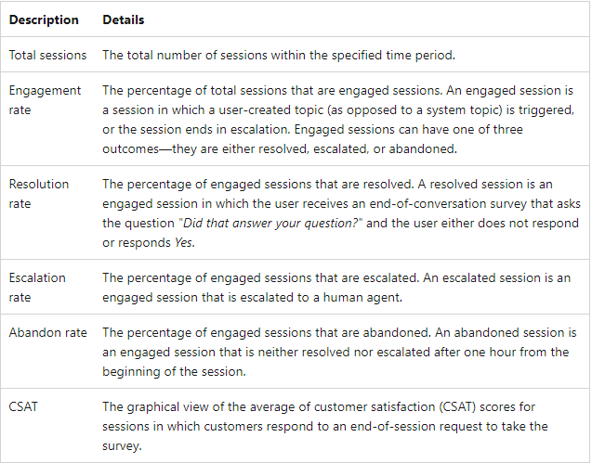
BOT MONITORING METRICS

Slide 17
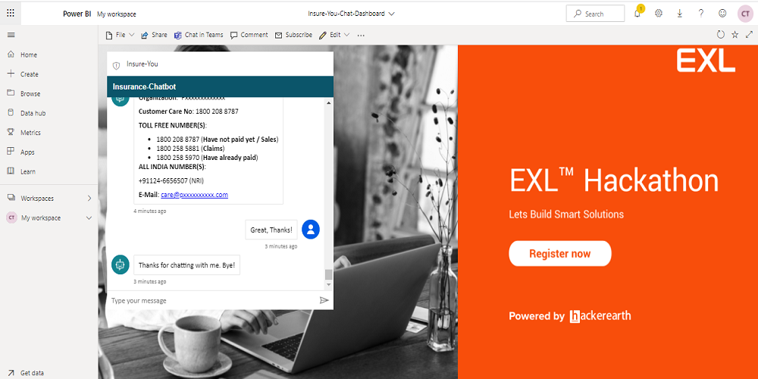
VIRTUAL AGENT power bi INTEGRATION

Slide 18
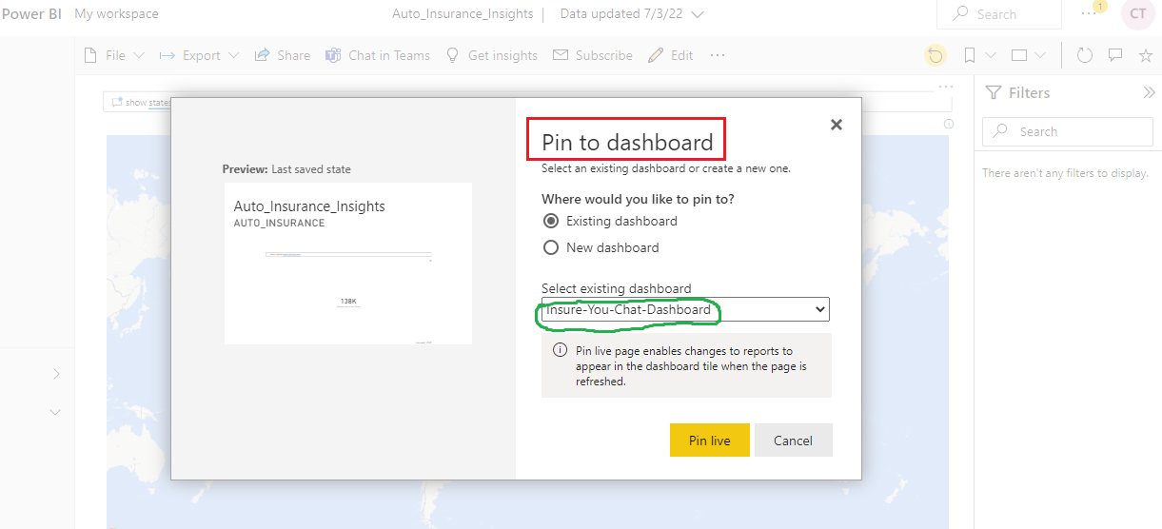
DASHBOARD PINNING

Slide 19
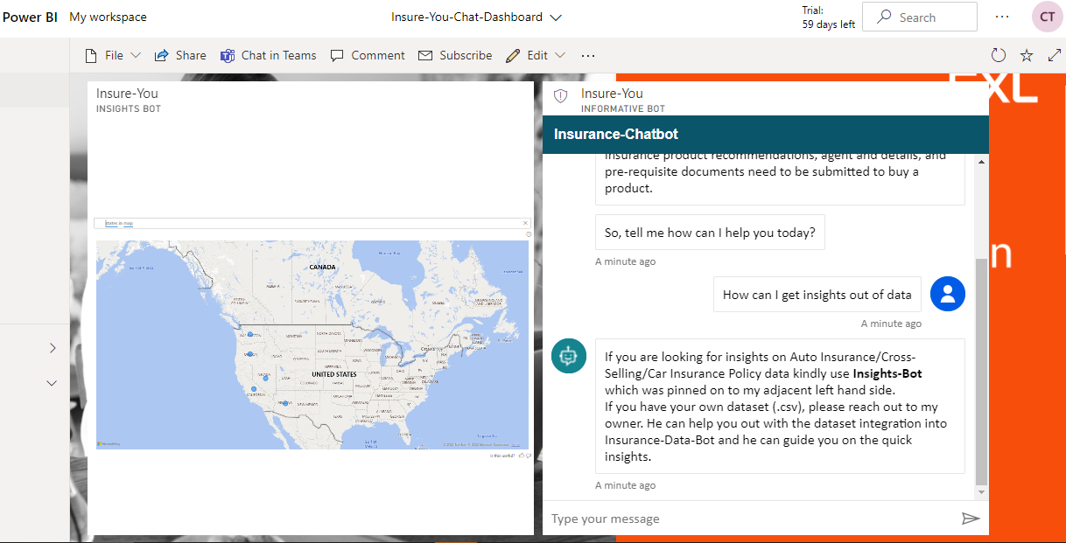
INSURE-YOU PRODUCT

Slide 20
END CREDITS
AUTHOR: SURYA TEJA CHALLAPALLI
BOT NAME: INSURE-YOU
VERSION: 1.0
BOT FUNCTIONALITY: INSURANCE INFORMATIVE SERVICES, USER ONBOARDING, BOT ANALYTICS, PRODUCT RECOMMENDATION, DATA INSIGHTS
TECHNOLOGIES USED: MICROSOFT AZURE BOT SERVICE, VIRTUAL AGENT, POWER BI, Q & A
TECHNOLOGY STACK: NATURAL LANGUAGE PROCESSING, REGEX, KEYWORD EXTRACTION, DIALOGFLOW, DATA VISUALIZATION, BI DASHBOARD

Slide 21
THANKS

