Slide 1

Seasonal Agriculture Performance Analysis
Chamakura Yamini
Ace Engineering College
AICTE STU ID : STU6a6a06382be941785333304

Slide 2

PROBLEM STATEMENT
Agricultural activities are influenced by seasonal variations in environmental conditions, farming practices, resource availability and market conditions. As a result, agricultural performance may differ from one season to another. However, raw agricultural data does not clearly explain how agricultural performance changes across seasons or what patterns can be observed in different seasonal conditions. The problem is to analyze the given agricultural dataset and investigate seasonal differences in agricultural performance by identifying meaningful patterns, trends, relationships and variations within the available data.

Slide 3
Project Description
​Overview: Detailed Exploratory Data Analysis (EDA) of 4,000 agricultural records across multiple Indian states and crop types.
​Analytical Focus: Evaluates the interaction between environmental metrics (rainfall, temperature, humidity, soil moisture), agricultural inputs (fertilizer, pesticide, seed quality, irrigation), and seasonal outputs (yield, production, market prices, net profit).
​Methodology: Data cleaning, missing value handling, seasonal grouping, correlation analysis, and data visualization using Python.

Slide 4

WHO ARE THE END USERS?
Agricultural Policy Makers: To design targeted seasonal subsidy programs and optimize regional water management schemes.
​Farm Management Consultants & Agronomists: To advise farmers on high-yield crop selection and resource allocation per season.
​Agricultural Lenders & Insurance Providers: To evaluate seasonal financial risk profiles and pest risk variations for credit underwriting.

Slide 5

Technology Used
  ​Programming Language: Python 3.x
  ​Data Manipulation & Analysis: Pandas, NumPy
  ​Data Visualization: Matplotlib, Seaborn
  ​Development Environment: Jupyter Notebook / Google Colab
  ​Version Control: Git & GitHub

Slide 6
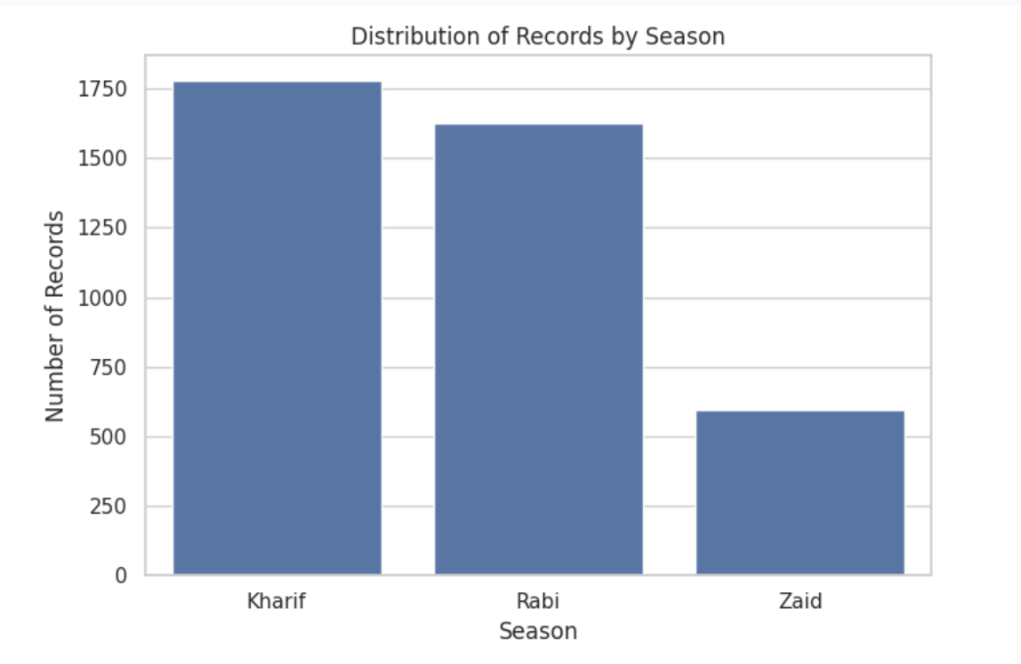
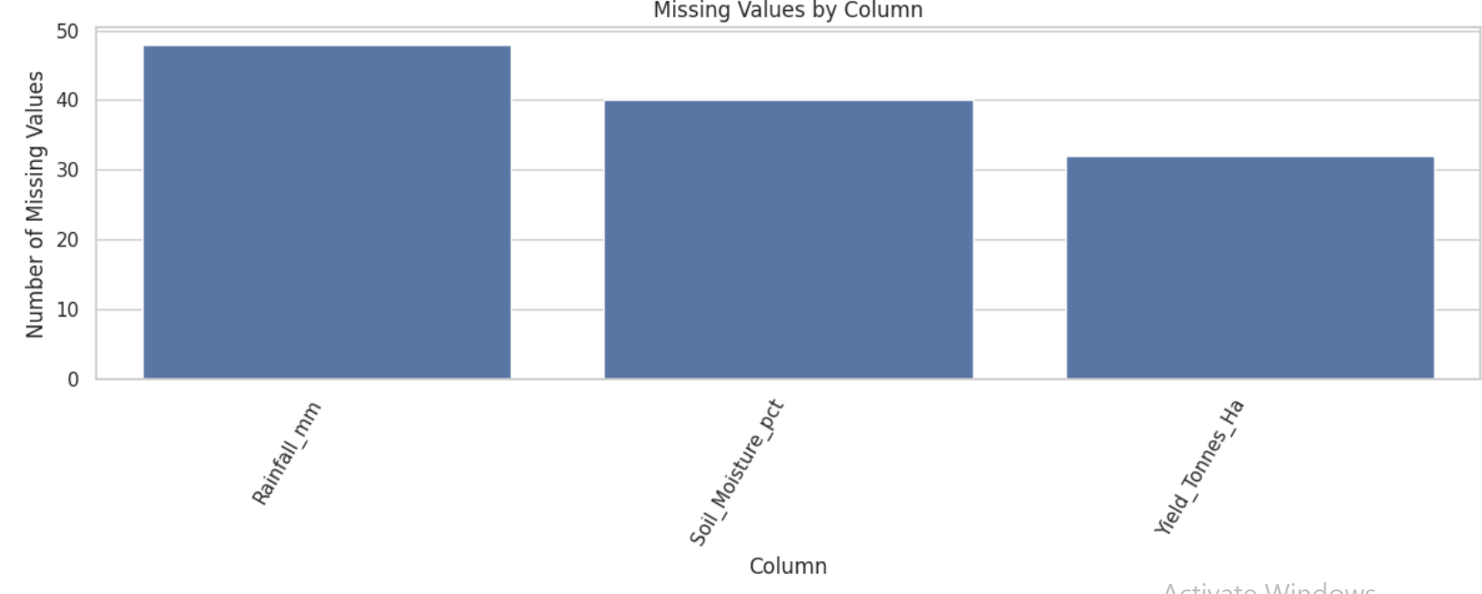
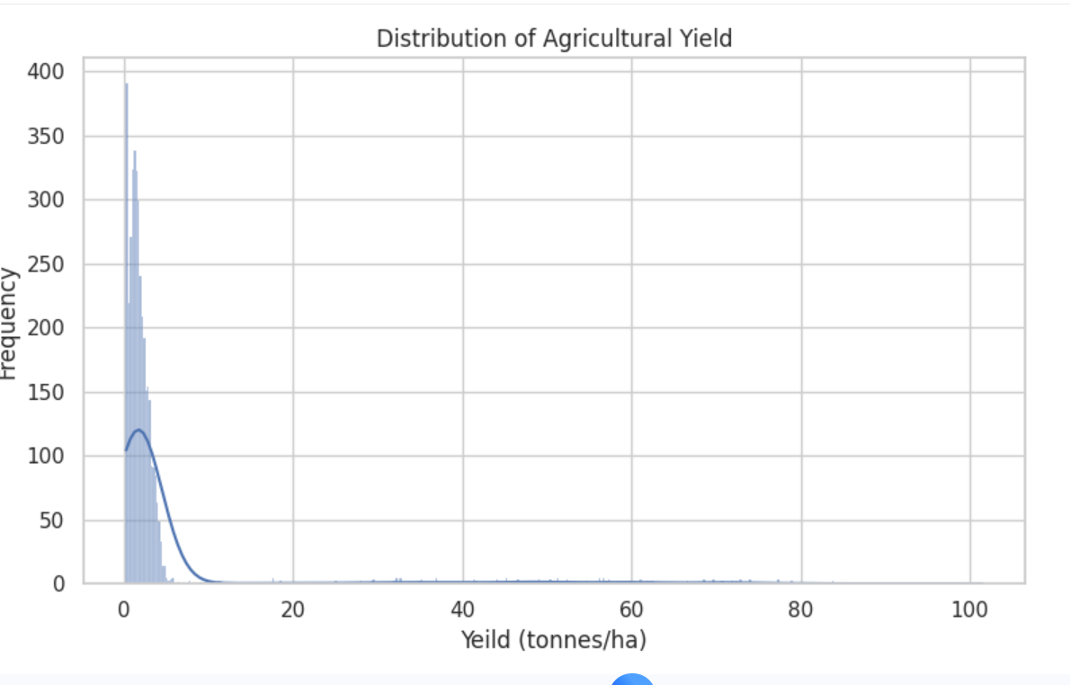
RESULTS

Slide 7
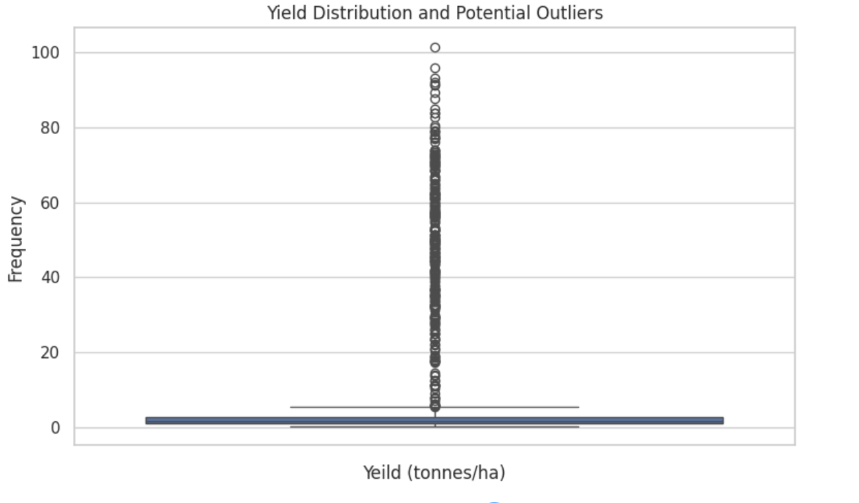
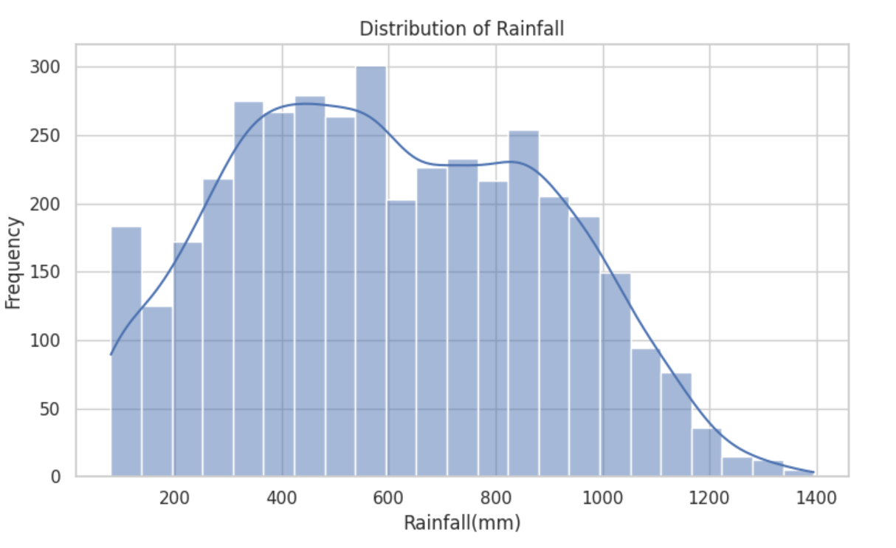
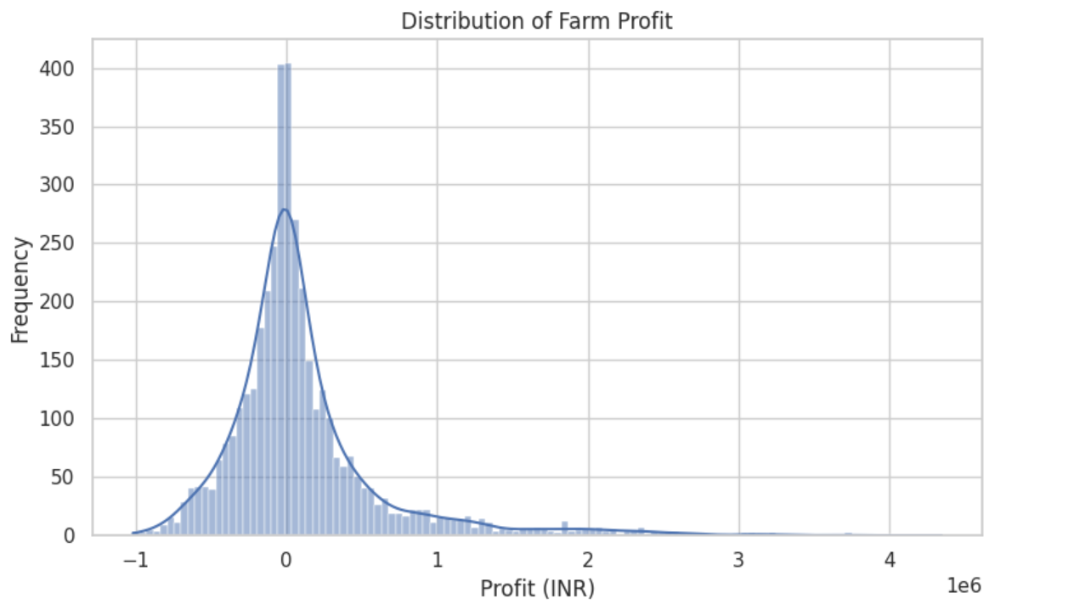
RESULTS

Slide 8
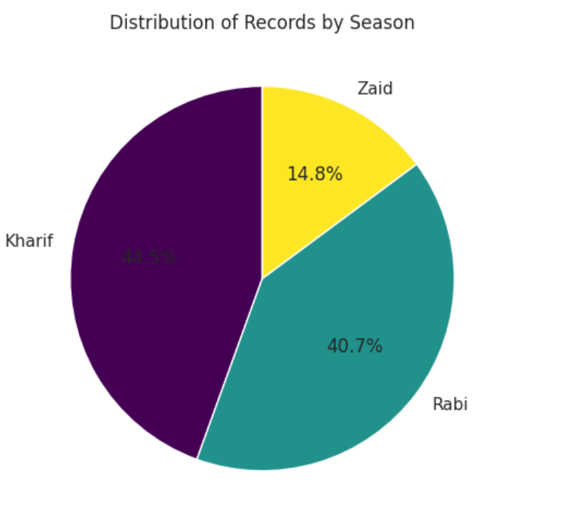
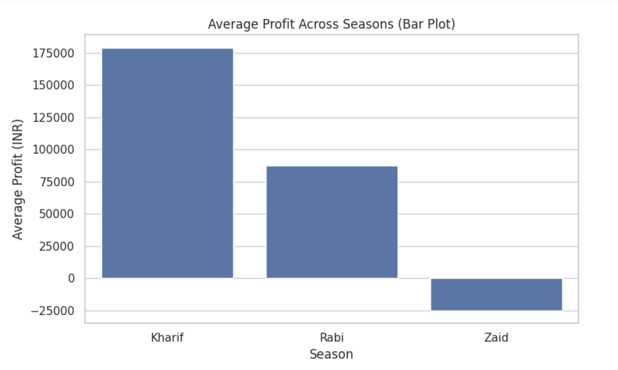
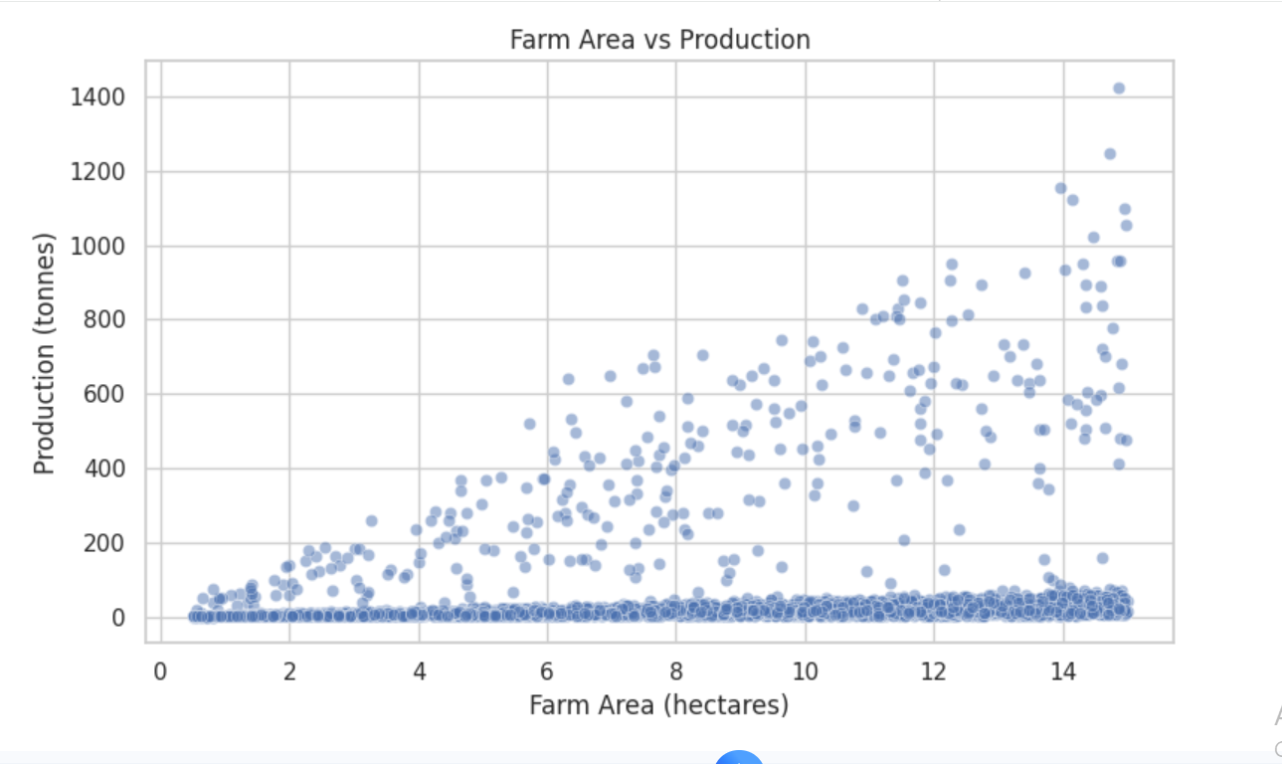
RESULTS

Slide 9
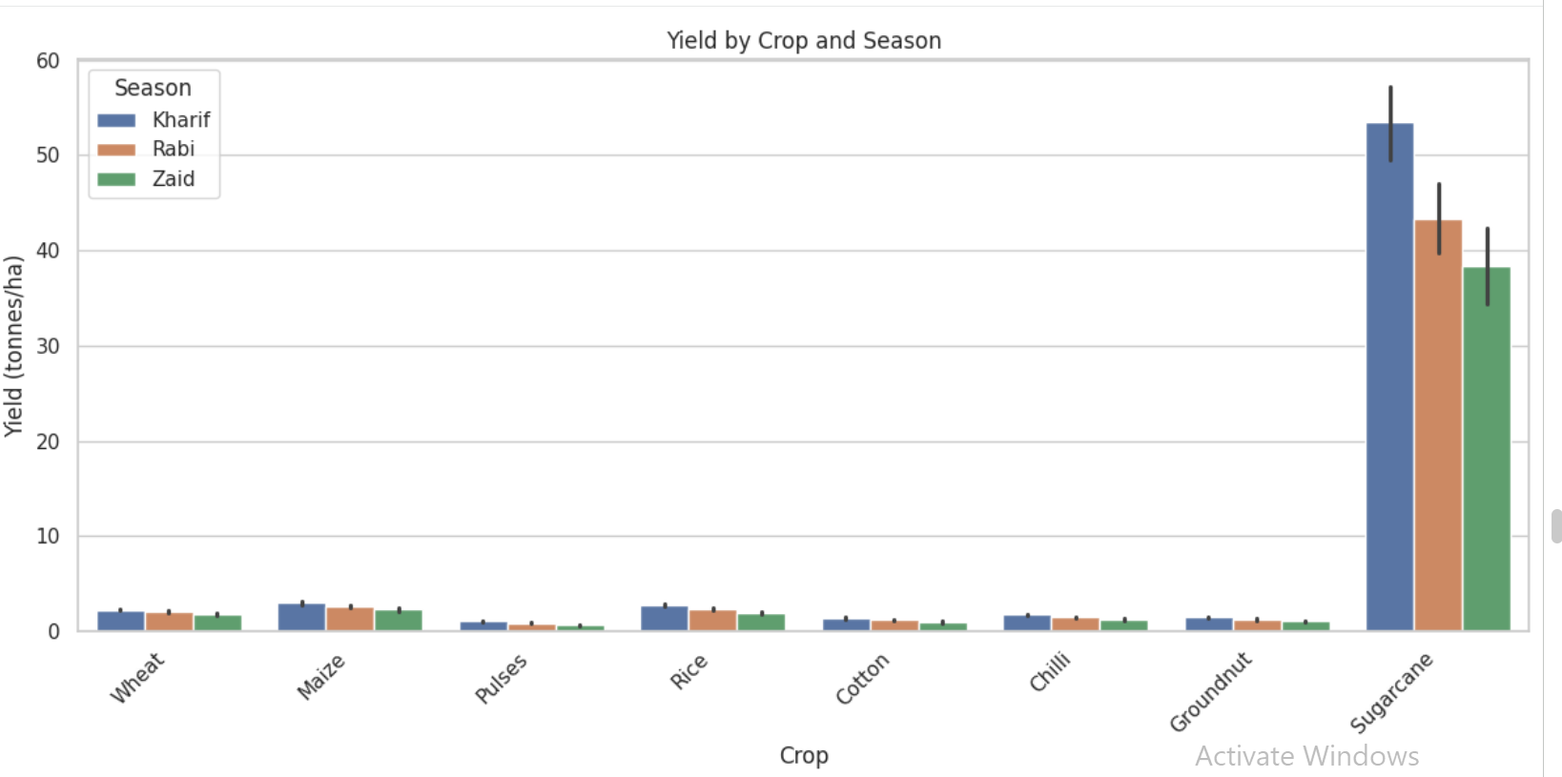
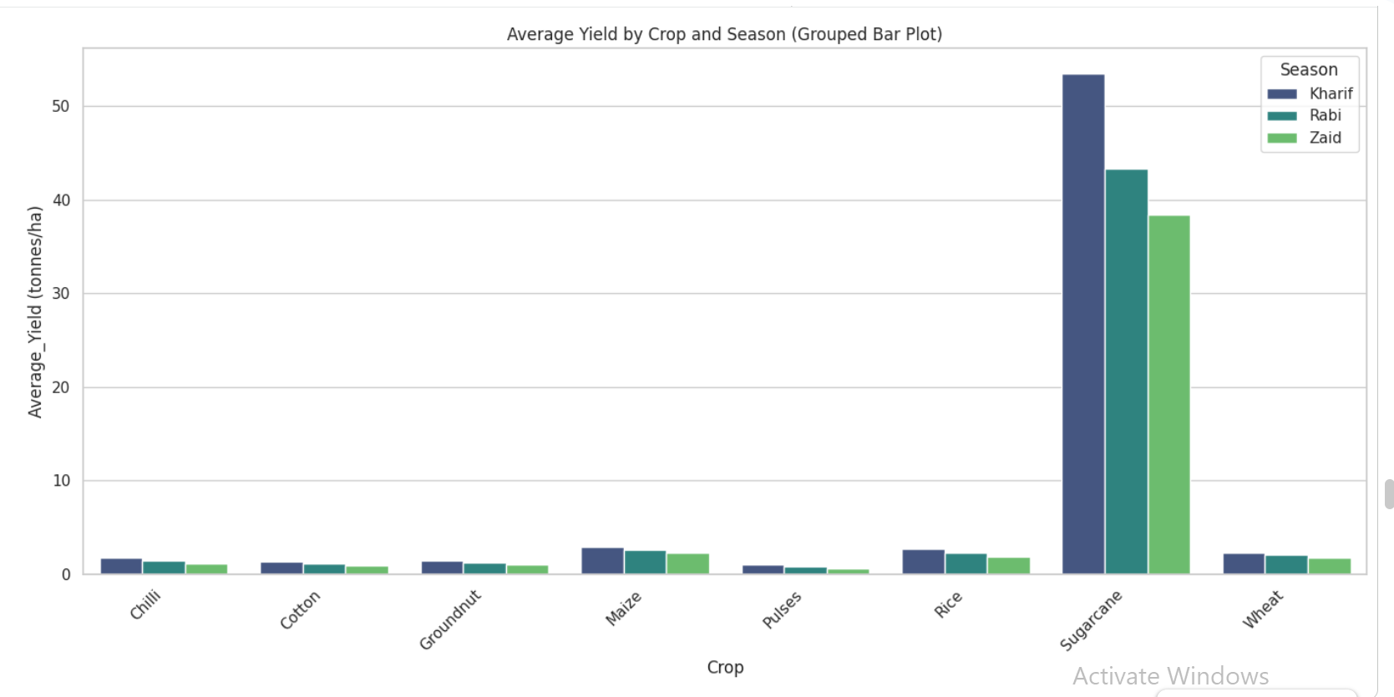
RESULTS

Slide 10
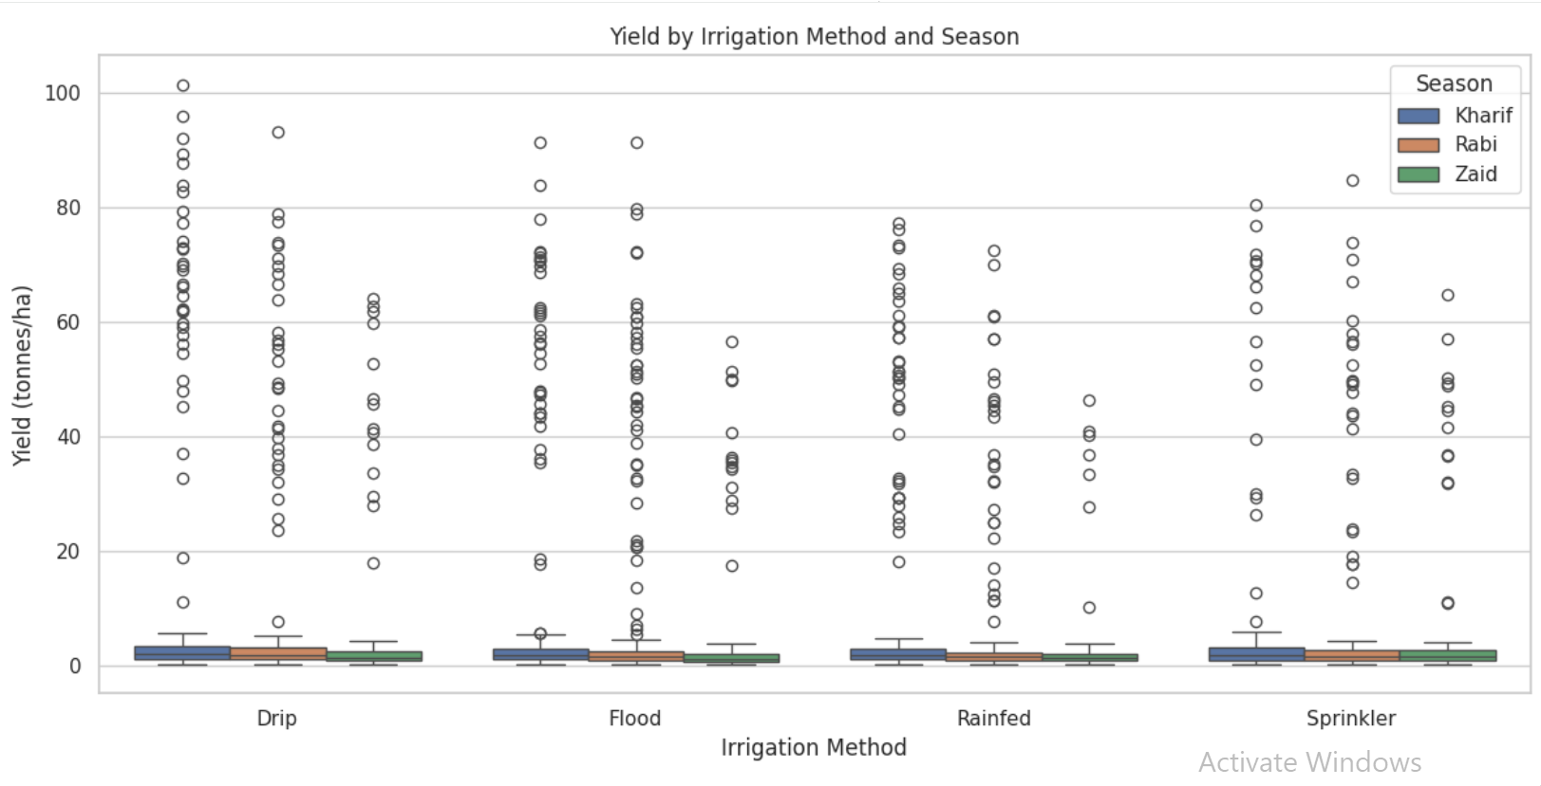
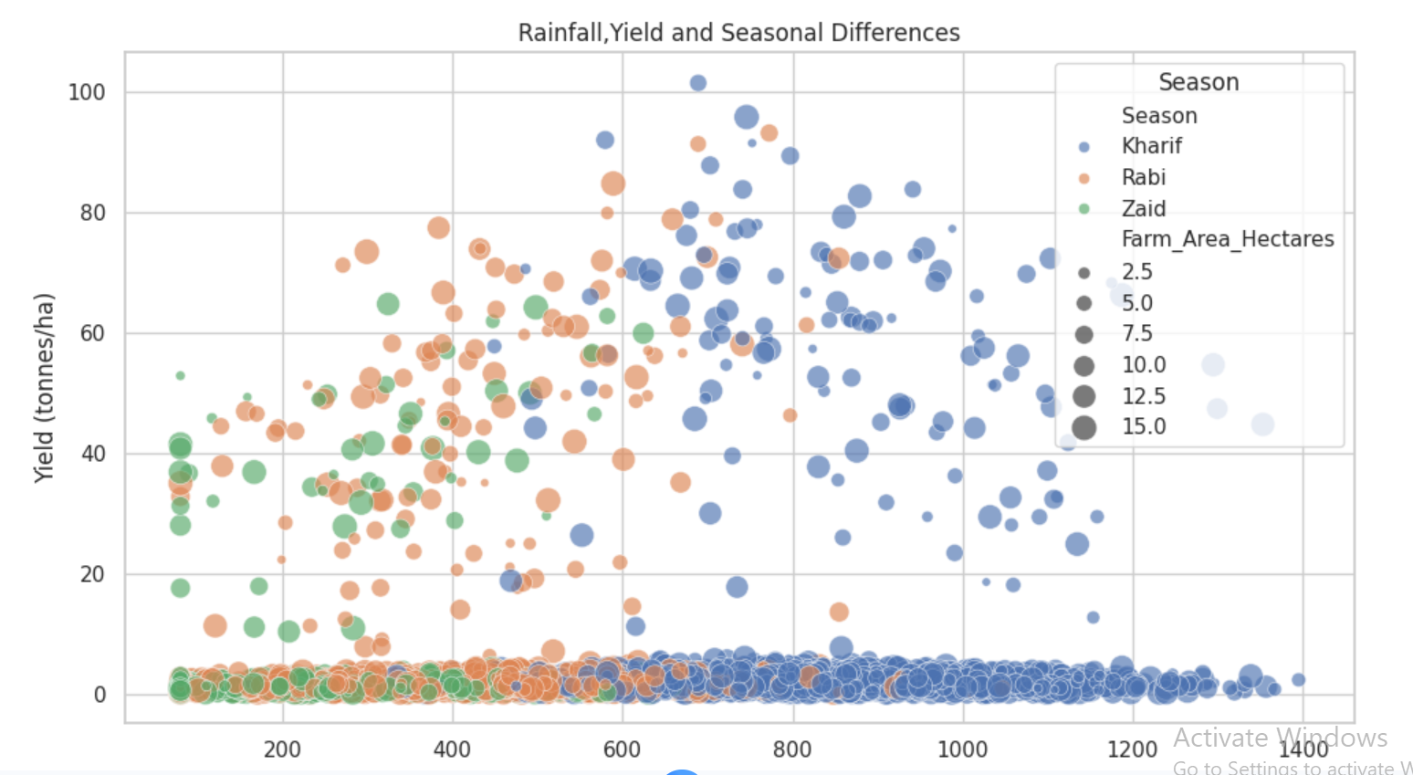
RESULTS

Slide 11
Future scope
​Machine Learning Predictive Modeling: Implement regression algorithms (Random Forest / XGBoost) to forecast seasonal crop yield based on early weather forecasts.
​Optimization Systems: Build resource allocation algorithms to minimize water consumption during low-rainfall periods.
​Geospatial & Dynamic Data Integration: Incorporate real-time satellite imagery (NDVI indices) and live market price feeds to support dynamic profit predictions.

Slide 12
GitHub Link

Slide 13

VOIS Course completion certificate -
Course name- Data Visualization

Slide 14
Thank you
.
.

