Slide 1
Optical Character Recognition
Stelios Barberakis
<chefarov@gmail.com>
Machine learning
Chania, TUC
26/03/2014

Slide 2
Introduction
What is Optical Character Recognition (OCP)?
Why do we need OCP technology?
  Usefull applications:
    Assisting blind and/or visually impaired people
    Automatic Postcode recognition
    And more...
  First small step towards defeating Captcha

Slide 3
Introduction (2)
Evaluated some Machine Learning (ML) methods/techniques:
Multilayer Perceptron Networks (MLP)
  Both a two (2) and three (3) hidden layer
K-Nearest Neighbors (knn)
Support Vector Machine (SVM)
Working on the input space

Slide 4
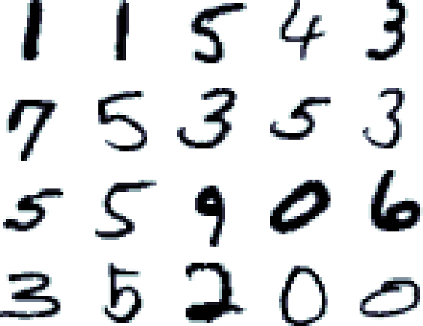
MNIST Dataset
Used for Comparing methods
Train set: 60000 sample
Test set: 10000 samples
Test set: people not participating in training set
Resolution: 28x28
Train set: random ordering
Test set: 5000 easy, then 5000 harder

Slide 5
Related Work
MNIST test error rate:
  Linear Classifiers: 7.6 - 12%
  KNN: 0.63 - 5%
  Boosted Stumps: 0.87 - 7.7%
  PCA with Quadratic Classifiers: 3.3%
  SVM: 0.56 - 1.4%
  ANN (e.g. MLP, CNN): 0.23 – 4.7%
    MCDNN: 0.23%
  Human error: 0.2%

Slide 6
Best implementation so far
CNNs: state of the art classifiers for image recognition. Natively translational and scaling invariant
MCDNN by Ciresan, Meier, Schmidhuber
Test Error: 0.23%, Human error: 0.2%
20/23 of misclassified: correct 2nd guess
Traffic signs dataset: Achieved half of the human error (1.1% → 0.54%)

Slide 7
Preprocessing
Removed padding and scaled pictures to 14x14
Performance of scaled dataset similar to the one on the original dataset (10% used)
Scaling intensity values to [-1, 1]. Pictures with different intensity ranges can be classified
note: before calling the trained classifier for a random picture, it must be also normalized to [-1 1]

Slide 8
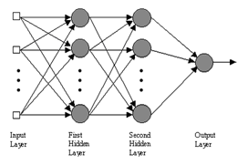
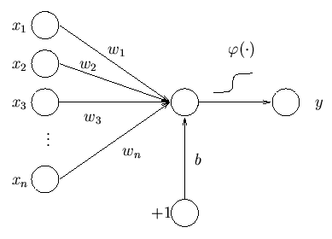
Multilayer Perceptron Network (MLP)
Fully connected feed-forward network
Non-linear classifier
Input: MxN, M samples, each of N attributes
Batch (native) or sequential training (faster- preferred for huge datasets).
3 layer with sigmoidal activation function can approximate any function to arbitrary accuracy

Slide 9


Backpropagation (BP) – Gradient Descent (GD)
Learning occurs by adjusting weights in order to decrease error:
Derivation show that in order to follow the
gradient downwards we update weights by:
Other BP training functions also exist

Slide 10
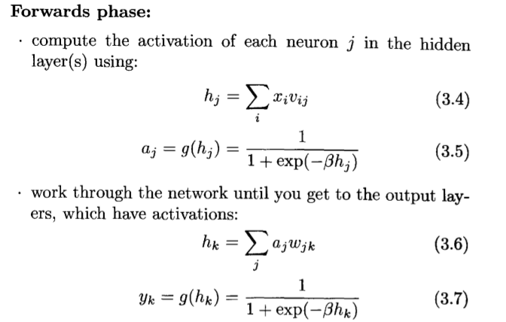
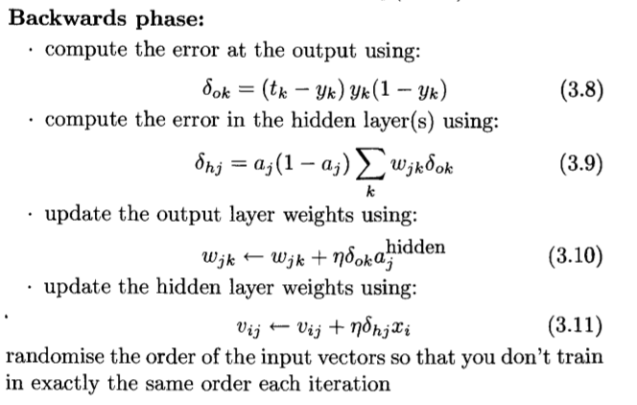
Training procedure

Slide 11
Stopping
To avoid overfitting: Earlystopping or L1,L2 regularization (extra term to the loss function)
EarlyStopping:
  Iteratively call train(for some epochs). Use validation set to determine how well the network has generalized.
  Heuristics to decide when to stop.
  Simplest one: Stop if validation error in last 2 or 3 (earlystopping-iterations) was increasing

Slide 12

Parameters
Number of layers (2 is usually enough)
Number of nodes in each layer
Activation function (each node): sigmoid function: differentiable. Neuron behavior. Gradient descent
Learning rate(η): How fast it converges. The lower the safer (Reduce oscillations, and avoiding local minimum)
Momentum(α): Δw depends on the previous Δws. Allows lower (η) and increases convergence speed.

Slide 13
Applying on MNIST dataset
Input: Arrays (50000x14x14), reshape to (50000x196)
Construct MLP (X, T, nodes, layers, outtype)
Train(X,T, η, n_iterations) #before calling earlystopping!
Earlystopping(X,T,valid_X,valid_T, η)
Calculate confusion matrix (test_X, test_T)
Save trained NN (serialized in disk) using Pickle
Recall phase: Call forward function for custom input
Output: 1-of-N encoding using soft-max:
[0.02, 0.30, 0.14 … 0.05]: classified as '1' (argmax=1)

Slide 14
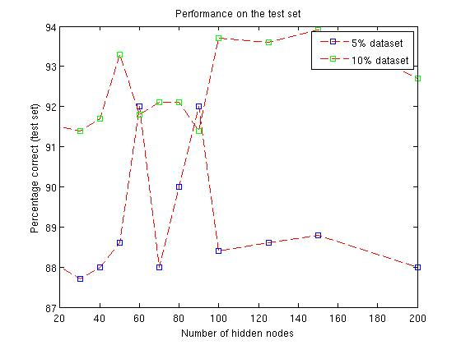
Performance per architecture (2 layer - MLP)

Slide 15
Performance of MLP
Using Rprop from Pybrain (50 nodes) gave: 99.1% performance !?
Architecture (nodes) | Dataset usage % | Performance | Training time
50 | 50 | 95.60 | 14h 40m
50 | 100 | 96.83 | 33h 20m
100 | 100 | 97.44 (vs 95.3 of 300-nodes reported) | 66h 0m
–---------------- | –---------------- | –----------------- | –----------------
150-100 | 100 | 97.17 | 5days 15h
200-100 | 100 | 97.41 | 52h
300-100 | 100 | 97.64 (best reported: 97) | 8days

Slide 16
Optimize performance
Parallelize Back propagation: Each thread calculates activation function for each neuron(sequential learning), or dataset is divided in subsets (batch learning).
Use other training functions instead of Gradient Descent, as is the resilient Back Propagation (Rprop):
  Each weight has its own update rule in the opposite direction of that weight's partial derivative.
Best (paranoic) MLP reported:2500-2000-1500-1000-500-10, has performance: 98.43%, affine + elastic preprocessing: 99.69%

Slide 17
Advantages & Disadvantages
+ Invariant features detection
+ General applicability
+ Can approximate complex models
- A lot of experimentation needed
- Training phase too long, need for parallelization
- Difficult to make use of prior knowledge

Slide 18

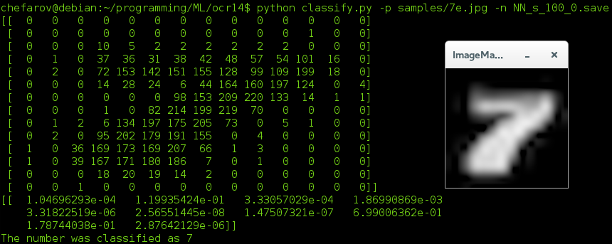
Script to classify a character
Parameters:
Image path
trained net object path
Foreground color

Slide 19
kNN
Non-parametric model, predictions straight from the data. No need for training phase
For each test point to be classified:
  Compute distance (usually euklidean), to every candidate
  Predict by averaging the closets k elements.
Use cross validation to choose k. Not necessary when large datasets are available
We found out k=3 as the best value for small subsets of the dataset

Slide 20
Performance
Using the entire dataset we got : 96.4% accuracy (3h 37m), working in input space
Best performance reported (without preprocessing/FE): 96.91%
Feature extraction boosts the performance by making the model robust against various input space distortions like (in OCR): translation, rotation, scaling, thinning, etc
Best results achieved by
  Shape Contexts (reported 99.37% performance)
  Deformation models (reported: up to 99.48% performance)

Slide 21
Conclusion on knn
+ Very simple, works suprisingly well in various scenarios
+ Easily implemented and pamaterized
+ Usefull for quick experiments
- Doesn't learn from the data. Repeats the N comparisons and sorting for each classification
- Sensitive to noisy data
- Doesn't generalize well

Slide 22
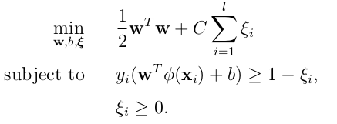
SVMs
Binary classifier. Using multiple binary classifiers (eg: one-versus-one: n(n-1)/2) to perform multiclass classification
Map the input in higher dimensional space in order to be linearly separable Φ(x)
Find a linear separating hyperplane with the maximal margin
Given (xi,yi), i=1, . . . , l
where xi ∈ R^n
and y ∈ {1, −1}
optimize:

Slide 23

SVMs - steps
Transform data to the format of an SVM package
Conduct simple scaling on the data
Consider the RBF kernel
Use cross-validation on a small subset to find a good neighborhood for (C,γ).
Make a finer grid search on the neighborhood to find better approximation for the optimal (C,γ)
Use the best parameter C and γ to train the whole training set
Evaluate generalization performance on the test set

Slide 24
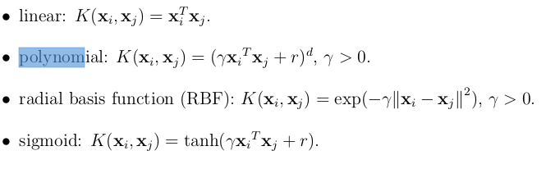
SVMs – basic kernels
Polynomial more complex more parameters.
Linear kernels only when data linearly separable
using 10% dataset, performed grid search (each parameter 6-7 values), for poly and rbf kernel's parameters:
RBF kernel: 50min, Polynomial kernel: 2h

Slide 25
performance
Making a grid search on MNIST gave as an optimal
RBF: (C,γ): C=2.8, γ=0.0073. Performance: 98.6%,. Same performance like the MNIST page reports
Poly (C,γ,ρ,d): C=0.35, ρ=0.125, γ=0.0625, d=3. Performance: 98,25%, some minutes
Stronger implementations:
  Poly: Degree:4 reported 98.9% performance
  Best: Virtual SVM, deg-9 poly, 2-pixel jittered achieved 99.44%

Slide 26
Conclusion – Future work
Deeply researched issue – human competitive results
From individual character recognition to more general tasks
I don't intent to further study this issue...
If anyone comes up with this, consider using CNN's

