Slide 1

DEPARTMENT OF ARTIFICIAL INTELLIGENCE AND MACHINE LEARNING
UNDER THE GUIDANCE OF
DR. SHAILA K
PROFESSOR & HOD, DEPT OF AIML-VKIT
PROJECT PHASE II PRESENTATION
ON
“PrintChakra – An AI-Powered Smart Print
& Capture Solution”
PRESENTED BY
CHAMAN S 1VK22AI007
GOWTHAM S 1VK22AI013
KARTHIK KUMAR V GUPTA 1VK22AI016
https://vitb.ac.in/

Slide 2




CONTENTS
Introduction
Problems Statement
Problems Solved
Objectives
Literature Survey
Gaps Identified
Block Diagram
Technology Stack
Algorithmic Enhancements
Hardware Alternatives
System Requirements
Performance Evaluation
Implementation – Development environment
Conclusions
Future Scope
References
DEPT OF AI&ML, VKIT
https://vitb.ac.in/

Slide 3
INTRODUCTION
Traditional document management across educational, institutional, and corporate environments is inefficient, manual, and prone to errors.
Recent advancements have introduced AI and OCR technologies to improve accuracy and speed.
PrintChakra AI addresses issues like slow workflows, inaccurate text extraction, and lack of offline synchronization.
To solve these challenges, we implement intelligent image enhancement, precise OCR, and seamless offline synchronization between mobile and desktop platforms.
This method makes handling documents easier and faster, improving accuracy and reliability in different work environments.
DEPT OF AI&ML, VKIT
https://vitb.ac.in/

Slide 4
PROBLEMS STATEMENT
Traditional document workflows remain slow, inaccurate, and wasteful, taking several minutes per file with frequent mis-scans, duplicates, and paper waste, caused by manual processes and outdated systems lacking AI/OCR automation.
DEPT OF AI&ML, VKIT
https://vitb.ac.in/

Slide 5
OBJECTIVES
Develop an AI-driven system for automatic document detection, enhancement, text extraction and document conversion
Implement real-time communication and synchronization between mobile devices, PCs, and printers without relying on internet connectivity.
DEPT OF AI&ML, VKIT
https://vitb.ac.in/

Slide 6
PROBLEMS SOLVED
Eliminates slow, manual, and repetitive document printing and scanning workflows.
Prevents mis-scans, wrong labels, and data entry errors through automated AI-based document handling.
Reduces paper waste by avoiding reprints and duplicates through digital synchronization.
Enables real-time, offline file sharing and synchronization between mobile, PC, and printer using WebSockets.
Enhances document quality and readability via automatic enhancement and correction.
Provides seamless cross-device integration without relying on internet connectivity.
Replaces legacy, error-prone systems with an intelligent, AI-driven, and efficient solution.
Integrated AI chat assistant which can do intelligent conversations while managing manual workflows.
DEPT OF AI&ML, VKIT
https://vitb.ac.in/

Slide 7
LITERATURE SURVEY
Author(s) | Paper Title | Objective | Methodology | Pros & Cons
Idris, N. et al. [1] | A Generic Review of Web Technology: Django and Flask | To build a lightweight REST API backend for document processing and printer management | Implements Flask with Blueprint architecture, Socket.IO integration, and modular service layers for backend operations | Pros: Lightweight, fast startup, easy Socket.IO integration, modular routing Cons: Manual configuration required for larger features
Sisodia, P. and Rizvi, S.W.A. [2] | Optical Character Recognition Development Using Python | To extract text from scanned documents and images for search and indexing | Uses PaddleOCR with OpenCV preprocessing for multi-language text extraction | Pros: High accuracy, multi-language support Cons: Depends on image quality
Snehalatha, B.K. et al. [3] | Image Streaming Using Real Time Protocol | Enable real-time document status updates and file synchronization | Socket.IO for bidirectional WebSocket communication | Pros: Low-latency updates, real-time sync Cons: Requires persistent connections
Santos-González, I. et al. [4] | Implementation and Analysis of Real-Time Streaming Protocols | Instant voice transcription feedback and UI synchronization | Socket.IO client with event-driven React architecture | Pros: Instant feedback, smooth UI sync Cons: Network dependent
Hämäläinen, M. et al. [5] | OCR with Neural Networks and Post-processing | Improve OCR accuracy on low-quality scans | PaddleOCR CNN+RNN ensemble with confidence scoring | Pros: Handles noisy documents Cons: Higher computational cost
DEPT OF AI&ML, VKIT
https://vitb.ac.in/

Slide 8
Author(s) | Paper Title | Objective | Methodology | Pros & Cons
Otsu, N. [6] | A Threshold Selection Method from Gray-Level Histograms | Convert grayscale images to binary | Automatic thresholding in multi-stage enhancement pipeline | Pros: No manual tuning Cons: Uneven lighting issues
Venkatesh, S. et al. [7] | Image Enhancement using CLAHE Algorithm | Enhance document contrast for OCR | Histogram equalization during preprocessing | Pros: Improves faded text Cons: May cause artifacts
Zaharescu, M. et al. [8] | Survey on Document Image Skew Detection | Detect and correct skewed documents | Perspective transform with contour-based detection | Pros: Improves OCR accuracy Cons: Fails without clear edges
Frei et al. [9] | Fast Boundary Detection Algorithm | Detect document boundaries | OpenCV contour detection with polygon approximation | Pros: Fast and robust Cons: Needs good contrast
Zhao, L. et al. [10] | NLP for Requirements Engineering | Interpret voice commands for print/scan | Regex-based intent parsing with Ollama LLM fallback | Pros: Flexible interpretation Cons: Complex commands need LLM
DEPT OF AI&ML, VKIT
https://vitb.ac.in/

Slide 9
Author(s) | Paper Title | Objective | Methodology | Pros & Cons
Pudasaini, S. et al. [11] | NLP for Information Extraction | Extract print parameters from voice commands | Regex-based structured parameter extraction | Pros: High accuracy for known patterns Cons: Limited patterns
Mubeen, S. et al. [12] | OCR Using Tesseract | Provide alternative OCR engine | Used as fallback; PaddleOCR is primary | Pros: Open-source, multi-language Cons: Lower accuracy
Lynn, N.D. et al. [13] | Real-Time Edge Detection using Canny and Sobel | Document edge detection | Contour-based detection preferred; Canny optional | Pros: Clean edges Cons: Extra processing
Pandey, A. and Jain, A. [14] | Comparative Analysis of KNN Algorithm | Document classification for print presets | Not implemented; rule-based logic used | Pros: Enables smart classification Cons: Needs training data
Abadi, M. et al. [15] | TensorFlow: A System for Large-Scale ML | ML framework for deployment | PyTorch-based models used instead | Pros: Industry standard Cons: Heavy dependency
DEPT OF AI&ML, VKIT
https://vitb.ac.in/

Slide 10
GAPS IDENTIFIED
Data Integration: Lack of smooth integration between mobile devices, PCs, and printers for document capture and processing, especially without internet connectivity.
Standardization: No common protocols for AI-based document detection, OCR processing, and offline synchronization across different platforms and devices.
Scalability: Challenges in expanding the system to handle large document volumes in educational, institutional, or corporate environments.
Affordability: High cost and hardware limitations restrict access to smart document management solutions for small organizations and schools.
Offline Synchronization: Limited solutions for real-time communication and data sync between mobile, PC, and printer devices without relying on internet connections.
User Adoption: Hesitation to switch from manual workflows to automated systems due to trust issues and lack of familiarity with AI-driven tools.
Data Security & Privacy: Concerns about protecting sensitive document data during offline synchronization and storage without robust encryption.
DEPT OF AI&ML, VKIT
https://vitb.ac.in/

Slide 11
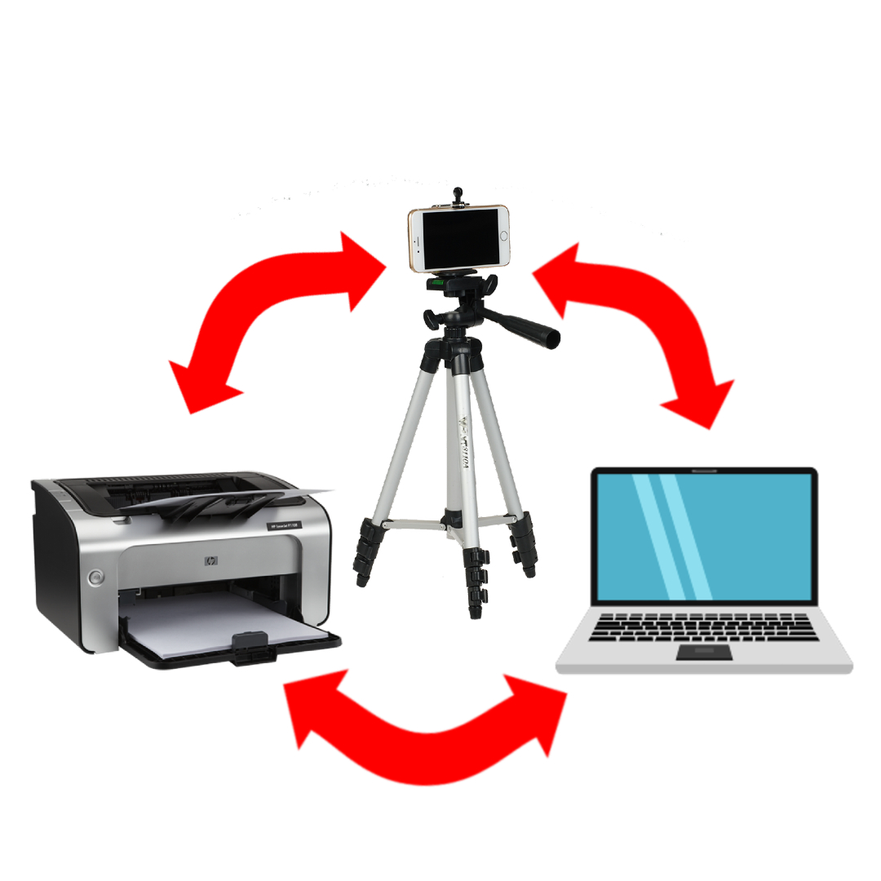
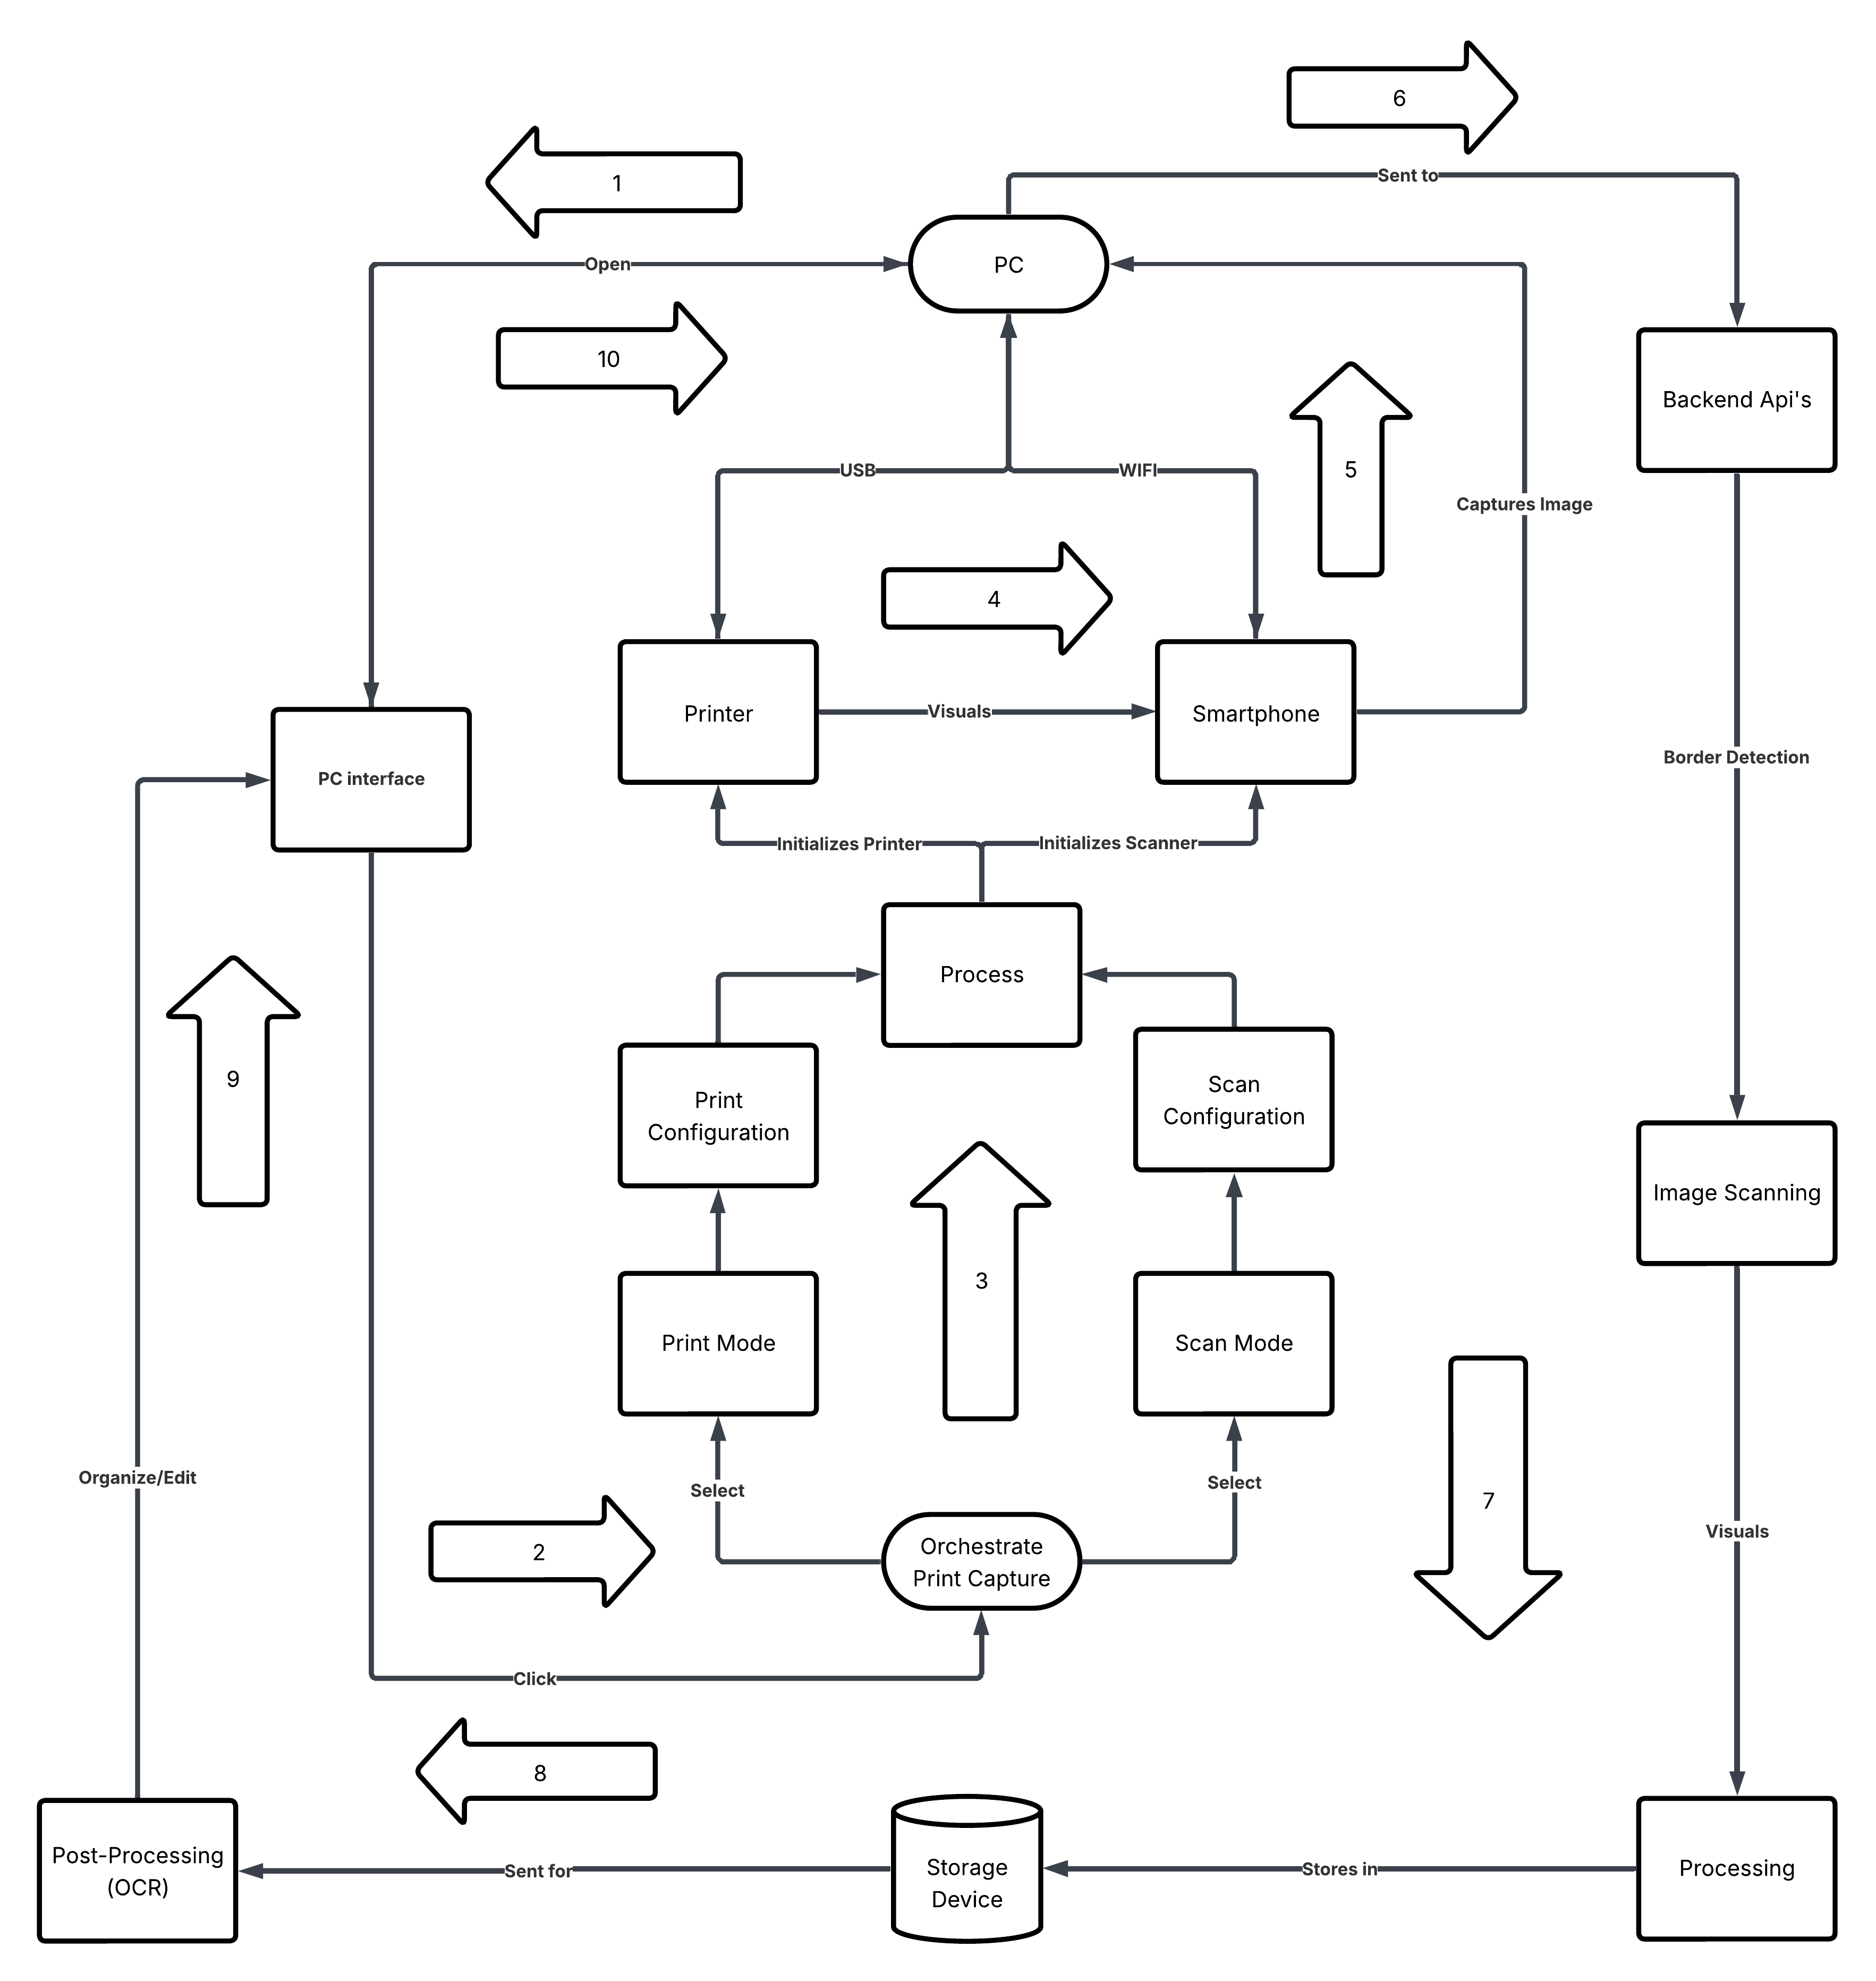

BLOCK DIAGRAM
Proceeds
DEPT OF AI&ML, VKIT
https://vitb.ac.in/

Slide 12
Technology Stack
[1] Core Technologies
Technology | Version | Purpose
Flask | 3.0.0 | Backend HTTP server
Flask-SocketIO | 5.3.5 | Real-time phone ↔ desktop communication
React + TypeScript | 18.0/ 5.1 | Frontend framework
Chakra UI | 3.30.0 | UI component library
[2] Windows Integration
Technology | Version | Purpose
PyWin32 | 307 | Printer APIs and device control
PyPiWin32 | 223 | Print job management
comtypes | 1.4.0 | COM-based Windows integration
DEPT OF AI&ML, VKIT
https://vitb.ac.in/

Slide 13
[3]Image & Document Processing
Technology | Version | Purpose
OpenCV (cv2) | 4.10.0.84 | Image capture, enhancement, edge detection
Pillow (PIL) | 11.0.0 | Image manipulation
NumPy | 1.24.0 | Matrix and array operations
fpdf2 | 7.9 | Print-ready PDF generation
PyMuPDF (fitz) | 1.23.0 | PDF reading and processing
pdf2image | 1.16.3 | Convert PDF to images
img2pdf | 0.5.1 | Convert images to PDF
python-docx | 1.1.0 | Word document handling
ReportLab | 4.0.0 | PDF layout and formatting
Poppler | 24.08.0 | PDF rendering engine
DEPT OF AI&ML, VKIT
https://vitb.ac.in/

Slide 14
[4] OCR & AI Recognition
Technology | Version | Purpose
PaddleOCR | 2.7.0 | Primary OCR
PaddlePaddle | 2.6.0 | Deep learning backend for OCR
Tesseract OCR | 5.3.0 | Fallback OCR engine
Ollama (smollm2) | 2:135m | Text structuring and post-processing
scikit-learn | 1.3.0 | Document classification (KNN)
[5] Voice & Audio
Technology | Version | Purpose
OpenAI Whisper | 3.0 | Speech-to-text (Large-v3 Turbo)
PyTorch | 2.0.0 | GPU acceleration for Whisper
TorchAudio | 2.0.0 | Audio preprocessing
Pyttsx3 | 2.99 | Text-to-speech (Windows SAPI5)
DEPT OF AI&ML, VKIT
https://vitb.ac.in/

Slide 15
[6] Pre-trained Models (Neural Networks)
Model | Type | Purpose | Provider
Whisper | Transformer ASR | Speech-to-text conversion | OpenAI
PaddleOCR | CNN + RNN Ensemble | Text detection and recognition | Baidu
Ollama (Smollm2:135m) | Large Language Model | Intent classification and reasoning | Meta
pyttsx3 Engine | Text-to-Speech System | Voice output generation | Built-in OS
[7] Techniques
Technique | Purpose | Implementation
State Machine | Workflow control | Multi-state flow (Dashboard → Scan/Print → Execution)
Voice-to-Intent Mapping | Command interpretation | Regex matching with LLM fallback
Confidence Scoring | Command validation | Threshold-based acceptance of parsed commands
DEPT OF AI&ML, VKIT
https://vitb.ac.in/

Slide 16
Algorithms:
Algorithm | Category | Purpose | How it Works
RMS Energy | Signal Processing | Voice activity detection | Computes root mean square of audio signal energy
Contour Detection | Computer Vision | Document boundary detection | Extracts object edge s using contour analysis
Perspective Transform | Geometry | Skew correction | Applies homography matrix for image alignment
Histogram Equalization | Image Processing | Contrast enhancement | Redistributes pixel intensity values
Regular Expression Matching | String Processing | Parameter extraction | Uses pattern matching for command parsing
Thresholding | Image Binarization | Black–white conversion | Converts grayscale image to binary using threshold
DEPT OF AI&ML, VKIT
https://vitb.ac.in/

Slide 17
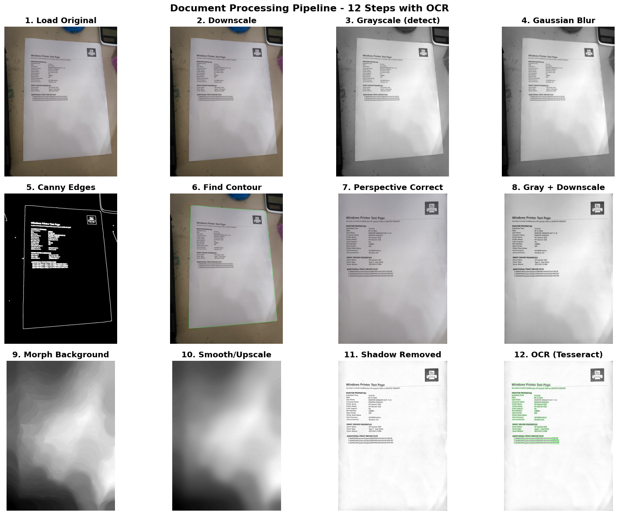
Document Processing Pipeline – 12 Steps with OCR
DEPT OF AI&ML, VKIT
https://vitb.ac.in/

Slide 18
Hardware Alternatives
For the PC
Hardware | Example | CPU Speed | RAM | Power Use | Suitability
Desktop PC | Intel i5/i7 Gen 10+ | 2.5–4.2 GHz | 8–32 GB | 150–300W | Best for full OCR + dashboard
Mini PC | Intel NUC / Beelink | 1.8–3.5 GHz | 4–16 GB | 30–90W | Ideal for lightweight processing
Embedded SBC | Raspberry Pi 5 | 2.4 GHz (Quad) | 8 GB | ~10W | Slower OCR (~1.5–2× longer tasks)
For the Smartphone
Device Type | CPU & RAM Example | Capture Speed | Processing Time | Offline Sync | Suitability
Modern Android | Snapdragon 778g / 6–8 GB | <100 ms/photo | ~1–2 s/document | via Wi-Fi Direct | Excellent for mobile capture
Mid-range Phone | Helio G85 / 4 GB | 200–300 ms/photo | ~3–5 s/document | Inconsistent | OK for scanning, not processing
Embedded Cam + MCU | Raspberry Pi + Pi Cam | 500+ ms/photo | 6–10 s/document | Limited Support | Only for basic imaging
DEPT OF AI&ML, VKIT
https://vitb.ac.in/

Slide 19
SYSTEM REQUIREMENTS
Hardware Requirements
Mobile Device: Smartphone or tablet with camera and Wi-Fi capabilities for document capture and wireless communication.
PC/Desktop: Windows-based computer for processing, synchronization, and managing captured documents.
Printer: Compatible printer supporting wired/wireless communication with the PC and mobile device.
Connectivity Module: Wi-Fi module to enable offline real-time data exchange between devices without internet.
Storage: Local storage (SSD/HDD) on PC and mobile device to save captured and processed documents securely.
Software Requirements
Mobile Application: App with AI-powered image enhancement and OCR capabilities for document detection and capture.
Desktop Application: Software for receiving, syncing, and managing documents, supporting offline wireless communication protocols.
Printer Interface: Driver or software component for seamless printing triggered via synchronized workflows.
AI & OCR Libraries: Tools like Paddle OCR, Tesseract OCR, OpenCV, or for text extraction and image processing.
Synchronization Protocol: Custom or standard protocols (e.g., HTTP, TCP using WebSockets) enabling real-time offline data sync.
DEPT OF AI&ML, VKIT
https://vitb.ac.in/

Slide 20
Computational Requirements
Processing Power: Adequate processing capability on mobile devices and PCs to perform real-time image enhancement, OCR, and synchronization tasks efficiently.
Storage: Sufficient local storage on devices (SSD/HDD) to store captured documents, processed data, and synchronization logs securely.
Data Requirements
High-Quality Images: Clear, high-resolution document images captured via mobile device cameras for accurate processing and text extraction.
Sensor Data: Optional metadata such as device status, connectivity signals, or user input to optimize capture and synchronization workflows.
Validation Data: Sample documents and ground truth text to verify OCR accuracy and system performance.
DEPT OF AI&ML, VKIT
https://vitb.ac.in/

Slide 21
Performance Evaluation
Performance:
Ensure low-latency detection and processing for near real-time document capture and OCR.
Achieve high accuracy in detecting documents and extracting text.
Reliability:
Operate effectively under varying lighting and environmental conditions (e.g., different indoor and outdoor scenarios).
Maintain stable performance with minimal errors during capture and synchronization.
Scalability:
Supports huge set of documents as requirements grows
Portability:
Ensure software compatibility with embedded platforms like Raspberry Pi or Jetson Nano for flexible deployment.
Maintainability:
Develop a modular codebase to facilitate easy updates and integration of new features, such as improved AI models or synchronization protocols.
DEPT OF AI&ML, VKIT
https://vitb.ac.in/

Slide 22
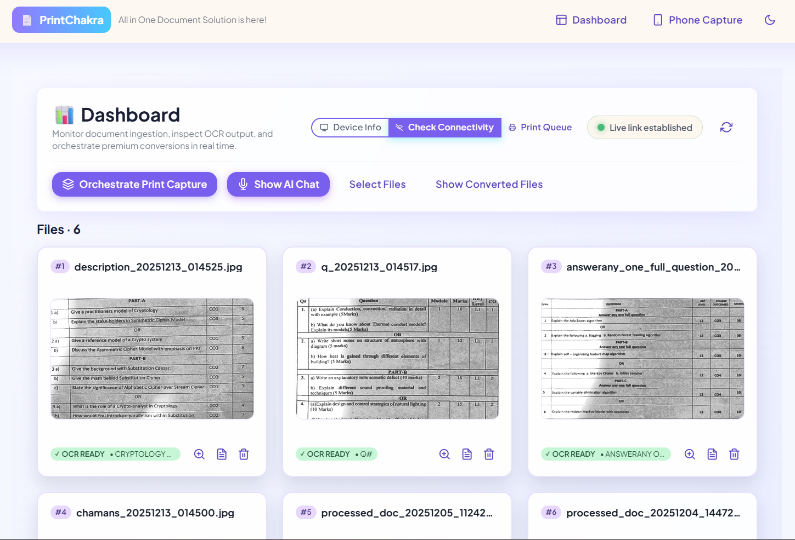
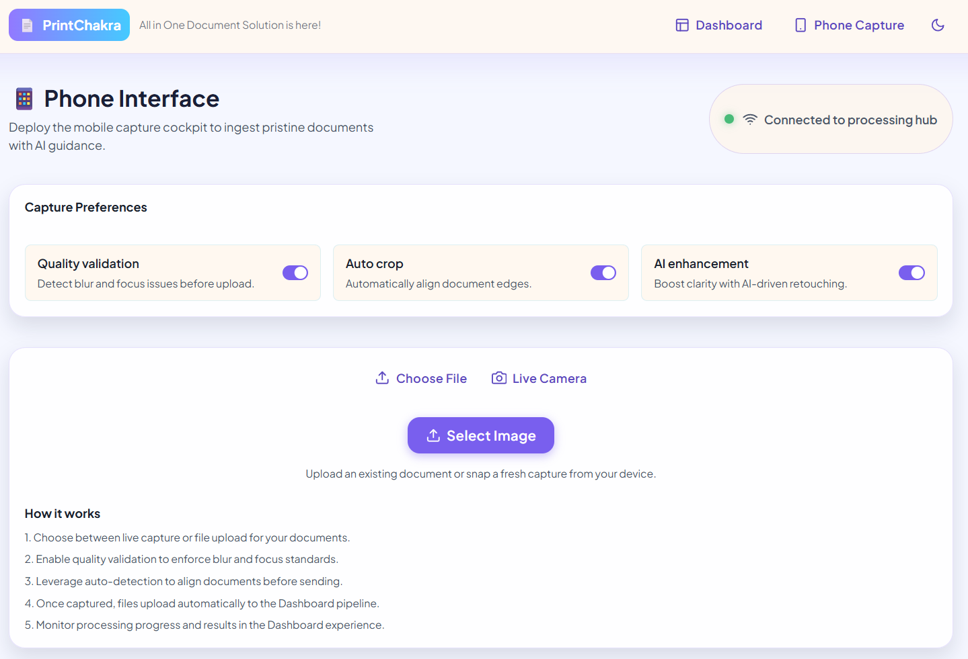
Snapshots
Figure 1: Dashboard Page
Figure 2: Phone Interface Page
DEPT OF AI&ML, VKIT
https://vitb.ac.in/

Slide 23
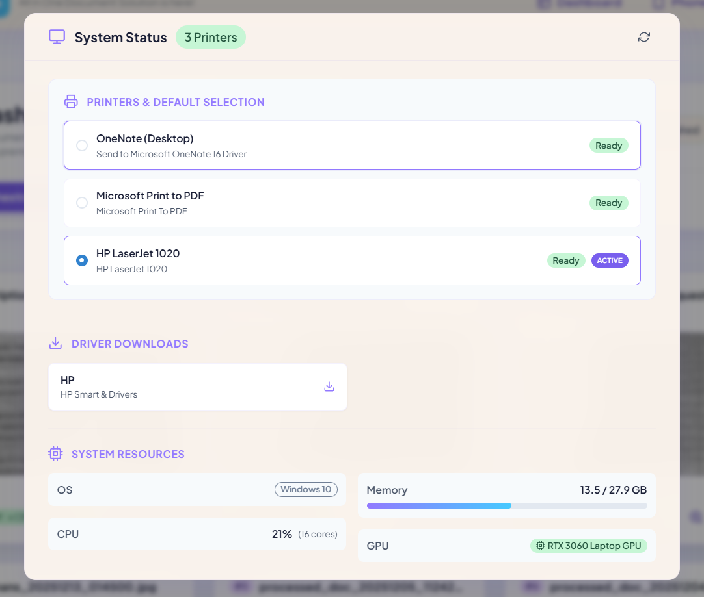
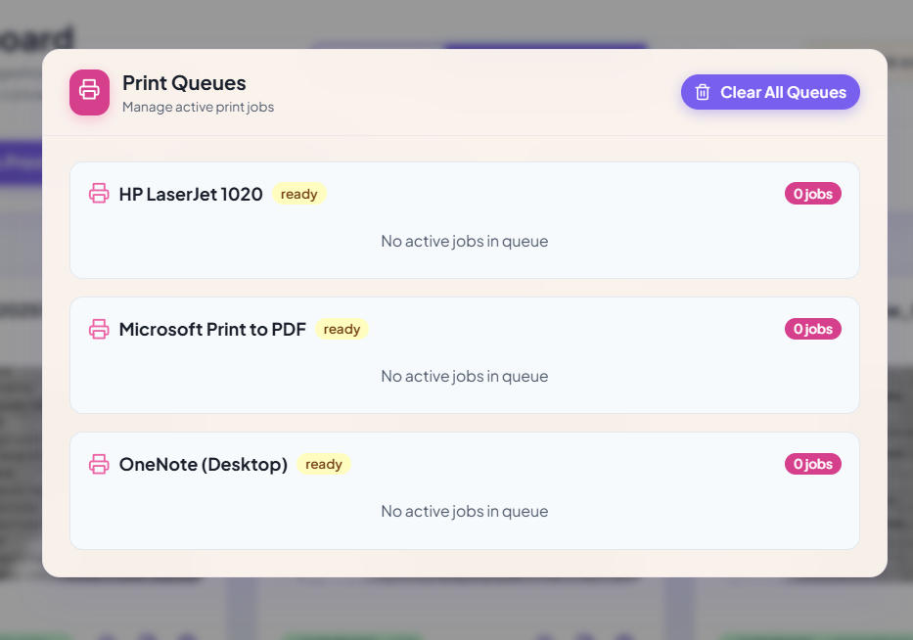
Snapshots
Figure 3: Device Info Interface
Figure 4: Print Queues Interface
DEPT OF AI&ML, VKIT
https://vitb.ac.in/

Slide 24
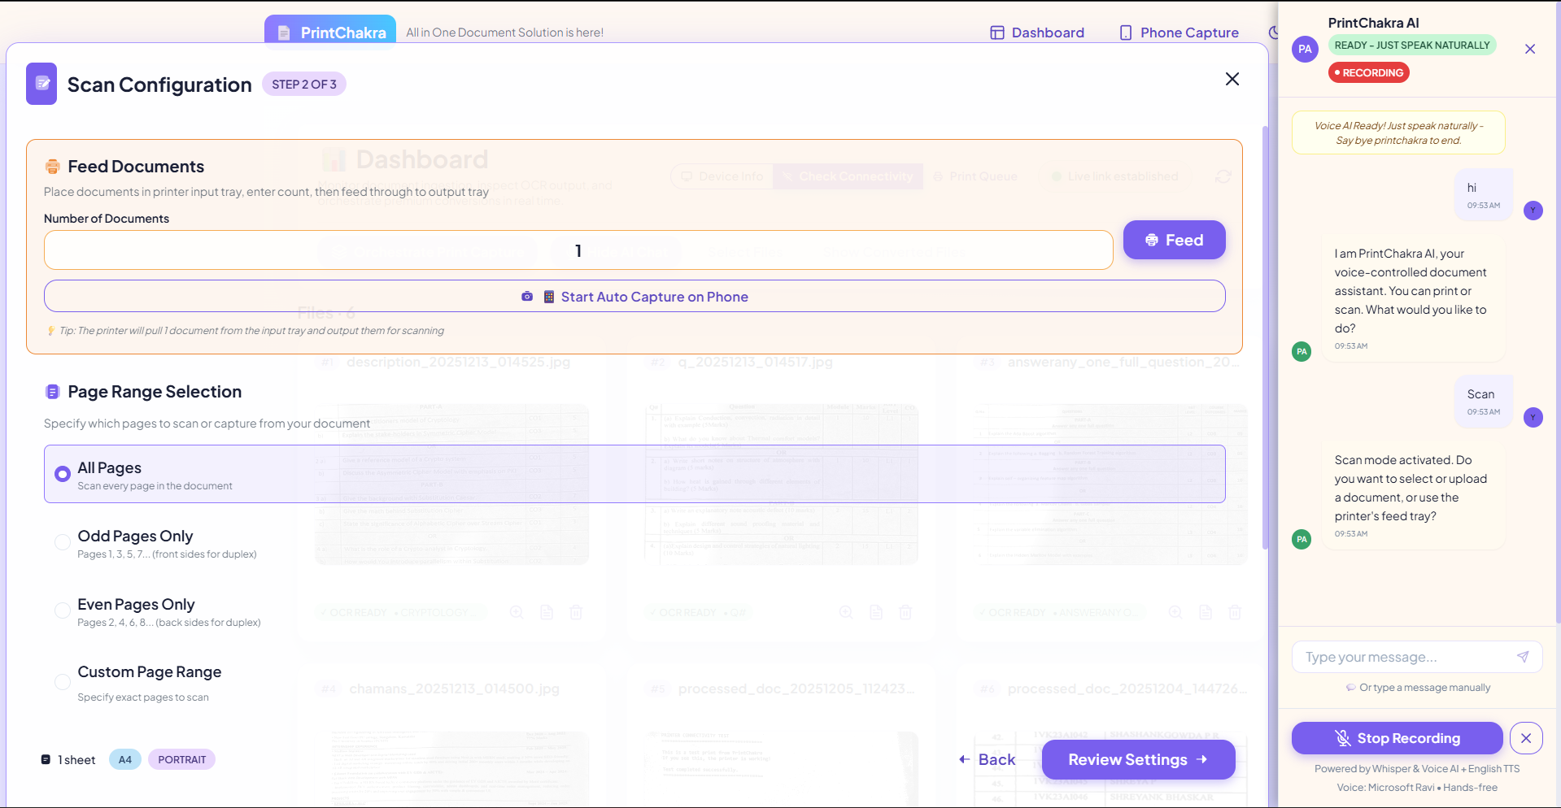
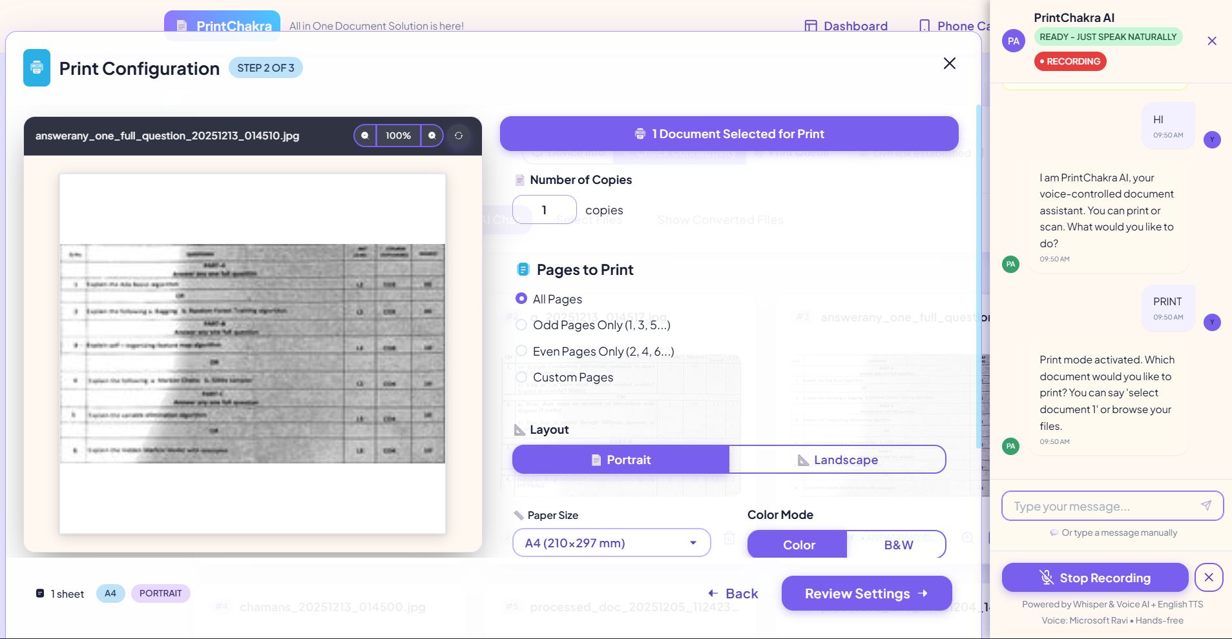
Snapshots
Figure 5: Scan Mode Configuration Interface
Figure 6: Print Mode Configuration Interface
DEPT OF AI&ML, VKIT
https://vitb.ac.in/

Slide 25
IMPLEMENTATION - DEVELOPMENT ENVIRONMENT
LAYING THE FOUNDATION FOR EFFICIENT AUTOMATION
A well-structured development environment is critical for building, testing, and deploying the PrintChakra system.
It includes tools, libraries, and platform access needed for intelligent document capture, processing, & device communication.
The upcoming sections outline the core technologies, setup procedures, and testing considerations.
SETTING UP THE ENVIRONMENT & UI CONSIDERATIONS
Local Development Setup:
Python virtual environments (venv) for dependency isolation.
Cross-platform printing libraries like win32print & WebSockets for integration with printer hardware and smartphone.
Device Access & Simulation:
Mobile devices and Windows machines are configured to simulate offline synchronization scenarios.
Network file transfer tools or local socket testing simulate real-world communication.
User Interface (UI):
Mobile and Windows UI built with react vite boilerplate
Emphasis on clean design and minimal user steps for document capture and sync.
DEPT OF AI&ML, VKIT
https://vitb.ac.in/

Slide 26
CORE DEVELOPMENT TOOLS & TECHNOLOGIES
Programming Language & IDE: Python programming language and it’s framework flask is used for AI/OCR tasks.
HTML, CSS, JavaScript and React.Js for desktop and mobile dashboard and interface. IDEs include PyCharm (for Python) and Visual Studio Code (for desktop).
OCR & AI Libraries: PaddleOCR (GPU-accelerated), OpenCV, and Ollama are used for text extraction and image enhancement
Pre-trained models are fine-tuned for document detection and layout analysis.
Platform Communication APIs: Use of HTTP/TCP protocols with socket-based local communication for file sharing across mobile, desktop, and printers. Print and sync logic includes fallback modes for offline operation.
Version Control (Git): Git is used for source code management and collaboration. Hosted on GitHub for tracking changes, rollbacks, and deployment coordination.
Deployment:
Desktop and Mobile UI web app is deployed on vercel and also the app can run locally with TCP/IP Socket.
Backend is currently running on local device to run the system offline.
DEPT OF AI&ML, VKIT
https://vitb.ac.in/

Slide 27
CONCLUSIONS
Without AI, document workflows heavily depended on repetitive manual tasks such as scanning, editing, organizing, and printing, often resulting in delays, inconsistencies, and resource waste. These conventional methods lacked adaptability, offline support, and smart processing capabilities.
With the implementation of PrintChakra AI, document handling has become significantly more intelligent and autonomous. The integration of real-time OCR, image enhancement, and offline synchronization bridges the gap between physical and digital processes.
The result is a streamlined system that reduces human effort, ensures higher accuracy, and enables consistent performance across devices, ultimately transforming outdated practices into a robust, modern document management solution.
DEPT OF AI&ML, VKIT
https://vitb.ac.in/

Slide 28
FUTURE SCOPE
Cloud & SaaS readiness
- Rework storage to support multi-tenant S3 buckets, tenant isolation, and per-tenant quotas.
- Offer hosted deployments with self-service signup and team management.
Background processing & scaling
- Move heavy image/OCR processing to background workers (Celery/RQ) with Redis and autoscaling workers.
- Add observability per task (latency, retries, failure rate).
Document intelligence
- Add document classification and structured extraction (invoices, receipts, forms). Provide export adapters (CSV, JSON, integrations).
- Provide configurable workflows using RAG, Langchain and N8N: when X detected → run Y → notify Z.
Ecosystem & integrations
- Provide connectors: Google Drive, Dropbox, Slack, Zapier, and accounting systems for automated flows.
DEPT OF AI&ML, VKIT
https://vitb.ac.in/

Slide 29
REFERENCE
[1] Idris, N., Foozy, C. F. M., and Shamala, P., “A Generic Review of Web Technology: DJango and Flask”, International Journal of Advanced Computing Science and Engineering, vol. 2, no. 1, pp. 34-40, 2020. https://doi.org/10.62527/ijasce.2.1.29
[2] Sisodia, P. and Rizvi, S. W. A., “Optical Character Recognition Development Using Python”, Journal of Informatics Electrical and Electronics Engineering (JIEEE), vol. 4, no. 3, pp. 1–13, 2023. https://doi.org/10.54060/jieee.2023.75
[3] Snehalatha, B. K et .al., “Image Streaming Using Real Time Protocol,” International Journal for Research in Applied Science & Engineering Technology (IJRASET), vol. 13, issue IX, 2025. https://doi.org/10.22214/ijraset.2025.74033
[4] Santos-González, I., Rivero-García, A., Molina-Gil, J., and Caballero-Gil, P., “Implementation and Analysis of Real-Time Streaming Protocols”, Sensors, vol. 17, no. 4, Article 846, 2017. https://doi.org/10.3390/s17040846
[5] Hämäläinen M et .al., “Optical character recognition with neural networks and post-processing,” Journal of Computational Science, vol. 45, Article 101139, 2020. https://doi.org/10.1016/j.jocs.2020.101139
DEPT OF AI&ML, VKIT
https://vitb.ac.in/

Slide 30
[6] Otsu, N., “A Threshold Selection Method from Gray-Level Histograms”, IEEE Transactions on Systems, Man, and Cybernetics, vol. SMC-9, no. 1, pp. 62–66, 1979. https://doi.org/10.1109/TSMC.1979.4310076
[7] Venkatesh S., John De Britto C., Subhashini P., and Somasundaram K., “Image Enhancement and Implementation of CLAHE Algorithm and Bilinear Interpolation”, Cybernetics Systems, 2022. https://doi.org/10.1080/01969722.2022.2147128
[8] Zaharescu, M., Boiangiu, C.-A., and Bucur, I., “A Survey on Document Image Skew Detection”, Journal of Information Systems & Operations Management, vol. 9, no. 2, 2015. https://www.researchgate.net/publication/287217803
[9] Frei et al., “Fast Boundary Detection: A Generalization and a New Algorithm”, IEEE Transactions on Computers, vol. 26, no. 10, pp. 988–993, 1977. https://doi.org/10.1109/TC.1977.1674913
[10] Zhao, L., Alhoshan, W., Ferrari, A., Letsholo, K. J., Ajagbe, M. A., Chioasca, E.-V., and Batista-Navarro, R. T., “Natural Language Processing (NLP) for Requirements Engineering: A Systematic Mapping Study”, ACM Computing Surveys, vol. 54, no. 3, Article 61, pp. 1–41, 2022. https://doi.org/10.1145/3444685
DEPT OF AI&ML, VKIT
https://vitb.ac.in/

Slide 31
[11] Pudasaini, S., Shakya, S., lamichhane, S., Adhikari, S., Tamang, A., and Adhikari, S., “Application of NLP for Information Extraction from Unstructured Documents”, in Data Engineering and Communication Technology, pp. 631–642, 2022. https://doi.org/10.1007/978-3-030-92128-0_54
[12] Mubeen, S., Brahmani, J., Kalyan, D. P., Jagirdar, A., and Kumar, A. P., “Optical Character Recognition Using Tesseract”, International Journal for Research in Applied Science & Engineering Technology (IJRASET), vol. 10, issue XI, pp. 672–675, 2022. https://doi.org/10.22214/ijraset.2022.47414
[13] Lynn, N. D., Sourav, A. I., and Santoso, A. J., “Implementation of Real-Time Edge Detection Using Canny and Sobel Algorithms”, IOP Conference Series: Materials Science and Engineering, vol. 1096, Article 012079, 2021. https://doi.org/10.1088/1757-899X/1096/1/012079
[14] Pandey, A. and Jain, A., “Comparative Analysis of KNN Algorithm using Various Normalization Techniques”, I. J. Computer Network and Information Security (IJCNIS), vol. 9, no. 11, pp. 36–42, 2017. https://doi.org/10.5815/ijcnis.2017.11.04
[15] Abadi, M., Barham, P., Chen, J., Chen, Z., Davis, A., Dean, J., Devin, M., Ghemawat, S., “TensorFlow: A System for Large-Scale Machine Learning”, in Proceedings of the 12th USENIX Symposium on Operating Systems Design and Implementation (OSDI '16), pp. 265–283, 2016. https://doi.org/10.48550/arXiv.1605.08695
DEPT OF AI&ML, VKIT
https://vitb.ac.in/

Slide 32
THANK
YOU!
DEPT OF AI&ML, VKIT
https://vitb.ac.in/

