Slide 1
Protractor
Automation tool
1/20/2018
Chaman Preet

Slide 2
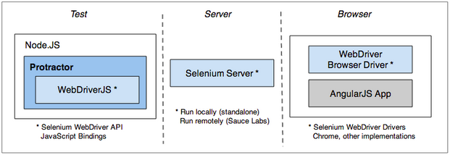
Protractor
“Protractor is an end to end test framework for AngularJS applications built on top of WebDriverJS. Protractor runs tests against your application running in a real browser, interacting with it as a user would.

Slide 3
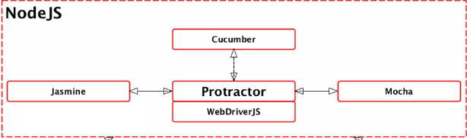
Framework used
Protractor is a Node.js (Node.js is an open source, cross-platform runtime environment for server-side and networking applications) program that supports the Jasmine, Mocha, and Cucumber test frameworks.
Protractor uses Jasmine (which is a behavior-driven development framework for testing JavaScript code) for its test syntax. Jasmine allows you to write your specs based on the behavior of the application.
Cucumber is another BDD framework that focuses more on features or stories. It mimics the format of user stories and utilizes Gherkin.

Slide 4
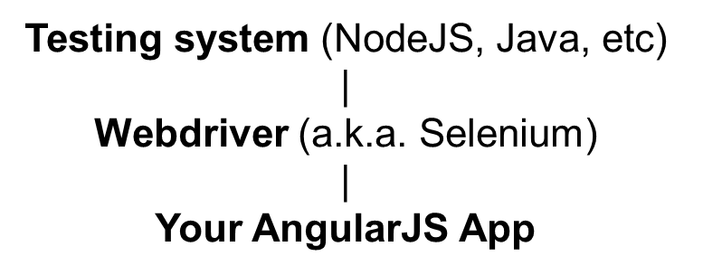
Protractor is built on top of WebDriverJS
Protractor uses Selenium WebDriver to drive browsers and simulate user’s interaction with an AngularJs application running in a browser.

Slide 5
Why Protractor over other tools
Protractor has built-in methods that listen for Angular’s JavaScript callbacks which indicate the page is fully loaded.
One of the greatest features of Protractor is its ability to "be smart" about waiting for a page to load, limiting the amount of waits and sleeps you use in your suite
Protractor is also incredibly flexible in that it allows you to incorporate different behavior-driven development (BDD) frameworks like Cucumber into your workflow.

Slide 6
Limitations of Protractor
It's only available for only one client (language) i.e for JavaScript only. So to work with it you must know JavaScript or typescript.
Asynchronous behaviour of javascript can be a challenge

Slide 7
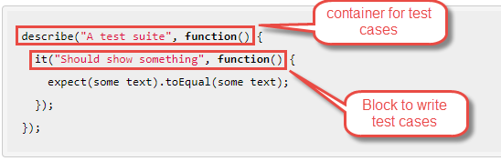
Big Picture
Protractor needs two files to run:-
spec file
configuration file
Spec file

Slide 8
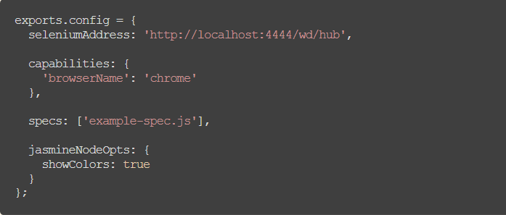
Config file

Slide 9
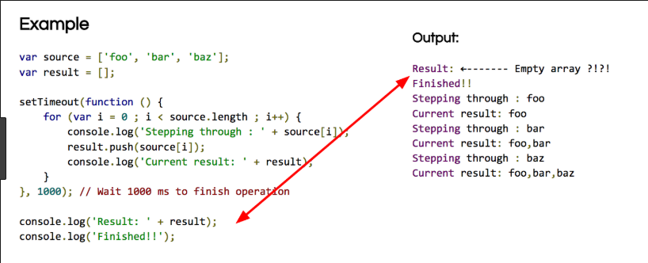
Asynchronous behaviour
WebDriverJS (and thus, Protractor) APIs are entirely asynchronous. All functions return promises, which are managed by a control flow.

Slide 10
Ways to handle asynchronous behaviour
Promise Manager/ Control Flow- WebDriverJS uses an object called theControlFlow, which coordinates the scheduling and execution of commands operating on a queue. Each call that interacts with the browser, such as get(), findElement(), sendKeys(), and click(), is being scheduled and pushed onto the WebDriver ControlFlow, allowing us to not have to worry about using .then() on the resulting promises. But for some cases promises do not resolve themselves like retrieving something from browser. So we have to use then statement everytime. It is now deprecated.
element(by.css("h2[class='ng-binding']")).getText().then(function(result){
console.log(result);
});

Slide 11
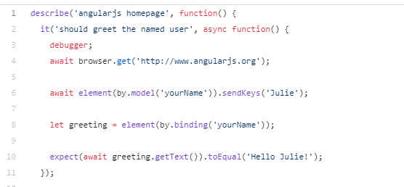
Using async/await
async await is a waiting mechanism for promises to be resolved and make javaScript code appear more synchronous without using '.then'.

Slide 12
Capabilities and options in Protractor
Can run protractor tests on multiple browsers in parallel.
Can pass multiple argument to browser to change default settings like start-maximized, disable-infobars, headless, ignore-certificate-errors.
Can execute multiple scripts on same browser with multiple instances using shareTestFiles and maxInstances. This will help to drastically reduce the overall test execution time and speed up the continuous delivery process.
Various Annotations-
beforeAll() and afterAll()
beforeEach() and afterEach()
onPrepare() and onComplete()
beforeLaunch() and afterLaunch()

Slide 13
Framework development using Protractor
Page Objects - These are the js files where you map the elements and write the functions to perform actions;
Exports and Require - This is how you connect your Page Objects to your Test Specs;
Test specs - These are the js files where you write your tests using jasmine syntax.

Slide 14
Continuous integration of protractor
Protractor tests can be integrated with:-
• TFS
• Jenkins

Slide 15


