Slide 1
Protractor
Automation test framework
1/30/2019
Chaman Preet

Slide 2
Table of Content
01 |  | What is Protractor tool | 3
02 |  | Why Protractor | 5
03 |  | Limitations of Protractor | 6
04 |  | Handling Asynchronous behavior | 7
05 |  | Big Picture | 8
06 |  | Capabilities and options available | 10
07 |  | Framework development | 11
08 |  | Continuous Integration for Protractor | 12

Slide 3
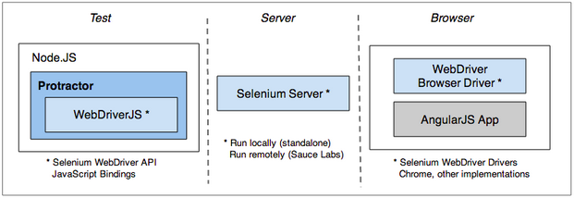
Protractor
Protractor is an end to end test framework for AngularJS applications built on top of WebDriverJS. Protractor runs tests against your application running in a real browser, interacting with it as a user would.

Slide 4
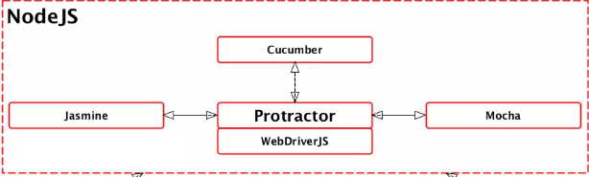
Frameworks for Protractor
Protractor is a Node.js program that supports the Jasmine, Mocha, and Cucumber test frameworks.

Slide 5
Why Protractor over other tools
Protractor supports Angular-specific locator strategies, which allows you to test Angular-specific elements without any setup effort on your part.
One of the greatest features of Protractor is its ability to "be smart" about waiting for a page to load, limiting the amount of waits and sleeps you use in your suite
Protractor is also incredibly flexible in that it allows you to incorporate different behavior-driven development (BDD) frameworks like Cucumber into your workflow.

Slide 6
Limitations of Protractor
It's only available for client framework i.e. for JavaScript only. So to work with it you must know JavaScript or typescript.
Asynchronous behaviour of javascript can be a challenge

Slide 7
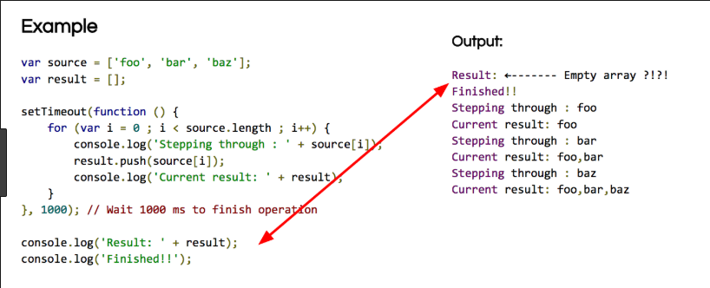
Asynchronous behavior and its handling
WebDriverJS (and thus, Protractor) APIs are entirely asynchronous. All functions return promises, which are managed by a control flow.
Now a days, with async await.

Slide 8
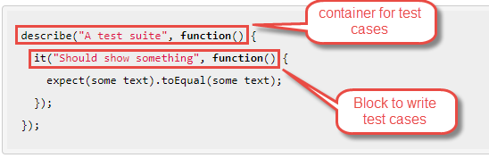
Big Picture
Protractor needs two files to run:-
spec file
configuration file
Spec file

Slide 9
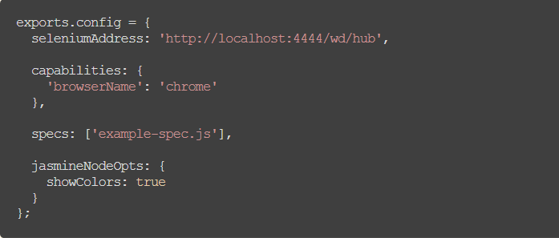
Config file

Slide 10
Capabilities and options in Protractor
Can run protractor tests on multiple browsers in parallel.
Can pass multiple argument to browser to change default settings like start-maximized, disable-infobars, headless, ignore-certificate-errors.
Can execute multiple scripts on same browser with multiple instances using shareTestFiles and maxInstances. This will help to drastically reduce the overall test execution time and speed up the continuous delivery process.
Various Annotations-
beforeAll() and afterAll()
beforeEach() and afterEach()
onPrepare() and onComplete()
beforeLaunch() and afterLaunch()

Slide 11
Framework development using Protractor
Page Objects - These are the js files where you map the elements and write the functions to perform actions;
Exports and Require - This is how you connect your Page Objects to your Test Specs;
Test specs - These are the js files where you write your tests using jasmine syntax.

Slide 12
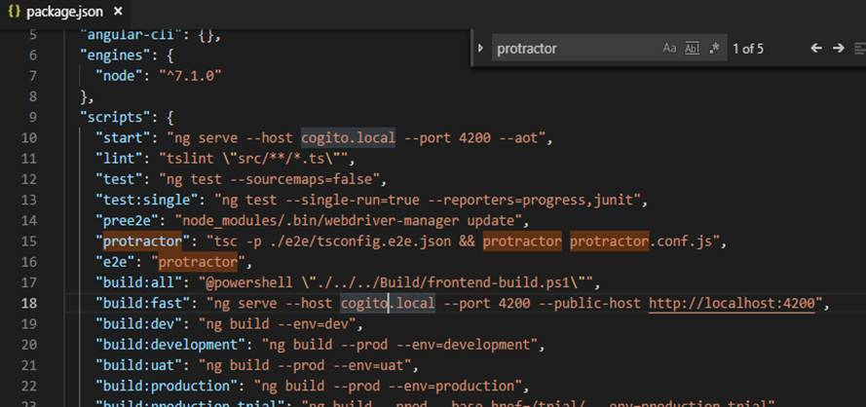
Json file of Pitchflow

Slide 13
Continuous integration of Protractor
Protractor tests can be integrated with:-
• TFS
• Jenkins

Slide 14


