Slide 1

Smart Voice Assistant (JARVIS)
By Chaman Singh
(20MA60R11)
M.Tech.(CSDP)
Dept. of Mathematics
IIT Kharagpur

Slide 2
Outline
Abstract
Introduction
Present System
Proposed System
Software Design
Software Details
Implementation Work Details
Commands for this Software
Conclusion
References

Slide 3
Abstract
As we recognize Python is an rising programing language so it turns into clean to put in writing a script for Voice Assistant in Python. The commands for the assistant may be treated as according to the requirement of user. Speech reputation is the method of changing speech into text. This is typically utilized in voice assistants like Alexa, Siri, Cortana etc.
1. It can open Calculator, MS word, Excel etc.
2. It can play music online and system music also.
3. It can open WhatsApp in web browser.
4. It can open terminal, your favorite IDE like Notepad etc.
5. It can do Wikipedia searches for you and it can print and speak two paragraphs according to Wikipedia.

Slide 4
Introduction
Artificial Intelligence while used with machines, it suggests us the functionality
of questioning like humans. In this, a pc device is designed in any such manner that
generally calls for interplay from human. As we understand Python is an rising
language so it will become clean to jot down a script for Voice Assistant in Python. For
Speech Recognition, In Python there's an Package known as SpeechRecognition which lets
in us to transform speech into text.
As the voice assistant is the use of Artificial Intelligence subsequently the end
result that it's far imparting are fairly correct and green. The assistant can assist to lessen
human attempt and consumes time whilst appearing any task, they eliminated the idea
of typing absolutely and behave as some other man or woman to whom we're speaking
and asking to carry out task.

Slide 5
Present System :
We are familiar with many existing voice assistants like Alexa, Siri, Google Assistant, Cortana which uses concept of language processing, and voice recognition. They listens the command given by the user as per their requirements and performs that specific function in a very efficient and effective manner. As those voice assistants are the usage of Artificial Intelligence for this reason the end result that they may be offering are tremendously correct and green.
Proposed System:
It was an interesting task to make my own assistant. It became easier to open MS word, Calculator, MS Excel, Searching on Google without opening the browser, and performing many other daily tasks like playing music, opening your favorite IDE like Visual studio Code, Sublime Text etc. with the help of a single voice command. JARVIS is different from other traditional voice assistants in terms that it is specific to desktop and user does not need to make account to use this, it also require internet connection while getting the instructions to perform any task.

Slide 6
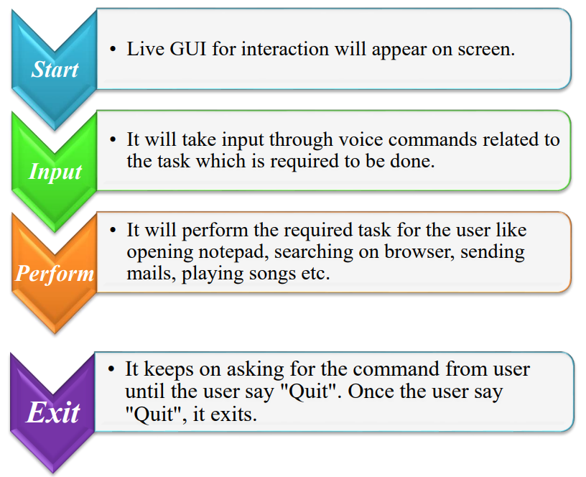
Software Design
Data Flow :
The data flow for JARVIS is as follow:

Slide 7
Software Details
The IDE used in this project is Visual Studio Code . All the python files were created in Visual Studio Code and all the necessary packages were easily installable in this IDE. For this project following modules and libraries were used i.e. pyttsx3, SpeechRecognition, datetime, Wikipedia, pywhatkit, pyjokes, PyQt5 etc. I have created a live GUI for interacting with the JARVIS as it gives a design and interesting look while having the conversation.
For GUI (Graphical User Interface) I have used PyQt5 Qt Designer for live GUI, PyQt5 is the most important python binding. It contains set of GUI widgets. PyQt5 has some important python modules like QtWidgets, QtCore, QtGui, and QtDesigner etc.

Slide 8
Implementation Work Details
Real Life Application :
Saves time : JARVIS is a laptop voice assistant which matches at the voice command supplied to it, it may do voice searching, voice-activated tool manipulate and can allow us to whole a fixed of tasks.
Reactive nature : The laptop assistant is reactive this means that it know human language thoroughly and apprehend the context this is furnished via way of means of the person and offers reaction withinside the equal way, i.e. human comprehensible language, English. So person reveals its response in an knowledgeable and clever way.
Multitasking : The principal software of it may be its multitasking ability. It can ask for non-stop training one after different till the person “QUIT” or “EXIT” it.

Slide 9
Libraries and Packages :
pyttsx3: It is a python library which converts text in to speech.
SpeechRecognition: It is a python module which converts speech in to the text.
pywhatkit: It is python library to send WhatsApp message at a particular time with some additional features like searching on web.
datetime: This library provides us the actual date and time in string format.
wikipedia: It is a python module for searching anything on Wikipedia.
pyjokes: It is a python libraries which contains lots of interesting jokes in it.
Functions :
TakeCommand(): The function is used to take the command as input through microphone of user and returns the output as string.
TaskExecution(): This is the function which contains all the necessary task execution definition like open MS Excel, MS word, open whatsapp, open calculator, set alarm, and many conditions in if condition like “open google” etc.
playAlarmSound(): This function is used to play specific alarm ringtone when alarm is set.
speak(): This function used for speak anything.

Slide 10
Commands for this Software
I’m giving some commands and it’s responses here for using My “SMART VOICE ASSISTANT” (JARVIS).
Commands Responses
open calculator → it will open calculator.
open ms word → it will open MS word.
open powerpoint → it will open PowerPoint.
open notepad → it will open Notepad.
open paint → it will open Paint app.
play system music → it will play random song of system music and print all songs.
play music online → it will play online music on https://www.jiosaavn.com/
send email → it will ask what is message then it will sent email via Gmail.
open google → it will asking “what do you want to search on Google” then it will search.
NOTE : If it doesn't understand your voice then it will exit automatically and understand something and those are not in our specific command then it will search on Google.

Slide 11
Conclusion
JARVIS is a very useful voice assistant without any doubt as it saves time of the user by conversational interactions, its effectiveness and efficiency. But while working on this project, there were some limitations encountered and also realized some scope of enhancement in the future which are mentioned below:
LIMITATIONS :
Security is somewhere an issue, there is no voice command encryption in this project.
Background voice can interfere.
Misinterpretation because of accents and may cause inaccurate results.
JARVIS can't be referred to as externally every time like different conventional assistants like Google Assistant may be referred to as simply via way of means of saying, “Ok Google!”

Slide 12
SCOPE FOR FUTURE WORK :
Make JARVIS to learn more on its own and develop a new skill in it.
JARVIS android app can also be developed.
Make more Jarvis voice terminals.
Voice commands can be encrypted to maintain security.

Slide 13
References
VOICE ACTIVATED DESKTOP ASSISTANT USING PYTHON (Dhiraj Pratap Singh, Deepika Sherawat, Sonia) School of Computer Science & Engineering, Galgotias University Greater Noida-203201
https://www.youtube.com/c/wscubetechjodhpur
https://www.youtube.com/c/AviUpadhyay
https://www.geeksforgeeks.org/voice-assistant-using-python/
https://docs.python.org/3/library/index.html
https://www.stackoverflow.com

Slide 14
Thank you

