Slide 1

HTML & CSS
By Chaman Singh
(20MA60R11)
M.Tech.(CSDP)
Dept. of Mathematics
IIT Kharagpur

Slide 2
Outline
HTML
Introduction
History
How does HTML work?
Tags and Attributes
HTML Template
Key Structural Elements
Basic HTML Document
Links and Images
CSS (Cascading style sheets)
Selectors
Colors
Box Model
References

Slide 3
Introduction
HTML was first introduced by Tim Berners-Lee in 1989.
HTML is a language for describing the basic structure of web pages.
HTML stands for Hyper Text Markup Language.
It is not a Programming Language.
HTML is the universal mark-up language for the web.
HTML lets you format text, add graphics, create links, input forms, frames and tables etc and save it in text file in that any browser can read and display.

Slide 4
History
HTML Versions Timeline:
Version Specification Release Date
1 N/A 1994-01-01
2 RFC 1866 1995-11-24
3 W3C: HTML 3.2 Specification 1997-01-14
4 W3C: HTML 4.0 Specification 1998-04-24
4.1 W3C: HTML 4.1 Specification 1999-12-24
5 WHATWG: HTML Living Standard 2014-10-28
5.1 W3C: HTML 5.1 Specification 2016-11-01

Slide 5
How does HTML work?
Telling the browser what to do, and what props to use.
HTML document are files that end with a .html or .htm extension.
You can view then using any web browser (Such as Goggle Chrome, Safari, Mozilla Firefox etc.)
The browser reads the HTML file and renders its content so that
internet users can view it.

Slide 6
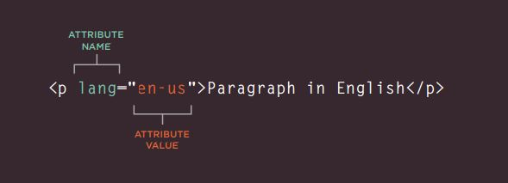
Tags and Attributes
An element usually consists of an opening tag <elementName>,
A closing tag </elementName>, which contain the element's name
Surrounded by angle brackets, and the content in between.
Elements: video, audio, table, footer, etc.
Tags: <video>, <audio>, <img>, <html>, <table>, <form> and <footer> etc.

Slide 7
HTML Template
The following code can be copied and pasted to form the
foundation of a basic web page:
<!DOCTYPE html>
<html>
<head>
<title></title>
</head>
<body>
All content goes here…
</body>
</html>

Slide 8
Key Structural Elements
Element | Name | Description
<h1> </h1> | Heading 1 | Reserved for strongest emphasis.
<h2> </h2> | Heading 2 | Secondary level heading. Headings level go down to level 6, but <h1> through <h3> are most common.
<p> </p> | Paragraph | Most of the body of a page should be enclosed in paragraphs.
<div> </div> | Division | Similar to a paragraph, but normally use for mark a section of a page. Division usually contain paragraphs.

Slide 9
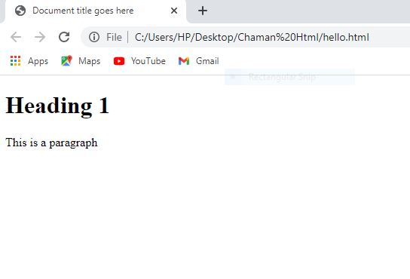
Basic HTML Document
In its simplest form , following is an example of a HTML Document---
<!DOCTYPE html>
<html>
<head>
<title>Document title goes here</title>
</head>
<body>
<h1>Heading 1</h1>
<p>This is a paragraph</p>
</body>
</html>
Output:

Slide 10
Links and Images
Links and images are both used to incorporate external resources into a page. Both are reliant on URLs (Uniform Resource Indicators). Commonly referred to as URLs or addresses.
<a> (anchor)
The anchor tag is used to provide the basic web link
<a href=“http://www.iitkgp.ac.in”>IIT Kharagpur</a>
In above example, http://www.iitkgp.ac.in is the site to be visited.
The text “link to IIT kharagpur” will be highlighted as a link.

Slide 11
<img> (image tag)
The image tag used to embed an image into a page. Usually
includes the following attributes:
<img src=“logo.jpg” alt=“This is a logo” width=“150” height=“100”>
Here src attribute describes where the image file can be found, and
the alt attribute describes alternate text that is displayed if the
image is unavailable.
Image tag doesn’t required closing image tag.

Slide 12
HTML Enteties
Character | Name | Code | Description
 | Non-breaking space | &nbsp; | Adds white space
< | Less than | &lt; | Used to display HTML code or Mathematics
> | Greater than | &gt; | Used to display HTML code or Mathematics
& | Ampersand | &amp; | If you’re not displaying an entity but really want the & symbol
c | Copyright | &copy; | Used to displaying Copyright symbol
R | Registered trademark | &reg; | Used to displaying Registered trademark

Slide 13
CSS (Cascading style sheets)
Cascading Style Sheets (CSS) is a style sheet language used for describing the presentation of a document written in a markup language such as HTML.
CSS treats each HTML element as if it appears inside its own box and uses rules to indicate how that element should look.
CSS rules usually appear in a separate document, although they may appear within an HTML page.

Slide 14
Selectors
A CSS selector selects the HTML element(s) you want to style.
There are many selectors here i am cover only simple selectors.
Simple selectors: select elements based on name, id, class.
Example: <p class=“center” id=“para>This is a paragraph</p>
p{ color: red; } .center{ color: red; } #para{ color: red; }

Slide 15
Colors
The color syntax in CSS is given by as follows…
Property name Property value
h1{ color: red; } /* color name */
h2{ color: #ee3e80; } /* hex value */
p{ color: rgb(100, 100, 90); } /* rgb value */
The Background color syntax in CSS is given by as follows…
h2{ background-color: yellow; }

Slide 16
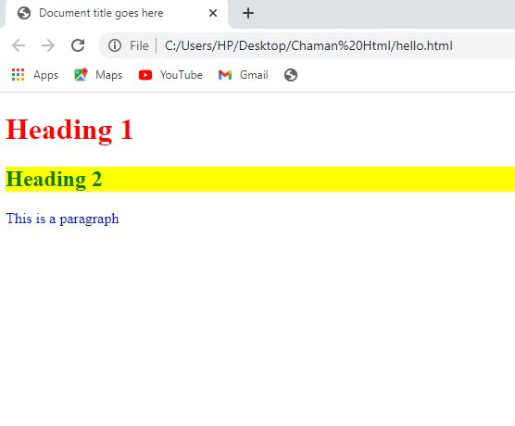
Example:
Output:
<!DOCTYPE html>
<html>
<head>
<title>Document title goes here</title>
<style>
h1{ color: red; } /* color Name */
h2 { color: #05800b; } /* hex value */
.para{ color: rgb(7, 26, 204); } /* rgb value */
h2 { background-color: yellow; }
</style>
</head>
<body>
<h1>Heading 1</h1>
<h2>Heading 2</h2>
<p class=“para”>This is a paragraph</p>
</body>
</html>

Slide 17
Box Model
The syntax of the box in CSS is given as follows…
p{
padding: 30px;
margin: 20px;
border: 5px solid black;
font-size: 40px;
}

Slide 18
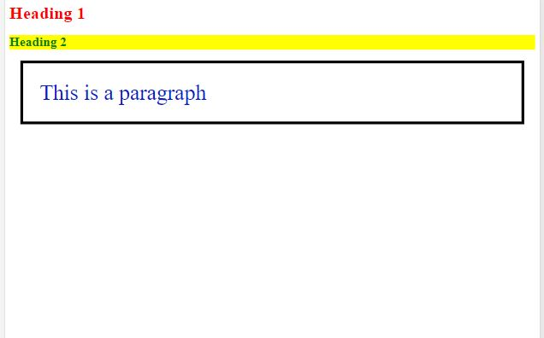
Example:
Output:
<!DOCTYPE html>
<html>
<head>
<title>Document ttle goes here</title>
<style>
h1{ color: red; }
h2{ color: #05800b; }
p{ color: rgb( 7, 26, 204); }
h2{ background-color: yellow;}
p{
padding: 30px;
margin: 20px;
font-size: 40px;
border:5px solid black;
}
</style>
</head>
<body>
<h1>Heading 1</h1>
<h2>Heading 2</h2>
<p>This is a paragraph</p>
</body>
</html>

Slide 19
References
https://en.wikipedia.org/wiki/HTML
https://en.wikipedia.org/wiki/CSS
HTML & CSS Design and build Websites by Jon Duckett , 2011 by John Wiley & Sons, Inc., Indianapolis, Indiana.
Learning Web Design, 4th Edition by Jennifer Robbins, August 2012 Publisher(s): O'Reilly Media, Inc. ISBN: 9781449319274

Slide 20
Thank you

