Slide 1

CAREER IN COMPUTER SCIENCE
By Piyumi Radeeshani

Slide 2

INTRODUCTION
3 main
careers
1. Computer Engineering
2. Information Technology
3. Software Engineering

Slide 3
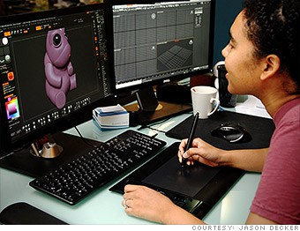
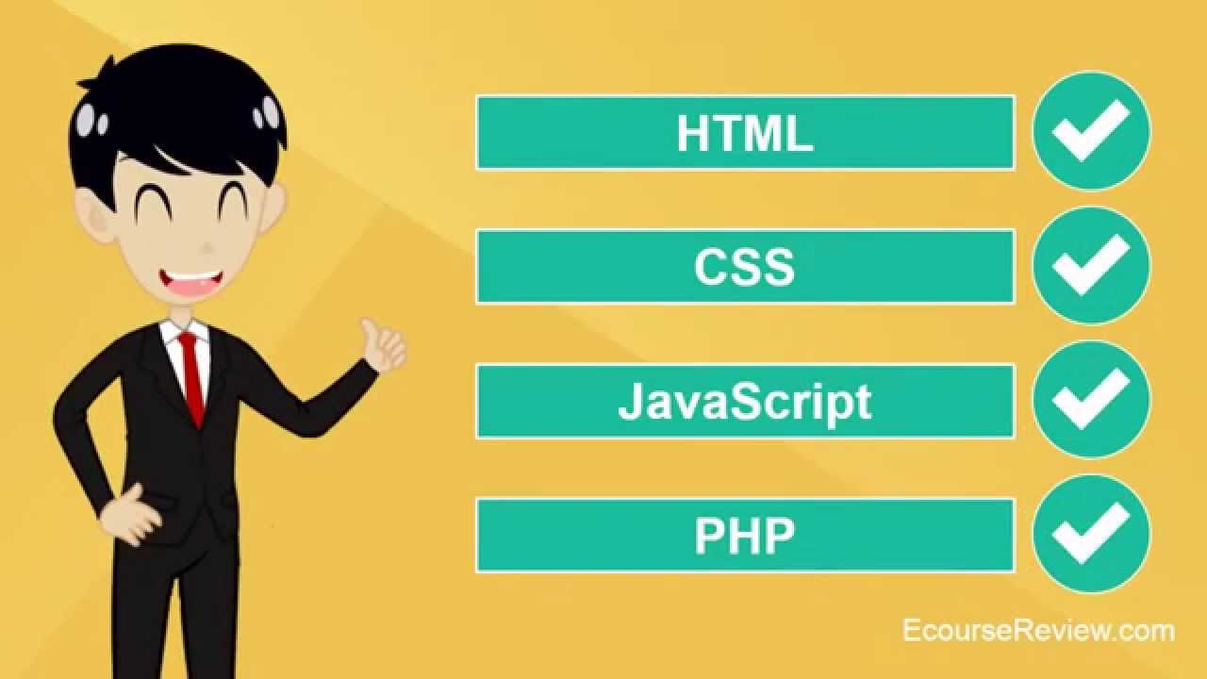


JOBS
Computer Programmer
Web Developer
Computer Network
Architect
Database Administrator

Slide 4



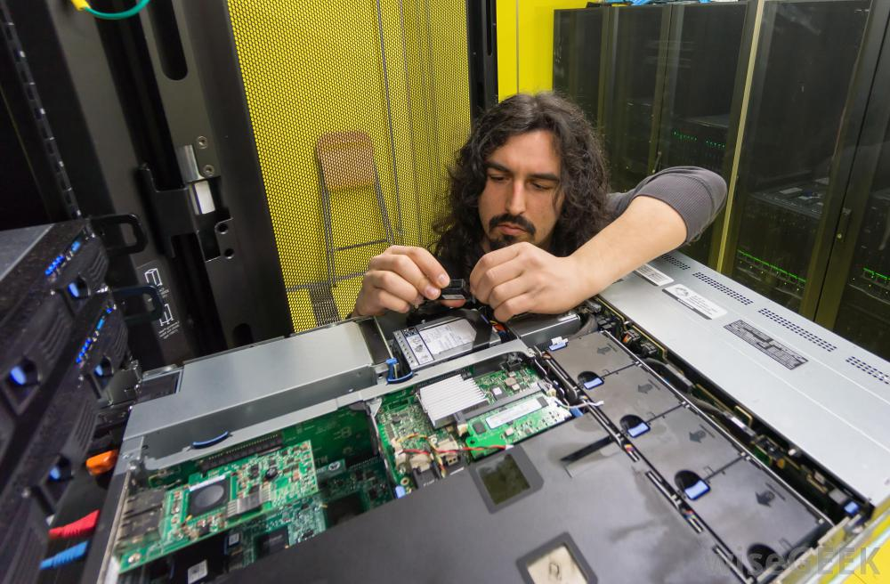
Systems Software
Developer
Applications Software Developer
Computer Systems
Analyst
Computer Systems
Administrator

Slide 5
Skills Need Required:-
Educational background
Programming languages
Software engineering
Research or work experience
Coping with rapid technological changes
Problem-solving and maths
Communication
Teamwork and leadership
Coping with rapid technological changes

Slide 6



Why a Career in Computer Science???
Enables you to solve complex, challenging problems.
Many types of lucrative careers.
Helps you even if your primary career choice is something else.
Jobs are here ,regardless of where you are located.
Future opportunities in computing are without boundaries.

Slide 7

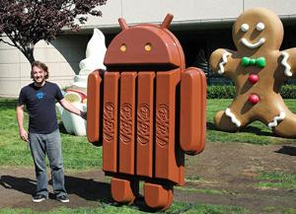
Conclusion
Do you like to get involve in a career with COMPUTER SCIENCE???

Slide 8

Now it is TIME
to clarify your
DOUBTS...

Slide 9
Thank You!!!

