Slide 1
EX ANTE ANALYSIS · FULL WALKTHROUGH
Mapping the public and private returns to
Enhanced Rock Weathering in Sub-Saharan Africa
Bisrat Haile Gebrekidan (CIMMYT-Ethiopia) · Jordan Chamberlin (CIMMYT-Kenya)
A spatially explicit, decomposed profitability model — 44 SSA countries · 23 crops · per-pixel grid
Working draft for Agricultural Economics — coauthor review

Slide 2
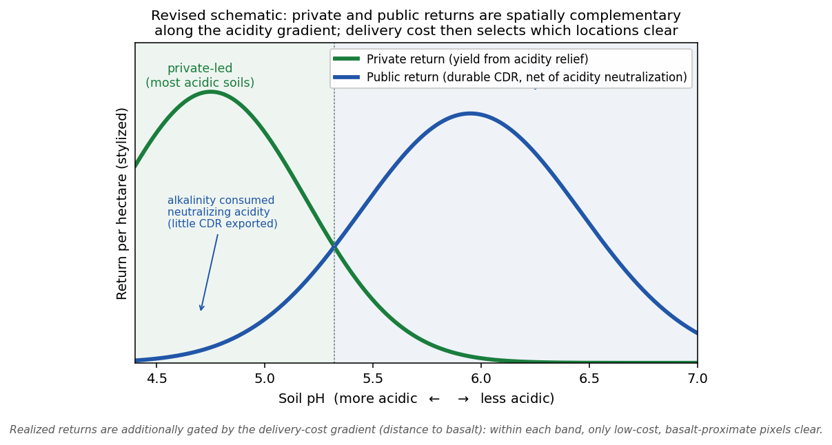
THE PROPOSITION
ERW pays the farmer twice
Spreading finely ground basalt on cropland couples two value streams that are usually separate:
PRIVATE — agronomic
Alkalinity neutralizes soil acidity like agricultural lime, raising yields. Accrues to the farmer.
PUBLIC — carbon (CDR)
Weathering durably removes atmospheric CO₂, monetizable through voluntary carbon markets (VCM).
Central question: where does each return justify deployment — and where does neither suffice alone, yet together they do?
Enhanced Rock Weathering — public & private returns in SSA · Gebrekidan & Chamberlin (2026)
2

Slide 3
WHAT WE ASK
Six research questions
Q1
Where does the private (yield) return alone justify ERW investment?
Q2
Where does the public (carbon) return alone justify it?
Q3
Where do the two coincide — the intersection?
Q4
Where does neither stream alone suffice, but the combined margin is positive?
Q5
How robust is the deployable geography to parameter assumptions?
Q6
What would shift the public (carbon) envelope outward?
Enhanced Rock Weathering — public & private returns in SSA · Gebrekidan & Chamberlin (2026)
3

Slide 4
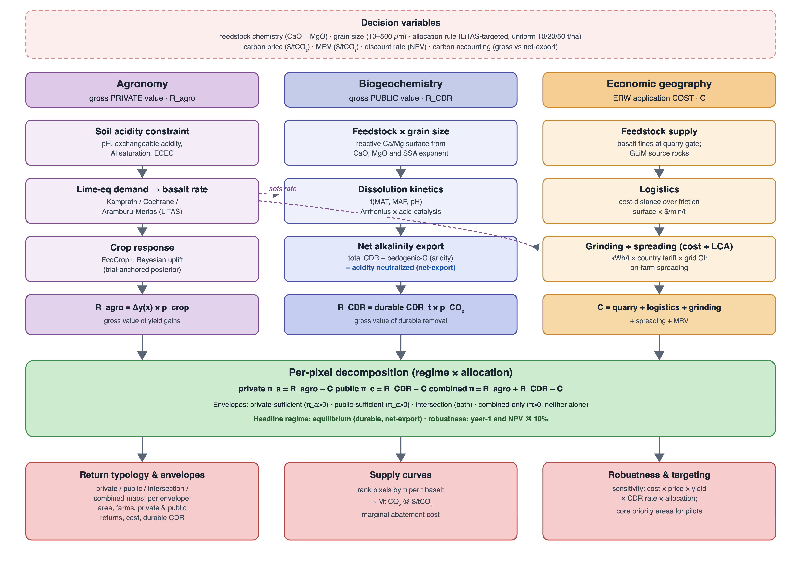
MODELING FRAMEWORK
A decomposed per-pixel gross margin
π = Ragro + RCDR − C
per-hectare gross margin = private agronomic return + public carbon return − full delivered cost
Resolution ~0.083° grid × 44 SSA countries × 23 SPAM crops, area-weighted to each pixel.
Three streams Agronomic yield uplift, durable CDR credit, and a fully decomposed delivered cost.
Decision object Each pixel is classified by which stream(s) make the margin positive — not a single supply curve.
Regimes Evaluated at year-1, NPV @ 10%, and equilibrium steady state (headline).
Enhanced Rock Weathering — public & private returns in SSA · Gebrekidan & Chamberlin (2026)
4

Slide 5
INPUTS
Public data layers behind every pixel
SOIL
CROPS
AGRONOMY
SoilGrids
SPAM v2
EcoCrop
pH, ECEC, texture on cropland
23 crop distributions & production
crop pH-suitability response
FEEDSTOCK
LOGISTICS
CLIMATE
GLiM
MAP friction
WorldClim
basalt source geology
travel-time delivered-cost surface
temperature & moisture for weathering
PRICES
LIME REQ.
CARBONATE
FAOSTAT
LiTAS
Merlos / Kamprath
2016–20 producer-price medians
lime-equivalent dose (targeting)
acidity sink for net-export
Enhanced Rock Weathering — public & private returns in SSA · Gebrekidan & Chamberlin (2026)
5

Slide 6
PART I
The assumption sets
Five modeling choices govern every result: delivered cost, carbon price, net-export CDR accounting, an over-liming private penalty, and kinetic weathering saturation.

Slide 7
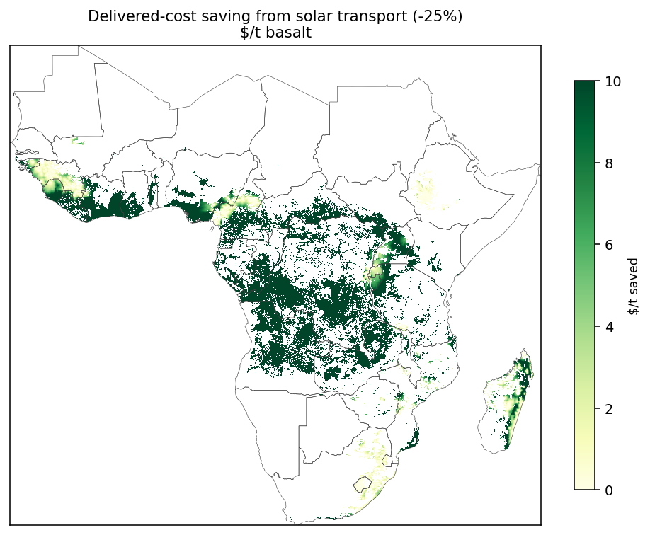
ASSUMPTION 1 · DELIVERED COST
Cost is dominated by transport — a real lever
Decomposed cost
Grinding + feedstock + freight + spreading + MRV, built up per pixel from the friction surface.
Transport binds
Delivered cost rises steeply with travel time; remote acid soils are priced out even where agronomy is strong.
The solar lever
Electrified / solar-assisted haulage cuts variable transport cost; a ~25–40% reduction visibly expands the viable frontier.
MRV
A per-tonne monitoring cost m is netted from the carbon price (see Assumption 2).
Enhanced Rock Weathering — public & private returns in SSA · Gebrekidan & Chamberlin (2026)
7

Slide 8
ASSUMPTION 1 · DELIVERED COST
Delivered basalt cost, decomposed
Component | Cost per t basalt | Type | Basis / source
Quarry-gate feedstock | $10 / t | fixed | basalt fines (aggregate by-product)
Grinding (50 µm) | 19.4 kWh/t × local tariff (≈$1.9/t) | fixed * | Strefler et al. 2018 energy curve
Transport (haulage) | travel-time × $0.04/min/t | variable | 30 t truck over MAP friction surface
Spreading | $8 / t | fixed | on-farm application
Delivered cost / t | quarry + grinding + transport + spreading | = sum | the delivered $/t consumed per pixel
MRV (netted separately) | $20 / tCO₂ | per tCO₂ | netted from carbon price; Levy et al. 2024 pilot $30
* grinding cost varies with the country electricity tariff. Transport is the only spatially varying term — it drives where ERW is deployable. Life-cycle CO₂ of grinding, transport, and spreading is separately deducted from gross removal.
Enhanced Rock Weathering — public & private returns in SSA · Gebrekidan & Chamberlin (2026)
8

Slide 9
ASSUMPTION 2 · CARBON PRICE
The carbon return uses a net VCM price
RCDR = durable CDR × ( p − m )
Public envelope grows with price (equilibrium, targeted)
$/tCO₂ | Public Mha | % treated | Durable CDR (Mt)
$100 | 0.35 | 2.0% | 1.7
$150 | 1.65 | 9.4% | 4.8
$250 | 2.51 | 14.3% | 6.1
$350 | 4.84 | 27.6% | 11.0
$500 | 8.76 | 49.9% | 15.8
p = VCM carbon price ($/tCO₂) · m = per-tonne MRV cost
Baseline today’s price is $150/tCO₂, but we sweep a full price ladder — price is one of the three levers that move the public envelope (Results).
At $150 the durable public envelope is 1.65 Mha (9.4% of treated cropland); it only becomes large at prices well above today’s.
Enhanced Rock Weathering — public & private returns in SSA · Gebrekidan & Chamberlin (2026)
9

Slide 10
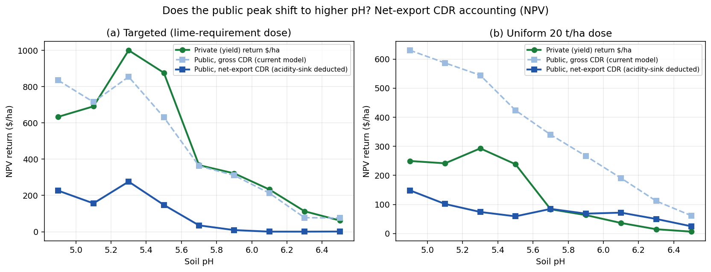
ASSUMPTION 3 · NET-EXPORT CDR
Credit only carbon that is durably exported
durable CDR = max( gross CDR − F · S , 0 )
F = 0.88 tCO₂ per tCaCO₂-eq · S = acidity sink (standing / maintenance)
Why it matters
≈ 80%
of credited removal is cut at first application once acidity neutralization is netted out.
Durable removal is largely a steady-state phenomenon — which is why the headline uses the equilibrium regime.
Alkalinity spent neutralizing soil acidity re-releases its CO₂ — exactly as agricultural lime does — so it must be deducted. A first-order sequential bound.
Enhanced Rock Weathering — public & private returns in SSA · Gebrekidan & Chamberlin (2026)
10

Slide 11
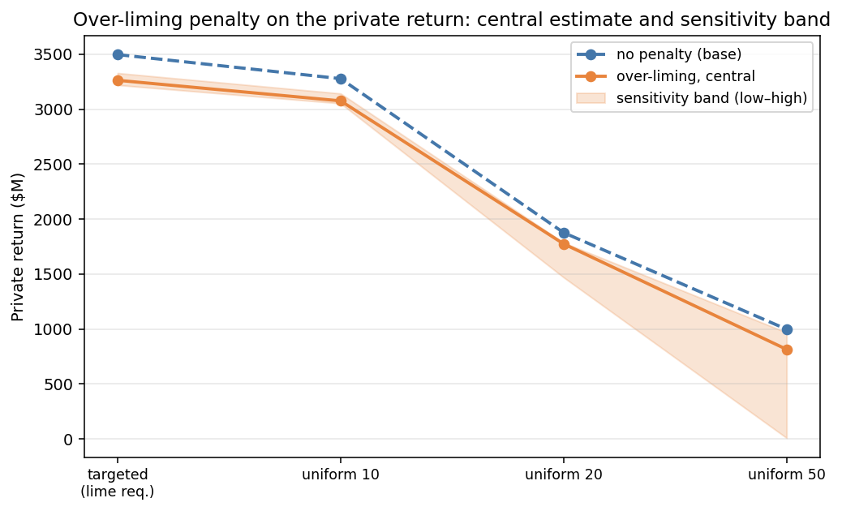
ASSUMPTION 4 · OVER-LIMING PENALTY
Too much alkalinity can depress yield
Mechanism
Beyond the lime requirement, pH is pushed past the crop optimum; the EcoCrop response applies a yield haircut at the post-application pH.
Buffered shift
pH change is damped by soil buffering (β = kβ·ECEC); reacted alkalinity A = gross CDR / F.
Effect
Concentrated on high uniform doses. Central estimate trims the targeted private return only modestly (4.31 → 4.02 Mha, −7%).
Sensitivity
A low–high band over (kβ, realized-alkalinity) is carried — the uniform-50 case is where it bites hardest.
Enhanced Rock Weathering — public & private returns in SSA · Gebrekidan & Chamberlin (2026)
11

Slide 12
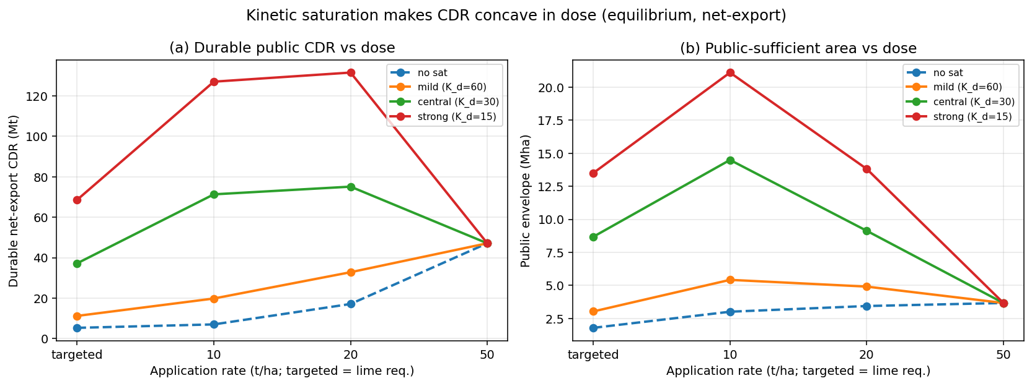
ASSUMPTION 5 · KINETIC SATURATION
Weathering reacts less-than-linearly with dose
sat(D) = ( Kd + 50 ) / ( Kd + D )
Key finding
Saturation makes CDR concave in dose (giving an interior optimum), but it does not drive the public envelope to zero. Below the 50 t/ha reference, per-tonne reactivity is higher — so at targeted doses durable CDR actually rises. What binds the carbon case is MAC > price, not kinetics.
Effective reacted tonnage saturates in applied dose D, normalized to the Lewis (2021) 50 t/ha reference (sat = 1 there). Reported as a band over Kd.
Enhanced Rock Weathering — public & private returns in SSA · Gebrekidan & Chamberlin (2026)
12

Slide 13
DESIGN SPACE
Temporal regimes × allocation rules
Two axes are swept alongside the assumption sets; the headline is equilibrium × targeted, net-export.
TEMPORAL REGIMES
ALLOCATION RULES
Year-1
One-time dose & cost; durable CDR net of standing acidity. Most conservative on carbon.
Targeted
LiTAS lime-equivalent dose — agronomically matched. Headline.
NPV @ 10%
Discounted stream of relief and durable removal.
Uniform 10 / 20 / 50 t/ha
Fixed rates — trace how CDR and over-liming scale with dose.
Equilibrium
Steady-state durable removal — the headline regime.
Enhanced Rock Weathering — public & private returns in SSA · Gebrekidan & Chamberlin (2026)
13

Slide 14
PART II
Results
Envelopes and the combined-only band · durable carbon and marginal abatement cost · what shifts the public frontier · optimal rates · the robust core geography.

Slide 15
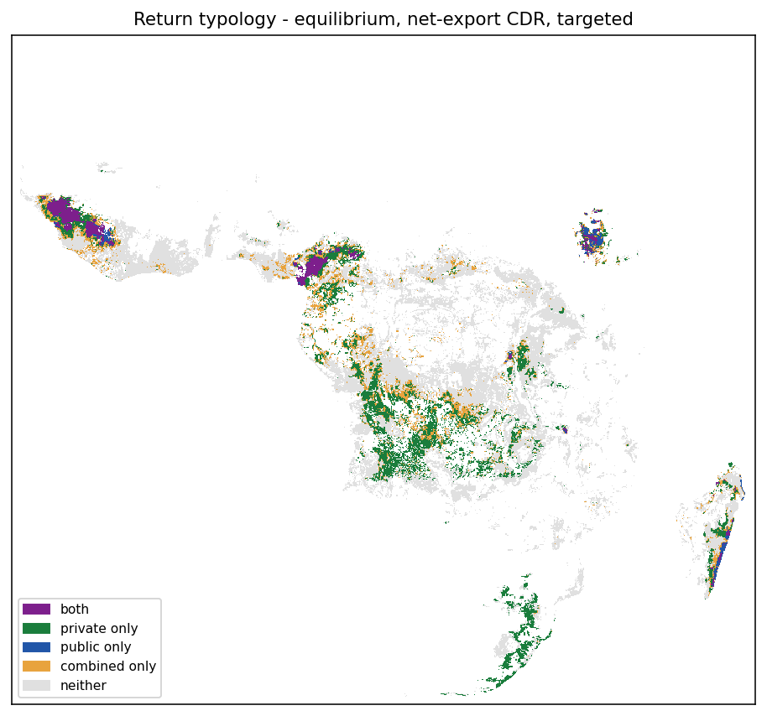
RESULTS · TYPOLOGY
A five-way pixel classification
Private-sufficient R_agro − C > 0
Public-sufficient R_CDR − C > 0
Intersection both hold at the same pixel
Combined-only neither alone, but GM > 0
Neither GM ≤ 0 — not deployable
Enhanced Rock Weathering — public & private returns in SSA · Gebrekidan & Chamberlin (2026)
15

Slide 16
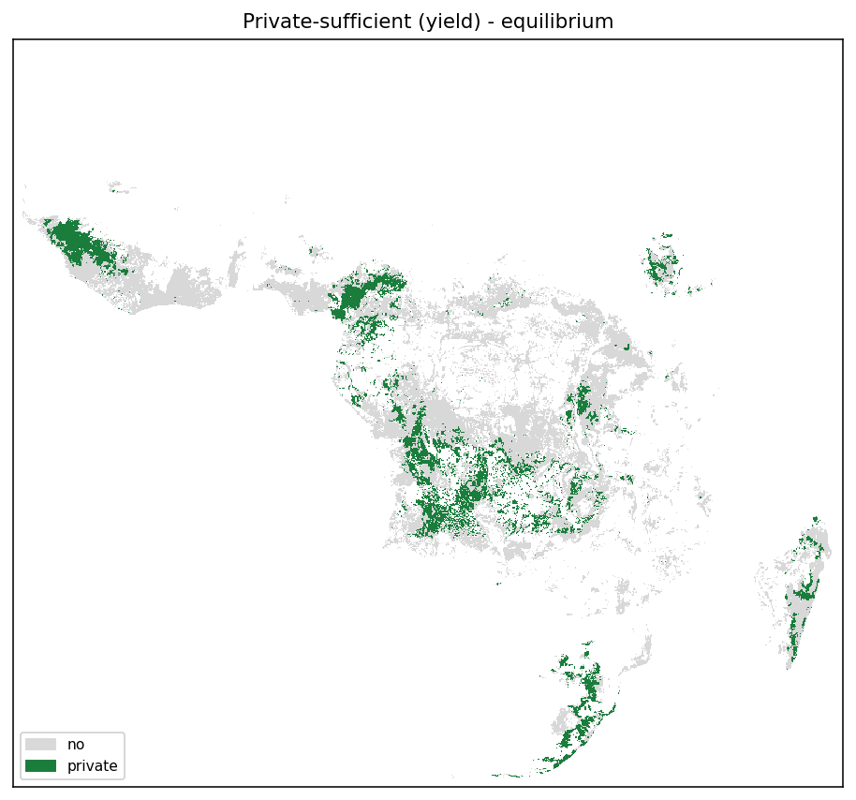
RESULTS · PRIVATE ENVELOPE
Where yield alone pays
Land where the agronomic return covers the full delivered cost with no carbon credit at all.
4.3 Mha
$3.5 B
private-sufficient area
private return
The largest single envelope under the targeted dose. But it is a minority of acid cropland — most viable land needs more than yield to pencil.
Enhanced Rock Weathering — public & private returns in SSA · Gebrekidan & Chamberlin (2026)
16
Notes:
Q: What total expenditure is required to achieve the $3.5 B private return? A: about $1.74 B in delivered basalt cost, summed over the 4.31 Mha private-sufficient envelope (equilibrium maintenance cycle, targeted allocation). So the $3.5 B is gross yield value; net of the $1.74 B ERW cost the private gross margin is about $1.75 B - a benefit-cost ratio of roughly 2:1, before any carbon revenue. Delivered cost here is quarry + grinding + transport + spreading (no MRV, since this is the yield-only case). Source: envelope table, targeted Private row - Area 4.31 Mha, Private $3,496 M, Cost $1,743 M, net-export CDR 7.1 Mt.

Slide 17
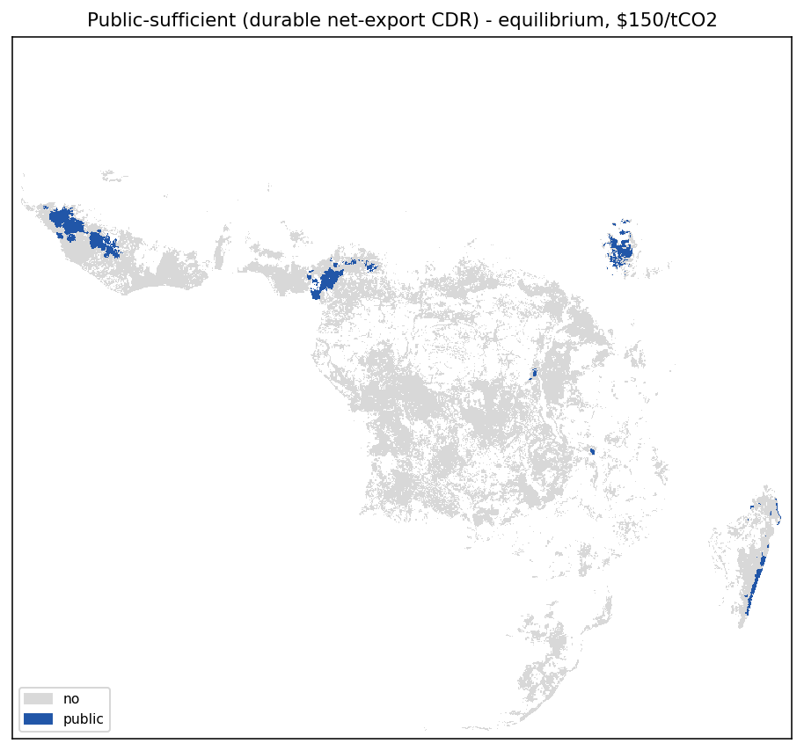
RESULTS · PUBLIC ENVELOPE
Where carbon alone pays (durably)
Land where durable, net-export CDR at $150/tCO₂ covers cost with no yield benefit.
1.7 Mha
9.4%
durable public area
of treated cropland
Smaller than the private envelope, and price-conditional. Net-export accounting and today’s VCM price keep the carbon-only case tightly bound — the reason the combined case matters.
Enhanced Rock Weathering — public & private returns in SSA · Gebrekidan & Chamberlin (2026)
17

Slide 18
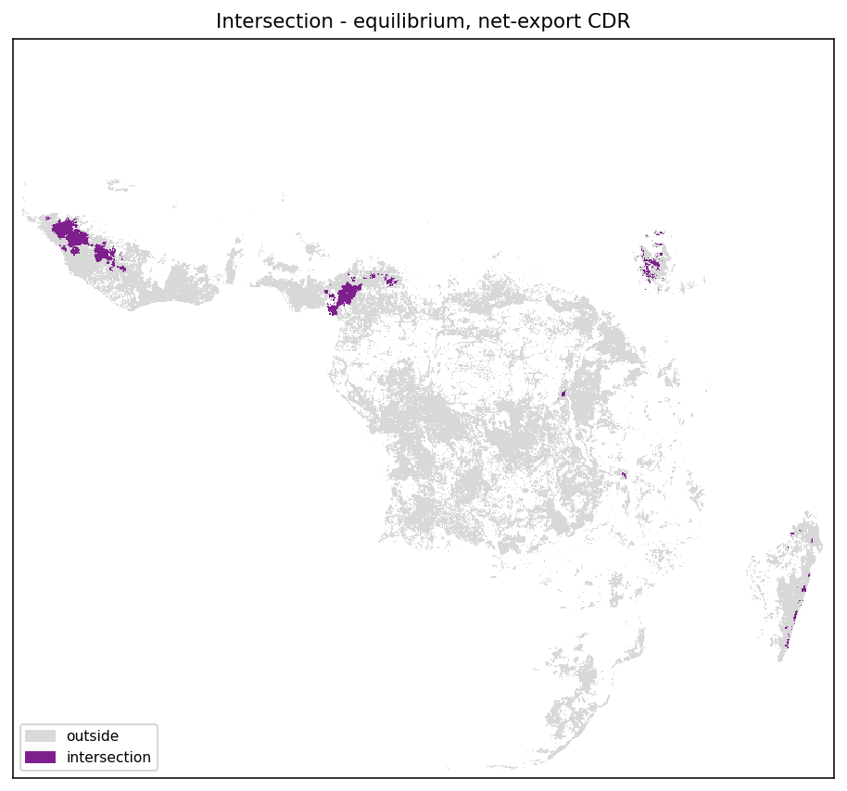
RESULTS · THE CENTRAL RESULT
The combined-only band is the policy object
2.1 Mha combined-only
neither the yield return nor the carbon return alone covers cost — yet together the margin is positive.
4.3
1.7
6.9
private (Mha)
public (Mha)
combined (Mha)
The economic point: voluntary carbon finance is not a bonus on an already-profitable practice — it is the marginal revenue that unlocks an otherwise-unprofitable, yield-improving investment.
Enhanced Rock Weathering — public & private returns in SSA · Gebrekidan & Chamberlin (2026)
18

Slide 19
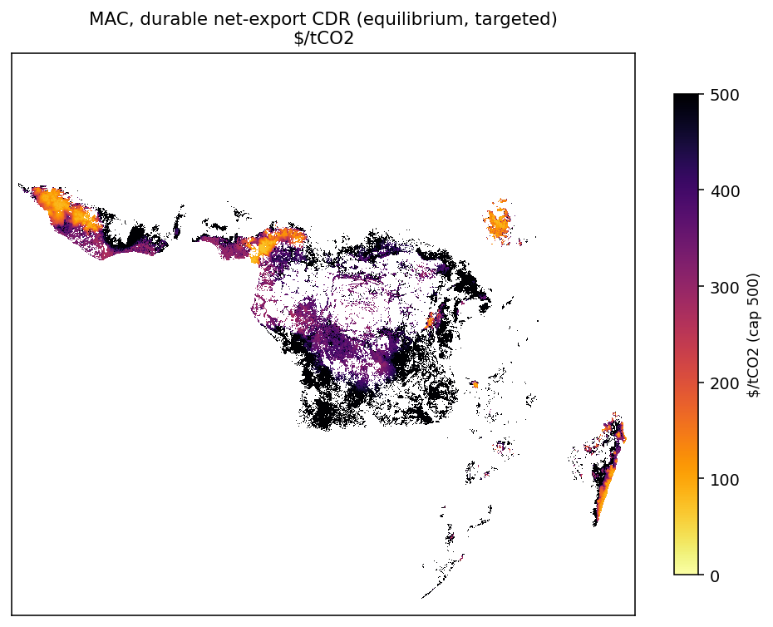
RESULTS · WHAT BINDS THE CARBON CASE
Marginal abatement cost, not kinetics
$446 / tCO₂
median marginal abatement cost — well above today’s $150 VCM price
MAC = delivered cost per tonne of rock ÷ durable CDR per tonne. The public envelope is exactly the land where MAC < net price (p − m).
So the carbon case is limited by how much CO₂ a tonne of rock verifiably removes — the largest and least-resolved lever, and the clear field-calibration priority.
Enhanced Rock Weathering — public & private returns in SSA · Gebrekidan & Chamberlin (2026)
19

Slide 20
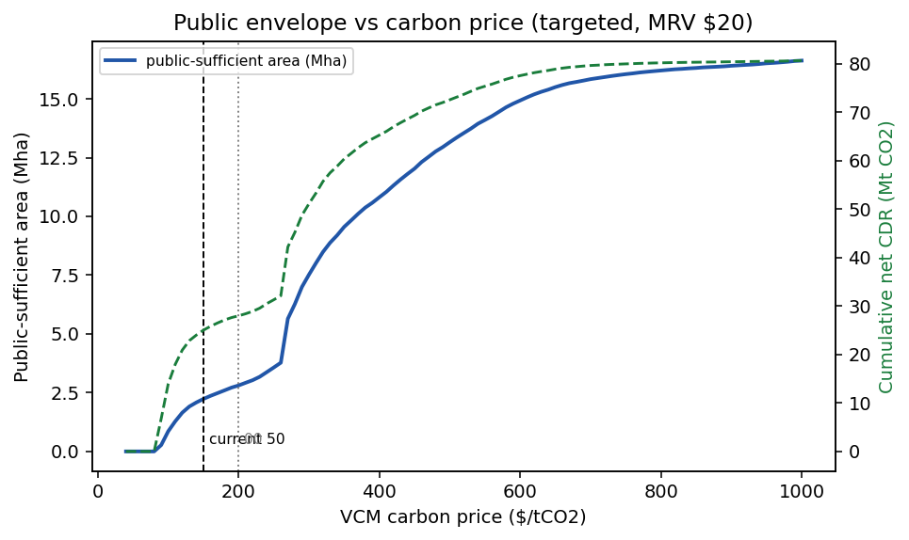
RESULTS · THREE LEVERS
What shifts the public envelope outward
Higher VCM price (p)
Public area climbs from 2% of treated cropland at $100 to ~50% at $500. The most direct lever.
1
Lower delivered cost (C)
Transport-cost reductions (e.g. solar haulage) lower MAC pixel-by-pixel — see Assumption 1.
2
More durable CDR per tonne
Raising verified removal per tonne of rock cuts MAC directly. Kinetic saturation is second-order here.
3
Enhanced Rock Weathering — public & private returns in SSA · Gebrekidan & Chamberlin (2026)
20

Slide 21
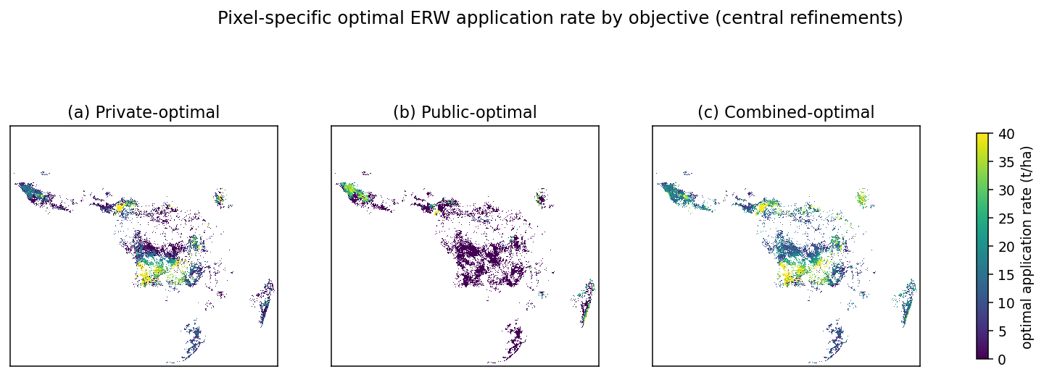
RESULTS · OPTIMAL APPLICATION RATES
Each objective has an interior optimum
With both refinements, each per-pixel objective is concave — so a pixel-specific optimal rate exists for the private, public, and combined margins. The combined optimum is moderate (typically well below blanket-high uniform doses): enough over-application to earn extra carbon, but not so much that over-liming and saturation erode the return.
Enhanced Rock Weathering — public & private returns in SSA · Gebrekidan & Chamberlin (2026)
21

Slide 22
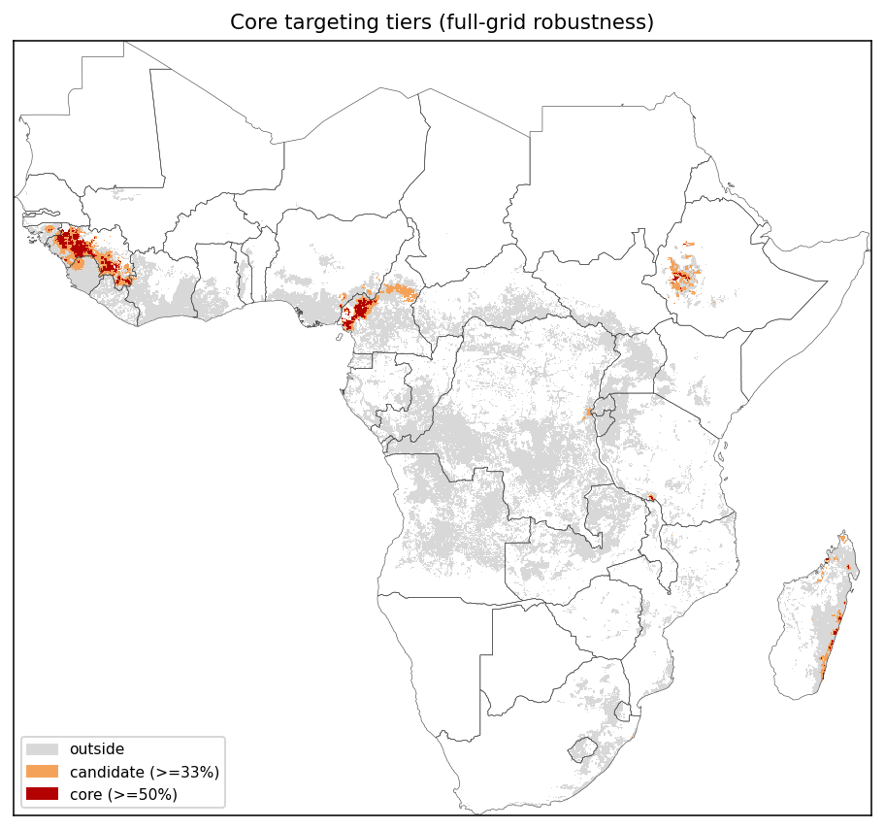
RESULTS · ROBUST CORE
A defensible priority geography
Intersecting the envelope across the plausible parameter grid isolates land that stays viable under most assumptions.
robust core-priority cropland
~0.8 Mha
farms reached
~0.5 M
crop value at stake
~$0.75 B
This is the geography one would deploy first — and the base to expand as price rises or cost falls.
Enhanced Rock Weathering — public & private returns in SSA · Gebrekidan & Chamberlin (2026)
22

Slide 23
TAKEAWAYS
ERW is a coupled agronomic-and-carbon proposition
1
The two returns rarely each suffice alone
But together they make a meaningful area of SSA cropland profitable that neither would — the 2.1 Mha combined-only band.
2
Carbon finance is the margin, not a bonus
On most viable land, VCM revenue is what unlocks a yield-improving investment. That reframes ERW away from a pure CDR supply curve.
3
The binding constraint is durable CDR per tonne
Net-export accounting cuts first-application removal ~80%; median MAC is $446. Price, delivered cost, and verified removal are the three levers.
4
Treating it as coupled changes the answer
It changes both where to deploy first (the robust core) and what to invest in to expand it (field calibration of removal).

Slide 24
NEXT
Caveats and where we go next
CAVEATS
NEXT
Priorities
Field calibration of durable removal per tonne is the single highest-value input — it sets MAC and the whole public case.
Sensitivity sweep
Expand around the parameters that move results most — removal per tonne, price, delivered cost, kβ, Kd.
Not yet modeled
Tenure and who finances the upfront cost, compaction / N₂O effects, and country-level credit eligibility (Article 6).
Optimal-rate maps
Fold the pixel-specific private and combined optimal-rate maps into the manuscript.
Farm counts
Based on national average holding sizes — order-of-magnitude.
Share & collaborate
Push erw-exante-v2 to GitHub for coauthor review; manuscript points to the repo.
Enhanced Rock Weathering — public & private returns in SSA · Gebrekidan & Chamberlin (2026)
24

