Slide 1
MARV
Twitter Sentiment Analysis

Slide 2
Purpose
Goals
Allow users to determine the public opinion of the item or company they are interested in researching.
Show public opinion by geographic location.
Retrieve Tweets associated with the users key word.
Use Sentiment Analysis to determine the emotion of the tweet.
Display map of public opinion by geographic location.
Notes:
Anna

Slide 3
Team Info
Anna Chambers
chambaa@mail.uc.edu
Mario Eid
eidmj@mail.uc.edu
Reed Klein
kleinrj@mail.uc.edu
Veronica Ufferman
uffermvg@mail.uc.edu
Project Advisor: Jillian Aurisano
Notes:
All – In order on screen

Slide 4
Abstract
The goal of this project is to create a web application that uses twitter and sentiment analysis to determine the public opinion about businesses, products, and people based on location. Once the public opinion has been determined, we will use data visualization to display the sentiment analysis based on geographic location. In addition to being able to see the public opinion, the users will be able to see what other words are associated with their object of interest. This product is intended to be used by businesses to analyze their products, and the public to decide where to work or what to buy.
Notes:
Anna

Slide 5
User Stories
As an applicant, I want to compare different companies so that I can decide on the best one to work for.
As a public relations specialist, I want to know if and when the public opinion of my company has changed in a location so that I can determine the source that caused the change.
As the head of marketing, I want to know how the public feels about my company, so that I have the necessary information to produce marketing campaigns.
As a consumer, I want to know how well a product is received so that I have enough knowledge to make a well-informed purchase.
Notes:
Veronica

Slide 6
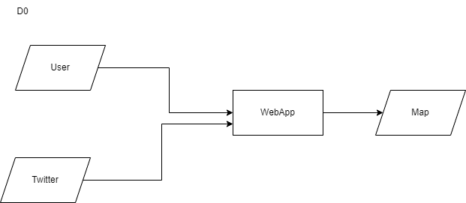
Design Diagram: D0
Notes:
Reed

Slide 7
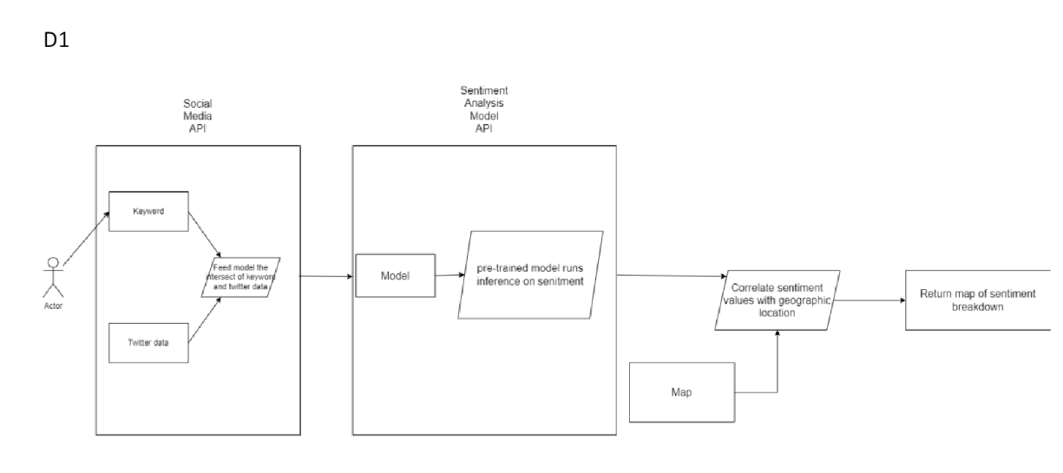
Design Diagram: D1
Notes:
Reed

Slide 8
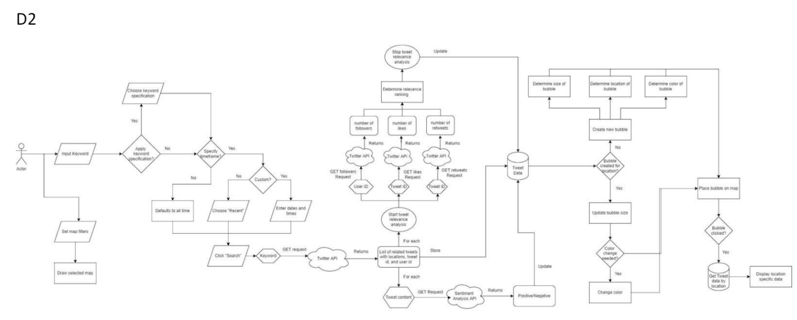
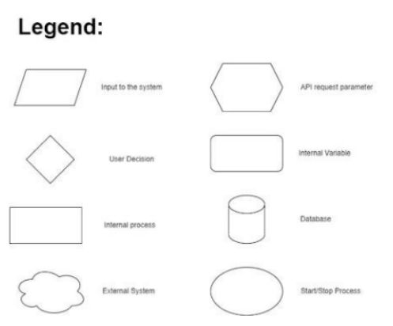
Design Diagram: D2
Notes:
Reed

Slide 9
Project Constraints
Legal
Twitter Guidelines for API usage
Diversity and Cultural
Factor cultural differences into sentiment analysis
Social
Ease of use
Ethical
Privacy and Representation
Notes:
Intro Veronica
Then each preset the parts we wrote

Slide 10
Project Progress
Current Phase: Research and Development
Coding base for front-end is currently being developed
Research for back-end design and implementation is underway
Notes:
Mario

Slide 11
Expected Accomplishments
Design front-end code structure (end-date: 11/6/22)
Design back-end code structure (end date: 11/6/22)
Develop code that pulls from Sentiment Analysis API to determine emotion associated (end date: 11/14/22)
Combine both API’s to ensure full data flow across application
(end date: 12/1/22)
Notes:
Mario

Slide 12
Division of work
Anna Chambers: Sentiment Analysis
Mario Eid: Front-End Development and Testing
Reed Klein: Testing and Front-End Development
Veronica Ufferman: Location API and Data Visualization
Notes:
Veronica Intro then each explain our roles

Slide 13
Expo Demo Plan
Exposition of APIs used and the intended functionality of the website.
Use a keyword that returns a large amount of Twitter data
Generate sentiment mappings from the Sentiment Analysis AI
Demonstrate the information and filtering abilities of the website
Notes:
Reed

