Slide 1
MARV Twitter Sentiment Analysis
Mario Eid, Anna Chambers, Reed Klein, Veronica Ufferman

Slide 2
Intellectual Merits and Goals
Intellectual Merits
Goals
Inferring public opinion from social media rather than relying on user feedback rating systems
Visualization of public appeal of subject
Retrieve Tweets associated with user key word
Use Sentiment Analysis to determine the emotion of the tweet
Display visualization of results and correlate with geographic location of the searched keyword

Slide 3
Broader Impacts
The Twitter data will show more up-to-date and realistic opinions from the public.
The data will be presented interactively and allow the user to break down the most recent tweets about a business.
Tweets are generally more accessible because more people are likely to have a Twitter account than create an account to review a business.
Businesses that might not have normally had access to public opinion metrics can use this web app to understand how the public feels about them and what they may need to change.

Slide 4
Design Specifications
A user will be able to input a keyword which will be used to get results from both Twitter and Google Maps APIs.
Once the Twitter Data is received, the data will be given to a Sentiment Analysis bot that will infer emotion from each tweet given.
Then, data visualizations via D3 will give an interactive breakdown of the overall sentiment expressed by the most recent tweets about the keyword.
This will be correlated with Google Maps data to show locations and ratings of the keyword.

Slide 5
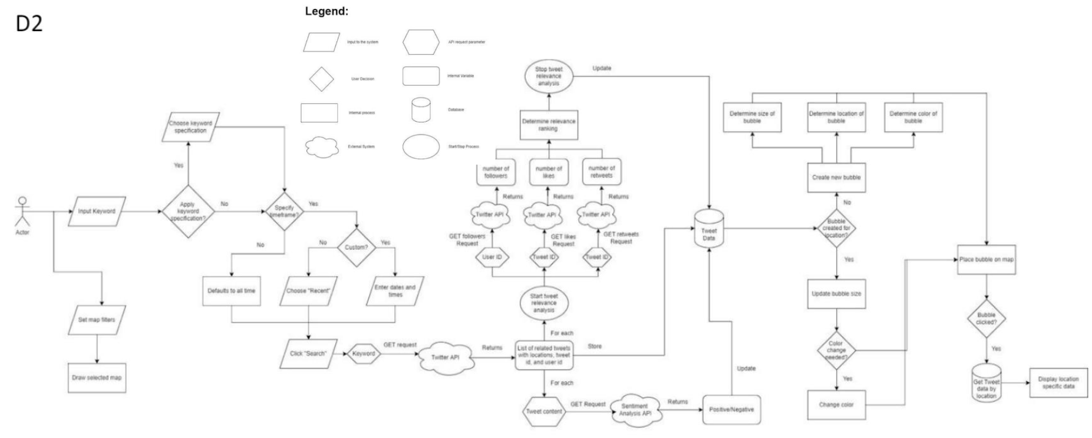
Design Diagram

Slide 6
Technologies
Twitter API
Twitter provides an API that allows (non-elevated) developers to gather the most recent 100 tweets and the metadata a tweeter allows Twitter to make visible.
Google API
The Google API provides location and review data for the businesses hosted on their map
Sentiment Analysis
Sentiment Analysis is a form of NLP that can infer emotion from a text prompt without manual input
D3
D3 is a visualization library that allows developers to quickly create intuitive, interactive data visualizations

Slide 7
Milestones
1. Complete back-end
Research both the Sentiment Analysis and Twitter APIs. Successfully hit the endpoints with mock data.
Integrate the APIs together so that the results of the twitter API are evaluated by the Sentiment Analysis API.
Store any necessary data.
Completed: 1/1/23
2. Complete front-end
Work on designing the Webapp UI.
Add functional elements to the UI such as search and filtering results.
Design a map to present data gathered from APIs.
Once this step is done the backend work should be visible and interactive via the Webapp.
Completed: 2/1/23
3. Connect front and back-end
Call API on search, show API data on the map
Incorporate the results returned from the backend into a visual result shown to the users.
Make sure results returned are relevant to search.
Completion date: 3/1/23
Completion date: 4/1/23
4. Publicly hosting the website
Research the best option for hosting the website publicly and execute necessary steps.
Ensure that all group members can access the hosted website without the application running locally.
Set up CI/CD pipeline to ensure automatic public updates.
Completion date: 3/8/23
5. Finished product
Finishing touches on the project.
Make sure all functionality is working as intended.
Clean up any UI or backend feature bugs that have been overlooked.

Slide 8
Results
Completed
Future Tasks
Front-end user interface that prompts the user to search for a keyword.
Twitter and Sentiment Analysis APIs integrated together.
APIs connected to front-end and return the sentiment analysis of the tweets corresponding to the keyword.
Google Maps API shows ratings associated with the keyword on the map.
Created Data Visualizations that show the Sentiment Analysis.
Look into expanding upon Twitter API access.
Include Sentiment Results on Map.
Show more locations on Google Maps.
Publicly host web application.

Slide 9
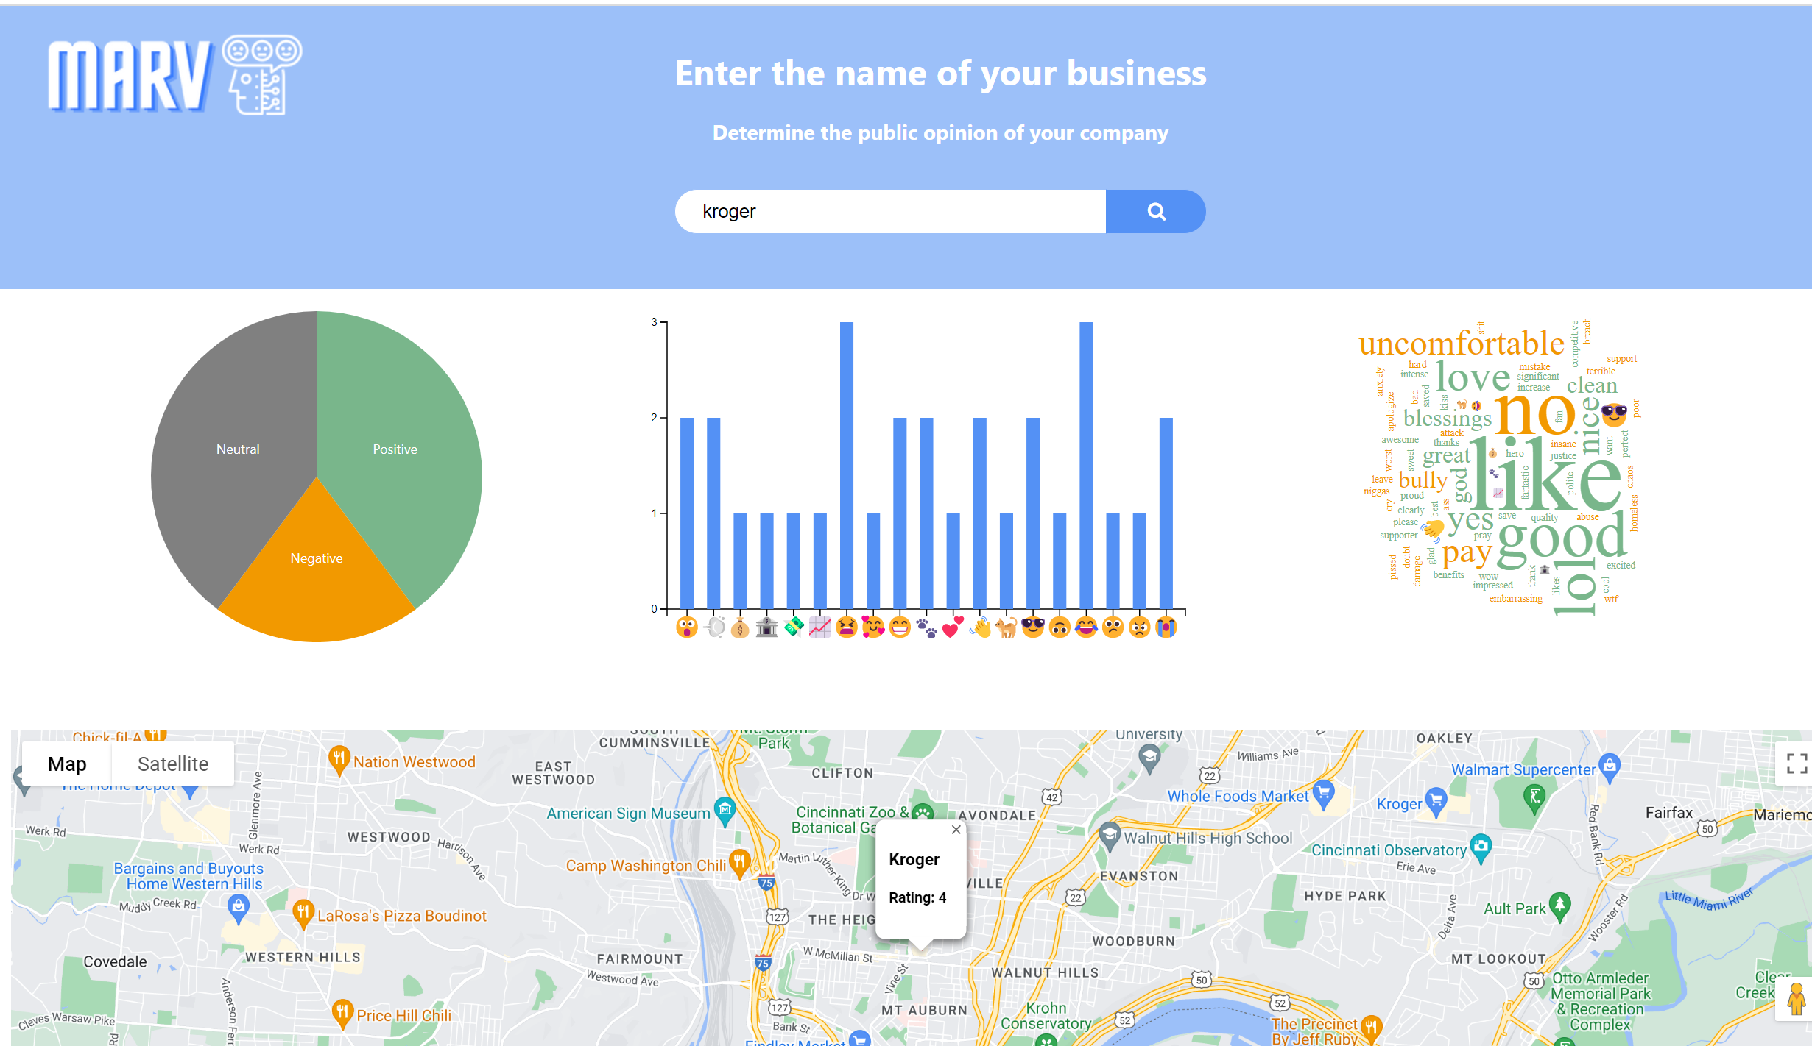

Slide 10
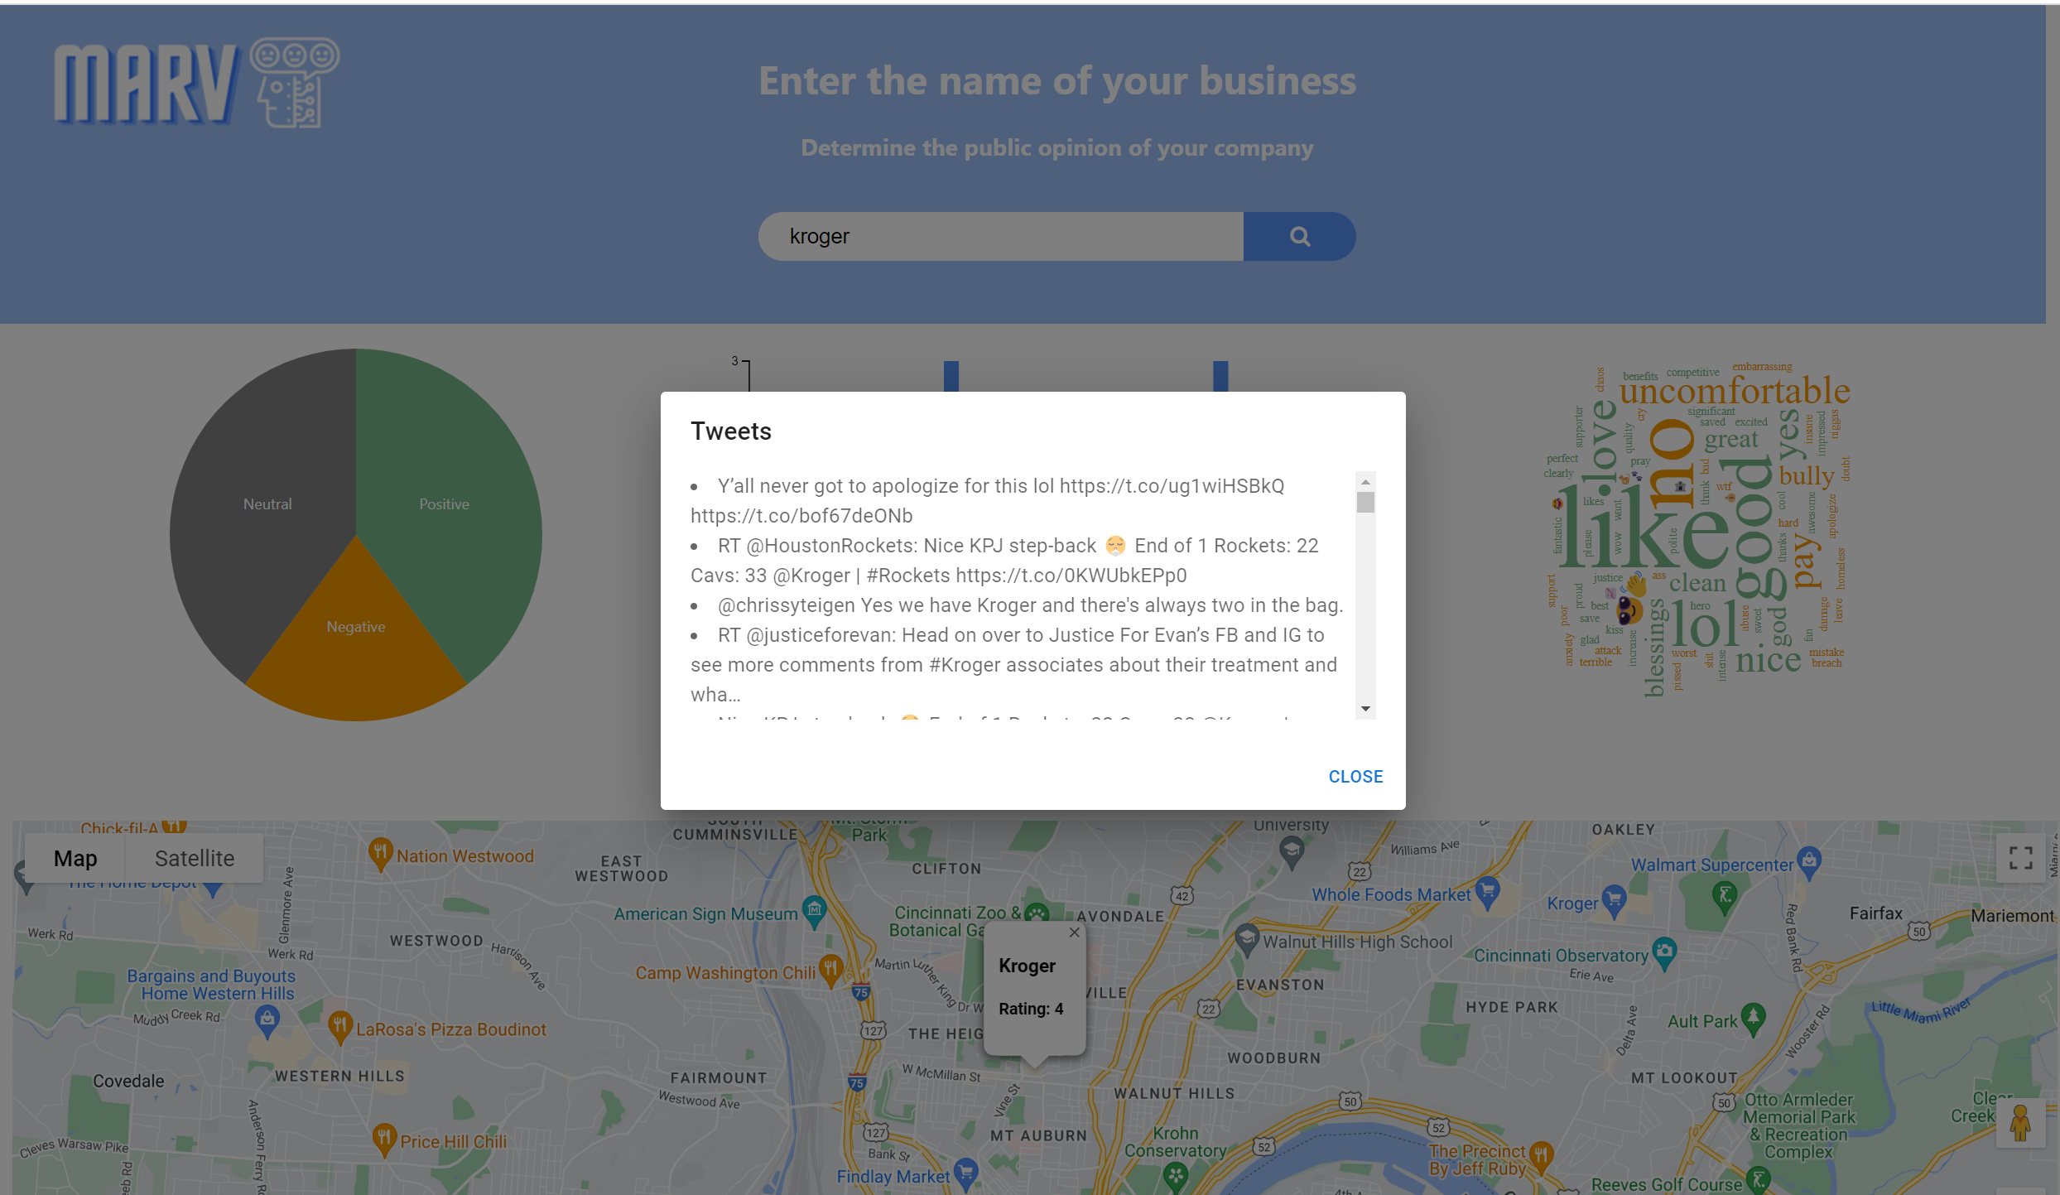

Slide 11
Challenges
Twitter API Constraints
The biggest challenge that faced was getting the access that we required to get the information we needed from the Twitter API.
With the level of access, we had we were unable to get geographical data associated with tweets.
We overcame this challenge by switching our project to use ratings from the Google API for the map portion.
D3 with React
After switching our Map data to be from the Google API we decided to show the Tweet Sentiment analysis using graphs made with D3.
Since we already started our project with React, we had to deal with the challenge of integrating D3 and React together.
The workaround that we have for this challenge is using a third-party library, React D3, to integrate D3 into our preexisting code base.
API blocked by CORS policy
The CORS (Cross-Origin Resource Sharing) policy can block API calls made from web applications that is hosted on a different domain than the API.
This challenge arose when integrating the Twitter API into our web application.
We fixed this challenge by setting up a proxy server using netlify to handle the requests.

