Slide 1
<> ARC 500
Programming with Python and Generative AI · Scripting, Data Analysis, Visualization, Problem-Solving, and Optimization
WEEK 5 · MEETING B · GROUPING AND OUTLIER STUDIO
Build a grouped, outlier-audited evidence table
Meeting B · groupby(), .agg(), dual-rule outlier flags, and your Project 1 checkpoint
JunHo Chun, PhD · School of Architecture · Syracuse University · Fall 2026
Notes:
Timing: 2 minutes.
Teaching notes: Students open the Week 5 handout and predict the zone_summary numbers before running any cell — most should recall South > North from Meeting A without looking.

Slide 2
LEARNING OUTCOMES
By the end, you should be able to…
1
Group and rank
2
Flag, both ways
Group Radley Hall rooms by zone and by room_type, produce multiple aggregations, and sort the result.
Write and apply an IQR-rule function and a z-score-rule function to the same column.
3
Decide, in writing
4
Transfer
Write a keep / investigate / exclude sentence for every flagged row, naming which explanation applies.
Apply the same two functions to a different column, then to your own Project 1 dataset, with self-written assert checks.
ARC 500 · Week 5 · Meeting B · Grouping and Outlier Studio
02
Notes:
Timing: 1 minutes.
Teaching notes: Point out outcome 4 is graded twice today: once as the required in-file transfer check, once as the Project 1 checkpoint itself.

Slide 3
ROAD MAP
Today’s learning sequence
01
Recall the grammar: group, aggregate, sort
02
Write and apply both outlier-flag functions
03
Decide keep / investigate / exclude, in writing
04
Transfer to a new case, then to your own dataset
ARC 500 · Week 5 · Meeting B · Grouping and Outlier Studio
03
Notes:
Timing: 1 minutes.
Teaching notes: Tell students the last agenda item is not optional practice — it is this week's graded assignment and the Project 1 milestone at once.

Slide 4
READ THE DATA
Recall four terms from Meeting A before writing any code
ARCHITECTURAL LENS
Grouping answers 'compared to what.' An outlier rule asks whether one row distorts that comparison. Today's studio uses both, first on Radley Hall and then on Project 1 data.
term
definition
example
groupby()
splits rows into categories before summarizing
df.groupby("zone")
IQR rule
flags values outside Q1 − 1.5×IQR to Q3 + 1.5×IQR
boxplot whiskers
z-score rule
flags values where |z| > 2, z = (x − mean) / std
z = (x − mean) / std
.agg(my_fn)
passes a function name in without calling it first
df.groupby(...).agg(my_fn)
ARC 500 · Week 5 · Meeting B · Grouping and Outlier Studio
04
Notes:
Timing: 1 minutes.
Teaching notes: Have students point to each term in their own Week 5 handout before Ctrl+Enter on the first real cell.

Slide 5
RECALL
Recall: groupby() exploded into four moves
df.groupby("zone")["energy_kwh_m2_yr"].mean()
1
2
3
4
1
df — the table
2
SPLIT by zone
3
SELECT one column
4
APPLY + COMBINE
Collect North rows together and South rows together.
All 24 rooms and their columns.
Choose the measurement to summarize.
Compute each group mean and return one Series.
ARC 500 · Week 5 · Meeting B · Grouping and Outlier Studio
05
Notes:
Timing: 1 minutes.
Teaching notes: Have students name split, select, apply, and combine in order before moving on.
[Sources]
- https://pandas.pydata.org/docs/user_guide/index.html
[/Sources]

Slide 6
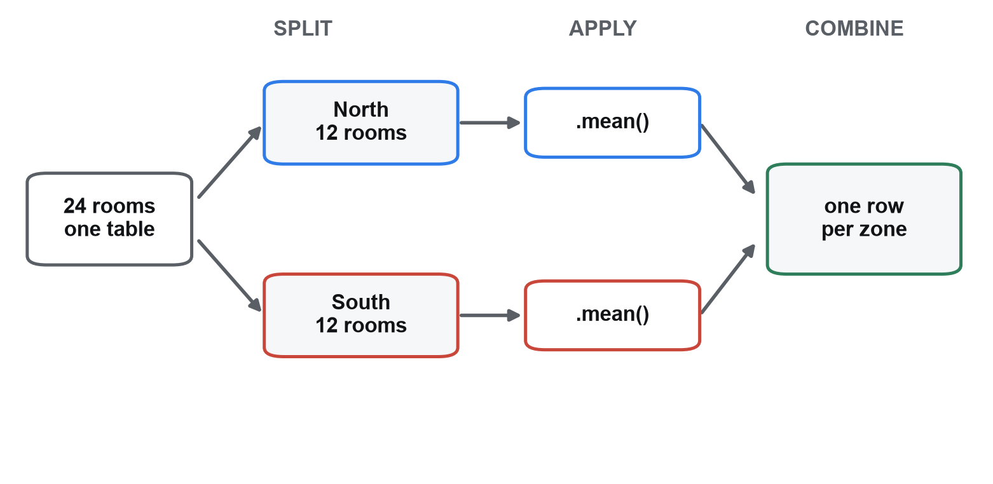
VISUAL EVIDENCE
Split, apply, combine - drawn
Three words, one shape
groupby('zone') does the split. .agg() or .mean() does the apply. pandas does the combine for you, which is why the result has one row per zone rather than one row per room. Knowing which of the three you are looking at is how you debug a summary that came back the wrong shape.
One table in, two groups, one aggregation each, one summary table out.
ARC 500 · Week 5 · Meeting B · Grouping and Outlier Studio
06
Notes:
Timing: 1 minutes.
Teaching notes: Ask what the output shape would be if the split were on room_type instead of zone - the diagram's middle column would have more boxes, and the combined table more rows.

Slide 7
METHOD
Build complexity only after the smaller part works
01
ONE COLUMN
02
GROUPED SUMMARY
03
OUTLIER FLAGS
Verify one summary
Add aggregations and rank
Write, then apply, both rules
Group by zone, compute one mean, and check it against Meeting A's headline number before trusting anything more complex.
Multiple named aggregations in one .agg() call, then sort_values().
One reusable function per rule, applied first to energy, then to area, then to your own data.
ARC 500 · Week 5 · Meeting B · Grouping and Outlier Studio
07
Notes:
Timing: 1 minutes.
Teaching notes: This sequence prevents students from debugging a groupby typo and an outlier-function typo at the same time.

Slide 8
PREDICT BEFORE YOU RUN
Predict: what dtype does this column show?
What prints, on this course's real pandas install?
df = pd.read_csv("building_rooms.csv")
print(df["zone"].dtype)
A
object — the classic pandas text-column dtype
B
str
C
string — pandas' nullable text dtype
D
category
ANSWER · B
Verified against pandas 3.0.5: text columns now print as str, not the object older pandas docs might lead you to expect.
ARC 500 · Week 5 · Meeting B · Grouping and Outlier Studio
08
Notes:
Timing: 1 minutes.
Teaching notes: This is the exact dtype line the next slide's df.dtypes call will show for room_id, zone, and room_type — confirm no one is thrown by str looking unfamiliar.
[Sources]
- https://pandas.pydata.org/docs/user_guide/index.html
[/Sources]

Slide 9
PYTHON SYNTAX
Load Radley Hall and recall the trustworthiness interview
import pandas as pd
df = pd.read_csv("building_rooms.csv")
print(df.shape)
print(df[["room_id", "zone", "room_type",
"area_m2", "energy_kwh_m2_yr"]].dtypes)
Same file, a new question
Week 4 asked whether this data could be trusted. Today assumes yes, and asks a new question: compared to what — and does any one row distort that comparison?
OUTPUT
(24, 12)
room_id str
zone str
room_type str
area_m2 float64
energy_kwh_m2_yr float64
dtype: object
ARC 500 · Week 5 · Meeting B · Grouping and Outlier Studio
09
Notes:
Timing: 2 minutes.
Teaching notes: Confirm every student's working directory actually contains building_rooms.csv before moving on; a FileNotFoundError here stalls everything downstream.
[Sources]
- https://pandas.pydata.org/docs/user_guide/index.html
[/Sources]

Slide 10
TERM, DEFINED
GroupBy object, defined
TERM
GroupBy object
IN PRACTICE
print(df.groupby("zone"))
Prints a line like <pandas.api.typing.DataFrameGroupBy object at 0x...> — a real, verified line from this course's pandas install, not a table of zone means.
The intermediate result produced by df.groupby(col) alone — a plan for splitting rows into groups, not a finished table. Nothing is summarized yet: chaining an aggregation like .mean() or .agg() afterward is what actually runs the split-apply-combine sequence and produces a readable Series or DataFrame.
COMMON CONFUSION
A GroupBy object is not a mistake to fix — it always sits between groupby() and an aggregation. Predict this exact print() on the next slide before you see it run.
ARC 500 · Week 5 · Meeting B · Grouping and Outlier Studio
10
Notes:
Timing: 2 minutes.
Teaching notes: Ask what students expected instead — most beginners expect groupby() alone to already show North/South means; that expectation is exactly what this term corrects.
[Sources]
- https://pandas.pydata.org/docs/user_guide/index.html
[/Sources]

Slide 11
PREDICT BEFORE YOU RUN
Predict: what prints before any aggregation runs?
What does this print?
print(df.groupby("zone"))
A
A DataFrame with one row per zone, every column already averaged
B
<pandas.api.typing.DataFrameGroupBy object at 0x...>
C
['North', 'South'] — just the two zone names
D
A ValueError, because no aggregation function was given
ANSWER · B
groupby() alone only plans the split — a GroupBy object, not a table. Chain .agg() or .mean() to compute anything.
ARC 500 · Week 5 · Meeting B · Grouping and Outlier Studio
11
Notes:
Timing: 2 minutes.
Teaching notes: This is the single most common groupby() misconception — some students will confidently guess option A. Run it live immediately after revealing the answer.
[Sources]
- https://pandas.pydata.org/docs/user_guide/index.html
[/Sources]

Slide 12
PYTHON SYNTAX
Recall from Meeting A: group, then aggregate
zone_summary = df.groupby("zone").agg(
mean_energy=("energy_kwh_m2_yr", "mean"),
mean_area=("area_m2", "mean"),
n=("room_id", "count"),
).round(2)
print(zone_summary)
Confirm before extending
Run this first and confirm you get exactly Meeting A's numbers — North 64.25, South 115.68 — before Studio 1 asks you to build the same pattern for a new category.
OUTPUT
mean_energy mean_area n
zone
North 64.25 40.98 12
South 115.68 38.25 12
ARC 500 · Week 5 · Meeting B · Grouping and Outlier Studio
12
Notes:
Timing: 2 minutes.
Teaching notes: This is a deliberate checkpoint: any student whose numbers differ here has a data or environment problem to fix before Studio 1, not after.

Slide 13
IN-CLASS CHECK
Studio 1: build the same pattern for room_type
WORK THROUGH IT
Group by room_type instead of zone, with the same three aggregations, then rank by mean energy.
1.
Write df.groupby("room_type").agg(mean_energy=(...), n=(...)).round(2).
2.
Sort by mean_energy, descending.
3.
Identify which two room types have n = 1 — flag them as thin evidence.
4.
Write one sentence: does a single-room category deserve the same confidence as a 10-room category?
ARC 500 · Week 5 · Meeting B · Grouping and Outlier Studio
13
Notes:
Timing: 4 minutes.
Teaching notes: Expected top of ranking: Server (410.0, n=1), Studio (94.0, n=6). Expected bottom: Closet (12.0, n=1). Both extremes rest on n=1 — press students to say so explicitly, not just report the number.

Slide 14
READ THE DATA
Confirm the headline finding before building on it
ARCHITECTURAL LENS
South-zone rooms use about 80% more energy per m² than North rooms, on identical n = 12 and nearly identical mean area. Everything from here forward — ranking, outlier flags, decision sentences — should be read against this one finding.
zone
mean_energy_kwh_m2_yr
mean_area_m2
n
North
64.25
40.98
12
South
115.68
38.25
12
ARC 500 · Week 5 · Meeting B · Grouping and Outlier Studio
14
Notes:
Timing: 2 minutes.
Teaching notes: Ask one student to state the 80% figure from memory before you reveal the table — most should already have it from Meeting A.

Slide 15
RECALL
Recall: .loc[] and .iloc[], now doing double duty
TERM
.loc[row, col]
IN PRACTICE
df.loc[df["room_id"]=="R306", "energy_kwh_m2_yr"].iloc[0]
df.loc[row_selector, column_selector] selects matching rows AND names which column to keep, in one call. Week 4 filtered rows only, with no column choice: rooms[rooms['zone']=='South']. The result keeps its ORIGINAL row labels — it is not renumbered from 0.
Row selector: room_id == 'R306'. Column selector: 'energy_kwh_m2_yr'. .iloc[0] then pulls the one matching value out BY POSITION, whatever that row's own label is.
COMMON CONFUSION
.iloc[0] does not mean 'the row labeled 0' — it means 'the first value in whatever .loc[] just returned.'
ARC 500 · Week 5 · Meeting B · Grouping and Outlier Studio
15
Notes:
Timing: 2 minutes.
Teaching notes: Write df.loc[condition, column] on the board next to Week 4's df[condition] — the comma-separated column choice is the only new part.
[Sources]
- https://pandas.pydata.org/docs/user_guide/index.html
[/Sources]

Slide 16
RECALL
Recall: tuple-unpacking, the pattern your function will use
TERM
low, high = ...
IN PRACTICE
low, high = iqr_bounds(df["energy_kwh_m2_yr"])
A function that returns two values separated by a comma, like return q1 - 1.5*iqr, q3 + 1.5*iqr, packages them as one paired value — a tuple. Writing low, high = iqr_bounds(df[col]) unpacks that pair into two names at once, in the order they were returned.
low receives the first returned number (18.25), high the second (134.25) — matched by ORDER, not by name.
COMMON CONFUSION
The names low and high are yours to choose — Python does not know which returned number is 'low.' Swap the two names and you silently swap which bound is which.
ARC 500 · Week 5 · Meeting B · Grouping and Outlier Studio
16
Notes:
Timing: 2 minutes.
Teaching notes: Write low, high = 1, 2 on the board and ask what each name holds before running any real code — this is the exact pattern the next slide's iqr_bounds() function returns.
[Sources]
- https://pandas.pydata.org/docs/user_guide/index.html
[/Sources]

Slide 17
RECALL
Recall: the IQR rule, before you code it
TERM
IQR rule
IN PRACTICE
iqr_bounds(df["energy_kwh_m2_yr"])
Q1 = 61.75, Q3 = 90.75, IQR = 29.0 → bounds (18.25, 134.25). Room R306 at 410.0 kWh/m²/yr sits far above the high bound — the room Studio 2 asks you to confirm.
Flags any value outside [Q1 − 1.5×IQR, Q3 + 1.5×IQR], where IQR = Q3 − Q1. A flag means 'investigate,' not 'delete' — the same convention Meeting A used.
COMMON CONFUSION
1.5× is a convention, not a law of statistics — Meeting A named it as a stated, defensible judgment call.
ARC 500 · Week 5 · Meeting B · Grouping and Outlier Studio
17
Notes:
Timing: 2 minutes.
Teaching notes: Ask students to recall these exact bounds from memory before showing them — most should still have 18.25 and 134.25 from Meeting A.
[Sources]
- https://pandas.pydata.org/docs/user_guide/index.html
[/Sources]

Slide 18
PYTHON SYNTAX
Write one reusable IQR-flag function
def iqr_bounds(values: pd.Series) -> tuple[float, float]:
"""Return (low, high) IQR fence bounds."""
q1, q3 = values.quantile(0.25), values.quantile(0.75)
iqr = q3 - q1
return q1 - 1.5 * iqr, q3 + 1.5 * iqr
def flag_iqr(df: pd.DataFrame, col: str) -> pd.Series:
"""True where df[col] sits outside the IQR bounds."""
low, high = iqr_bounds(df[col])
return (df[col] < low) | (df[col] > high)
One function, reused on every column
Recall the docstring and type-hint convention from Week 4: -> tuple[float, float] and -> pd.Series state what each function returns. Combining two Boolean Series needs & and | with parentheses around each condition — NOT Python's and/or from Weeks 2-3, which raises a ValueError on a Series. Write this once; Studio 2 through Studio 7 all call it, unchanged.
ARC 500 · Week 5 · Meeting B · Grouping and Outlier Studio
18
Notes:
Timing: 2 minutes.
Teaching notes: Ask why iqr_bounds() is written as its own small function rather than inlined into flag_iqr() — because Meeting A's boxplot-bound discussion and this flag both need the same two numbers. Flag the &/| point explicitly: it is a real, common beginner trap.
[Sources]
- https://pandas.pydata.org/docs/user_guide/index.html
[/Sources]

Slide 19
IN-CLASS CHECK
Studio 2: apply flag_iqr() to energy_kwh_m2_yr
WORK THROUGH IT
Confirm the function catches the room you expect from Meeting A.
1.
Add df["iqr_flag_energy"] = flag_iqr(df, "energy_kwh_m2_yr").
2.
Print only room R306's row.
3.
Confirm the flag is True.
4.
State the IQR bounds you computed, in your own words, without looking back at Meeting A.
ARC 500 · Week 5 · Meeting B · Grouping and Outlier Studio
19
Notes:
Timing: 5 minutes.
Teaching notes: Expected: True, with bounds 18.25 to 134.25. If a student gets False, the most common cause is calling flag_iqr on the wrong column name.

Slide 20
RECALL
Recall: the z-score rule, before you code it
TERM
z-score rule
IN PRACTICE
z = (x - mean) / std
For energy_kwh_m2_yr: mean = 88.85, std = 72.54. Room R306 at 410.0 kWh/m²/yr → z = 4.43, far past |z| > 2 — the same room the IQR rule flagged.
Restates one value as 'how many standard deviations from the mean': z = (x − mean) / std. This course flags any row where |z| > 2 — some fields use 3; the threshold is a stated judgment call, not a universal constant.
COMMON CONFUSION
threshold=2.0 in the next slide's flag_zscore() is a default argument, not a hard-coded rule — a caller can pass threshold=1.5 or threshold=3.0 instead.
ARC 500 · Week 5 · Meeting B · Grouping and Outlier Studio
20
Notes:
Timing: 2 minutes.
Teaching notes: Contrast the two rules once more before coding: IQR uses quartiles (resistant to extremes), z-score uses mean and standard deviation (sensitive to them) — that difference is why they can disagree.
[Sources]
- https://pandas.pydata.org/docs/user_guide/index.html
[/Sources]

Slide 21
PYTHON SYNTAX
Write one reusable z-score-flag function
def flag_zscore(
df: pd.DataFrame, col: str, threshold: float = 2.0
) -> pd.Series:
"""True where |z-score| of df[col] exceeds threshold."""
z = (df[col] - df[col].mean()) / df[col].std()
return z.abs() > threshold
A default argument, doing real work
Recall default arguments from Week 3: threshold=2.0 is used unless a caller overrides it, e.g. flag_zscore(df, "area_m2", threshold=1.5). The rule's strictness becomes a stated, changeable parameter — not a hidden constant.
ARC 500 · Week 5 · Meeting B · Grouping and Outlier Studio
21
Notes:
Timing: 2 minutes.
Teaching notes: Ask what would happen to R309's flag if threshold were raised to 3.0 — students should reason that 2.82 < 3.0, so it would stop being flagged, without needing to run it.

Slide 22
IN-CLASS CHECK
Studio 3: apply flag_zscore() and compare with Studio 2
WORK THROUGH IT
Confirm the two independent rules agree on this column.
1.
Add df["z_flag_energy"] = flag_zscore(df, "energy_kwh_m2_yr").
2.
Print R306's row with both flag columns side by side.
3.
Confirm both are True.
4.
Write one sentence: why does agreement between two differently-built rules increase your confidence more than either rule alone?
ARC 500 · Week 5 · Meeting B · Grouping and Outlier Studio
22
Notes:
Timing: 4 minutes.
Teaching notes: This is the 'clean' case from Meeting A, now reproduced by the student's own two functions rather than watched as a demo — the point is that they built both tools themselves.

Slide 23
PREDICT BEFORE YOU RUN
Predict: do the two rules agree on room R309?
R309 is a 120.0 m² gallery. Do both rules flag it?
df["iqr_flag_area"] = flag_iqr(df, "area_m2")
df["z_flag_area"] = flag_zscore(df, "area_m2")
print(df.loc[df["room_id"] == "R309",
["iqr_flag_area", "z_flag_area"]])
A
Yes — both flag it, the same way they agreed on R306
B
No — neither rule flags it
C
No — the IQR rule flags it, the z-score rule does not
D
No — the z-score rule flags it, the IQR rule does not
ANSWER · D
Verified: z = 2.82 flags R309, but area_m2 IQR bounds (−47.25 to 123.95) do not — same room, different verdicts.
ARC 500 · Week 5 · Meeting B · Grouping and Outlier Studio
23
Notes:
Timing: 2 minutes.
Teaching notes: Most students expect the two rules to always agree after Studio 2-3's clean case — this is the moment that expectation breaks, on purpose.
[Sources]
- https://pandas.pydata.org/docs/user_guide/index.html
[/Sources]

Slide 24
READ THE DATA
Now apply both functions to area_m2 — the rules disagree
ARCHITECTURAL LENS
IQR bounds on area_m2: −47.25 to 123.95 — wide because small offices and large studios both sit in this data, so even a 120.0 m² gallery fits inside. R110, a 3 m² closet, is not extreme enough by either rule. Same functions, same dataset, genuinely different verdicts.
room_id
room_type
area_m2
z-score
IQR flag
z flag
R309
Gallery
120.0
2.82
No
Yes
R110
Closet
3.0
-1.28
No
No
ARC 500 · Week 5 · Meeting B · Grouping and Outlier Studio
24
Notes:
Timing: 2 minutes.
Teaching notes: Walk through this as a guided reveal before Studio 4 asks students to reproduce it themselves — the point is that this disagreement is real, not a bug in anyone's code.

Slide 25
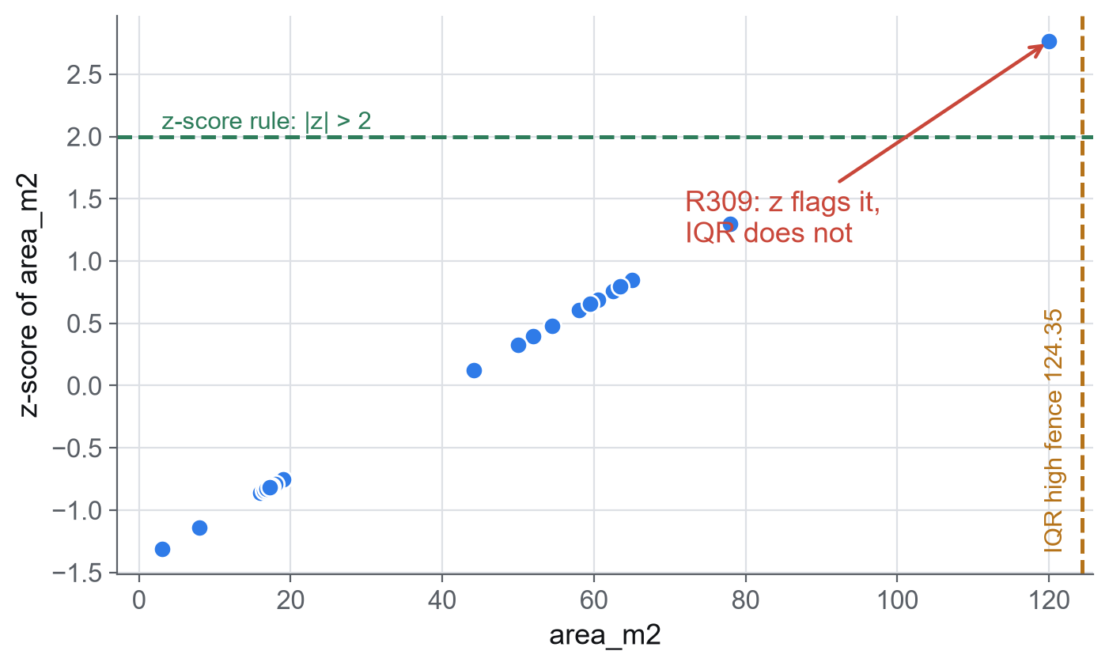
VISUAL EVIDENCE
Where the two rules part company
R309 lands between the two rules
R309 is a 120 m2 double-height gallery. The z-score rule flags it; the IQR rule does not, because this building's mix of small offices and large studios widens the interquartile range enough to swallow it. Neither rule is broken. They encode different ideas of 'unusual', and this room is where that difference becomes visible.
Every room's area_m2 against its own z-score. Green line = the z-score rule. Amber line = the IQR high fence.
ARC 500 · Week 5 · Meeting B · Grouping and Outlier Studio
25
Notes:
Timing: 2 minutes.
Teaching notes: Resist resolving this. The honest answer is that the room needs a human decision, which is exactly what Studio 5's keep/investigate/exclude sentence is for.

Slide 26
IN-CLASS CHECK
Studio 4: reproduce the disagreement yourself
WORK THROUGH IT
Run your two functions on area_m2 and confirm the table above, then look for one more debatable row.
1.
Add iqr_flag_area and z_flag_area columns using your two functions.
2.
Print the rows for R309 and R110 and confirm they match the table.
3.
Sort the whole dataset by area_m2 and look at the 3 largest and 3 smallest rows.
4.
Name one row, other than R309 or R110, whose flag status you find debatable, and why.
ARC 500 · Week 5 · Meeting B · Grouping and Outlier Studio
26
Notes:
Timing: 5 minutes.
Teaching notes: There is no single correct 'one more row' answer here — grade the reasoning (relative to nearby values in the sorted list), not a specific room_id.

Slide 27
IN-CLASS CHECK
Studio 5: write the keep / investigate / exclude decisions
WORK THROUGH IT
Write one sentence for each of R306, R309, and R110 — this is graded evidence, not a private note.
1.
Name which explanation (measurement error, genuine extreme, missing variable) applies to each room.
2.
R306: justify KEEP, citing the server-room explanation.
3.
R309 and R110: since the rules disagree or both miss, justify INVESTIGATE rather than a silent keep or exclude.
4.
Save all three sentences in the cell provided — do not delete any flagged row from the DataFrame itself.
ARC 500 · Week 5 · Meeting B · Grouping and Outlier Studio
27
Notes:
Timing: 5 minutes.
Teaching notes: Watch for students who quietly drop a flagged row instead of writing a decision sentence — deleting evidence is exactly the silent-exclude failure mode this exercise is designed to catch.

Slide 28
PREDICT BEFORE YOU RUN
Predict: is R306 still an outlier on area_m2?
R306 was True/True on energy. What happens on area_m2 (8.0 m²)?
df["iqr_flag_area"] = flag_iqr(df, "area_m2")
df["z_flag_area"] = flag_zscore(df, "area_m2")
cols = ["area_m2", "iqr_flag_area", "z_flag_area"]
print(df.loc[df["room_id"] == "R306", cols])
A
True / True again — R306 is already established as an outlier
B
False / False — neither rule flags it on this column
C
True / False — only the IQR rule still flags it
D
False / True — only the z-score rule still flags it
ANSWER · B
Verified: z = −1.11, and 8.0 m² sits inside the IQR bounds. Outlier status is never permanent — it depends on the column.
ARC 500 · Week 5 · Meeting B · Grouping and Outlier Studio
28
Notes:
Timing: 2 minutes.
Teaching notes: Name the misconception directly: a flag is not a property of the room, it is a property of (room, column) together.
[Sources]
- https://pandas.pydata.org/docs/user_guide/index.html
[/Sources]

Slide 29
PYTHON SYNTAX
The SAME row can be ordinary on a different variable
df["iqr_flag_area"] = flag_iqr(df, "area_m2")
df["z_flag_area"] = flag_zscore(df, "area_m2")
r306 = df.loc[
df["room_id"] == "R306",
["room_id", "area_m2",
"iqr_flag_area", "z_flag_area"],
]
print(r306.to_string(index=False))
Outlier status is column-specific
.to_string(index=False) prints a DataFrame slice without pandas' default row-index column — a cosmetic touch, not a data change. R306 is an extreme outlier on energy_kwh_m2_yr (Studio 2-3: both flags True) but an entirely ordinary room on area_m2 (both flags False, here). 'Outlier' always means outlier ON ONE VARIABLE — never a permanent label for a row.
OUTPUT
room_id area_m2 iqr_flag_area z_flag_area
R306 8.0 False False
ARC 500 · Week 5 · Meeting B · Grouping and Outlier Studio
29
Notes:
Timing: 2 minutes.
Teaching notes: This is the model for the required transfer-safeguard check — the next slide asks students to turn exactly this comparison into their own assert statements.

Slide 30
IN-CLASS CHECK
Studio 6: write your own transfer-safeguard asserts
WORK THROUGH IT
Prove R306's area_m2 status with 2-4 assert statements you write yourself — a different input than energy_kwh_m2_yr, which you already tested live.
1.
assert flag_iqr(df, "area_m2")[df["room_id"] == "R306"].iloc[0] is False.
2.
assert flag_zscore(df, "area_m2")[df["room_id"] == "R306"].iloc[0] is False.
3.
Add one more assert of your choice, on a different room (e.g. R110 or R309), on area_m2.
4.
Restart the kernel, run the file from the top, and confirm silent, error-free output.
ARC 500 · Week 5 · Meeting B · Grouping and Outlier Studio
30
Notes:
Timing: 4 minutes.
Teaching notes: This satisfies the course's required lightweight transfer safeguard: a self-generated check on a different input (a different column, R306 on area_m2) than the one worked through live in Studio 2-3 (energy_kwh_m2_yr).

Slide 31
METHOD
This studio IS your Project 1 checkpoint
01
DATASET
02
QUESTION
03
PROVENANCE
You already chose it
Restate it here
This is the milestone
In Week 4 you selected and cleaned your own Project 1 dataset. Today's pipeline runs on THAT file, not a new one.
Write your Week 4 research question again before grouping — the grouping choice should serve that question, not the other way around.
A grouped/ranked table, dual-rule outlier flags, and decision sentences on your own data — submitted this week — IS the Project 1 dataset/question/provenance checkpoint. No separate memo is required.
ARC 500 · Week 5 · Meeting B · Grouping and Outlier Studio
31
Notes:
Timing: 2 minutes.
Teaching notes: Say this explicitly and only once, clearly: nothing extra is owed beyond what Studio 7 produces. Point to Project 1 Part II in the syllabus if anyone is unsure.

Slide 32
IN-CLASS CHECK
Studio 7: apply today's pipeline to your OWN dataset
WORK THROUGH IT
Repeat group → aggregate → sort → flag_iqr → flag_zscore → decision sentences on your Week 4 Project 1 dataset.
1.
Set DATA_PATH to your Week 4 cleaned CSV (it defaults to Radley Hall's file so this cell still runs before you edit it).
2.
Set GROUP_COL and VALUE_COL to your own categorical and numeric columns.
3.
Group, aggregate, sort, and print the ranked summary for your data.
4.
Apply flag_iqr and flag_zscore to VALUE_COL, and write one keep / investigate / exclude sentence per flagged row.
ARC 500 · Week 5 · Meeting B · Grouping and Outlier Studio
32
Notes:
Timing: 4 minutes.
Teaching notes: Circulate here more than anywhere else this session — column names, missing values, and group sizes will differ a lot across student datasets. The functions should not need to change; only the three variables at the top of the cell should.

Slide 33
IN-CLASS CHECK
Studio 8: audit an AI-generated outlier function
WORK THROUGH IT
AI wrote a z-score flag function that only checks one direction and silently drops flagged rows instead of recording them.
1.
Explain why z > 2 (not abs(z) > 2) misses low outliers entirely.
2.
Name the missing IQR cross-check this function never runs.
3.
Rewrite the function so a flag is recorded in a new column, never deleted from the DataFrame.
4.
Confirm the repaired function still flags R306 on energy_kwh_m2_yr.
ARC 500 · Week 5 · Meeting B · Grouping and Outlier Studio
33
Notes:
Timing: 3 minutes.
Teaching notes: Show the AI code: def flag_outliers(s): return s[((s - s.mean())/s.std()) > 2]. Require evidence from a rerun, not just a claim the repair looks better.
[Sources]
- https://skillsbuild.org/adult-learners/explore-learning/artificial-intelligence
- https://www.unesco.org/en/articles/guidance-generative-ai-education-and-research
[/Sources]

Slide 34
METHOD
Submit a small, reproducible evidence package
01
SCRIPT
02
FLAGS
03
DECISIONS
04
DISCLOSURE
Runs top to bottom
Both rules, shown
One sentence per flag
AI-use record
Restarted kernel, no leftover variables from earlier drafts.
iqr_flag and z_flag columns for at least one numeric column, on your own data.
keep / investigate / exclude, naming measurement error, genuine extreme, or missing variable.
Tool, prompt, what you accepted, modified, or rejected, and how you tested it.
ARC 500 · Week 5 · Meeting B · Grouping and Outlier Studio
34
Notes:
Timing: 2 minutes.
Teaching notes: Use peer verification before submission — one student runs the file from a restarted kernel while the other checks all four items against the screen.

Slide 35
WEEK 5 · MEETING B · GROUPING AND OUTLIER STUDIO
A flagged row is a question, not a conclusion
01
groupby() + .agg() turns many rows into one ranked, comparable table.
02
flag_iqr() and flag_zscore() are two independent lenses on the same column.
03
Agreement earns confidence; disagreement earns a written decision, not a coin flip.
04
This studio's output is this week's Project 1 checkpoint — on your own data.
Notes:
Timing: 1 minutes.
Teaching notes: Exit prompt: students state, out loud or in writing, which of their own dataset's flagged rows they are least confident about, and why.

