Slide 1
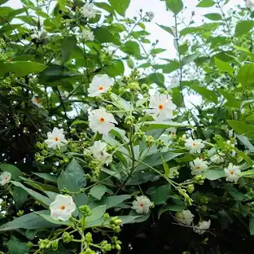
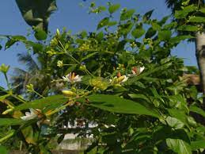
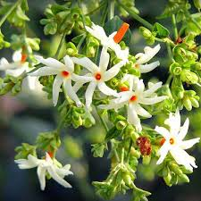
PARIJAT

Slide 2
Common name- Night-flowering jasmine
Scientific name- Nyctanthes arbor-tristis
Family- Oleaceae
Habit- Parijatak is one of the beautiful and mysterious plant whose flowers fall on the ground after blooming. The flowers bloom at night and drop down from the branches at the first rays of light.
Distribution-Parijat grows in the outer Himalayas and is found in tracts of Jammu & Kashmir, Nepal to the East of Assam, Bengal, and Tripura, extending through the Central region up to the Godavari in the South. Besides India, they are found in Thailand, Indonesia, Nepal, and Pakistan.

Slide 3
DESCRIPTION-
Height- The parijat is an ornamental shrub that can reach heights of up to 13 feet.
Flower- The flowers of it are beautiful with bright orange stem and orange centre connected to white flower. It also have very nice fragrance. Frequently throughout the summer and spring, night-blooming jasmine produces flowers.
Leaves- The leaves of it are in the lower portion has five tips like the fingers of a hand, while at the upper reaches it has seven.
Bark: The grey bark of parijat plant has alkaloids and glycosides.

Slide 4
USES :
Controlling excessive blood sugar levels is one of the main health benefits of parijat.
The leaves have been used for sciatica, arthritis, and fevers and as a laxative in Ayurvedic and homoeopathic treatment.
Due to the presence of ethanol in it, Parijat flowers and leaves function as immunostimulatory to strengthen immunity.
Relieves the pain of menstrual cramps.
Oil extracted from the plant is used for its healing properties.
An alcoholic extract called parijat tincture is also used medically.
Parijat also helps in preventing other scalp-related conditions, such as hair thinning and greying.
Parijat is also used to make various “face packs,” as it gives the face a garish shine and provides a guaranteed cure for several skin conditions.
The flower is used to make incense sticks because of its potent aroma also used as food colours and yellow dye for clothing.

