Slide 1
(DASI) Digital Arts for Social Impact
An NFT Project partnering with SVCAO Cambodia (Samrong Village Community Austria Organization)
© DASI, 2022. DESIGNED BY CHAM DESIGN INFO.

Slide 2
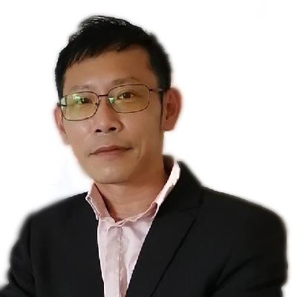
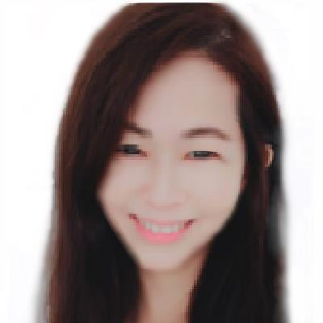
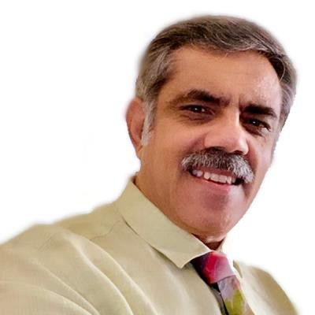
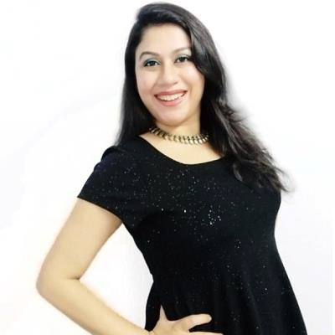
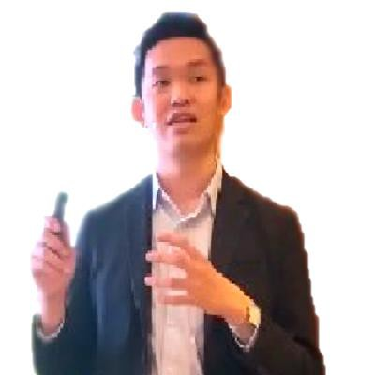
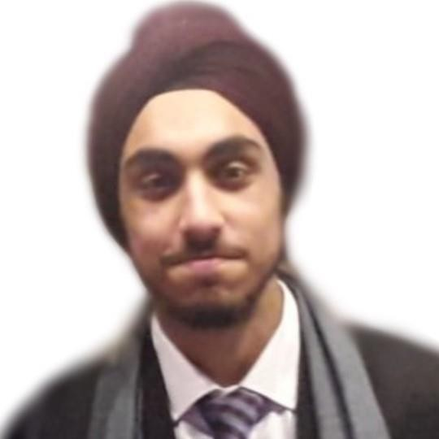
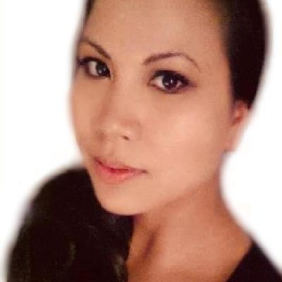
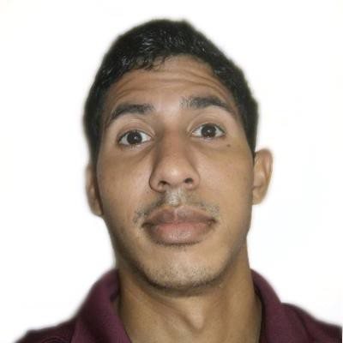
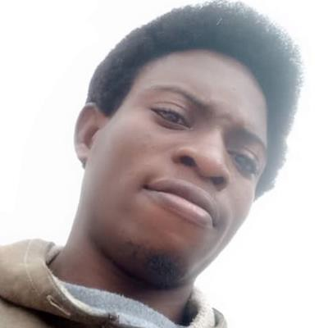
Meet the Team
Darren Tan
Chief Executive Officer
Celest Lee
Chief of Operations
Raj A. Kapoor
Chief Advisor
Sonny Mohanty
Chief Strategy Officer
Stanley Kan
Chief Marketing Officer
Arnavdeep Singh Arneja
Stack Developer
Cham Bou
(ChamDesignInfo) Digital Artist | Designer & Stack Developer
Jorge Timaure
(OnemanArtmy) Digital Artist | Designer & Stack Developer
Godson Omaje Efe
(Megmangart) Digital Artist

Slide 3
Meet the Team
Darren has over a decade of business development experience, with experience working from Nasdaq listed companies to Fortune 500 organisations.
His vision is to create more business opportunities to help advance social good for the less fortunate countries in the world, starting with DASI’s NFTs for social good.
Darren Tan
Chief Executive Officer

Slide 4
Meet the Team
Celest has over a decade of experience working as an entrepreneur and possess remarkable business insights & unique perspective to scale opportunities.
She believes in DASI’s mission, and she is committed to leverage on NFTs to help support the less privileged societies to achieve their social impact goals.
Celest Lee
Chief of Operations

Slide 5
Meet the Team
Raj is an Advisory Board Member at several blockchain companies and the Founder and Chairman of the India Blockchain Alliance, the largest Indian emerging technology tech think tank.
He is an accomplished Tech innovation professional, Drupal Web Application Developer, Blockchain & Cryptocurrency Educator, Certified Bitcoin Professional (CBP), Blockchain Solution Architect, Community organizer and friend of disruptive ideas, protem Chairman for Organization of Blockchain Technology Users (OBTU). He is also the Asia Lead, Technology & Innovation at Blockspace Technologies ltd. and Advisor of Techbuild Innovation Partners. His organisation, IBA is the official blockchain partner at the Africa Tech week 2020. Raj was also selected this year as a top cryptocurrency and blockchain influencer by Asian Market Cap. Raj is also mentoring 20+ blockchain startups across the globe.
Raj A. Kapoor
Chief Advisor

Slide 6
Meet the Team
Sonny has over a decade of extensive finance experience, having worked with fortune 500 & conglomerates, as well as presently running her own NFT platform.
She resonates with DASI’s mission to use NFTs for social impact goals, and she is committed to helping the team to lead the strategy frameworks to drive effective adoption.
Sonny Mohanty
Chief Strategy Officer

Slide 7
Meet the Team
Stanley is an experienced entrepreneur with over 10 years of experience In the realm of marketing, brand, lead generation and sales innovation. Presently he leads and advises multiple 7-figures digital agencies as well as angel invests in strategic business projects aligned to his marketing expertise. Stanley has grown businesses in markets across countries in the APAC region as well as assisted numerous clients in advising how marketing & technology can scale businesses. This also include several forays into the Crypto, Blockchain & NFT space. He is well regarded in the area of driving integrated marketing amongst brands, and works directly with Marketing Heads & CEOs ranging from SMEs to big conglomerates like Oki Data, Sephora, CUCKOO, Ferrari & Reckitt Benckiser (RB) etc.
Stanley Kan
Chief Marketing Officer

Slide 8
Meet the Team
Cham has over a decade of full stack & design experience, and she has worked extensively on purposeful global projects & business initiatives.
Her vision is to put her skillsets to help advance social good for the less fortunate countries in the world, starting with DASI’s NFT artwork for social good.
Cham Bou
(ChamDesignInfo) Digital Artist | Designer & Stack Developer

Slide 9
Meet the Team
Jorge has extensive working experience being a digital artist, as well as a stack developer, and he is experienced with the creation of unique digital artwork as well as NFTs.
His vision is to put his skillsets to help advance social good for the less fortunate countries in the world, starting with DASI’s NFT artwork for social good.
Jorge Timaure
(OnemanArtmy) Digital Artist | Designer & Stack Developer

Slide 10
Meet the Team
Godson has extensive working experience being a digital artist, and he is very familiar with the creation of unique digital artwork as well as NFTs.
His vision is to put her skillsets to help advance social good for the less fortunate countries in the world, starting with DASI’s NFT artwork for social good.
Godson Omaje Efe
(Megmangart) Digital Artist

Slide 11
Meet the Team
Arnavdeep is a budding Engineer, with deep knowledge about about Software Design and Data Structures.
As an explorer, and an avid observer about the growing Tech world, he is also highly interested in enabling the success of DASI’s platform, that has a meaningful social impact goal by way of implementation of the NFTs.
Arnavdeep Singh Arneja
Stack Developer

Slide 12
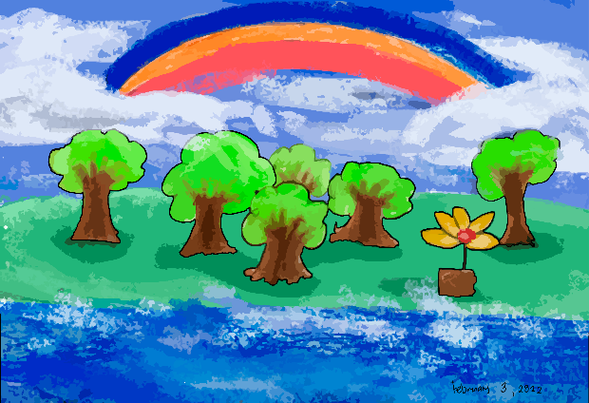
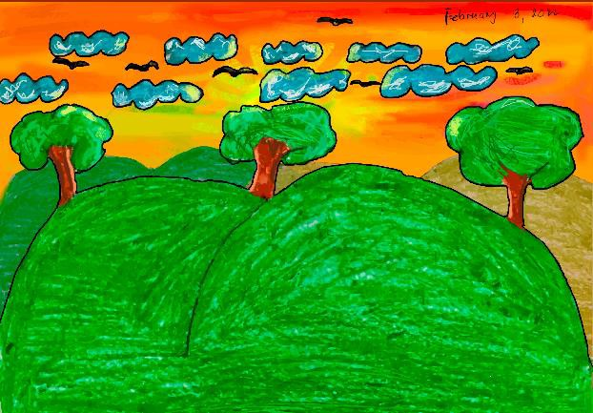
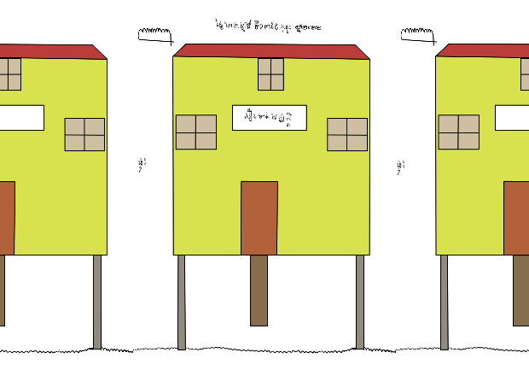
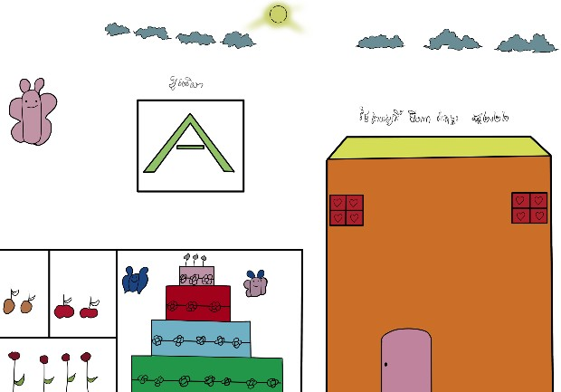
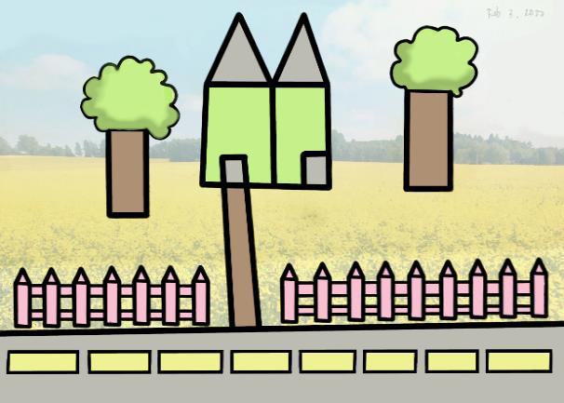
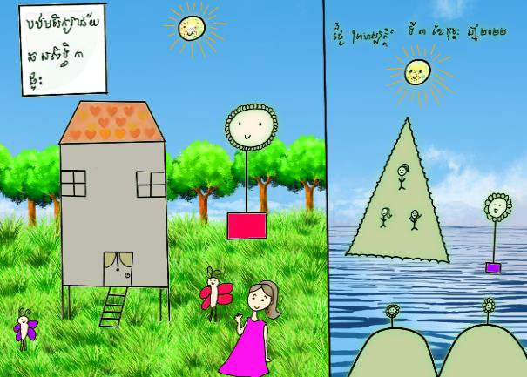
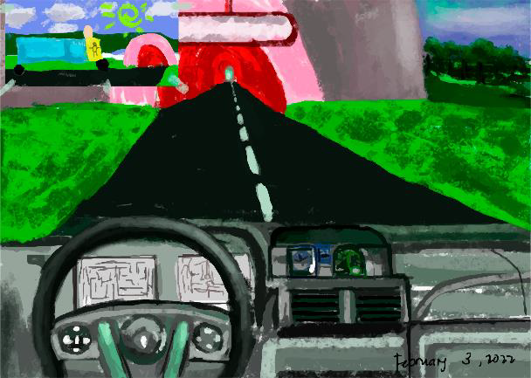
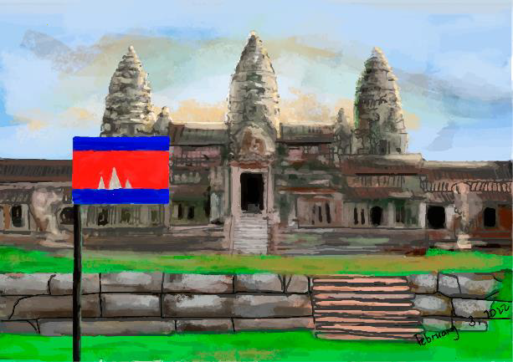
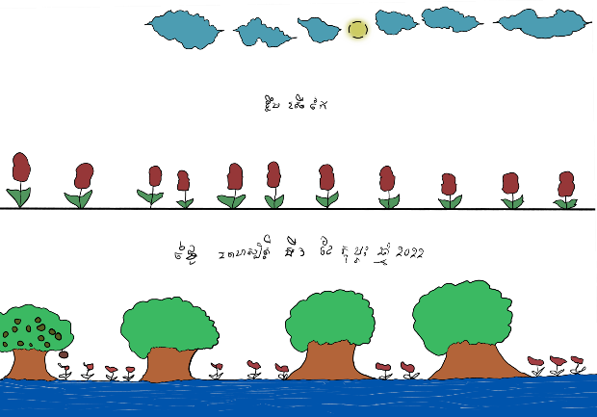
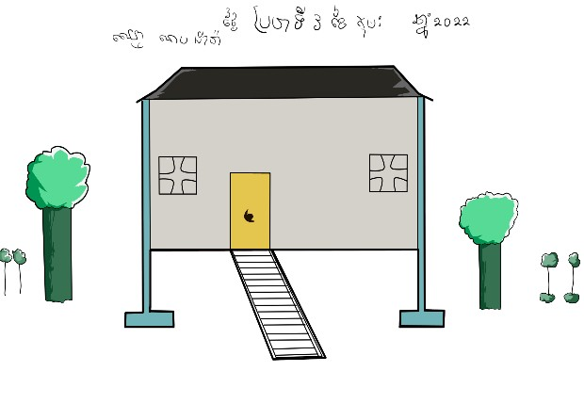


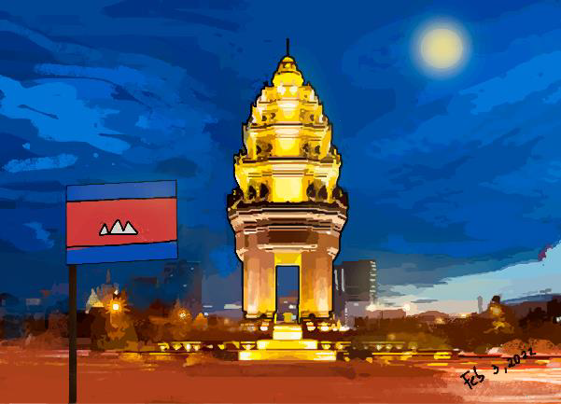
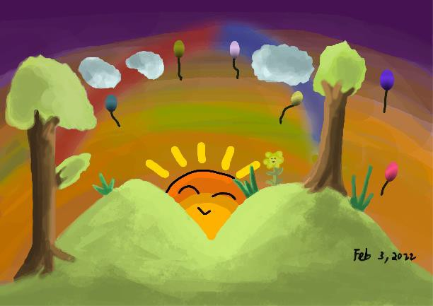


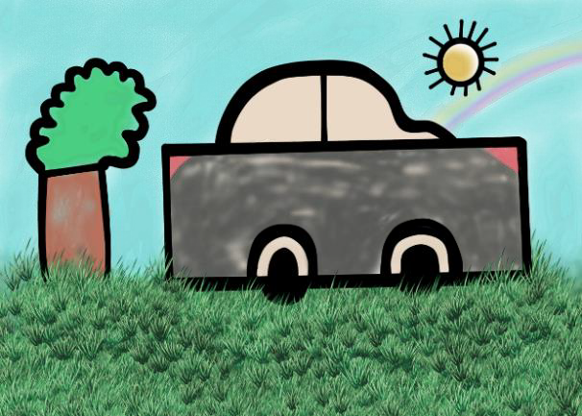
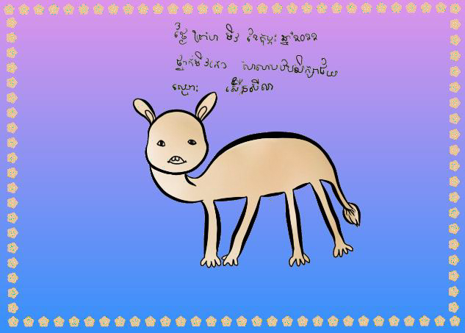
ARTWORKS
Jorge Timaure
@OnemanArtmy
Godson Omaje Efe
@Megmangart
Cham Bou
@ChamDesignInfo

