Slide 1
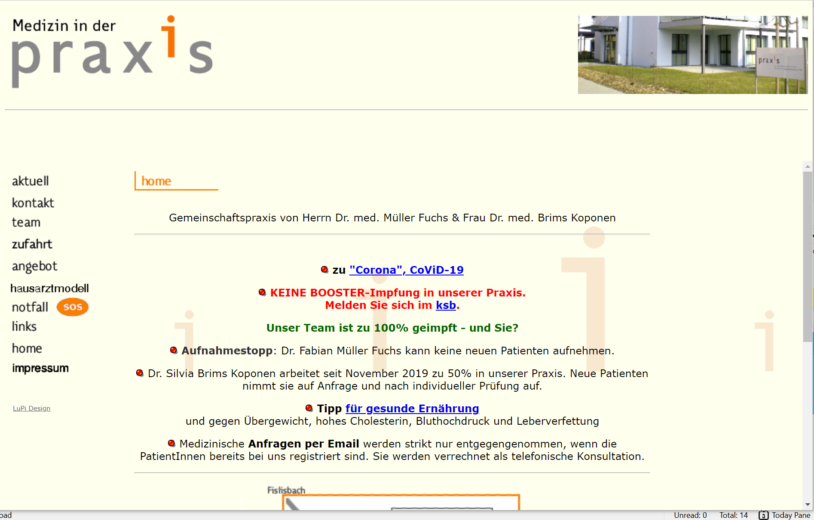

Slide 2
Info.zeile1
Info.zeile2

Slide 3


Slide 4
Info.zeile1
Info.zeile2

