Slide 1

"Sanwada" - Dialog act recognition for Sinhala
Members :
Ahsan M.S.A.
Bandara B.M.C.K.
Palihakkara S.
Sahabandu D.M.
Dr. Surangika Ranathunga
Notes:
This is the research that we are carrying out for our fyp under the supervision of Dr. Surangika Ranathunga.

Slide 2
Introduction
Notes:
Before moving on to our research work, let’s see what are the problems that we are going to solve.

Slide 3
Problem
Getting a computer to understand a spontaneous dialogue precisely is still an open issue
Some of the characteristics of modelling a spontaneous dialogue have already been identified
DA holds an important place
But not yet done for Sinhala
Notes:
To understand a spontaneous dialogue, it is important to model and automatically identify the structure of that Dialogue, because it will make it easier to get a better interpretation of that spontaneous dialogue. Among these clearly identified characteristics, “Dialogue Acts” hold an important place.

Slide 4
Dialogue Acts
“A Dialogue Act represents the meaning of an utterance at the level of illocutionary force”[1]
-Austin (1962)-
ඔයා දැන් පාසල් යනවද ?- yes-no question
ඔව් - yes answers
මම දැන් උසස්පෙළ ඉගෙන ගන්නෙ - statement
විභාගය කවදද ? – open question
ලබන මාසෙ. – Back-Channel/ Acknowledge
[1] Austin, J. L. 1962. How to do Things with Words. Clarendon Press, Oxford.
Notes:
Here I will explain what are dialogue acts in simple words. DA recognition means recognizing an utterance or a sentence as a specific DA type. Example, ඇයට කෑම පිසින්න පුලුවන්ද - question, ඇයට කෑම පිසින්න පුලුවන් - statement. So, given an utterance we need to automatically identify which DA type this is belong to. aim of this paper is to make use of the already existing research for DAR for English and explore how it can be used in the context of Sinhala.

Slide 5
SOLUTION
Make use of classical machine learning approaches to carry out Dialogue Act Recognition for text based Sinhala

Slide 6
OUR APPROACH
Corpus Building
Selection of Dialogue Act Tag Set
Feature Selection
Classifier Selection
Analysing Results
Performance Evaluation
Tool implementation
Notes:
The process of identifying the DAs for a particular language consists of fixed set of steps. That process is independent from the natural language used for the DAR. First and foremost step of the DAR procedure is to identify the set of DA tags that is relevant for the task. After that, relevant informative features have to be computed from the speech signal. That is a very critical step since the accuracy of identifying the DA heavily depend on the identified feature set. then DA models will be trained on these identified features set using a suitable classifier.

Slide 7
"Sanwada" Corpus
Notes:
Since no corpus was available for DAR for Sinhala, it was required to build a standard corpus from the scratch.

Slide 8
Our approachES to build “Sanawada” Corpus
Translate an Existing Standard English Corpus
Sinhala Chat Tool
Sinhala subtitles of English movies
- 1.8 Million untagged utterances
- 12000 Tagged utterances
Notes:
Finding translators was not possible so we abandoned the first option. slow because it was difficult to get volunteers and the volunteers were tend use many English and slang words. They have very large set of subtitles and they are almost in grammatically correct Sinhala. One issue with this method is that some movies have frequent scene changes. This is problematic for extracting consistent conversations. To overcome this we had to manually select the movies that contained long consistent scenes.

Slide 9
Identifying Tag Set
Notes:
To select a suitable tag set for Sanwada corpus, we adapted a generic tag set by referring to the DAMSL tag set and the study by Stolcke et al. To measure the necessity and sufficiency for tagging Sanwada corpus we performed several iterations of manual tagging for a separate set samples. In each iteration we added necessary new tags and removed unnecessary tags from the set. I’ll just highlight the some important decisions we took during this process.
Dialogue Act Markup in Several Layers (DAMSL) - [220 tags - Conversational dialogue type ]
The Switchboard SWBD-DAMSL [220 tag elements -> 42 tag classes-Conversational dialogue type ]
The Meeting Recorder [50 tags - Task Oriented dialogue type]
The VERBMOBIL [46 tags - Task Oriented dialogue type]
The Map-Task [12 tags - Task Oriented dialogue type]

Slide 10
Horizontal tag set analysis of popular research papers relevant to the context
Dialogue act modeling for automatic tagging and recognition of conversational speech [ Andreas Stockle-2000]
Classifying Dialogue Acts in One-on-One Live Chats[Su Nam Kim-2000]
Dialogue Act Classification Based on Intra-Utterance Features[Nick Webb-2000] - SWITCHBOARD Dialogue Acts(42 tag Classes)
Automatic Instant Messaging Dialog using statistical model and dialog acts- [Edward Ivonic-2008]
Text Based Dialogue Act Classification for Multiparty Meetings. [Matthias Shirberg - 2006]
Lexical and Discourse Analysis of Online Chat Dialog - [Eric N. Forsyth and Craig H. Martell- 2007 ]
Combinations of Classifiers for Automatic Recognition of Dialogue acts[ Pavel Kral-2005]
Lexical, Prosodic, and Syntactic Cues for Dialogue Acts [ Daniel Jurafsky – 1997]

Slide 11
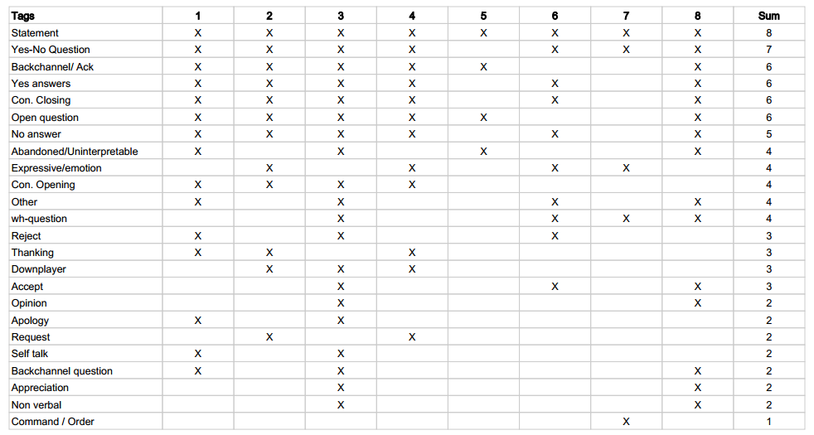
Horizontal Analysis

Slide 12
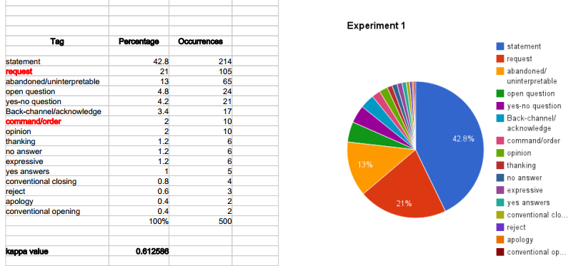
Experiment 1
Notes:
16 tags
In the initial tag set we had two separate tags for Request and Command/Order. For English there is a clear separation in utterances between these two tags. Most of the Requests include the word “Please” or a similar phrase in contrast to Command/Orders where it does not. In Sinhala, different forms of the same word is used to indicate whether it is a request or a command.

Slide 13
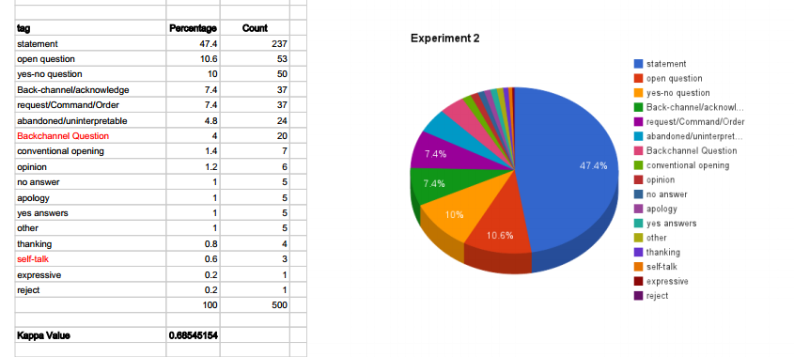
Experiment 2
Notes:
The rate of occurrence of Backchannel Questions are comparatively high in Sinhala. So we introduced it as a separate tag. Backchannel Questions are Back-Channels or Acknowledges in question form. For example in Sinhala conversations we often come across the phrase “එනහෙද?” (ehemada?) in response, roughly it means “is it?”. We are eliminated self talk due to its lower frequency.

Slide 14
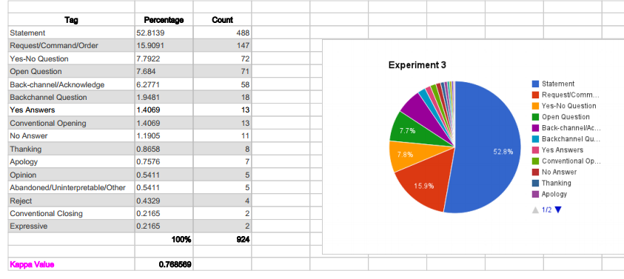
Experiment 3
Notes:
16 tags
Wh-Question,
we have selected four independent contributors. After tagging the complete corpus manually, we have calculated the inter-annotator
agreement among them using Fleiss kappa value and the agreement was 0.8161. To calculate the kappa value we implemented a tool based on the equations introduced by Fleiss.

Slide 15
Finalized Tag Set for “Sanwada” Corpus
Statement
Request/Command/Order
Yes-No Question
Open Question
Back-channel/Acknowledge
Backchannel Question
Yes Answers
Conventional Opening
No Answer
Thanking
Apology
Opinion
Abandoned/Uninterpretable/Other
Reject
Conventional Closing
Expressive
Notes:
This is the finalized tag set. There are 16 tags in the finalized tag set.

Slide 16
Feature Selection

Slide 17
FeatureS
Features are the input given to the classifier as a vector for each utterance.
Can be extracted from the utterances
Heavily depends on the language
Notes:
heavily depends on depends on the language unlike DA tag set.

Slide 18
Selected features for Sinhala
Feature | Status
Number of words in the segment | Selected
Bigrams/Trigrams of words | Selected
Previous Dialogue Act | Selected
Verb of the Sentence | Selected
Punctuation marks | Selected
Frequent words for each tag | Selected
First two words | Not-selected
Last two words | Not-selected
First verb type/ Second verb type | Not-selected
Words in last 10 Dialogue Acts | Not-selected
N-grams of previous Dialogue Acts | Not-selected
Bag-of–words | Not-selected
Unigrams | Not-selected
Notes:
since we are using the Bigrams as a feature, feature first two words and last two words were omitted.
First verb type and Second verb type is omitted due to the unavailability of Sinhala PoS tagger.
Taking previous Dialogue Acts as features can introduce a cumulative error
Unigrams are ineffective for long utterance, although their effectiveness has been shown for chat messages
Bag of words has used as the base test.
WEKA’s StringToWordVector option with the word count of 100.

Slide 19
Exclusive features for Sinhala
Last letter of the last word of the utterance
Last word of an utterance
The presence of specific Sinhala cue phrases
Notes:
Unlike in English, the last letter of the utterance makes a big impact on the dialogue act of the utterance.
For instance most of the Yes/No questions ends with the letter ‘ද’(da),
most of Request/Command/Order ends with one of the letters ‘න්’(n), ‘න’(na), or ‘ නු’(nu),
most of Open questions end with ‘නේ’(ne).

Slide 20
Individual Feature Performance
Rank | Feature | InfoGain
1 | Punctuation marks | 0.71
2 | Last word of the utterance | 0.60
3 | Frequent words for each tag | 0.42
4 | Trigrams/Bigrams | 0.31
5 | Last letter of the last word of the sentence | 0.30
6 | Verb of the Sentence | 0.24
7 | Number of words in the segment | 0.18
8 | Cue Phrases | 0.17
Notes:
The InfoGain value evaluates the worth of a feature by measuring the information gain resulted only by that particular feature. For example, a feature with an InfoGain value of 1 means that all of the information available in that feature contributes to classification. You can see sinhala specific feature have a significant contribution.

Slide 21
Problems
No fully completed PoS tagger tool for Sinhala
Improperly used punctuation marks
Various Grammar patterns of Sinhala
**
** Mr. Prasad jayaweera presented his work on Sinhala POS tagger at SLTSA , January 2, 2015
Notes:
as lack of resources for PoS tagging for Sinhala. Therefore we used a set of commonly used Sinhala verbs to check the presence of those verbs in a given utterance as feature.

Slide 22
Best Combination
Punctuation marks
Last word of the utterance
Trigrams/Bigrams
Last letter of the last word of the sentence
Frequent words for each tag
Cue Phrases

Slide 23
Classifier Selection
Notes:
So far we discuss about corpus , tag selection and feature selection. Let's discuss the classifier selection now. DA classification means assigning DA types to individual utterances.

Slide 24
Classifiers We used
Statistical & Probabilistic
- Naive Bayes, Logistic, Simple Logistic
Decision tree
- J48, REPTree, LMT, Random Forest, Hoeffding Tree,
Decisionstump
Support Vector Machines
- Sequential minimal optimization
Rule Based
- Decision Tables
Notes:
Logistic regression uses regression analysis for the classification process. Simple logistic model uses linear regression.
J48 classifier is a predictive machine learning model that decides the target value of a testing data on various attribute values of the built decision tree .Here, the attribute with the highest normalized information gain is chosen to make the classification decision. REPTree uses information gain and prunes it using reduced-error pruning. LMT(Logistic Model Trees) is a standard decision tree which combines logistic regression functions at the leaves.
Decision tables are simple supervised classifiers which group rules that have similar conditions and actions, and help to spot problems such as overlaps and gaps among the rules.
SMO is an iterative algorithm widely used to train support vector machines

Slide 25
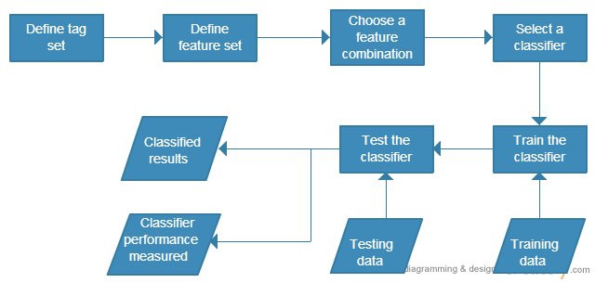
Classification process
Notes:
initially, we tested the classification accuracy by just using the features used for DAR in English. From the best performing features such as Punctuation marks, Trigrams/Bigrams and Frequent words for each tag are the three features used in the context. The other three features are specific for Sinhala. Using those three features used for English we were able to gain an accuracy of 71.14% in classification using the J48 classifier. Then we have used all six features and classified using the same classifier and we were able to improve the accuracy to 78.68%.

Slide 26
Best performing feature set for each classifier
Classifier | Feature Set | F-measure | Recall | Precision | Accuracy
J48 | segmentLength, punctuation, verb | 0.755 | 0.789 | 0.773 | 78.92%
RandomForest | segmentLength, lastWord, punctuation, lastletter, cuephrases, verb, ngrams | 0.776 | 0.792 | 0.78 | 79.23%
PART | segmentLength, lastWord, punctuation, cuephrases, verb, ngrams | 0.756 | 0.786 | 0.757 | 78.61%
LMT | segmentLength, punctuation, cuephrases, verb, ngrams | 0.762 | 0.794 | 0.78 | 79.44%
REPTree | segmentLength, punctuation, verb, ngrams | 0.731 | 0.782 | 0.761 | 78.19%
SimpleLogistic | segmentLength, punctuation, lastletter, cuephrases, verb, ngrams | 0.765 | 0.794 | 0.772 | 79.44%

Slide 27
Classifier performance
Classifier | CPU Usage (%) | Memory Consumption (%) | Elapsed Time (S)
J48 | 44.83 | 3.55 | 12
RandomForest | 39 | 5.8 | 6
PART | 28.47 | 7.62 | 119
LMT | 26.21 | 11.67 | 651
DecisionTable | 26.25 | 16.13 | 70
SimpleLogistic | 26.05 | 17.15 | 105
SMO | 26 | 17.5 | 4
DecisionStump | 26 | 13.5 | 2
NaiveBayes | 26 | 13.5 | 4
HoeffdingTree | 26 | 13.51 | 14
REPTree | 26 | 13.6 | 4

Slide 28
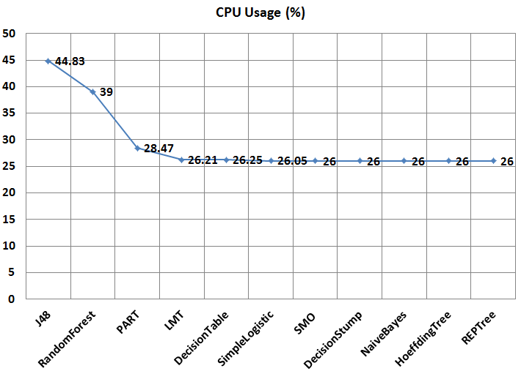

Slide 29
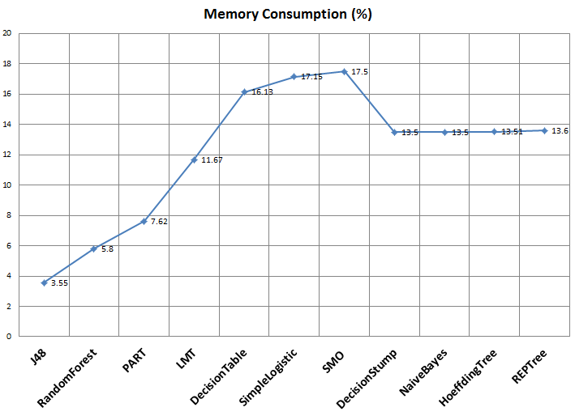
Notes:
Statistical & Probabilistic and support vector machines more memory

Slide 30
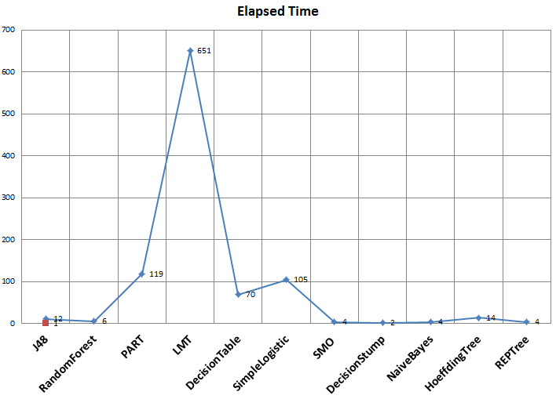
Notes:
LMT is best accuracy but time consume is high
RandomForest is Good accuracy and low classification time

Slide 31
71.14 % accuracy for features used in English on LMT
79.44 % accuracy with Sinhala specific features on LMT
The classifier tests revealed that most of the classifiers perform well with the Sinhala corpus without any classifier parameter tuning
Simple Logistic and LMT classifiers give the highest recall value
They have identified more correctly tagged utterances compared to others.
Notes:
Using features used for English we were able to gain an accuracy of 71.14% in classification using the RandomForest
classifier. Then we have used all six features and classified using the same classifier and we were able to improve the accuracy to 78.68%. As the next step we have used the same feature set and classified the same data set using different classifiers to model the performance of different classifiers on Sinhala.

Slide 32
Tools
Desktop Application
Android Application
Web Application
RESTful API

Slide 33
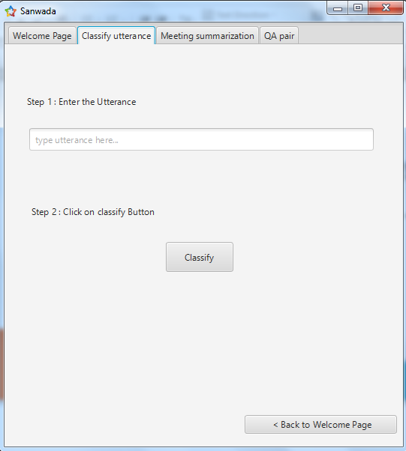
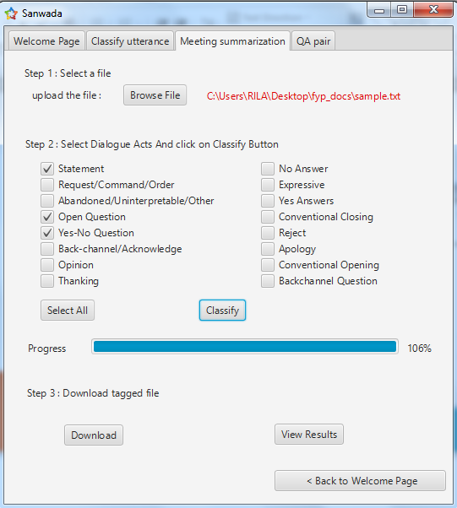
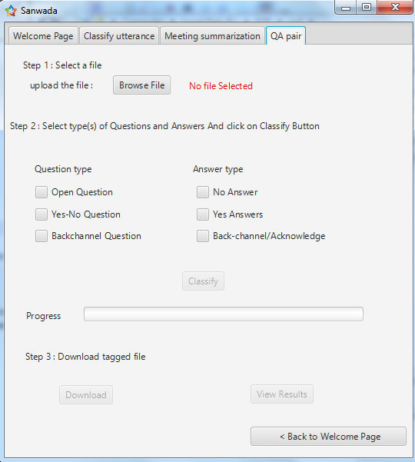
Desktop Application

Slide 34
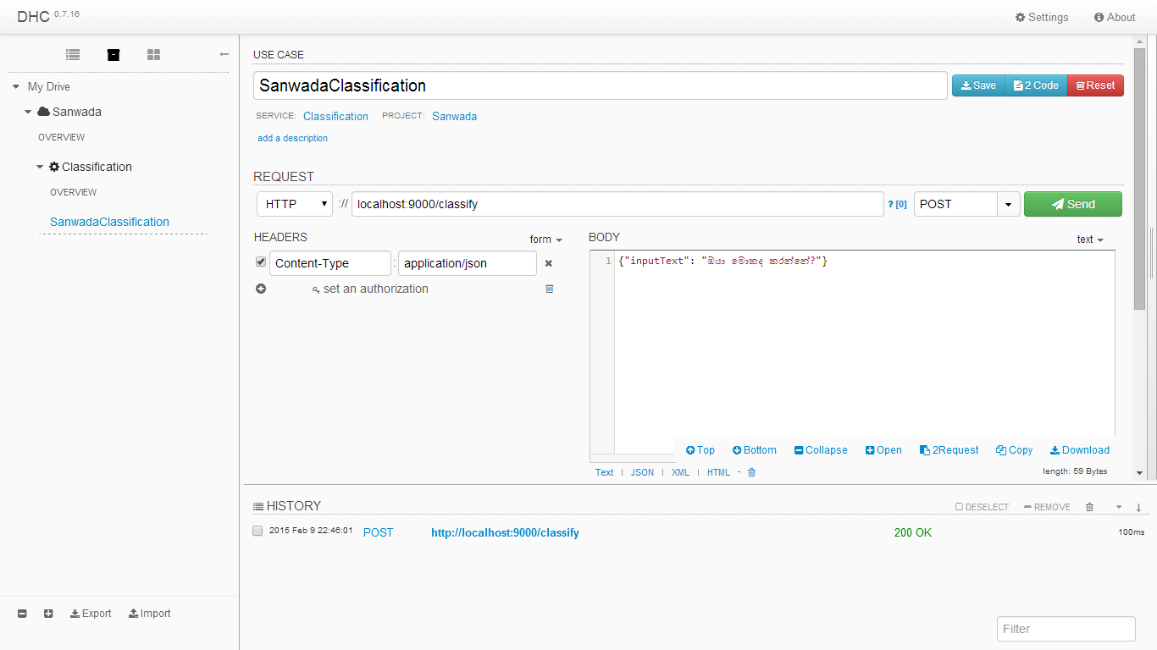
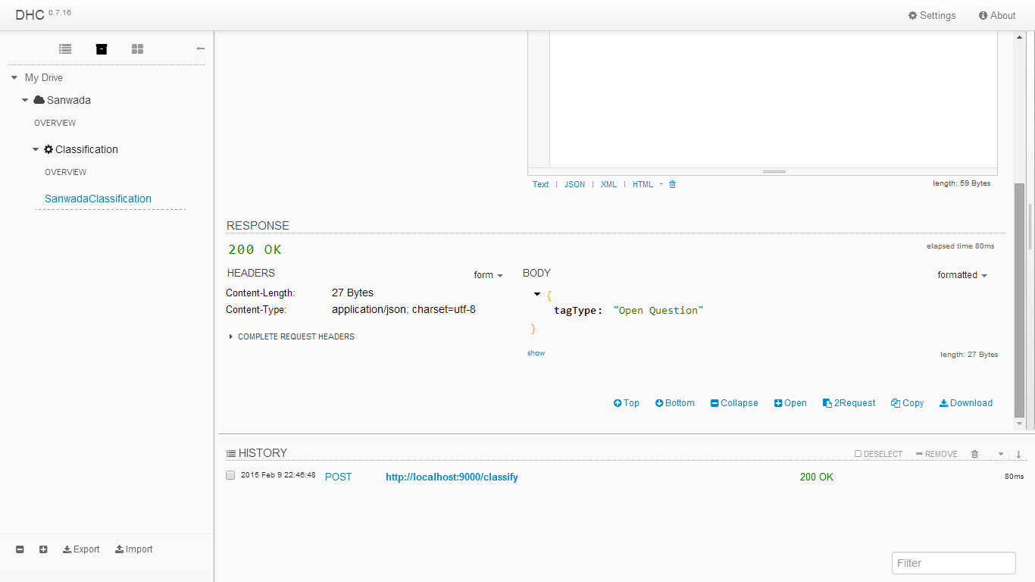
RESTful API

Slide 35
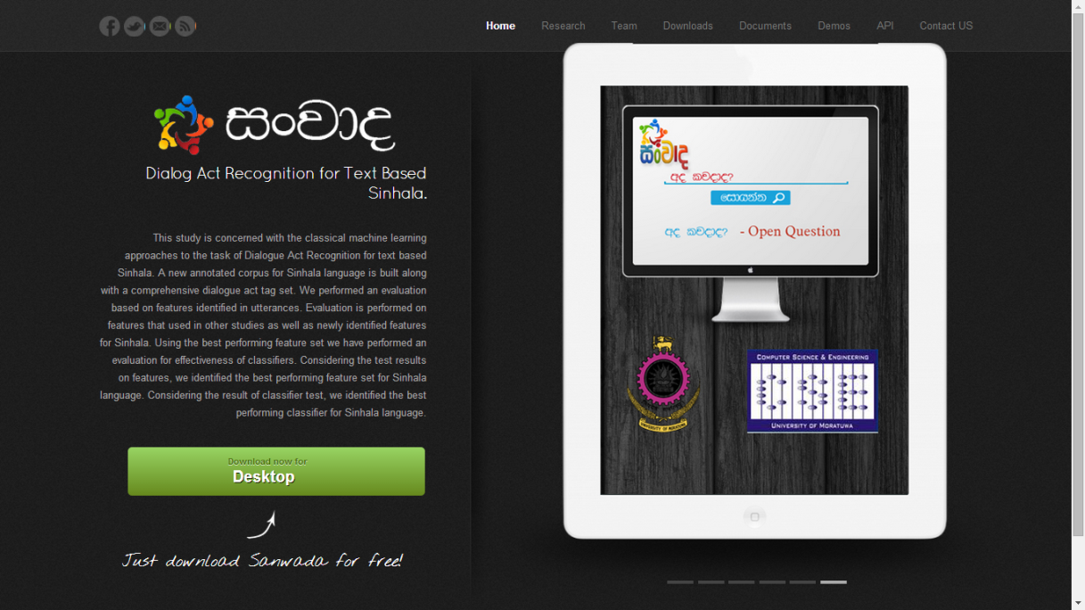
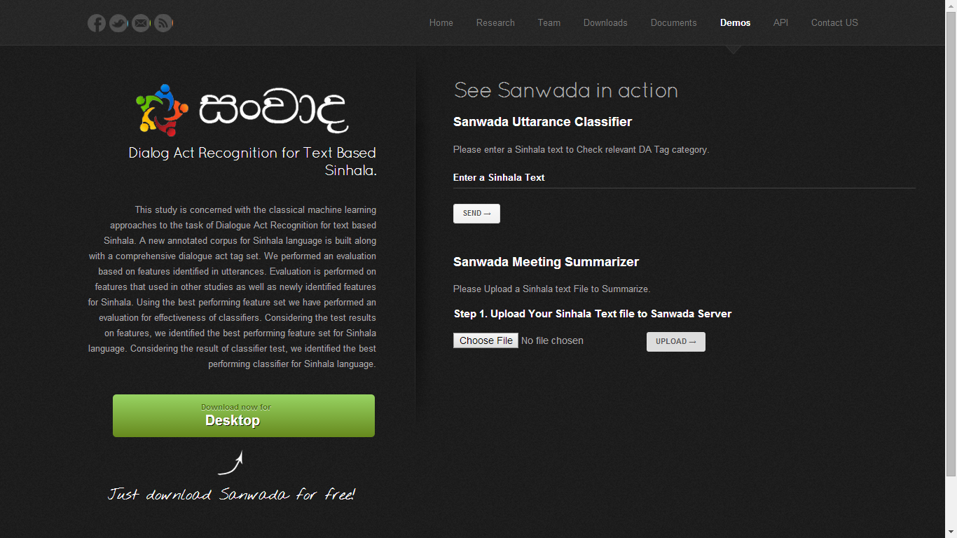
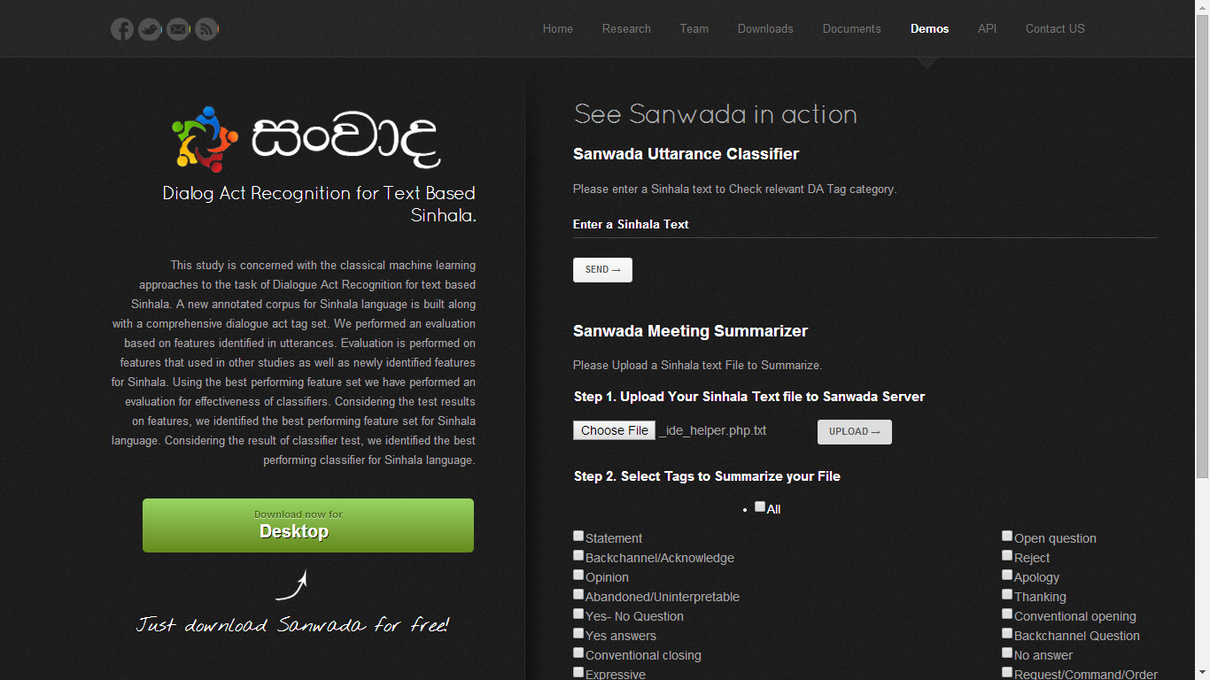
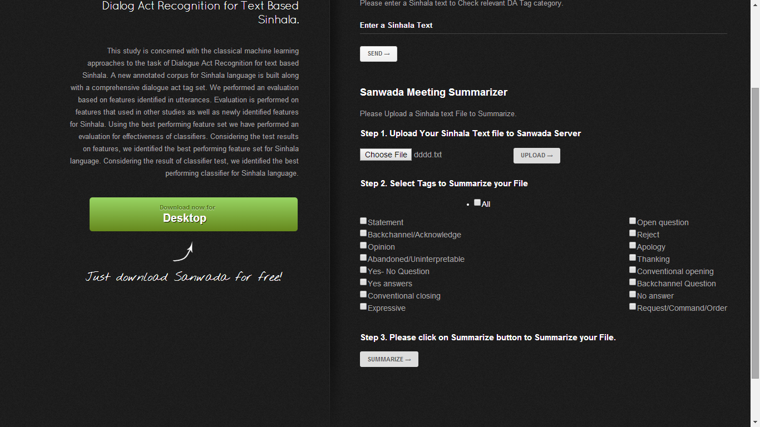
Web application

Slide 36
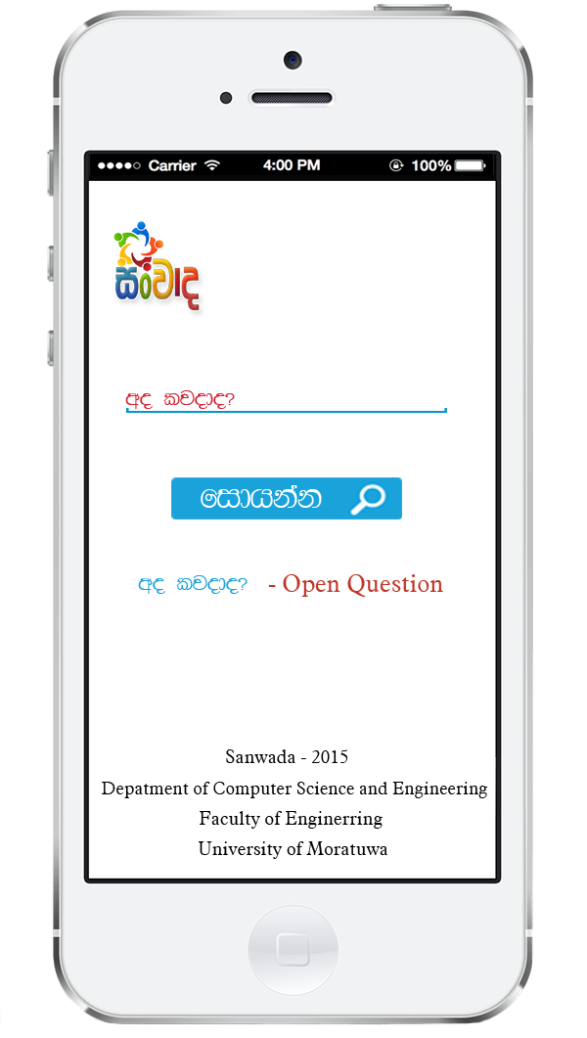
Android Application

Slide 37
Future work
Taking Prosodic information into the context
Classifier optimization
Extended meeting summarization
Intelligent voice assistance for Sinhala

Slide 38
publications
Symposium on Language Technology for South Asia 2015 in Sri Lanka - Presented
4th International Conference on Artificial Intelligence and Applications in Engineering and Technology, IEEE ICAIET2014 in Malaysia - Accepted
2015 Conference of the North American Chapter of the Association for Computational Linguistics – Human Language Technologies (NAACL HLT 2015) – Rejected
Notes:
2015 Conference of the North American Chapter of the Association for Computational Linguistics – Human Language Technologies (NAACL HLT 2015)
-Acceptance rate 30%
-A grade conference
ACL Conference Beigine ,SIGDIAL Hnagary Prag.
Finally, we conclude by noting that with the identification of specific language-specific features, dialog act recognition can be carried out successfully even for an under-resourced language such as Sinhala.

Slide 39
Thank You!

