Slide 1

SafeLAN: Adaptive Secure File System for LAN environment
RP-25-26J-067

Slide 2

Research Motivation
Research Problem
Many advanced security features today are internet or cloud-dependent. As a result, LAN only environments are left with much weaker protections.
The motivation of this research is to develop a secure file system for LAN environment with attributes that doesn’t require the usage of the Internet.

Slide 3

Why our solution matters ?
Protects files from unauthorized access.
Smooth operation without the use of Internet.
Multiple security features in one system.
This Photo by Unknown Author is licensed under CC BY-SA

Slide 4

Solution Overview
Summary : Secure desktop-based file System for LAN environments with multiple security features.
Key Features delivered :
Hand gesture based 2FA
Face Recognition Authentication (Continuous)
Mouse Movement Behavioral Recognition (Continuos)6
Contextual and keystroke dynamics based authentication.
Blockchain-Based Security Logging

Slide 5
Solution Overview
Non – functional focus :
Scalability - Can add/reduce no of clients.
Usability - Simple, user - friendly interfaces.
Security - Securely storing sensitive data.
Accuracy - Biometrics work with great accuracy.
Current Completion status : 90%
The Face Recognition and Mouse movement component weren’t compatible when creating the LAN.

Slide 6
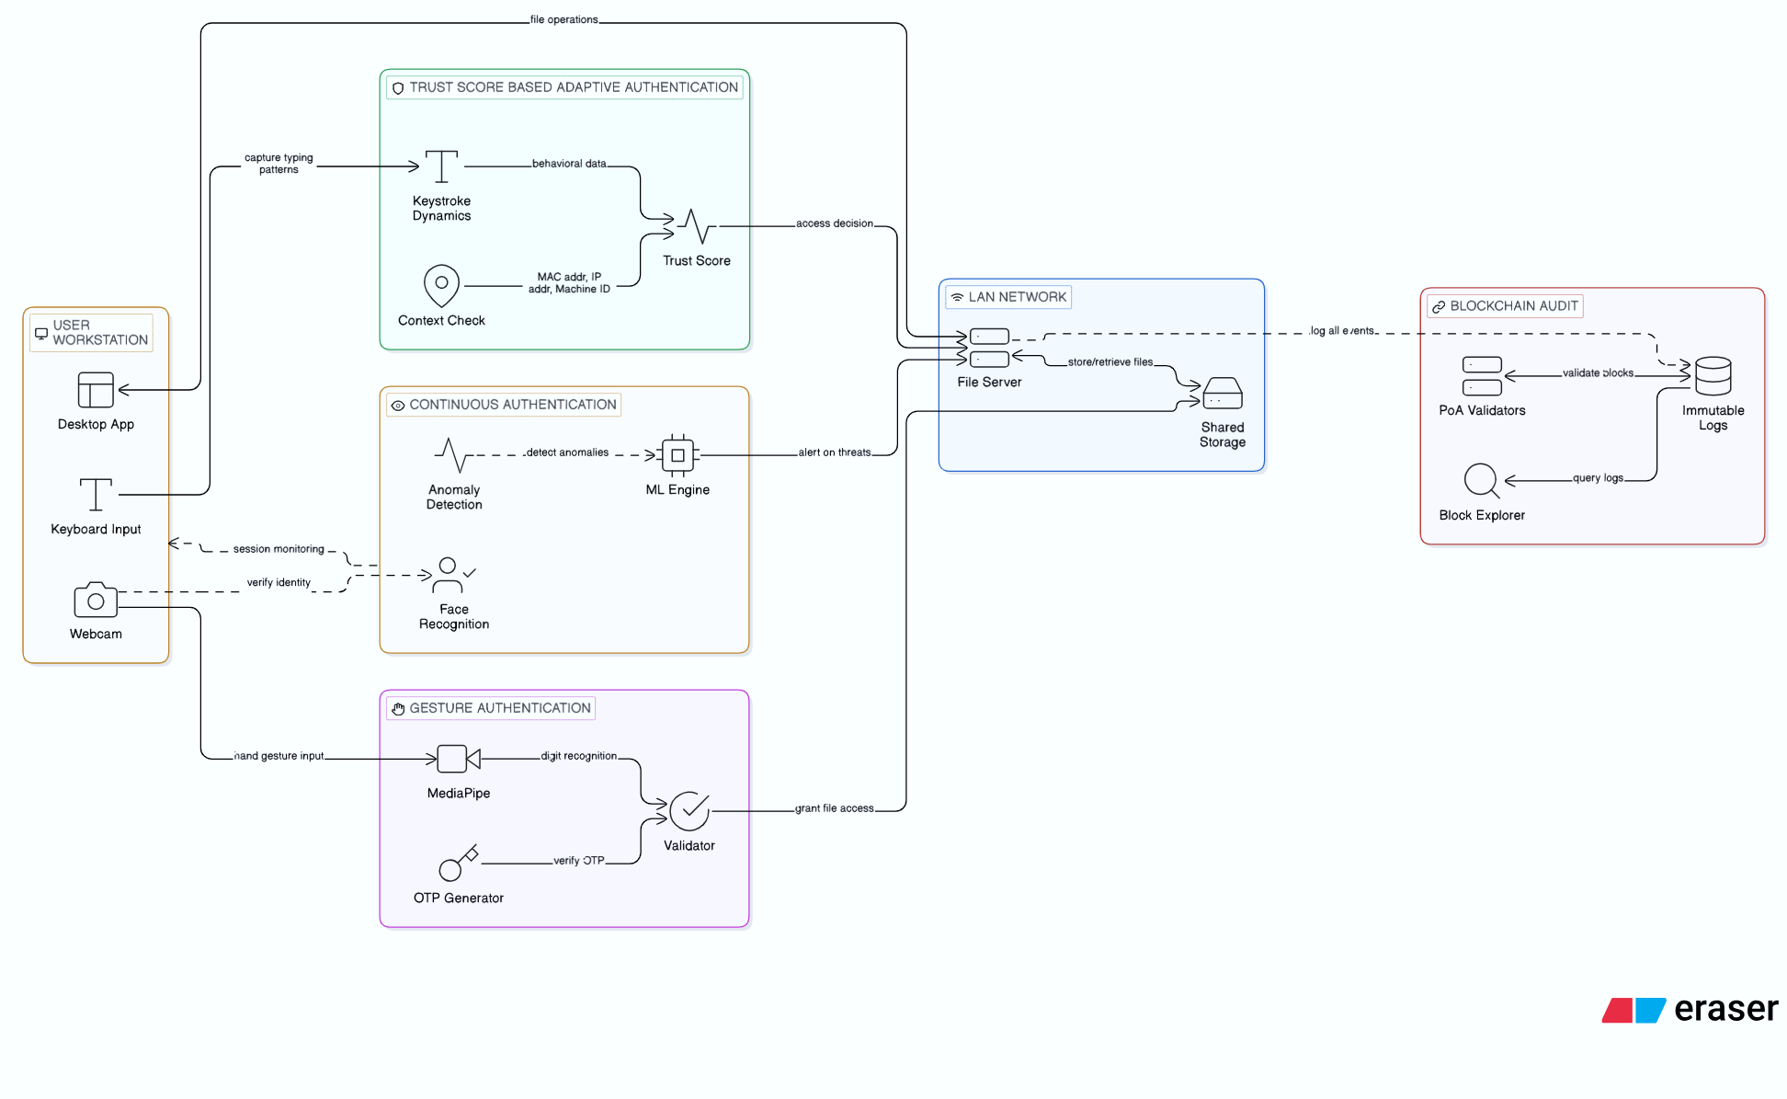
System Architecture & Integration

Slide 7

Commercialization
Target users / market : Small to medium sized organizations.
Value proposition : Provides high-level security without expensive enterprise security infrastructure.

Slide 8

Commercialization
Cost and feasibility :
Primarily software-based.
Uses commonly available hardware
Operationally feasible – Little to no training required.
Adoption plan :
Begin with pilot deployment on one department.
User training and feedback.
Gradual organization-wide deployment.
Provide technical support if required and feasible.

Slide 9
Our Demonstration Plan ......

Slide 10


