Slide 1
JAVA 8 : WHAT’S NEW?
By Shazin Sadakath

Slide 2
Little bit About Me
Java and Open Source Enthusiast.
Little over Half a Decade of Industry Experience in Java.
Passionate follower of InfoQ Presentations.

Slide 3
History of Java
Java version 1.0 was released on 13th January 1993.
Latest Java version before Java 8 was Java SE 7 Update 80 which was released on 14th March 2015.
Java 8 was released on 18th March 2015.
Java is said to have an asymmetric architecture to support multiple languages and platforms.

Slide 4
Java Language Characteristics
Object Oriented
Supports primitives
Platform independent
Language is strongly typed
Supports multi threading

Slide 5
Java 8 Improvements
Java 8 has done significant improvements in both the Java language and JVM.
First significant Java language syntax change since Generics

Slide 6
Java 8 Improvements
JSR 223, JEP 174: Project Nashorn, a JavaScript runtime which allows developers to embed JavaScript code within applications
JSR 308, JEP 104: Annotation on Java Types
Unsigned Integer Arithmetic
JSR 310, JEP 150: Date and Time API
JEP 153: Launch JavaFX applications
JEP 122: Remove the permanent generation (MetaSpace)
Default and Static Methods in Interfaces
JSR 335, JEP 126: Language-level support for lambda expressions/closures
Streams API

Slide 7
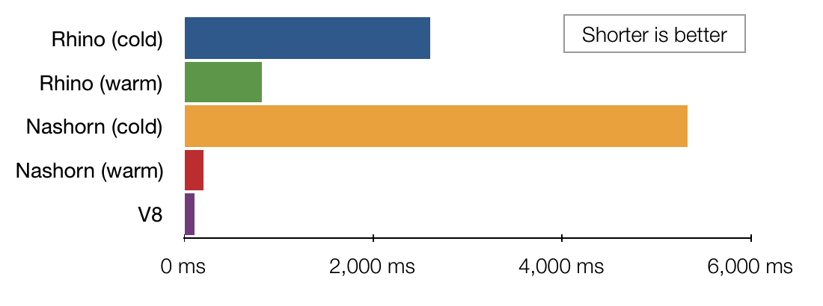
Nashorn
JVM is Designed to support multiple languages from version 1.0
Fast JavaScript Engine for JVM
Can embed in Java Application or run directly in JVM

Slide 8
Annotations on Java Types
Annotations can be used in
Receivers
Type Casting
Inheritance
Creation of new objects
Generics and Arrays

Slide 9
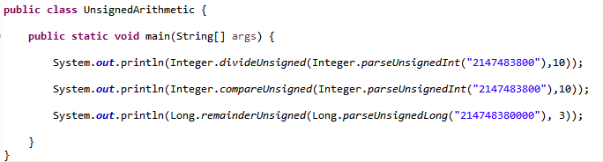
Unsigned Integer Arithmetic
Now can do arithmetic operations on values int 0 – 2³² and long 0 – 2⁶⁴ respectively.

Slide 10
JEP 153: Launch JavaFX applications
javafx.* packages is now part of the Java 8 Runtime
Can create and run JavaFX UI Applications just like Java Swing

Slide 11
JEP 122: Removed the permanent generation (MetaSpace)
No more java.lang.OutOfMemoryError: PermGen (Hopefully)
PermSize and MaxPermSize flags will be ignored with a warning.
Class Meta Data will be stored in MetaSpace and MaxMetaspaceSize flag can be used to control the maximum size of this.

Slide 12
Default and Static Methods in Interfaces
Interfaces can now have method bodies.
These method bodies can be in the form of Default or Static methods.
If an interface has a default method, then it is not a must to implement that method in the implementing class.
Static methods will not be inherited to implementing classes.

Slide 13
JSR 335 : Language-level support for lambda expressions/closures
Brings back functional programming.
Functions are also treated as first class citizens.
Can pass around functions just like primitives and objects.
Eliminates the need for boiler plate codes.
Reduces the deployment size.

Slide 14
JSR 335 : Language-level support for lambda expressions/closures
Contracts of Function/Method
Function/Methods should not modify shared mutable states.
Function/Methods should not modify input parameters.
Function/Methods should not do harm to the world.
Function/Methods should not change the execution flow (Exceptions must be returned as data not thrown).

Slide 15
Streams API
Not Something New, Frameworks such as Google Guava Library supported this even in Java 7.
An API to perform common functionalities in Java in a Declarative manner as opposed to the Imperative.
Improves performance by using Immutability and Lazy processing.
Simplifies Java code understanding and readability.
Encapsulates implementation logic and eases parallelization.

Slide 16
Date Time API

Slide 17
Conclusion
According to Dr. Venkat Subramaniam, "The biggest change in Java 8 are in the minds of the programmers".
According to Dr. Venkat Subramaniam, “Familiar code is not readable code”
According to Maurice Naftalin with the arrival of multi-core systems we have to learn to develop using functions.
The time you invest to learn features of Java 8 are totally worth it.

Slide 18
Thanks!
Q&A

Slide 19
References
Java History - https://en.wikipedia.org/wiki/Java_version_history
Javafx - https://docs.oracle.com/javafx/2/get_started/jfxpub-get_started.htm
Nashorn – http://www.oracle.com/technetwork/articles/java/jf14-nashorn-2126515.html , http://ariya.ofilabs.com/2014/03/nashorn-the-new-rhino-on-the-block.html

Slide 20
References
Default/Static Methods - https://docs.oracle.com/javase/tutorial/java/IandI/defaultmethods.html
Streams API – http://www.oracle.com/technetwork/articles/java/ma14-java-se-8-streams-2177646.html
Java 8 Language Capabilities. What's in It for You? - http://www.infoq.com/presentations/java8-streams-lambda
Java Lambdas, Java 8 Streams, Parallelism - http://www.infoq.com/interviews/naftalin-lambda-streams
Functional Principles for Object-Oriented Developers - http://www.infoq.com/presentations/fp-principles-oop

