Slide 1

Producing Favorable Word
Submitted by: Prashant Kumar

Slide 2
Agenda
Problem Statement
Data Description
Feature Engineering
Results

Slide 3
Producing Favorable word
Business wants to attract more number of clients into their new sector: restaurant through ads. Ads should contain top favorable word from Yelp Reviews.
First, identify the category of restaurant to approach and then produce a small set of ‘favorable’ word to use in ad campaign.
PROBLEM STATEMENT
HIGH LEVEL SOLUTION

Slide 4
Data from 2 different json files was used for analysis
File : business.json
Shape : 192609*14
File : review.json Shape : 6685900*9

Slide 5
Feature Engineering
Data Preprocessing
Drop unwanted column and rows with empty categories from business dataset
Get count of different categories and Identify which category to focus on.
Filtered the rows which has Pizza or Italian in their respective rows merge it with Review dataset
Categorize good and bad reviews based on star value
Create WordCloud for top 50 words for both the category
Identify common words between good and bad WordCloud and remove it from good WordCloud to get the favorable text

Slide 6
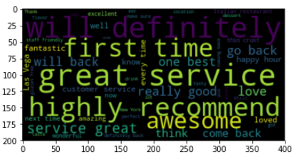
Final List of Favorable Word

