Slide 1
Georgia’s Healing House
Sumeet Babu, Ana Coy, Ashley Huynh, Michael Liao, Jason Valenzuela

Slide 2
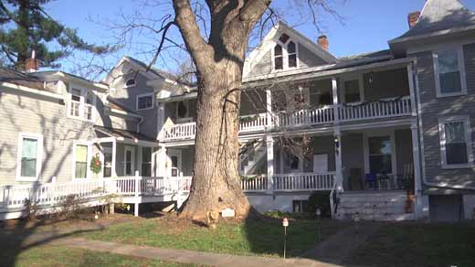
Georgia’s Healing House Background
Nonprofit based in Charlottesville
Structured living for women recovering from substance abuse
Philosophy: Supportive living environment and family structure will help women maintain sobriety and build a new life after incarceration or treatment
Notes:
Ashley

Slide 3
Project Description
Create a system to aggregate resident information and data
Generate resident statistics
Manage residents and staff
Simplify the application process
Notes:
Ashley

Slide 4

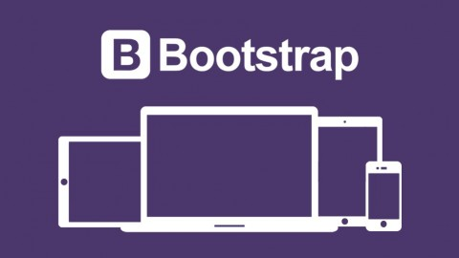

Technologies Used
Django
Form Tools
Bootstrap
Amazon Web Services
Notes:
Ana

Slide 5

Tools Used
Git/Github
TravisCI
Notes:
Ana

Slide 6


Positives
Easy Deployment
Django Knowledge
Group Synergy
Notes:
Ana

Slide 7


Challenges
Customer Communication Issues
Large number of fields
Lost a group member
Notes:
Jason

Slide 8

Significant Requirement Changes
Financial Tracking
Volunteers
Direction of the project
Notes:
Jason

Slide 9
Residency Workflow
Application
Interview
Residency
Termination
Notes:
Sumeet & Michael

Slide 10
Demo
Notes:
Sumeet & Michael

