Slide 1
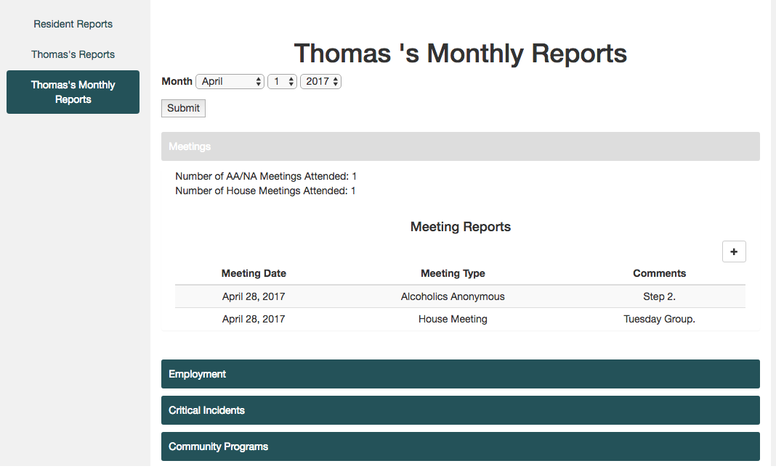
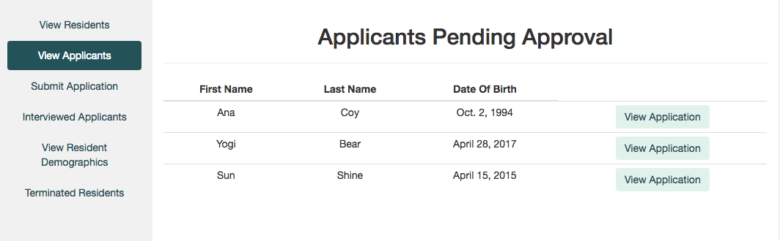

Georgia’s Healing House
Resident interview and application management system
Data warehouse for past and present residents
Report and meeting notation system
Filterable monthly reports per resident

