Slide 1
CA683 Data Analytics and Data Mining Project
Manoj Kumar Palanisamy (16212065)
Rohit Thomas (16210779)
Anjana Aggarwal (16210381)
Champa Ramaiah (16211712)

Slide 2
Step 1: Business Understanding
Predicting accident hotspots.
Predicting accident severity types (Fatal/Serious/Slight).
Analysing the various factors through visualizations like age/ Vehicle Type/Vehicle manoeuvre/Gender/Month/Weekday contributing to most of accidents in Great Britain.

Slide 3
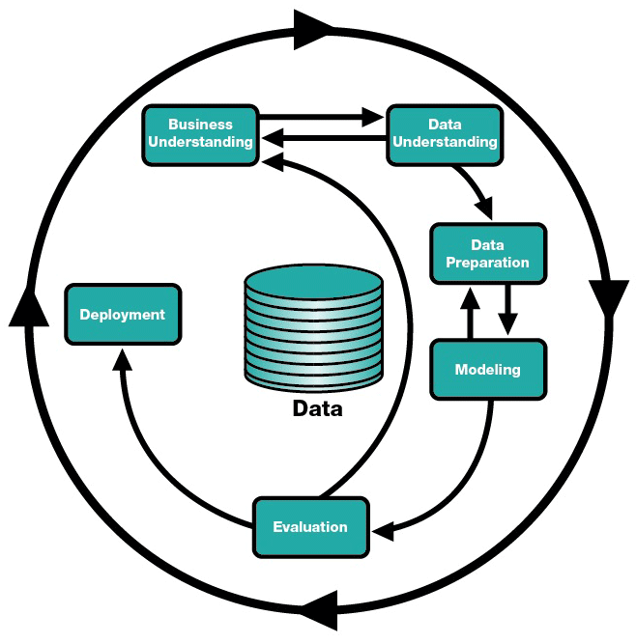
CRISP–DM Model

Slide 4
Great Britain Road Accident Data
The dataset contains information about road accidents in Great Britain over the years 2005-2015.
It consists of has 70 features/columns and around approximately 1.6 million records.
Dataset Link:
https://data.gov.uk/dataset/road-accidents-safety-data

Slide 5
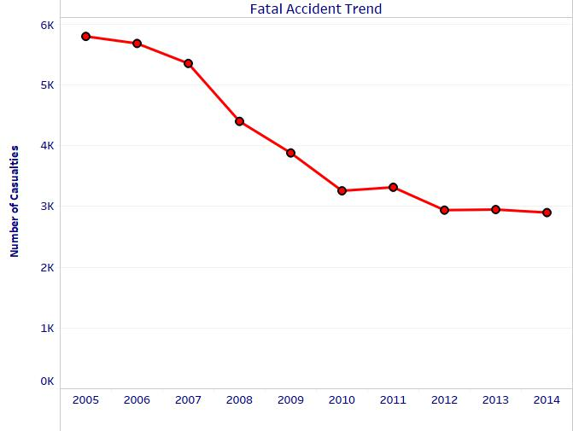
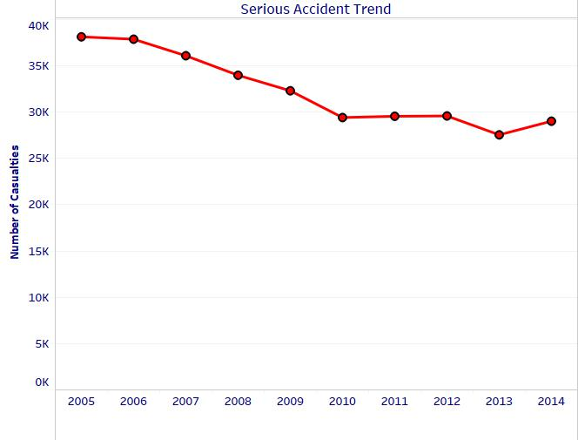
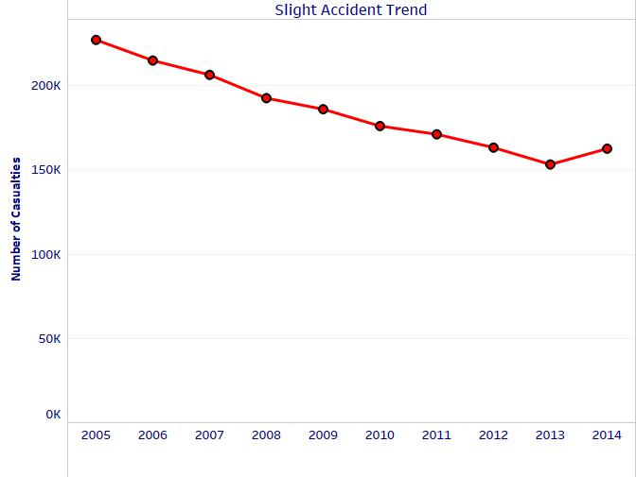
Step 2: Data Understanding

Slide 6
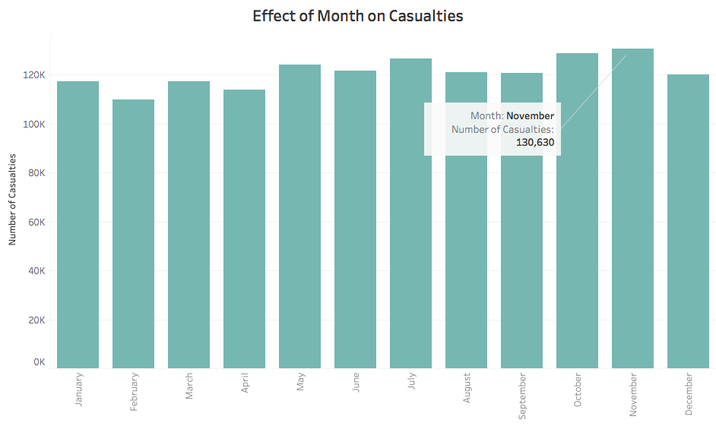

Slide 7
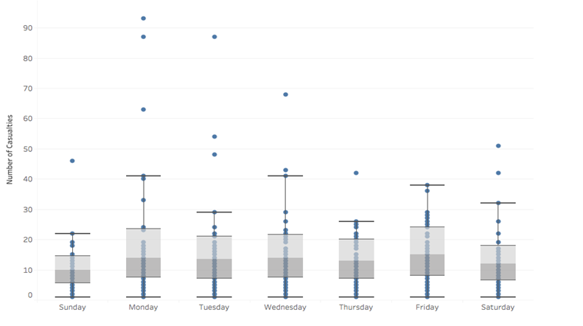
E
Effect of Day on Casualties

Slide 8
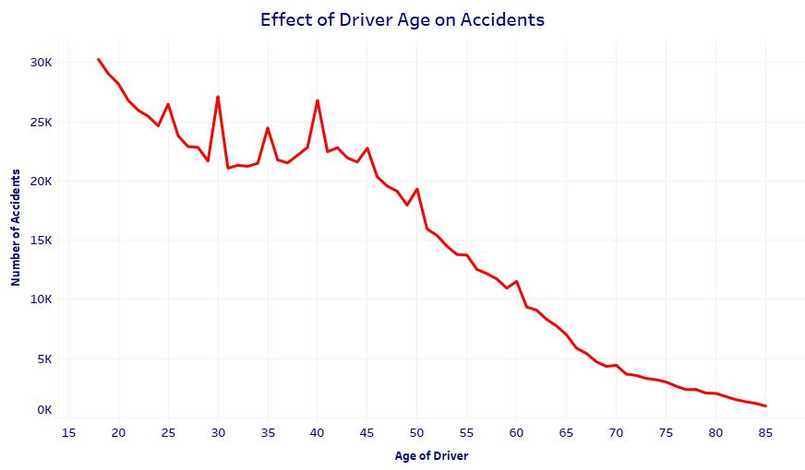
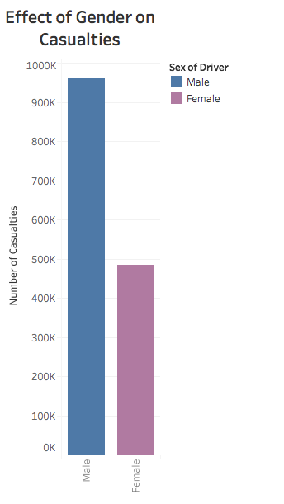
.

Slide 9
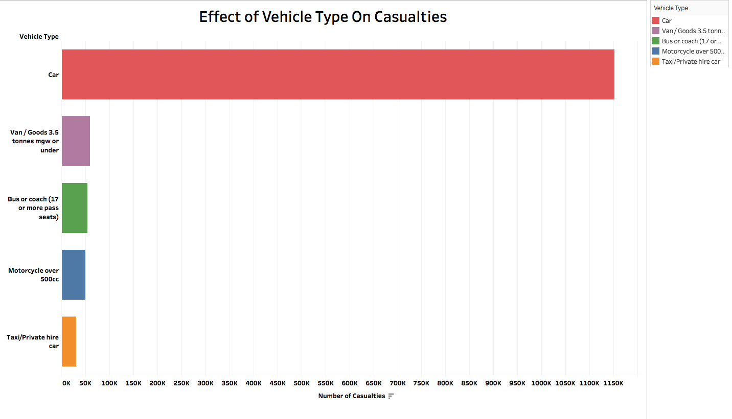

Slide 10
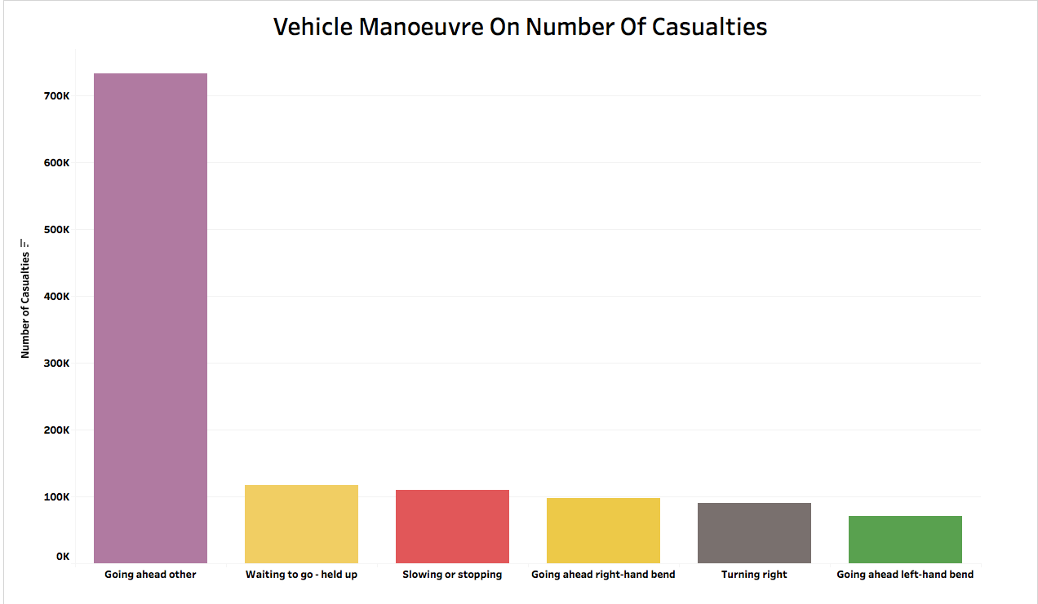

Slide 11
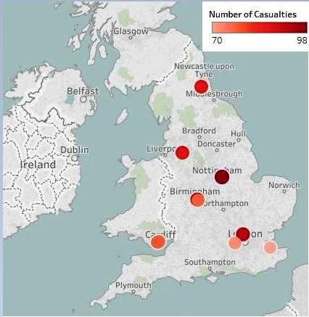
HotSpot Analysis

Slide 12
Step 3 DATA PREPARATION
Data Transformation
Data Integration
Missing Value Treatment
Redundant Features

Slide 13
Data Transformation Using Talend ETL Tool
Talend has been used to transform the data for solving the problems
Transformation 1
Hotspot feature Addition
Transformation 2
Severity feature Classification

Slide 14
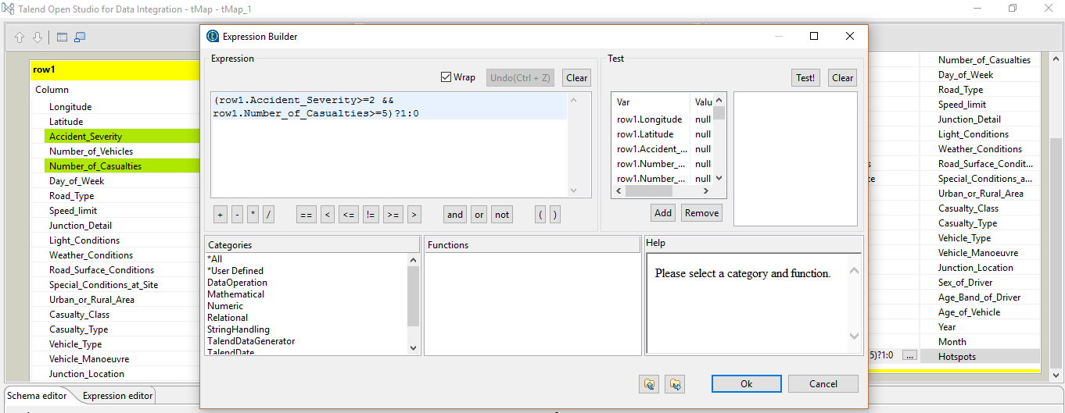
Transformation of Data for Hotspot Feature

Slide 15
Tools
Python Sklearn(Model Building)
Tableau (Data Visualization)
Talend ETL Tool(Data Preprocessing)

Slide 16
Step 4 Modelling
Random Forest
Decision Tree
We have used above methods to resolve our problems.
Training dataset consists of data from 2005-2014 and testing dataset consists of data from 2015.

Slide 17
Step 5 Evaluation
Problem1- Accident Hotspot Prediction | Accuracy
Decision Tree | 94%
Random Forest Classification | 78%
Problem 2- Accident Severity Prediction | Accuracy
Decision Tree | 85%
Random Forest Classification | 83%

Slide 18
Conclusion
Factors contributing to Accidents :
Male gender has more impact on the number of accidents.
November month has more number of accidents.
Friday (weekday) has more number of accidents.
Young drivers of age 18-30 cause more number of accidents.

Slide 19
Conclusion
For hot spots prediction decision tree (94%) gives better accuracy random forest (78%).
For accident severity decision tree (85%) gives better accuracy than random forest classifier (83%).

Slide 20

Project Plan-Gantt Chart

Slide 21
Deliverable's link: https://github.com/champaramaiah/Data-Analytics-and-Mining-Project

Slide 22
Thank You

Slide 23

Thank You

