Slide 1
CA683 Data Analytics and Data Mining Project
Manoj Kumar Palanisamy (16212065)
Rohit Thomas (16210779)
Anjana Aggarwal (16210381)
Champa Ramaiah (16211712)

Slide 2
Great Britain Road Accident Data
The dataset contains information about road accidents in Great Britain over the years 2004-2015.
It consists of has 170 features/columns and around approximately 16 lakh records.
Dataset Link:
https://data.gov.uk/dataset/road-accidents-safety-data

Slide 3
Crisp Model : Step 1: Business Understanding
Predicting accident hotspots which would help in identifying areas where extra traffic control is needed.
Identifying accident frequency and severity types (fatal accident trends)
Identifying the factors of the driver (age group, gender/driving/purpose of driving) which causes most accidents in Great Britain.
Factors like number of vehicles/pedestrian movement/traffic Vehicle Type/Vehicle manoeuvre contributing to road accidents?
Predicting number of accidents with respect to locations.

Slide 4
Crisp Model : Step 2: Data Understanding Visualizations are a great way of understanding the data. Trends have been analyzed through visualizations.

Slide 5
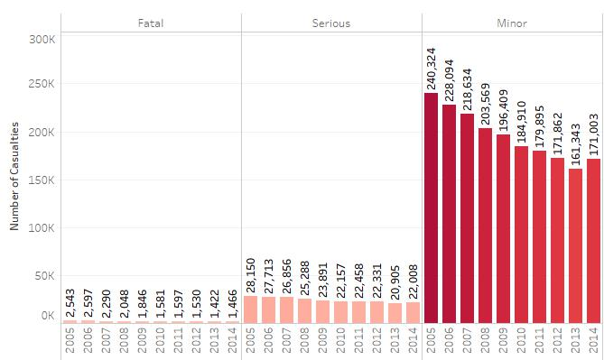
Data understanding via visualization

Slide 6
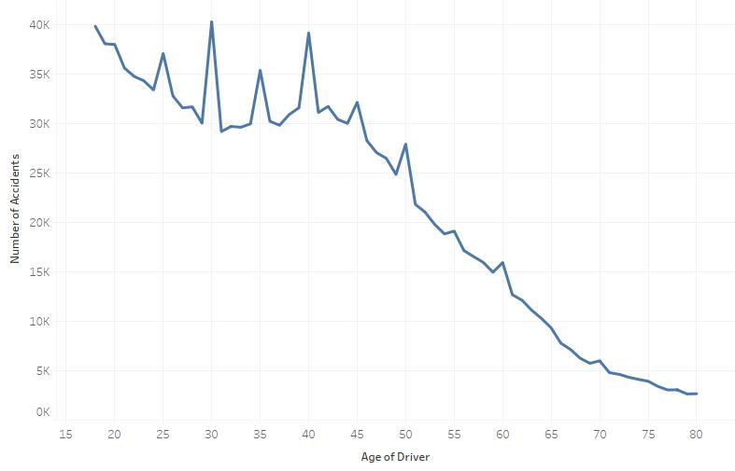
Data understanding via visualization

Slide 7
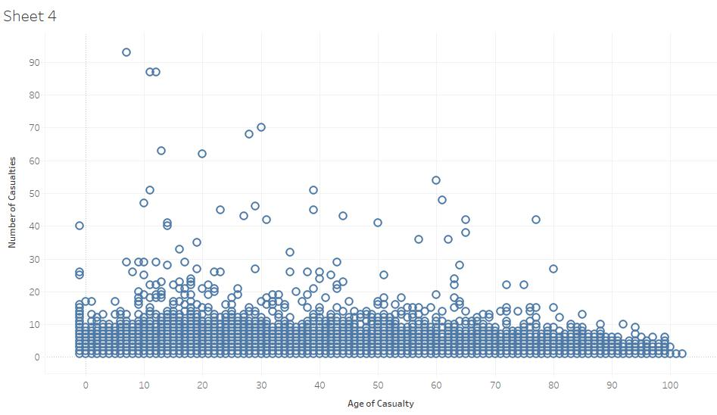
Data Understanding via visualization

Slide 8
Crisp Model : Step 3: Data Preparation Talend – Data Integration Tool : is mainly used for data integration, data management, data quality, data preparation and enterprise application integration software and services. Using this tool we have integrated different datasets into a single dataset.

Slide 9
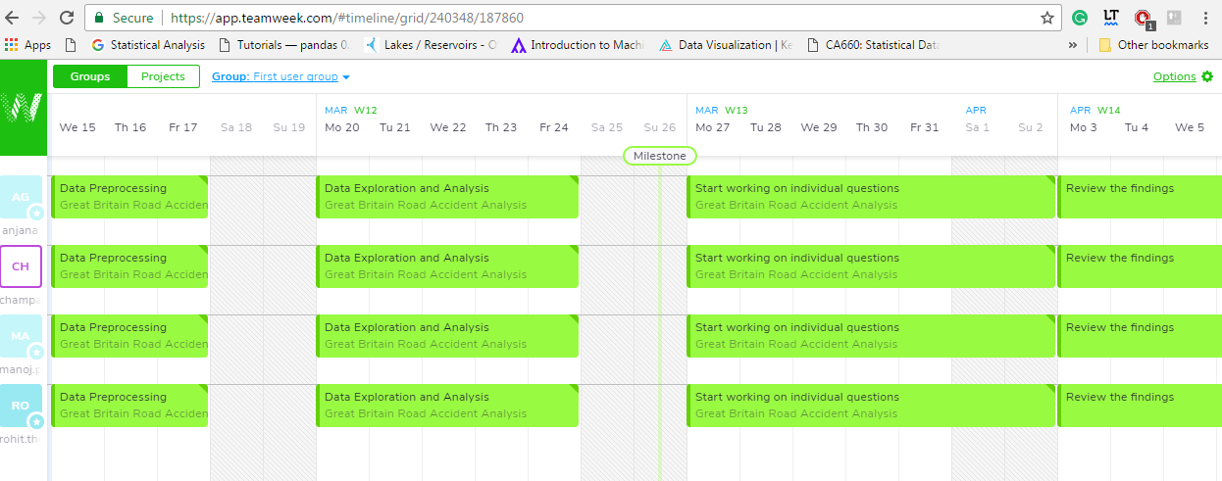
Project Plan

Slide 10
Dataset and deliverables link: https://github.com/champaramaiah/Data-Analytics-and-Mining-Project

Slide 11
Thank You

