Slide 1

Feature Engineering and Cross-Validation
Introduction to Data Science – Fall 2018
Session 7

Slide 2
AGENDA
Bias and variance tradeoff
Feature engineering
Cross validation

Slide 3
Introduction to Data Science
Data
Evaluation
Cross Validation
Advanced Error
Metrics
Visualization
Deep
Learning
Forecasting or NLP
-RNN
Computer Vision
-CNN
Neural Networks
Learning the steps in the Data Science Process
Learning multiple model methodologies
Machine
Learning
Decision trees and
Ensembles
Time Series
Clustering
Statistical
Learning
Linear
Regression
Logistic
Regression
PCA–dimensionality
reduction
Data
Cleaning
Feature
Engineering
Data Prep
Visualization
Foundation
Statistics
Python
Linear Algebra

Slide 4
Bias and variance
How does the model fit the data

Slide 5
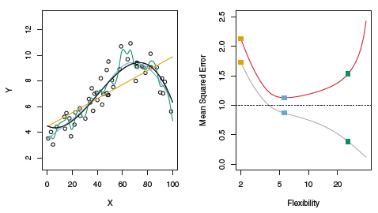
Examining model fits
Left: Three estimates of observed data
Right:
MSE of training set (gray)
MSE of test set (red)
Colored squares represent MSE of fitted models on left

Slide 6
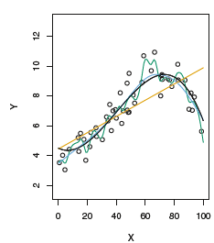
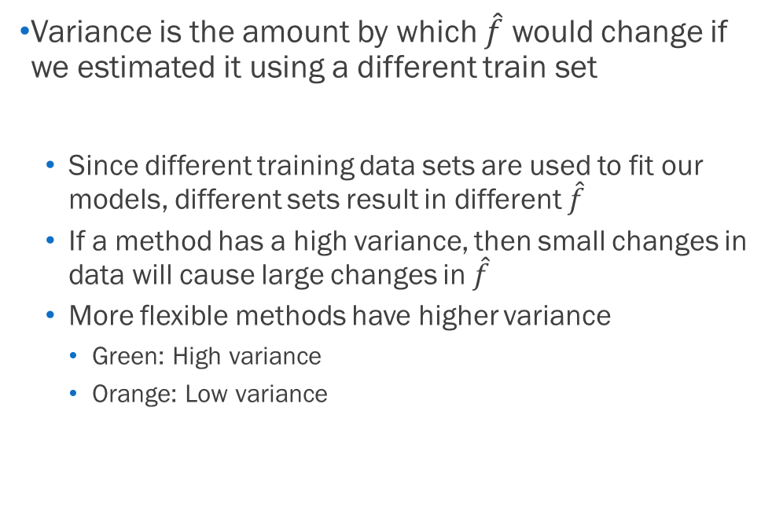
Model variance
Variance is the amount by which $\hat{f}$ would change if we estimated it using a different train set
Since different training data sets are used to fit our models, different sets result in different $\hat{f}$
If a method has a high variance, then small changes in data will cause large changes in $\hat{f}$
More flexible methods have higher variance
Green: High variance
Orange: Low variance

Slide 7
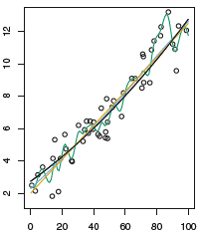
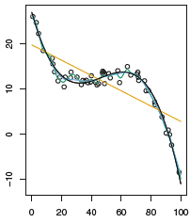
Model bias
Bias is the error introduced by solving a real-life problem with a simple model
No problem is truly linear
Linear data: Linear model has LOW bias
Non-linear data: Linear model has HIGH bias

Slide 8
Model bias
Bias is the error introduced by solving a real-life problem with a simple model
No problem is truly linear
Linear data: Linear model has LOW bias
Non-linear data: Linear model has HIGH bias

Slide 9
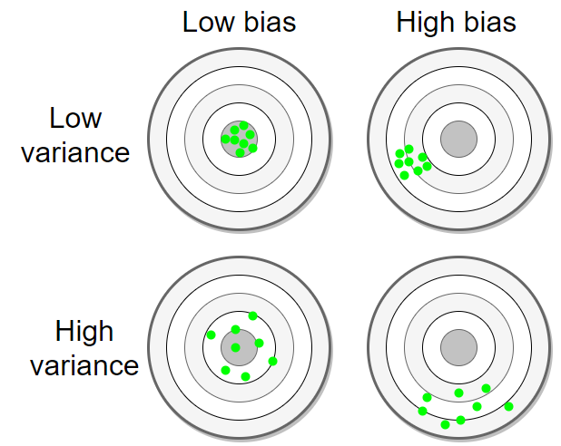
Another bias/variance visualization

Slide 10
Feature engineering
Modifying the independent variables

Slide 11

What is feature engineering?
The process of creating features to make machine learning algorithms work more efficiently and accurately
This requires an understanding of your data and the algorithm

Slide 12
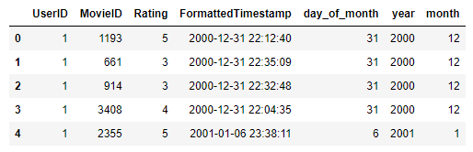
You have already been doing this
Movie ratings dataset from Pandas session
Reformatting timestamp and extracting features

Slide 13
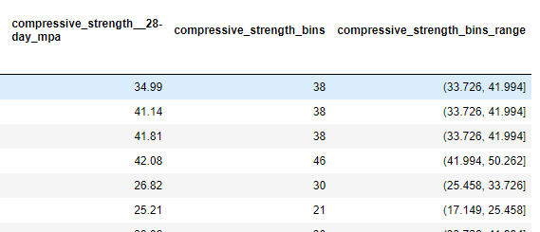
You have already been doing this
Concrete data set from the Tree and Forest session
Binning the responses into categorical data

Slide 14
Today we add to our experience
Standard scaling – mean and unit variance
Min max scaling – results between 0 and 1
Feature transformations – reduce skew in feature distributions
Handling categorical features – using dummy variables
Handling missing values - imputation

Slide 15

Which models require scaling?
Regularized regression
Linear classifiers
Principle Components Analysis
Clustering Methods
Decision Trees
Random Forest
Boosted trees

Slide 16
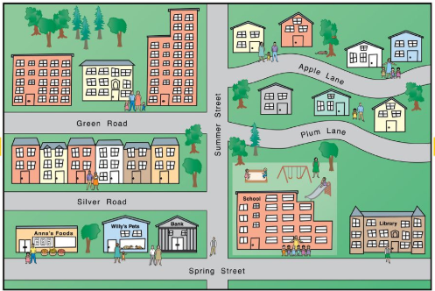
What is K nearest neighbors?
Classification algorithm – discrete response
Supervised learning – labeled response
Non-parametric – no coefficients
Instance-based – doesn’t hard code a model
Distance metric – Euclidean distance
Which K – lowest test error metric

Slide 17
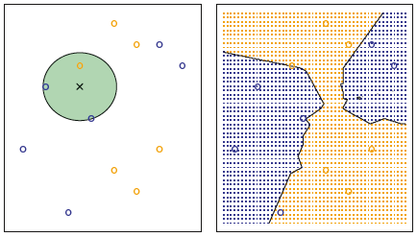
KNN approach where K = 3
Classification algorithm
Identify the K (3) closest points
Calculate the probability of classes (blue or orange)
Apply rule to classify the test observation (black x)
Training data set: 6 blue, 6 orange
Goal: Predict color of black x
Results: Predictions for all possible values of our feature space (X1, X2)
Decision Boundary: Black line

Slide 18
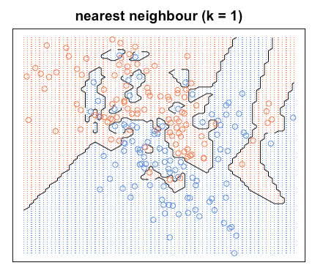
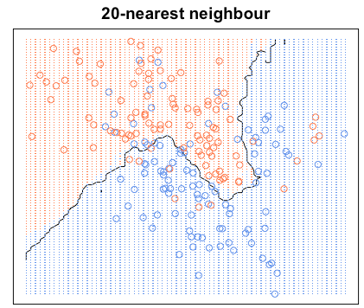
K nearest neighbors
The choice of K has a drastic effect on the KNN classifier obtained
When K =1, the decision boundary is overly flexible (low bias/high variance)
What is the training error for K=1?
As K grows, the boundary becomes less flexible and approaches a linear boundary ( low variance / high bias)

Slide 19
KNN pros and cons
Simple to understand
Easy to implement
Works with multiclass or binary
Non-parametric is good for unusual data
Computationally expensive
Skewed class distributions in train/test
Accuracy can suffer with high-dimensional data

Slide 20
Cross-validation
Improving upon train/test methodology

Slide 21

Validation set approach
Divide the entire set into two parts
Fit the model on the training set
Use that fitted model to predict on the test set
aka validation set, hold-out set
Examine error metric for fitted model

Slide 22
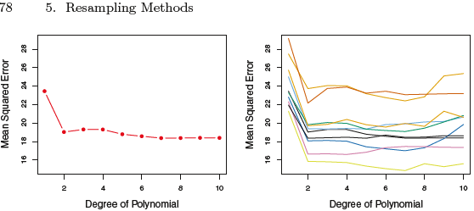
Validation set approach
Left: Validation (test set) error estimates for a singular (what we have been doing so far) split on training and test set
Right test/train methodology was repeated ten times, each using a different random split.
Takeaway: Simple train/test splitting can lead to varied MSE metrics

Slide 23
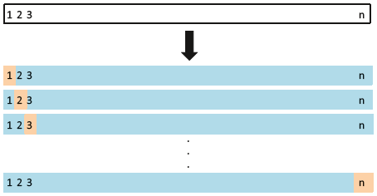

LOOCV - Leave-one-out cross-validation
Split a data set with n observations into a test set of 1 and a train set of n-1
Calculate the MSE
Repeat procedure n times
Aggregate the error metrics

Slide 24
LOOCV pros and cons
Less bias than validation approach
Always get the same results, no randomness in the training/validation set splits
Can be used with any kind of models
Potentially expensive to implement based on n

Slide 25
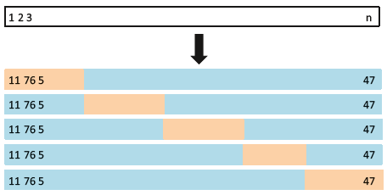

K-fold cross-validation
Randomly divide the set into k groups or folds of equal size
The first fold is a hold out, method is fit on remaining k-1 folds
MSE is calculated on the hold out fold
Repeat process k times and average MSEs

Slide 26
K-fold cross-validation pros and cons
Faster than LOOCV
Variability in MSE is lower than validation approach
Use to select the “best fit” model
Variability in MSE is higher than LOOCV

Slide 27
Bias-variance tradeoff for K-folds CV
LOOCV gives unbiased predictions
KFCV will give more biased predictions
LOOCV gives a higher variance
Why is this?

Slide 28
Bias-variance tradeoff for K-folds CV
LOOCV gives unbiased predictions
KFCV will give more biased predictions
LOOCV gives a higher variance
Each of the n fitted models are trained on an almost identical set of data
KFCV is fit with less correlated sets
The mean of many highly correlated quantities has higher variance than the mean of many quantities that are not as highly correlated
K=5 or k=10 have been shown to yield test error estimate rates that don’t suffer from very high bias nor from very high variance

Slide 29
Appendix

Slide 30
Transformations
Modifying the dependent variable

