Slide 1

Time Series Analysis
Introduction to Data Science – Fall 2018
Extra Session 8

Slide 2
AGENDA
Time series data
ARIMA
ARIMA variants
Facebook prophet
Google bsts

Slide 3
Time series data
Time dependent data

Slide 4
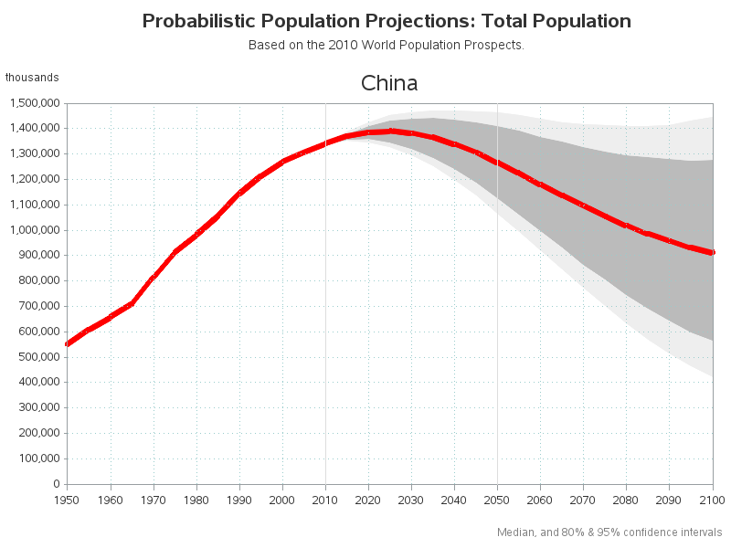
Forecasting
Uses of forecasting:
Forecasting populations
Should we build another power plant in the next five years due to forecasts of energy demand?
Scheduling staff in a call center based on forecasts of call volume
Stocking an inventory based on forecasts of purchases
Forecasting stock prices?

Slide 5

Basic steps in a forecasting task
Problem definition
Who, what, how will be using the forcasts
Gather information
Exploratory analysis
Choosing and fitting models
Depends on data, relationships, ways forecasts are to be used
Using and evaluating a forecast model

Slide 6
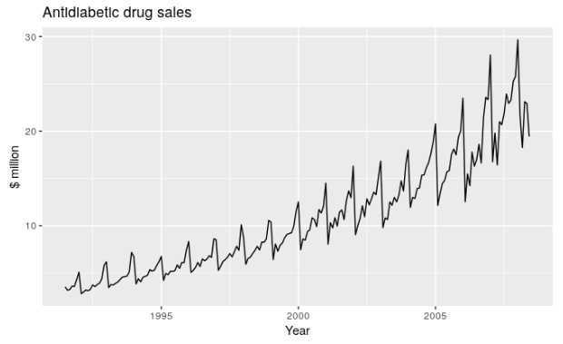
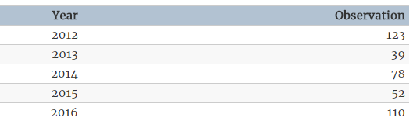
Visualizing time series data
Time series plot
X axis is typically time
Time series data
Ordered by date

Slide 7
ARIMA
The Classic time series model

Slide 8
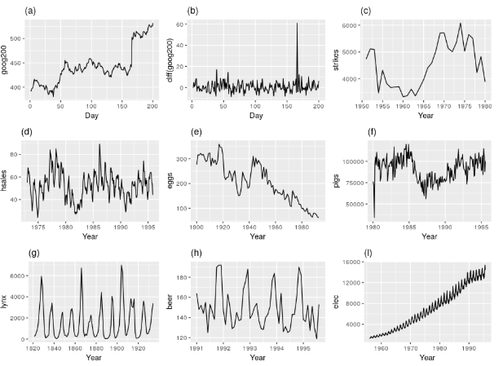
Stationarity and differencing
Stationary time series: properties do not depend on the time when the series is observed
No seasonality
No trend
Constant variance
Which ones are stationary?
Hint: only 2

Slide 9

No seasonality
Stationary time series: properties do not depend on the time when the series is observed
No seasonality
No trend or level changes
Constant variance

Slide 10

No trends or changing levels
Stationary time series: properties do not depend on the time when the series is observed
No trend
No seasonality
Constant variance

Slide 11
Stationary series
Stationary time series: properties do not depend on the time when the series is observed
No trend
No seasonality
Constant variance

Slide 12
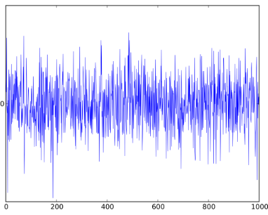
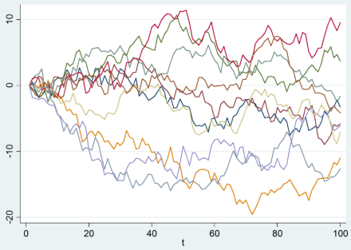
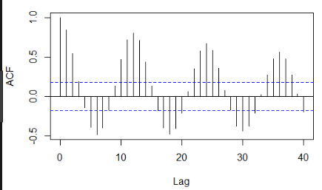
Terminology
White noise
Variables are independent and identically distributed with a mean of 0
All variables have the same variance and zero correlation with other values in the series
Random walk
Each step is random, but is dependent on the location of the previous step
Autocorrelation
Plot of correlation between observations

Slide 13
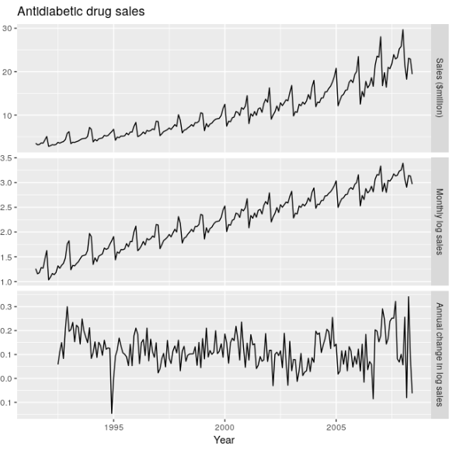
Stationarity and differencing
Log transformation helps stabilize the variance of a time series
Differencing is computing the differences between consecutive observations
Helps to stabilize the mean of the time series by removing changes in the level
Log difference is a common transformation

Slide 14
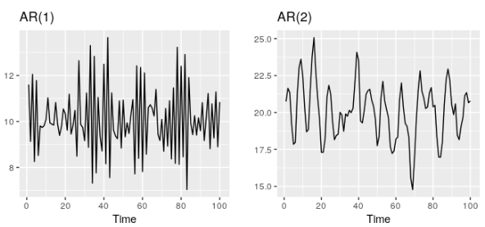

AR – autoregressive models
Forecast the variable of interest using a linear combination of past values of the variable.
Order of p
Et is white noise
AR(p) model: an autoregressive model of order p

Slide 15
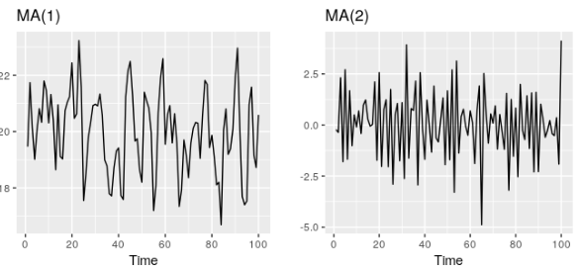
MA – moving average models
Forecast the variable of interest using the past forecast errors in a regression like model.
Order of q
Et is white noise
MA(q) model: a moving average model of order q

Slide 16

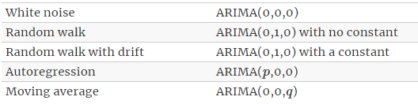
ARIMA – putting it together
Combine differencing with auto regression and a moving average model
ARIMA Auto Regressive Integrated Moving Average model
ARIMA(p,d,q) model
Special cases of ARIMA

Slide 17
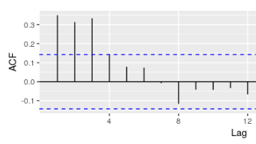
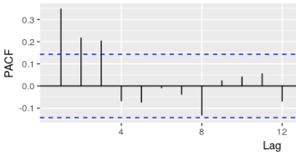
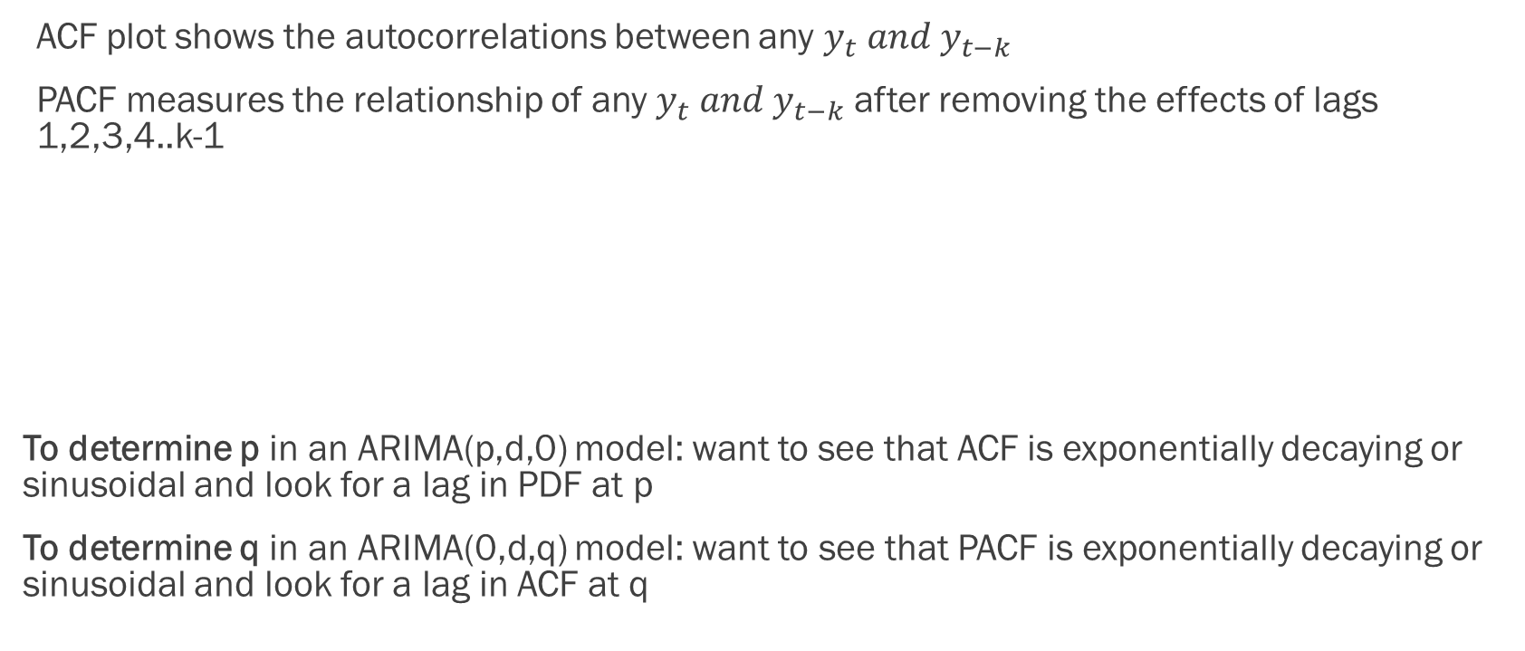
ACF and PACF plots
ACF plot shows the autocorrelations between any $y_{t} and y_{t−k}$
PACF measures the relationship of any $y_{t} and y_{t−k}$ after removing the effects of lags 1,2,3,4..k-1
To determine p in an ARIMA(p,d,0) model: want to see that ACF is exponentially decaying or sinusoidal and look for a lag in PDF at p
To determine q in an ARIMA(0,d,q) model: want to see that PACF is exponentially decaying or sinusoidal and look for a lag in ACF at q

Slide 18
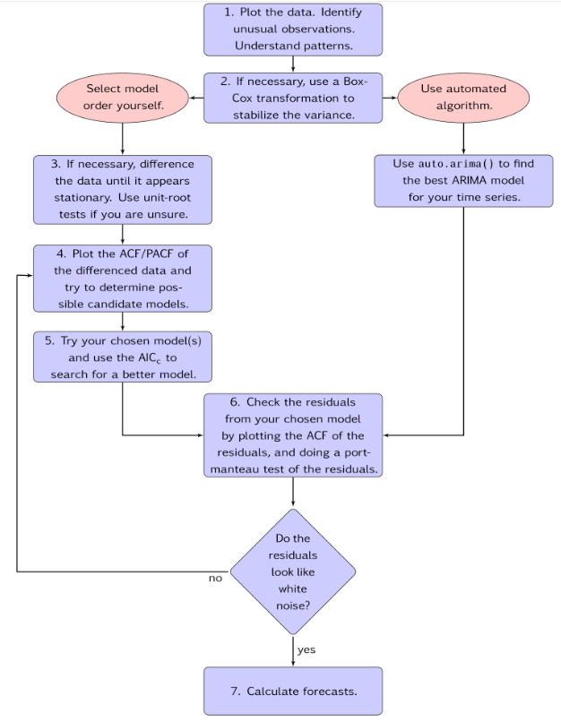
Modelling procedure
Plot the data and identify any unusual observations.
If necessary, transform the data (using a Box-Cox transformation) to stabilize the variance.
If the data are non-stationary, take first differences of the data until the data are stationary.
Examine the ACF/PACF: Is an ARIMA(p,d,0p,d,0) or ARIMA(0,d,q0,d,q) model appropriate?
Try your chosen model(s), and use the AICc to search for a better model.
Check the residuals from your chosen model by plotting the ACF of the residuals, and doing a portmanteau test of the residuals. If they do not look like white noise, try a modified model.
Once the residuals look like white noise, calculate forecasts

Slide 19
ARIMA variants
Different applications for arima models

Slide 20
Seasonal ARIMA models
Forecast

Slide 21
Regression with ARIMA errors
Forecast

Slide 22
VAR – Vector autoregressions
Forecast

Slide 23
Facebook prophet
Forecasting at scale

Slide 24

What is prophet?
Prophet is a procedure for forecasting time series data based on an additive model where non-linear trends are fit with yearly, weekly and daily seasonality, plus holiday effects
Prophet is open source software released by Facebook’s Core Data Science team.
Prophet is robust to outliers, missing data and dramatic changes in your time series
Use human interpretable parameters to improve your forecast by adding domain knowledge
Available in R and Python
https://facebook.github.io/prophet/

Slide 25
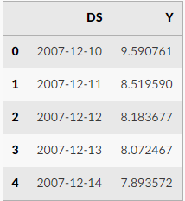

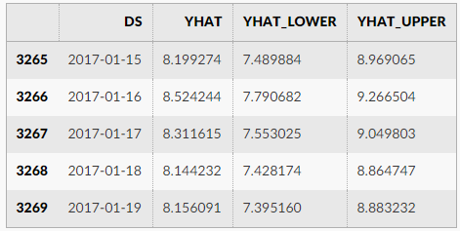


Using prophet in python
Create an instance of the Prophet class then call fit and predict methods
Input is a data frame with two columns: ds (datestamp: YYYY-MM-DD) and y (numeric)
https://facebook.github.io/prophet/

Slide 26
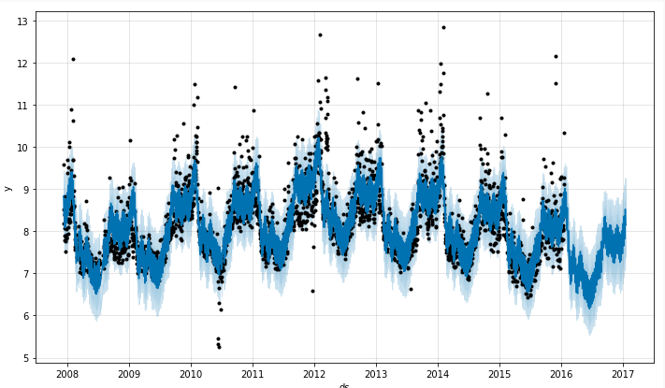

Plotting forecasts
Call the prophet.plot method and pass in the forecast data frame
https://facebook.github.io/prophet/

Slide 27
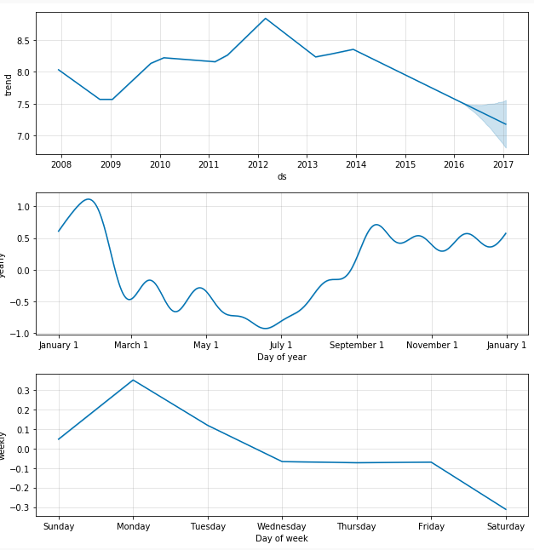

Forecast components
Call the prophet.plot_components method to see the trend yearly and weekly seasonalities
https://facebook.github.io/prophet/

Slide 28
Google bsts
Structural time series modeling

Slide 29
Appendix

Slide 30

Which models require scaling?
Regularized regression
Linear classifiers
Principle Components Analysis
Clustering Methods
Decision Trees
Random Forest
Boosted trees

