Slide 1
Distributed CSV Consumption
A quick tour through the creation of a Hadoop InputFormat and a Crunch FileSource implementation for CSV files
Notes:
==Creating a Hadoop InputFormat and Crunch FileSource implementation for CSV files==
End of iteration, time to pick a jira
Working on Content-Processing project (store nomenclatures in Hbase)
Nathan (content-processing guy) was out of town
Cache CSV files in HDFS and process them with crunch instead of doing it on the utility node and then bulk uploading them
Everything was going great until CVX…
Oops…

Slide 2
Hi.
Mac Champion
Software Engineer
Population Health – Record Development
Notes:
==Creating a Hadoop InputFormat and Crunch FileSource implementation for CSV files==
End of iteration, time to pick a jira
Working on Content-Processing project (store nomenclatures in Hbase)
Nathan (content-processing guy) was out of town
Cache CSV files in HDFS and process them with crunch instead of doing it on the utility node and then bulk uploading them
Everything was going great until CVX…
Oops…

Slide 3
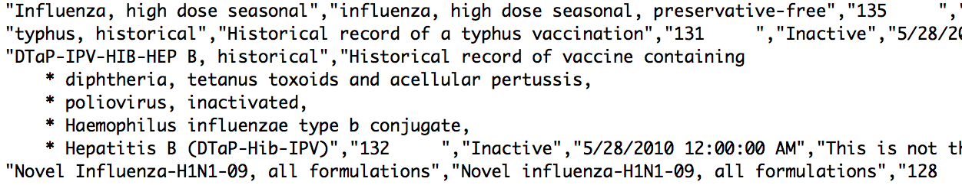
Ouch
Notes:
Bulleted list with newlines in between items
We have a problem…

Slide 4
The Problem
CSV files are weird.

Slide 5
How So?
They don’t have to be “comma separated values”
They have optional header rows
The fields can be surrounded by quotes, inside of which, pretty much anything goes, even newlines…
Notes:
So, why does this matter?
Hadoop’s InputFormats are simple (textinputformat and nlineinputformat)
Not good, will need to write my own.
Lot of research, lot of trial and error, lot of sanity checks

Slide 6
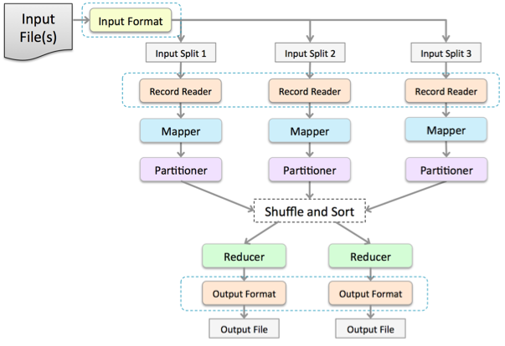
Input

Slide 7
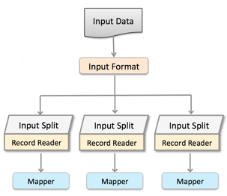
Input Format
InputFormats have two main responsibilities
1. Split data intelligently
2. Create a RecordReader for each split
Notes:
----- Meeting Notes (6/11/14 09:00) -----
TextInputFormat is a good example of a simple input format. It basically splits wherever it finds a convenient newline character. Not all data fits this scenario.

Slide 8
CSV Input Format
This class splits up input CSV files
Start at the beginning of the file and seek ahead an amount determined by a desired “split size”
Seek to the end of that line
Use a CSV utility class to determine if it is inside a CSV record (seek to the end if so) and mark the file for splitting
Notes:
Calculates split points for each file
by jumping over split-size-number-of-bytes and
then searching for the end of a CSV record

Slide 9
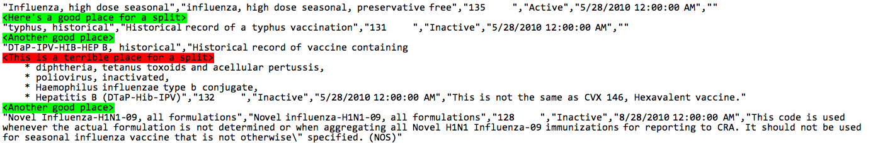
Where can we split this?

Slide 10
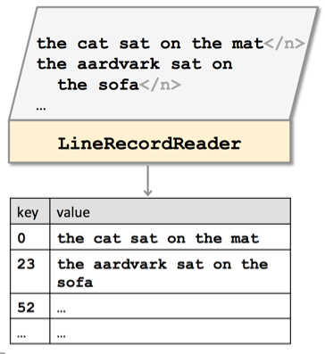
Record Reader
Each record reader is tasked with reading one split worth of information.
The record reader must parse the raw data in the split into “records”, which are key-value pairs.
Key: Byte location in the file where this record starts
Value: The content starting at that byte until the next record.
Notes:
----- Meeting Notes (6/11/14 09:22) -----
"Split" in this case is basically file location and a byte location where the split should start and end
Similarly, a record is, conceptually, a byte loaction where the record will start and the contents of that record.

Slide 11
CSV Record Reader
This class is essentially an iterator over the portion of CSV file which it is assigned to
It opens an input stream to the file, seeks to its assigned split position
And, as required, provides successive key (position) and value (record) pairs until the end of the split or of the file is reached
Notes:
----- Meeting Notes (6/11/14 09:22) -----
CSV Record Reader uses similar logic to the Input Format, except that it reads each CSV entry instead of skipping around.

Slide 12
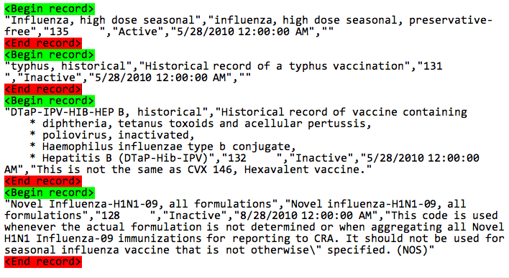
Results of Record Reading
Notes:
----- Meeting Notes (6/11/14 09:22) -----
Example records parsed and sent back by the Record Reader
Say stuff: that’s great, we now have a configurable hadoop InputFormat that can, at the very least, handle CSV files with records that contain linebreaks
This was probably the hardest part.
But, what about crunch?

Slide 13
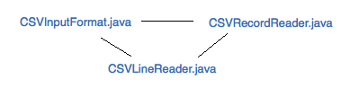
Hadoop InputFormat
Notes:
Our simple InputFormat solution
CSVInputFormat and CSVRecordReader use a utility class
CSVLineReader which handles the parsing
So, this is cool, but not very configurable.
In order to have some interesting functionality
(tab separated values, file encoding, custom control characters, etc)
We either need to subclass InputFormat or change it so that its
But what about crunch?

Slide 14
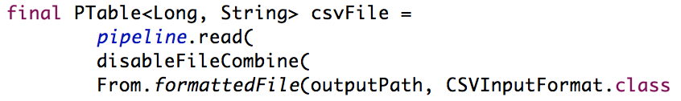
Crunch?
Now…
What we want…
Notes:
Now… inputformat
Most teams use crunch to process input and produce output

Slide 15
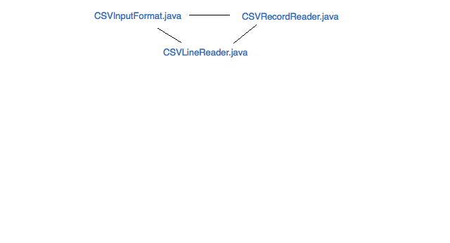
Hadoop
Notes:
So, we start with the three classes required for the hadoop Input Format

Slide 16
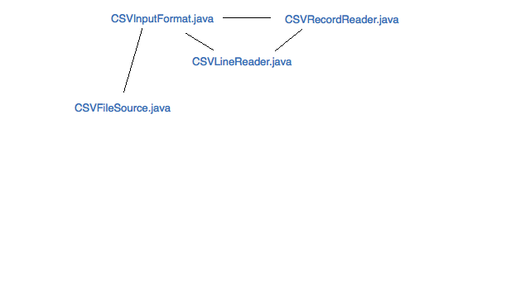
Crunch…
Notes:
What’s needed is a CSVFileSource, right?
This class takes in all sorts of configuration options
It sets all of these options in the job configuration

Slide 17
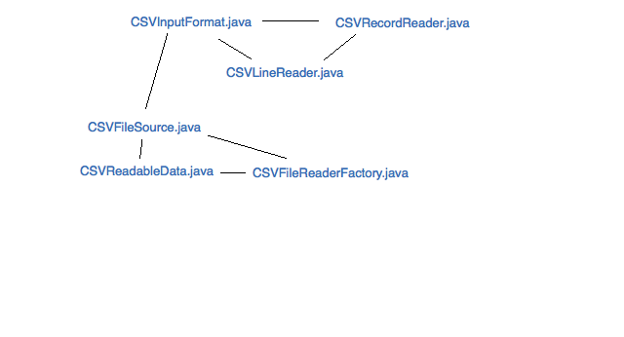
More Crunch…
Notes:
It needs to be able to create these other two classes, a “Readable data” and a “file reader factory” class,
NEXT SLIDE

Slide 18
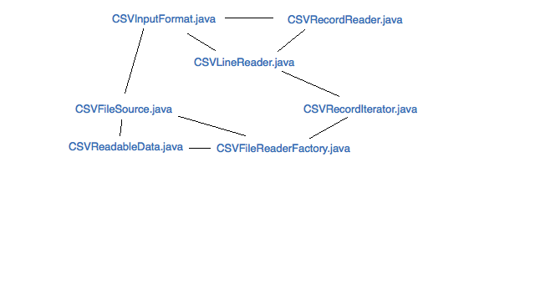
Extra
Notes:
Both of which are really just a wrapper for a simple iterable file reader, which is really just another wrapper, for the CSVLineReader
Honestly, I also could have just made CSVLineReader an iterable class, but this seemed much cleaner.

Slide 19
Summary
A File Source marks an Input Format for use in a job and takes care of configuration.
An Input Format splits an input file and also creates and configures a Record Reader.
A Record Reader iterates through a file’s records and returns them.
Notes:
Both of which are really just a wrapper for a simple iterable file reader, which is really just another wrapper, for the CSVLineReader
Honestly, I also could have just made CSVLineReader an iterable class, but this seemed much cleaner.

Slide 20
What did we learn?
CSV Files are weird
Inside every Crunch File Source is a good Hadoop Input Format.
Creating an Input Format around a file source isn’t incredibly hard, if you know your source well.
Knowing a source well means knowing where it can be split for distribution and how it can be broken into records.
Slides: https://github.com/champgm/Big-Data-Talk
Notes:
Both of which are really just a wrapper for a simple iterable file reader, which is really just another wrapper, for the CSVLineReader

