Slide 1
Distributed CSV Consumption
A quick tour through the creation of a Hadoop InputFormat and a Crunch FileSource implementation for CSV files
Mac Champion
Notes:
==Creating a Hadoop InputFormat and Crunch FileSource implementation for CSV files==

Slide 2
Hi.
Mac Champion
Software Engineer
Population Health – Record Development
Notes:
Almost a year ago
End of iteration
Nathan (manager) was out of town, pick JIRA
Cache CSV files in HDFS
process them with crunch instead of utility node
Good to learn HDFS, Hadoop, Crunch
Everything was going great, several sources
Until full load encountered CVX
Oops…

Slide 3
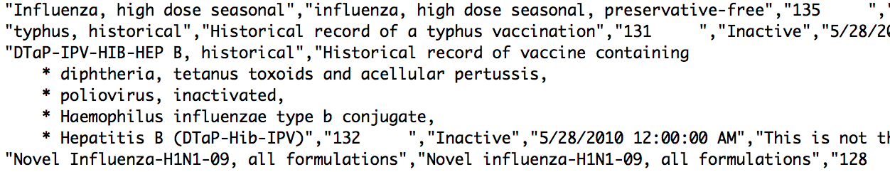
Ouch
Notes:
4 records here
First 2 = 1 line
Third record has quoted field
Inside, bulleted list separated by newline characters
My code blew up

Slide 4
CSV Files Are Weird
They don’t have to be “Comma Separated Values”
The fields can be surrounded by quotes, inside of which, pretty much anything goes, even newlines…
Crunch’s TextFileSource and Hadoop’s TextInputFormat cannot handle this.
Notes:
Any field in any file can be surrounded by quote, weird stuff, such as NEWLINES
Hadoop-TextInputFormats and Crunch-TextFileSource not VERSATILE
They read line-by-line
CSV = too much complexity
Not good, eventually realized: will need to write my own.

Slide 5
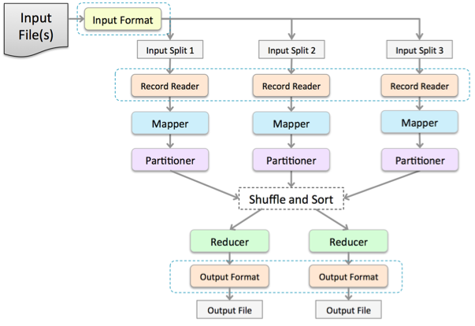
MapReduce Flow
Notes:
If you have had any hadoop training, you’ve probably seen this picture
Map-reduce flow from input file to processed output file
I was interested in the first three rows
Input format
Split files
Record readers

Slide 6
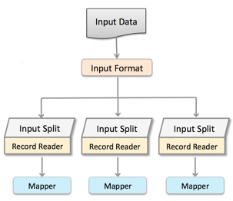
Input Format
Input Formats have two main responsibilities
1. Split data intelligently
2. Create a RecordReader for each split

Slide 7
CSV Input Format
Start at the beginning of the file and seek ahead an amount determined by a desired “split size”
Use a CSV utility class to determine if it is inside a CSV record (seek to the end if so) and mark the file for splitting
Notes:
Calculates split points for each file
by jumping over split-size-number-of-bytes and
then searching for the end of a CSV record

Slide 8
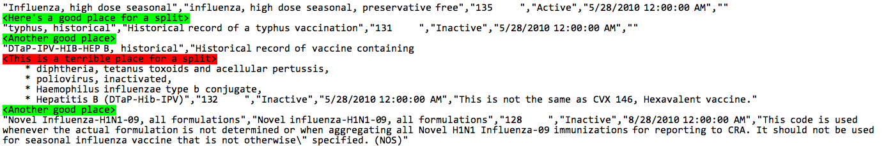
Where can we split this?
Notes:
Example from before
Line-by-line processing marks first two split places
Third place is bad
CSV InputFormat is able to skip to end and mark

Slide 9
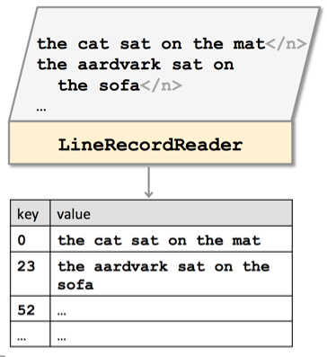
Record Reader
Record Readers have two main responsibilities
1. Read one split worth of information.
2. Parse the raw data into “records”
Notes:
Record readers
Read their split
Parse raw data into “Records”

Slide 10
CSV Record Reader
This class is essentially an iterator over the portion of CSV file which it is assigned to
It opens an input stream to the file, seeks to its assigned split position
Immediately begins parsing records until the end of the split or file is reached
Notes:
Input Format is smart enough to know where a record ends
Record Reader can start reading immediately

Slide 11
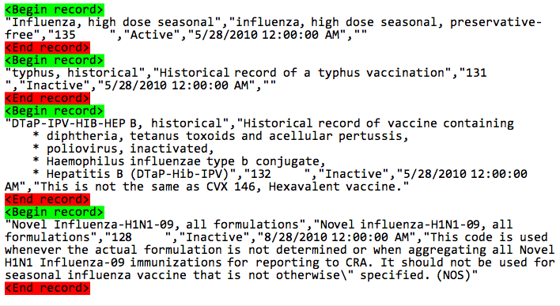
Results of Record Reading
Notes:
That’s great, we now have a hadoop InputFormat
Can split
Can distribute
Can parse
CSV

Slide 12
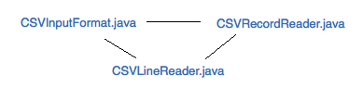
Hadoop InputFormat
Notes:
Mention utility class
This works, currently in content-processing
NOT easily configurable.
(tab separated values, file encoding, custom control characters, etc)
Users must manually set options
In hadop job configuration
Right now, options hard coded into input format

Slide 13
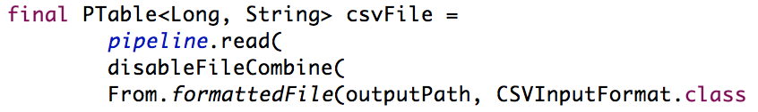
Crunch?
Now…
What we want…
Notes:
Now… Crunch
Crunch takes care of configuration in a sane way. Crunch takes configuration for you and uses input format

Slide 14
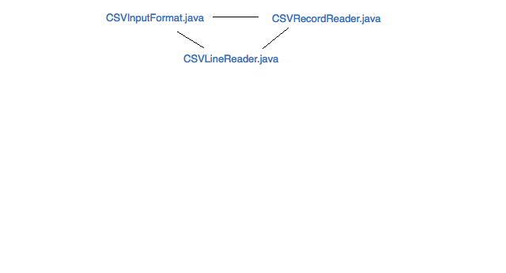
Hadoop
Notes:
So, What do we need?
we start with the three classes required for the hadoop Input Format

Slide 15
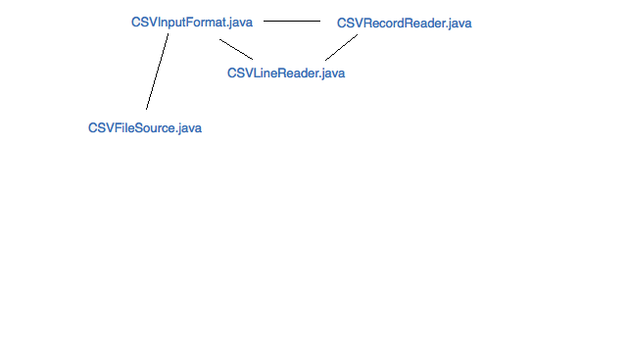
Crunch…
Notes:
What’s needed is a CSVFileSource, right?
This class takes in all sorts of configuration options
It sets all of these options in the job configuration

Slide 16
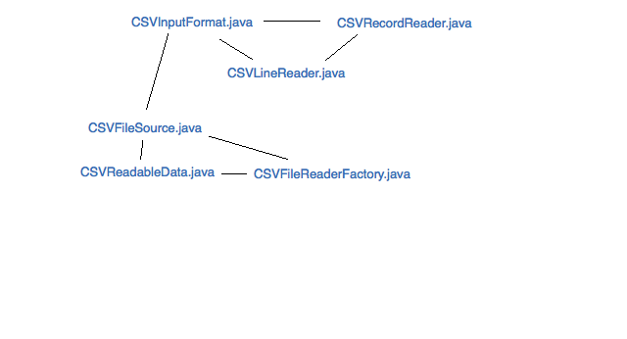
More Crunch…
Notes:
It needs to be able to create these other two classes, a “Readable data” and a “file reader factory” class,
NEXT SLIDE

Slide 17
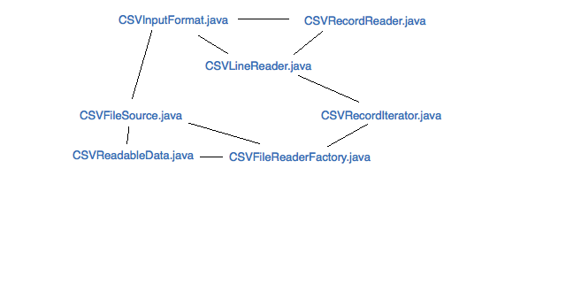
Crunch File Source
Notes:
Both of which are really just a wrapper for a simple iterable file reader, which is really just another wrapper, for the CSVLineReader
Honestly, I also could have just made CSVLineReader an iterable class, but this seemed much cleaner.

Slide 18
Summary
An Input Format splits an input file and also creates and configures a Record Reader.
A Record Reader iterates through a file’s records and returns them.
A File Source marks an Input Format for use in a job and takes care of configuration.

Slide 19
What I learned
CSV Files are weird
Inside every Crunch File Source is a good Hadoop Input Format.
Creating an Input Format around a file source isn’t incredibly hard, if you know your source well.
Knowing a source well means knowing where it can be split for distribution and how it can be broken into records.
Slides: https://github.com/champgm/Big-Data-Talk

