Slide 1
The Battle of Neighborhood
Recommendation for Amsterdam tourist
By Champak Nandi

Slide 2
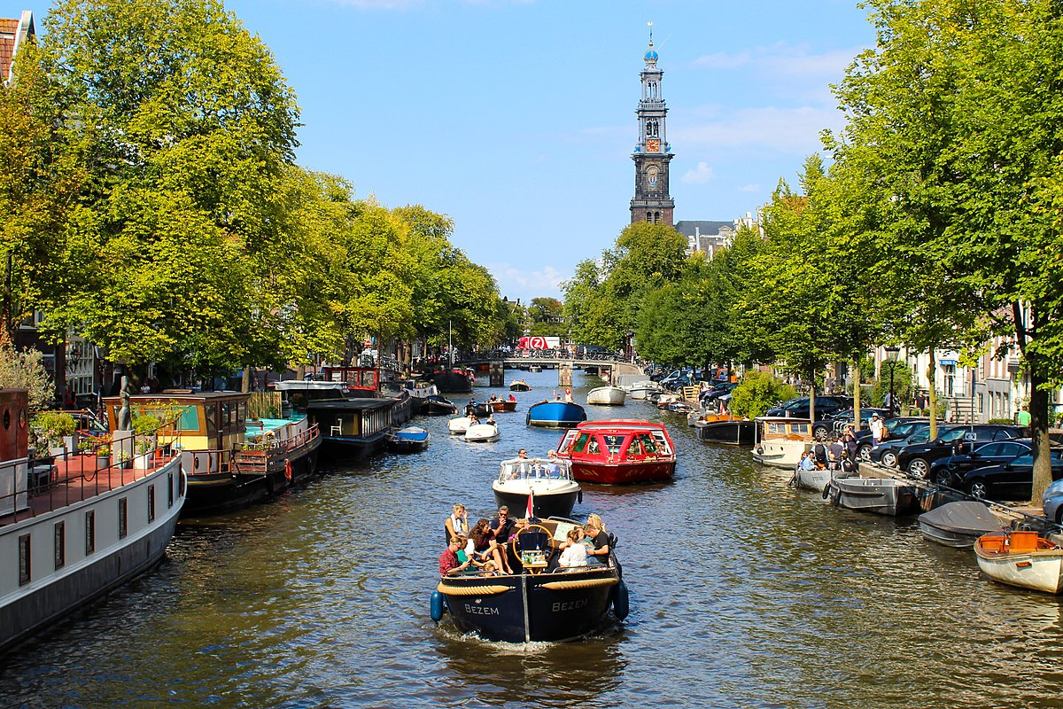
Amsterdam – Venice of the North
This Photo by Unknown Author is licensed under CC BY-SA

Slide 3
Introduction
This project is to take a glimpse at different neighborhoods of Amsterdam, Netherlands. Amsterdam is the capital city of Netherland and is a popular tourist destination from all over the world. Every year around 4 to 5 million tourists visit the city.
Travelers from outside who want to decide which area of Amsterdam is desirable to stay so as to be near to main attractions will find the information obtained from this project of interest.

Slide 4
Data
The city of Amsterdam has eight boroughs:
Centrum (Centre)
Noord (North)
West
Nieuw-West (New West)
Zuid (South)
Oost (East)
Zuidoost (Southeast)
Westpoort (West Gateway)

Slide 5
Data - Continued
I arranged the boroughs along with their latitude and longitude (programmatically) and used this information to explore places/venues of interest from a tourist points of view using the Foursquare api’s. The categories of venues retrieved were filtered to arts and entertainment, Event, food, nightlife, shops and service as these are most relevant categories to a tourist.

Slide 6
Methodology
Group venues by each Borough and to count how many venues before filter top 10 most common venue types of each Boroughs
Used K means clustering to get clusters of Boroughs

Slide 7
Results
Noord (North) and West Boroughs have top number of desired venues (82) within walking distance (500 meters)
Centrum (Centre) Borough has the second most (78)
Westpoort (West Gateway) Borough has the least number of desired venues (1, which is a Heliport)
Cafes, Hotels and Bars are very common in the boroughs Noord, West and Centrum
If you want to camp near Marina, then Nieuw-West is desirable (there are hardly any hotels)

Slide 8
Conclusion
For tourists, the boroughs Noord, West and Centrum are desirable locations to look for hotels/accommodation to stay as most of the desirable venues are within walking distance.

