Slide 1
Computer Graphics
Team Project Final
201732734 정현기 201835407 권성현
201835475 유경준 202035308 김다미

Slide 2
Index
Title
Team members information (+e-mail address)
Brief description
Key features (advantages)
Implementation details
Duties division

Slide 3
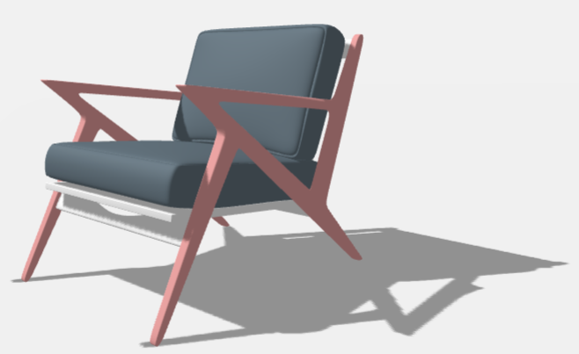
Part 1
Title
DIY - Design It Yourself
Objective
Design various objects easily by users.
Be able to make the design user wants fast and simple.

Slide 4


Part 2
Team members information (+e-mail address)
w
w
Name: 정현기
ID : 201732734
Email : jhg8342@gachon.ac.kr
Part: UI (Design)
Name: 권성현
ID : 201835407
Email : rushhour.k@gmail.com
Part: Modeling
w
w
Name: 유경준
ID : 201835475
Email : hermeskj0217@gmail.com
Part: Core Logic
Name : 김다미
ID : 202035308
Email : sspdami@gmail.com
Part: Texture

Slide 5



Part 3
Brief description
Design
Perspective
Accessibility
The user can easily change
materials and their design
with simple movements.
The user can see the object from various angles by applying various effects such as a light source.
It is easy for people of all
ages to use this program
without difficulties

Slide 6
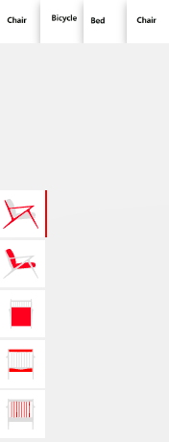
Part 4
Key features (advantages)
Product Selection
Users can choose the object they want (e.g. chairs, bike)
Users can choose the color or design they want to wear on the product

Slide 7
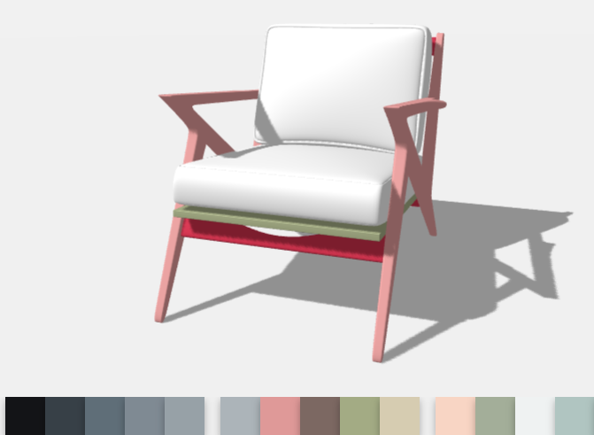
Part 4
Key features (advantages)
Customize function
Users can design its surface by selecting shapes or colors they want
Users can easily design the products just with a simple click
Users can design the divided parts of the product by selecting them separately (e.g. chair legs, body)

Slide 8
Part 4
Key features (advantages)
Dynamic Effects
Users can see various aspects of the product through shadows and shades of the product
Users can scroll or drag to see the product from various angles

Slide 9
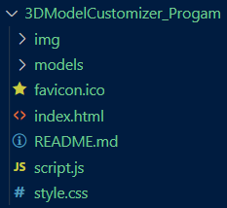
Part 5
Implementation details
img – composed of images of textures and divided products
models – composed of gltf and images of products
index.html – shows the screen of the program
script.js – detailed information about the products (colors, position)
style.css - css elements related to the program screen

Slide 10
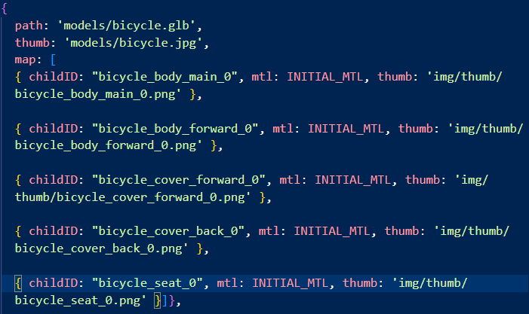
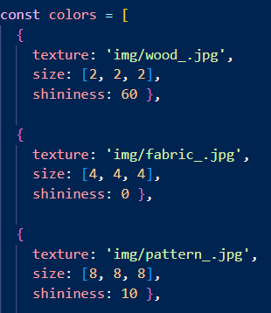
Part 5
Implementation details
Divided the parts of the products through childID
Applied various textures to the products

Slide 11
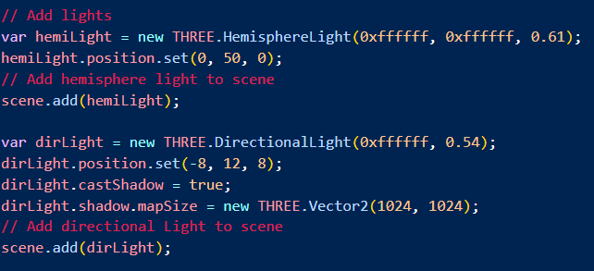
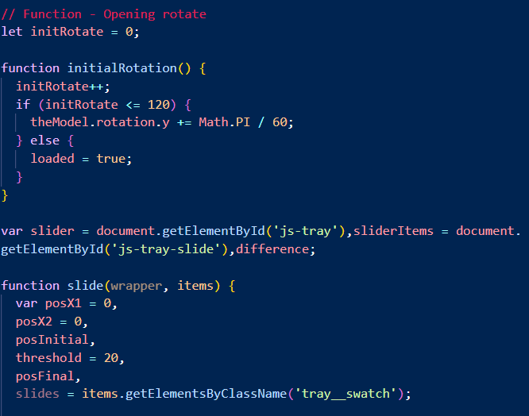
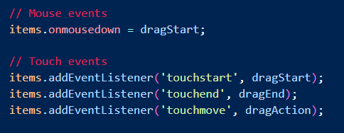
Part 5
Implementation details
Implementation of the light source part
Rotating part of the products
Dragging options part

Slide 12
Part 6
Duties division
w
w
Name : 정현기
- UI (Design)
- Product design management
- Dynamic effects (shadows, lights)
Name: 권성현
- Modeling
- Product Modeling management
- Applying proper models
w
w
Name: 유경준
- Core Logic
- Apply products division parts
- Manage entire codes
Name : 김다미
- Texture
- Find proper textures to apply
- Apply textures to products

Slide 13
Thank You

