Slide 1
Computer Graphics
Team Project Proposal
201732734 정현기 201835407 권성현
201835475 유경준 202035308 김다미

Slide 2
INDEX
01
DIY – Design It Yourself
02
Team Member Information
03
Brief description
04
Key features
05
Tasks scheduling

Slide 3
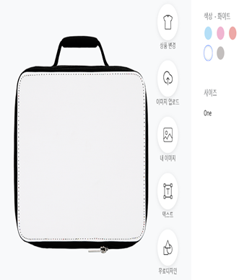
DIY - Design It Yourself
Object of this project is to design various objects easily by yourself.
With this project, you can make the design you want fast and simple.

Slide 4


Team members information
w
w
Name: 정현기
ID : 201732734
Email : jhg8342@gachon.ac.kr
Part: Modeling
Name: 권성현
ID : 201835407
Email : rushhour.k@gmail.com
Part: Texture
w
w
Name: 유경준
ID : 201835475
Email : hermeskj0217@gmail.com
Part: Core Logic
Name : 김다미
ID : 202035308
Email : sspdami@gmail.com
Part: UI(Design)
Youtube URL : https://www.youtube.com/watch?v=LQOHMHmaIl4

Slide 5


Brief description
-Design-
- Perspectives from various angles-
The user can easily change materials and their design with simple movements.
The user can see the object from various angles by applying various effects such as a light source.

Slide 6
Key feature
Select Object
Customize function
Dynamic Effects
You can choose the object you want, such as the shape of a cylinder or box
You can also use the object you have (e.g. glTF)
You can design its surface using drawing tools or image insertion
You can easily design with just a click and drag & drop
You can also enter the required values directly for more precise operations
You can see the results in the desired environment by applying various light source effects
You can see and check the results from various perspectives in real time

Slide 7
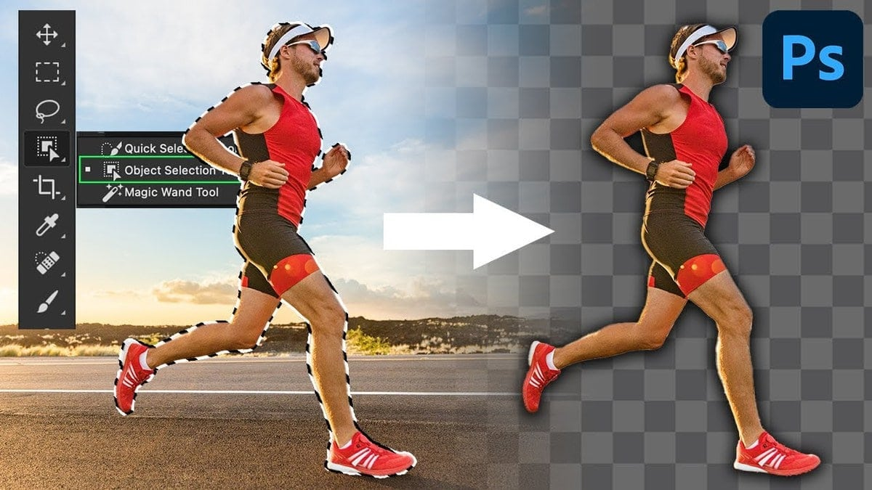
Select Object
We can select objects by using gITF
gITF is a standard file for three-dimensional scenes & models
You can take the image of the object you want and design it yourself
We’re exploring other ways than using gITF

Slide 8

Customize function
We will implement a technology that directly selects and applies the desired structure to the desired object
The surface of an object can be expressed in various materials
Anyone of all ages can participate and modify easily
It can be designed directly by inserting various options

Slide 9

Dynamic Effects
ThreeJS graphics library is used for rendering 3D graphics in web browser.
We expect various light source effects from various angles through the Three JS library
We expect that these effects will enable us to provide users with information from various visible aspects

Slide 10










Tasks scheduling
Step 1
• Discuss what
technologies should be used
• Research about background
Step 3
• Specify the function of
the program
• Complement shortcomings
Step 5
• Project Topic selection
• Make plans
• Discuss details
of the program
• Basic function
program creation
• Final check
• Finish the project
Step 2
Step 4

Slide 11
Thank you

