Slide 1

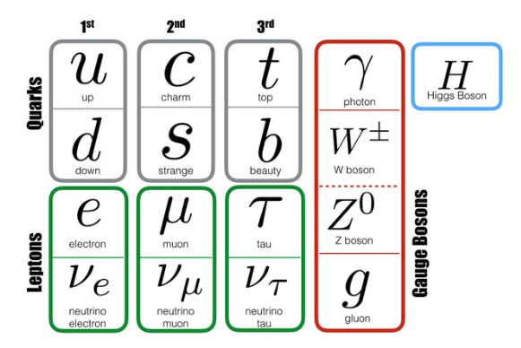
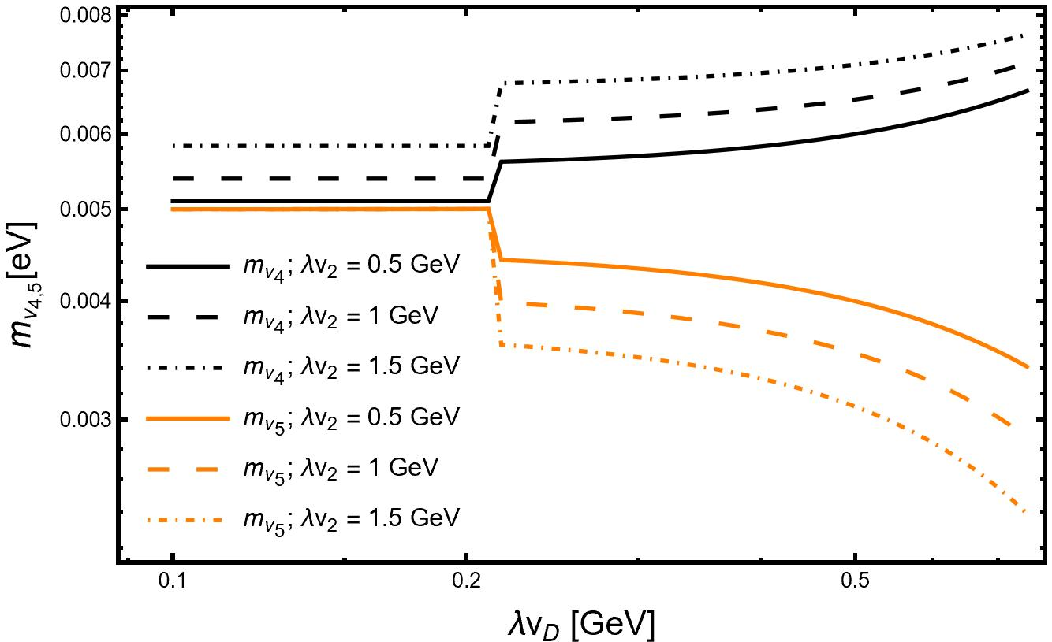
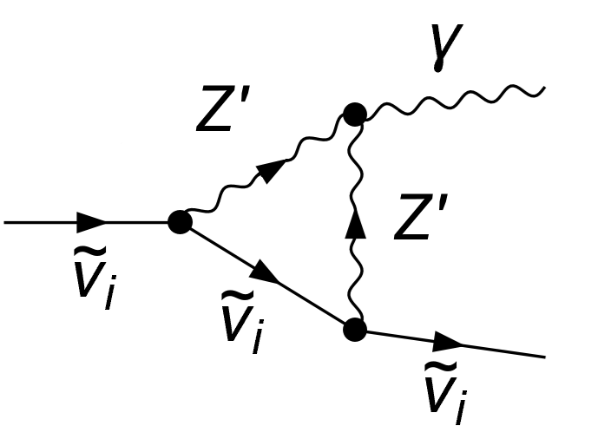
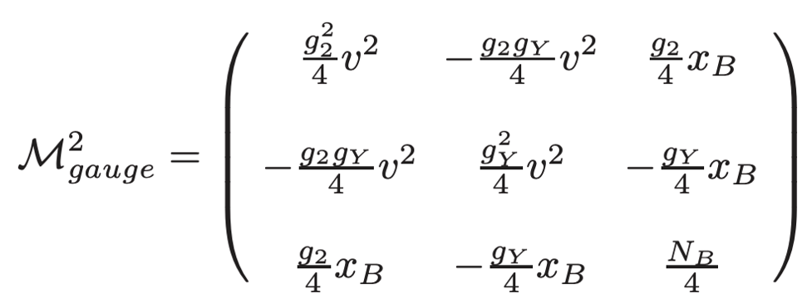
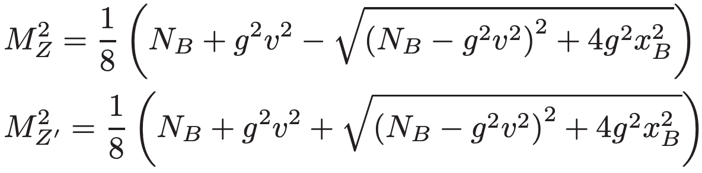
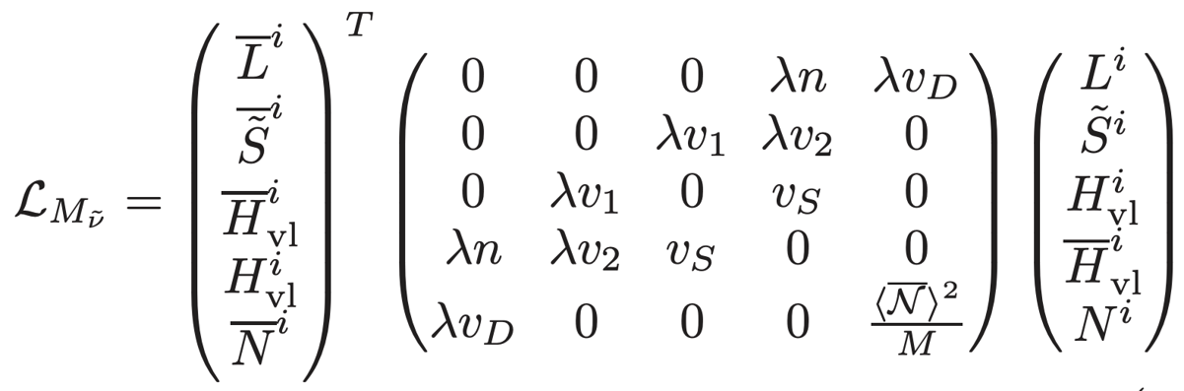
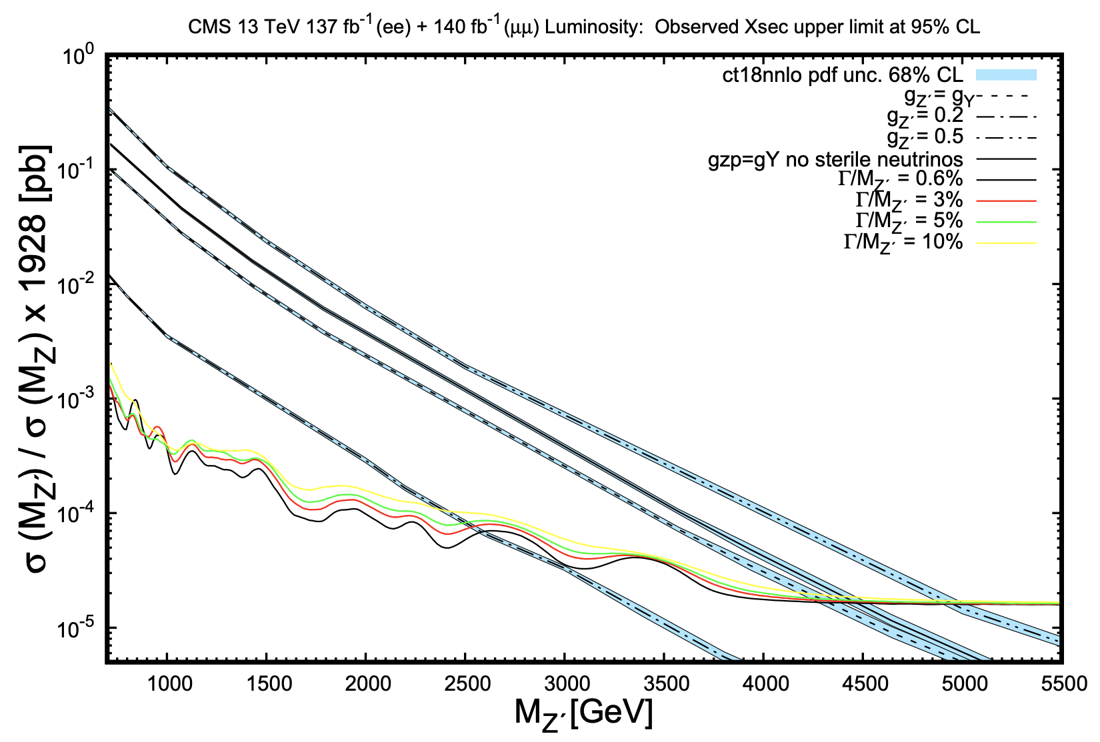
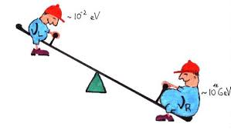
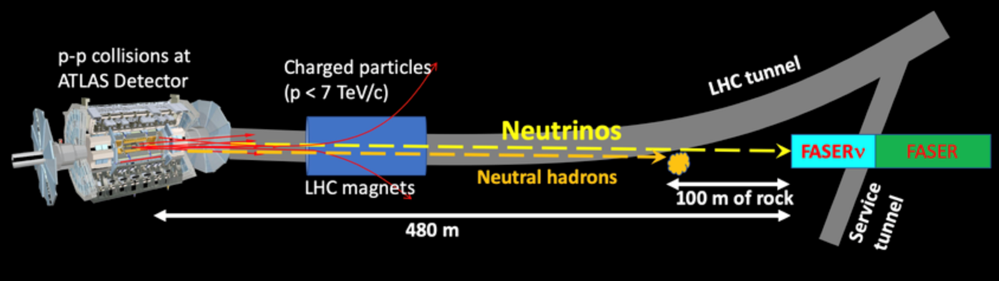


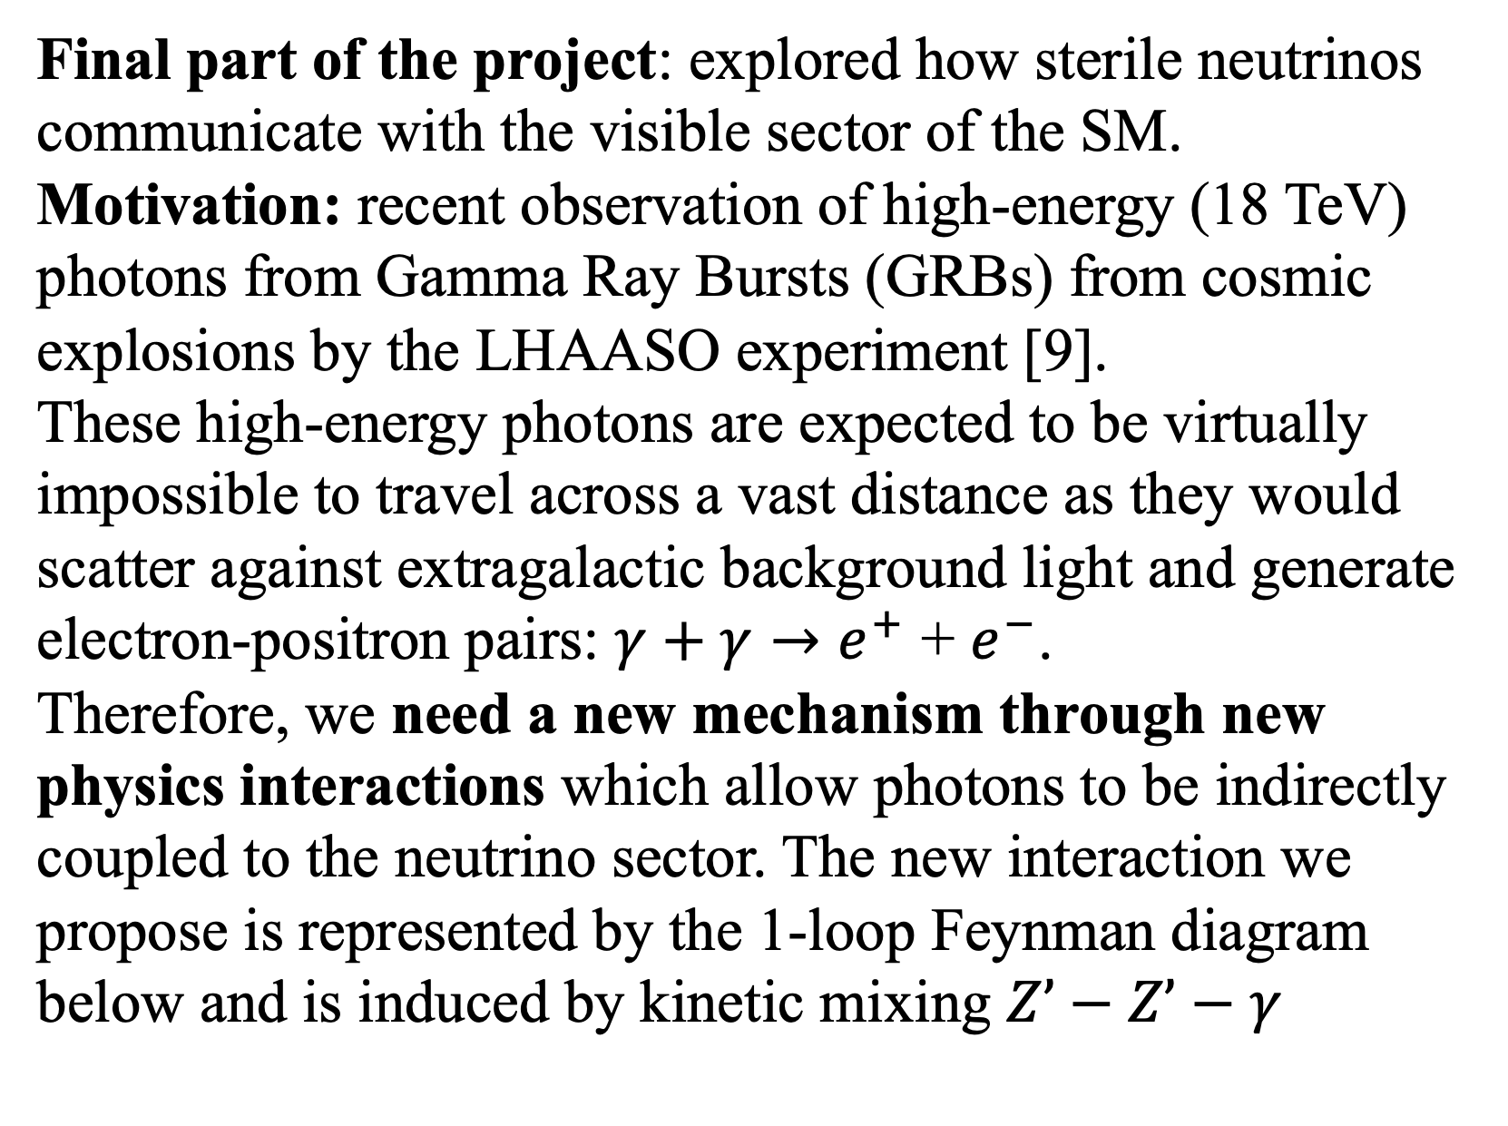
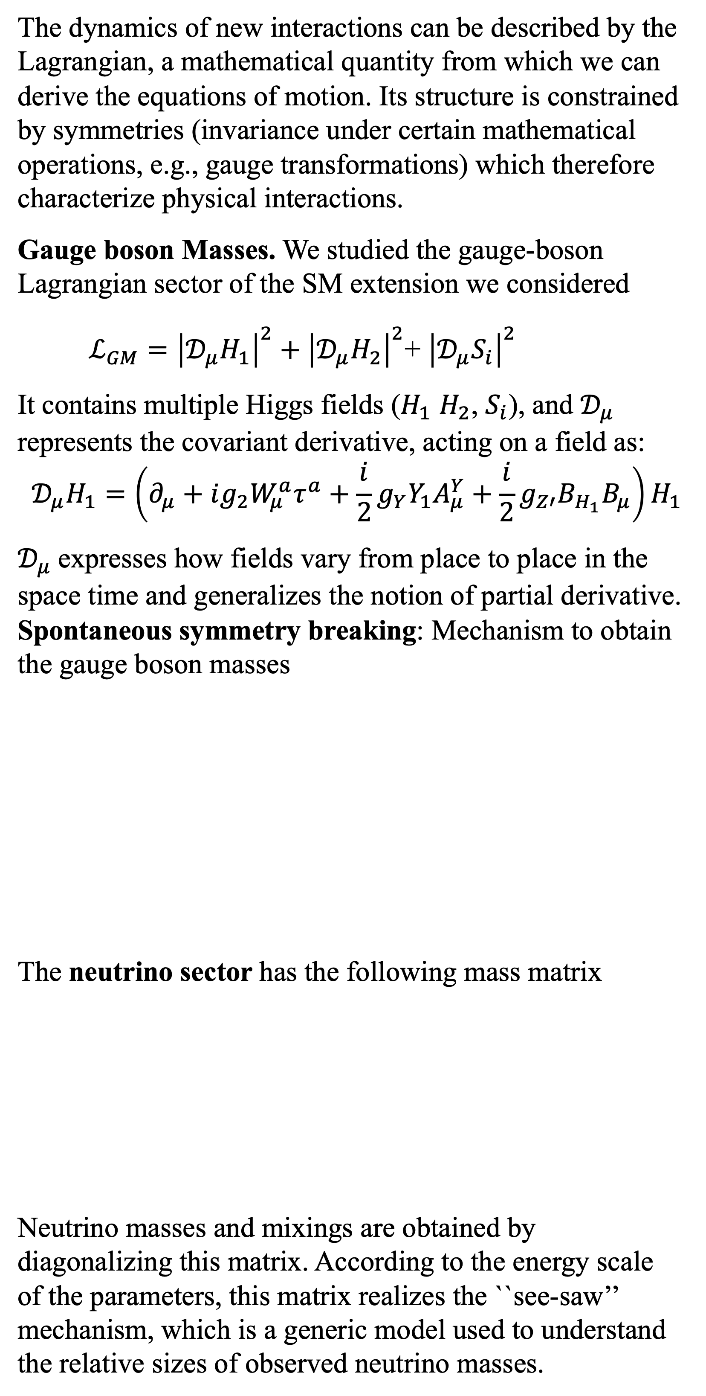
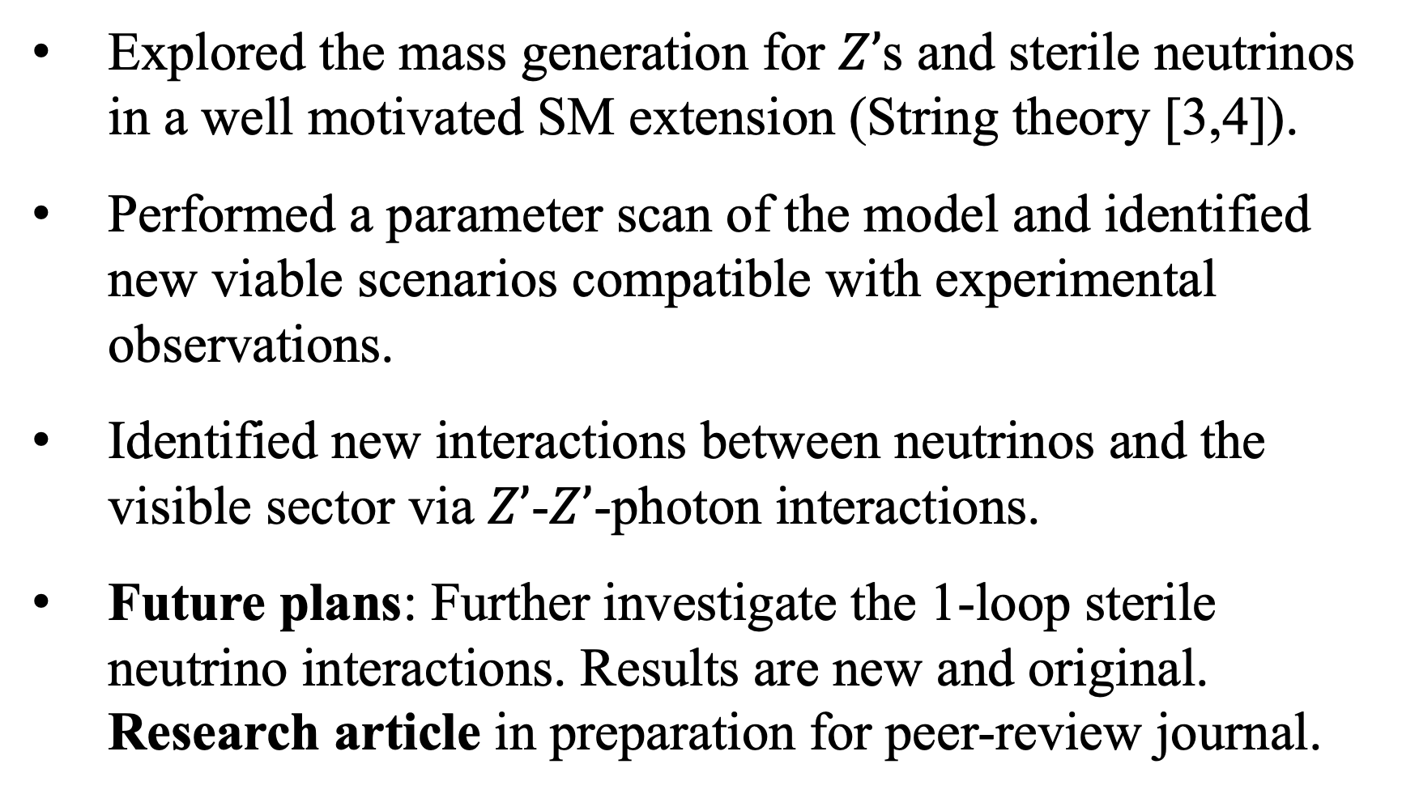
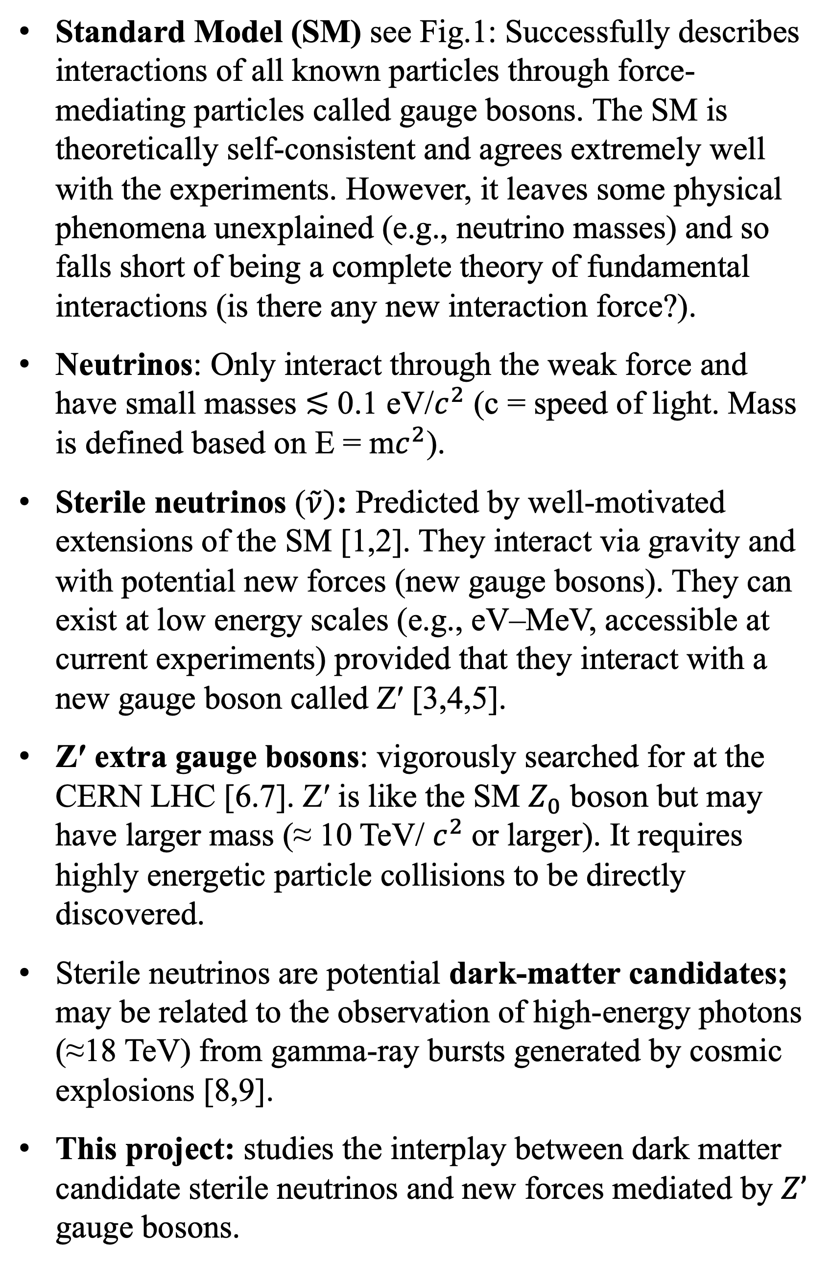

Z’ and Sterile-Neutrino Interactions in Connection to
Dark Matter
By: Johnny DeMont Mentor: Dr. Marco Guzzi
Department of Physics
THE STANDARD MODEL
Z’ AND STERILE-NEUTRINO MASSES
PARAMETER SPACE
RELATION TO COSMOLOGY
Is it the end of the story?
Are there new particles?
(Dark Matter)
New Interactions?
(Extra gauge bosons)
The dynamics of new interactions can be described by the Lagrangian, a mathematical quantity from which we can derive the equations of motion. Its structure is constrained by symmetries (invariance under certain mathematical operations, e.g., gauge transformations) which therefore characterize physical interactions.
Gauge boson Masses. We studied the gauge-boson Lagrangian sector of the SM extension we considered
$ℒ_{GM}={\left|𝒟_{μ}H_{1}\right|}^{2}+{\left|𝒟_{μ}H_{2}\right|}^{2}$+ ${\left|𝒟_{μ}S_{i}\right|}^{2}$
It contains multiple Higgs fields ($H_{1}$ $H_{2}$, $S_{i}$), and $𝒟_{μ}$ represents the covariant derivative, acting on a field as:
$$𝒟_{μ}H_{1}=\left(∂_{μ}+ig_{2}W_{μ}^{a}τ^{a}+\frac{i}{2}g_{Y}Y_{1}A_{μ}^{Y}+\frac{i}{2}g_{Z′}B_{H_{1}}B_{μ}\right)H_{1}$$
$𝒟_{μ}$expresses how fields vary from place to place in the space time and generalizes the notion of partial derivative. Spontaneous symmetry breaking: Mechanism to obtain the gauge boson masses
The neutrino sector has the following mass matrix
Neutrino masses and mixings are obtained by diagonalizing this matrix. According to the energy scale of the parameters, this matrix realizes the ``see-saw’’ mechanism, which is a generic model used to understand the relative sizes of observed neutrino masses.
We performed a scan of the parameter space of the neutrino sector. We found a non-trivial class of parameters that generates neutrino masses compatible with the current experimental limits.
The results are then used to explore $Z’$ and sterile neutrino interactions and their relation to SM particles.
Final part of the project: explored how sterile neutrinos communicate with the visible sector of the SM. Motivation: recent observation of high-energy (18 TeV) photons from Gamma Ray Bursts (GRBs) from cosmic explosions by the LHAASO experiment [9].
These high-energy photons are expected to be virtually impossible to travel across a vast distance as they would scatter against extragalactic background light and generate electron-positron pairs: $γ+γ→e^{+}$ + $e^{−}$.
Therefore, we need a new mechanism through new physics interactions which allow photons to be indirectly coupled to the neutrino sector. The new interaction we propose is represented by the 1-loop Feynman diagram below and is induced by kinetic mixing $Z’−Z’−γ$
Fig.1: Standard Model particle content
PROBLEM STATEMENT
Standard Model (SM) see Fig.1: Successfully describes interactions of all known particles through force-mediating particles called gauge bosons. The SM is theoretically self-consistent and agrees extremely well with the experiments. However, it leaves some physical phenomena unexplained (e.g., neutrino masses) and so falls short of being a complete theory of fundamental interactions (is there any new interaction force?).
Neutrinos: Only interact through the weak force and have small masses ≲ 0.1 eV/$c^{2}$ (c = speed of light. Mass is defined based on E = m$c^{2}$).
Sterile neutrinos ($\tilde{ν})$: Predicted by well-motivated extensions of the SM [1,2]. They interact via gravity and with potential new forces (new gauge bosons). They can exist at low energy scales (e.g., eV–MeV, accessible at current experiments) provided that they interact with a new gauge boson called Z′ [3,4,5].
Z′ extra gauge bosons: vigorously searched for at the CERN LHC [6.7]. Z′ is like the SM $Z_{0}$ boson but may have larger mass (≈ 10 TeV/ $c^{2}$or larger). It requires highly energetic particle collisions to be directly discovered.
Sterile neutrinos are potential dark-matter candidates; may be related to the observation of high-energy photons (≈18 TeV) from gamma-ray bursts generated by cosmic explosions [8,9].
This project: studies the interplay between dark matter candidate sterile neutrinos and new forces mediated by $Z’$ gauge bosons.
Fig.3: Light sterile neutrino masses from our model
Fig.5: Feynman diagram for the $\tilde{ν}\tilde{ν}γ$ 1-loop coupling.
Z’ DECAY RATES
CONCLUSIONS
We studied the decay rate of the $Z’$ into the lightest neutrino states we found. The SM $Z$ and the $Z’$ masses are
The $Z’→\tilde{ν}\overline{\tilde{ν}}$ decay rate is
$$Γ_{Z^{′}→i,j}=\frac{M_{Z′}}{12π}\left[g_{V,ij}^{2}+g_{A,ij}^{2}\right]$$
This has an impact on $Z’$ searches in proton-proton collisions at the LHC (see Fig. 4 from [4])
Explored the mass generation for $Z’$s and sterile neutrinos in a well motivated SM extension (String theory [3,4]).
Performed a parameter scan of the model and identified new viable scenarios compatible with experimental observations.
Identified new interactions between neutrinos and the visible sector via $Z’$-$Z’$-photon interactions.
Future plans: Further investigate the 1-loop sterile neutrino interactions. Results are new and original. Research article in preparation for peer-review journal.
REFERENCES
Y. Grossman, TASI Lectures hep-ph/0305245
Dasgupta and Kopp, Phys.Rept. 928 (2021)
Faraggi, Eur.Phys.J.C 78 (2018) 10, 867
Guzzi and Faraggi, EPJ C82 7, (2022)
McEntaggart, Guzzi, Faraggi, EPJ C83 1, (2023)
The CMS Coll. JHEP 07 (2021) 208; 2103.02708
FASER Exp. Anchordoqui et. al, Phys.Rept. 968 (2022)
Guo, Khlopov, et. al, PRD 108, L021302 (2023)
LHAASO, Y. Huang,et. al., GCN Circular 32677, 2022
Acknowledgments. I would like to express my deep gratitude to my mentor, and Birla Carbon for providing me with the opportunity and support to conduct this research.
Fig.2: FASER Experiment at CERN
Fig.3: See-saw mechanism animated cartoon [1]
Fig.4: $Z’$ mass limits for our model from CMS [4]

