Slide 1

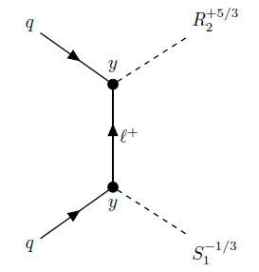
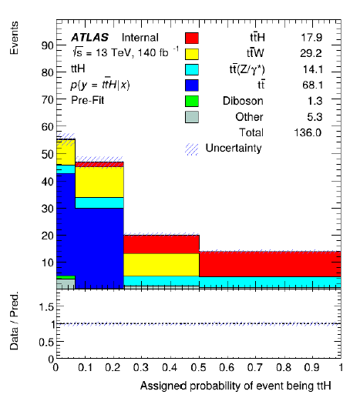
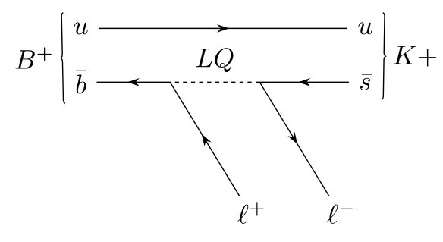

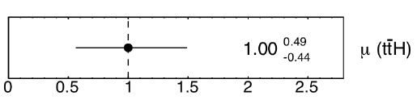



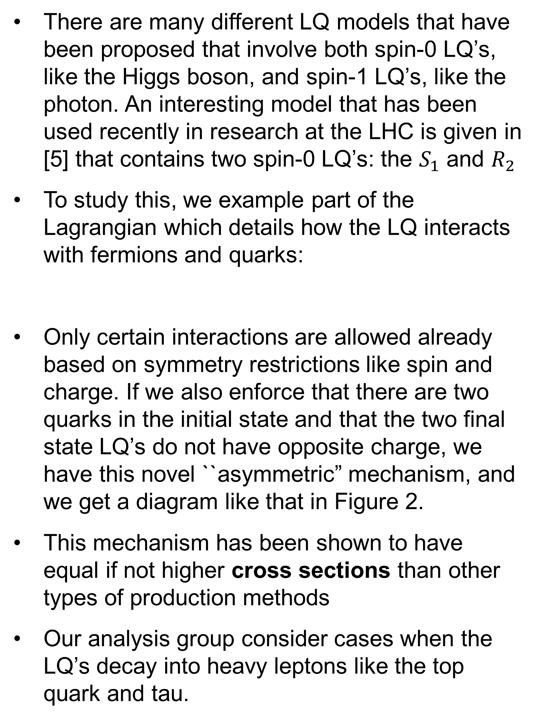
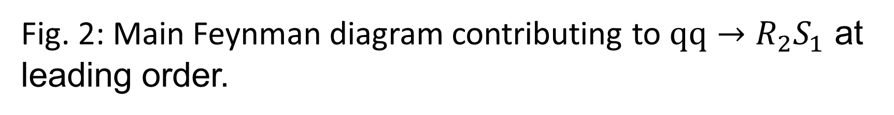
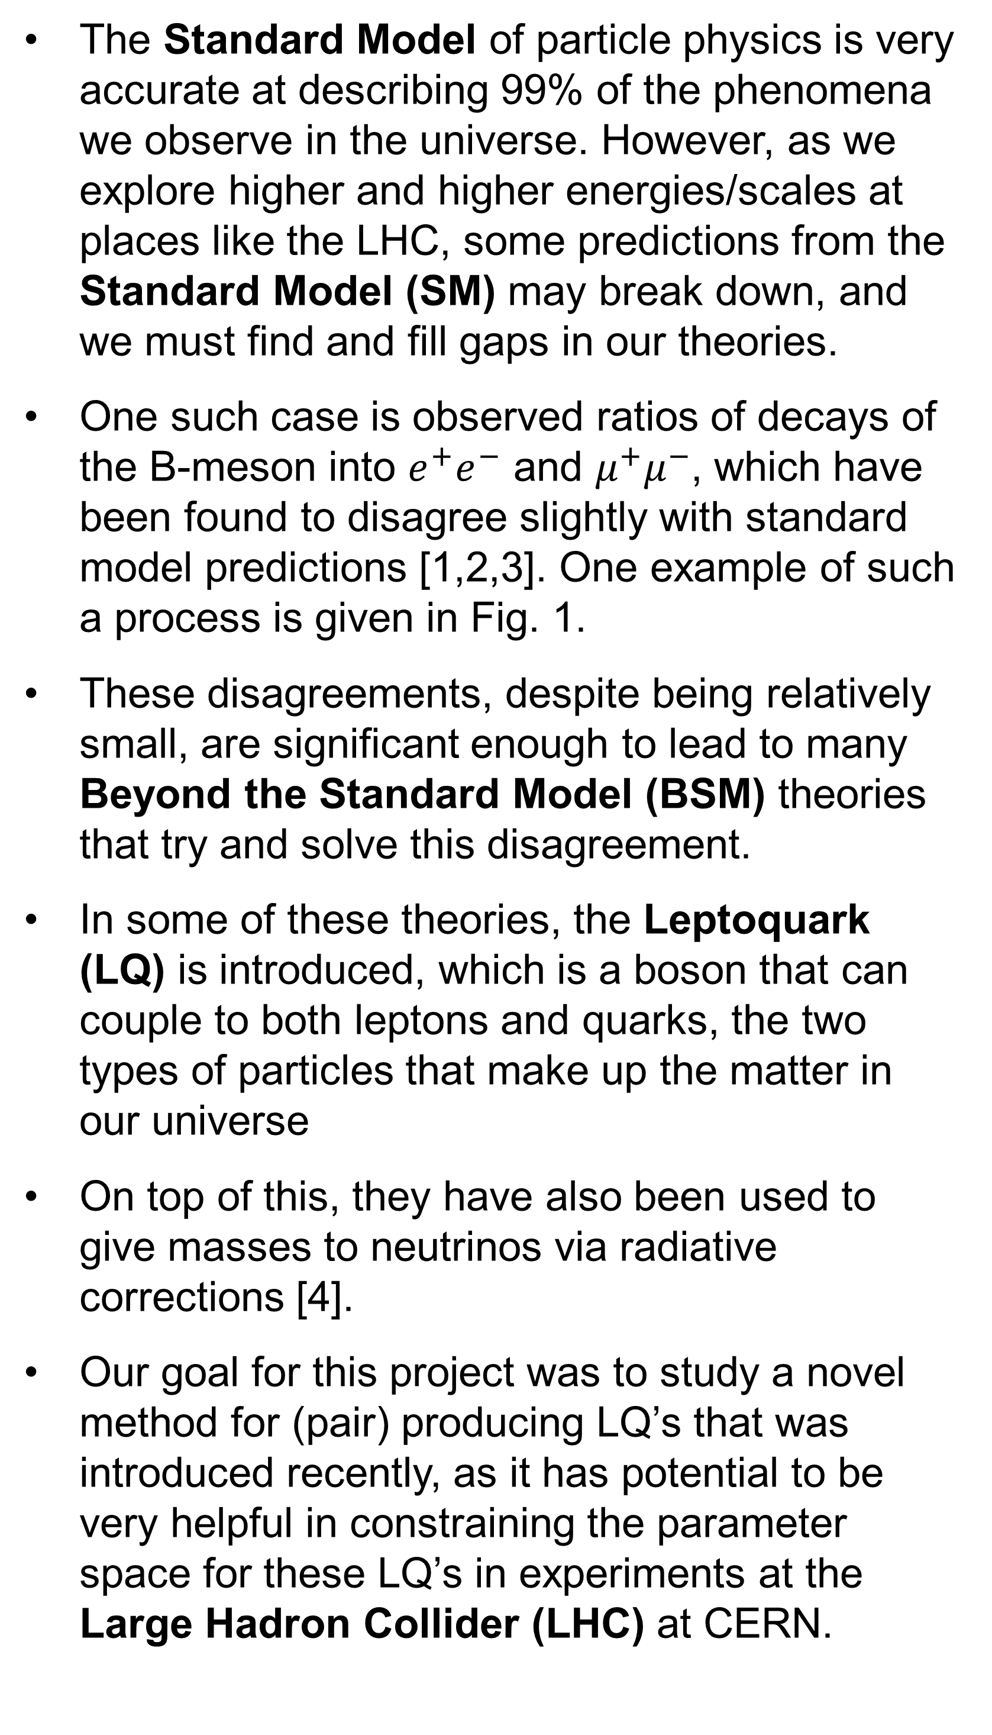
Novel Asymmetric Leptoquark Pair Production Mechanism
By: Casey Hampson
BACKGROUND
METHODOLOGY
RESULTS/CONCLUSIONS
The Standard Model of particle physics is very accurate at describing 99% of the phenomena we observe in the universe. However, as we explore higher and higher energies/scales at places like the LHC, some predictions from the Standard Model (SM) may break down, and we must find and fill gaps in our theories.
One such case is observed ratios of decays of the B-meson into $e^{+}e^{−}$ and $μ^{+}μ^{−}$, which have been found to disagree slightly with standard model predictions [1,2,3]. One example of such a process is given in Fig. 1.
These disagreements, despite being relatively small, are significant enough to lead to many Beyond the Standard Model (BSM) theories that try and solve this disagreement.
In some of these theories, the Leptoquark (LQ) is introduced, which is a boson that can couple to both leptons and quarks, the two types of particles that make up the matter in our universe
On top of this, they have also been used to give masses to neutrinos via radiative corrections [4].
Our goal for this project was to study a novel method for (pair) producing LQ’s that was introduced recently, as it has potential to be very helpful in constraining the parameter space for these LQ’s in experiments at the Large Hadron Collider (LHC) at CERN.
We call the full production/decay of LQ’s and subsequent decay of the top/tau as the signal, and we try and differentiate it from other processes that leave the same final state particles, called the background.
These processes include Higgs production, heavy boson production/decays, top quark pair production, and others.
We simulated these interactions using advanced event generators like MadGraph5 and to generate millions of events containing this signal and the associated final-state particles
CERN’s data format includes hundred of properties/parameters; we applied machine learning to our simulated dataset and previously simulated datasets from the backgrounds to see if the model could ``separate’’ our signal from background.
The analysis code that was used needed to be heavily modified and improved to take into consideration newer developments in CERN’s data format for simulation outputs
Our LQ signal was not ready; this pipeline was tested on previous Higgs production to ensure it was working correctly and make comparisons.
In Figure 4, we see the output of the machine learning model in classifying events as either the signal (Higgs production) or one of the backgrounds. Evidently, the model does well at separating the signal
In Figure 3 we see the uncertainties associated with the model‘s prediction; we note that this is an improvement over the previous analysis. [7]
In this project, we studied a promising novel mechanism for producing LQ‘s at the LHC
We tested/compared newly updated analysis code on ttH to ensure validity and make it ready for the soon-to-be-finished LQ signal
Next steps: At KSU, we are exploring higher order corrections and delving into the deeper proton structure, so with this knowledge, we will be able to make improved predictions for this novel LQ production mechanism in relation to its study at the LHC.
Fig. 2: Main Feynman diagram contributing to $qq→R_{2}S_{1}$ at leading order.
NOVEL PAIR PRODUCTION MECHANISM
There are many different LQ models that have been proposed that involve both spin-0 LQ’s, like the Higgs boson, and spin-1 LQ’s, like the photon. An interesting model that has been used recently in research at the LHC is given in [5] that contains two spin-0 LQ’s: the $S_{1}$ and $R_{2}$
To study this, we example part of the Lagrangian which details how the LQ interacts with fermions and quarks:
Only certain interactions are allowed already based on symmetry restrictions like spin and charge. If we also enforce that there are two quarks in the initial state and that the two final state LQ’s do not have opposite charge, we have this novel ``asymmetric” mechanism, and we get a diagram like that in Figure 2.
This mechanism has been shown to have equal if not higher cross sections than other types of production methods
Our analysis group consider cases when the LQ’s decay into heavy leptons like the top quark and tau.
REFERENCES
LHCb collab.: arXiv.2406.03387
LHCb collab.; arXiv.2312.09115
ATLAS/CMS collabs.; 2405.11572
Babu and Julio; arXiv.1006.1092
Doršner, Lejlić, Saad; arXiv.2210.11004
Doršner, Fajfer, Lejlić; arXiv.2103.11702
Yazykov; CERN-CDS:2871484
Acknowledgements: I would like to thank Dr. Marco Guzzi and the NSF for supporting my physics research, as well as UMICH and CERN for organizing the summer REU at CERN.
Fig. 1: Example of a Feynman diagram with a LQ involved in a flavor-changing B-meson decay.
Fig. 3: Uncertainty with machine learning model predictions (statistics only)
Fig. 4: Machine learning output for ttH classification.

