Slide 1

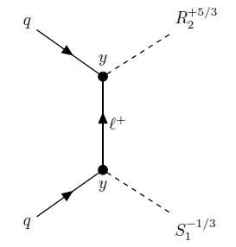
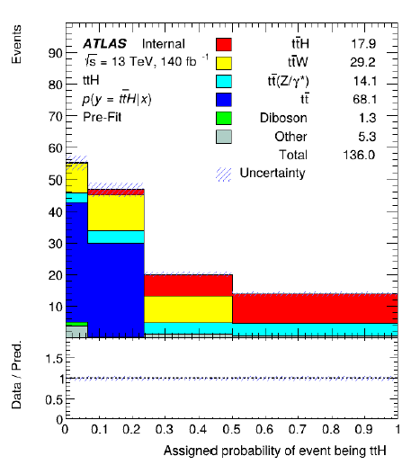
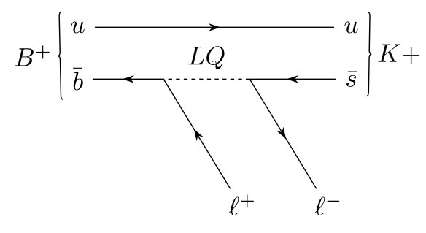

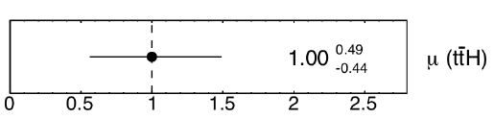



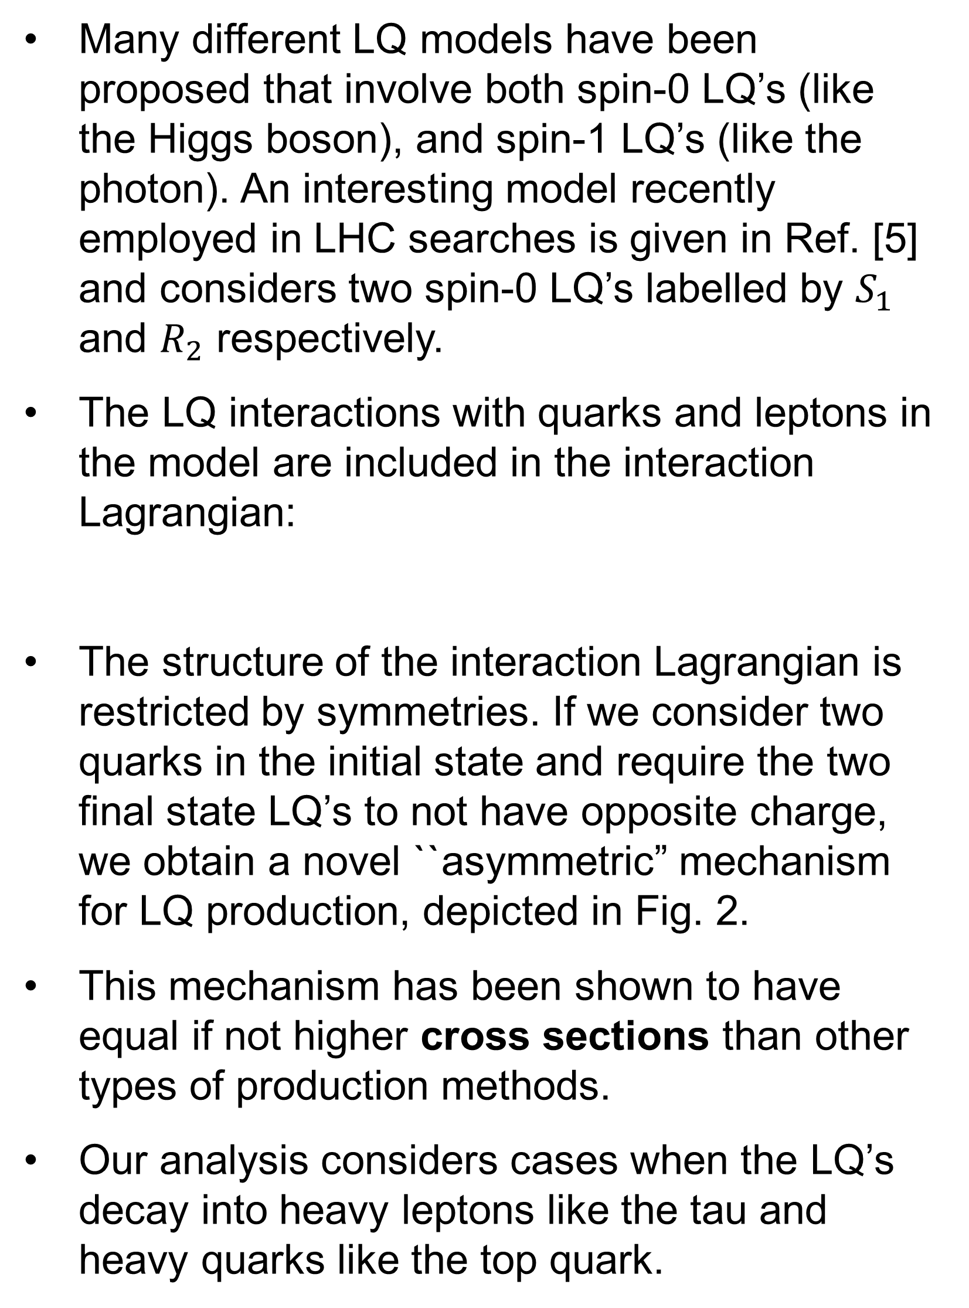
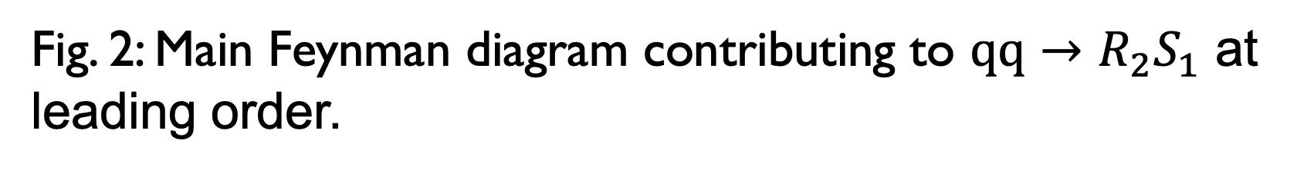
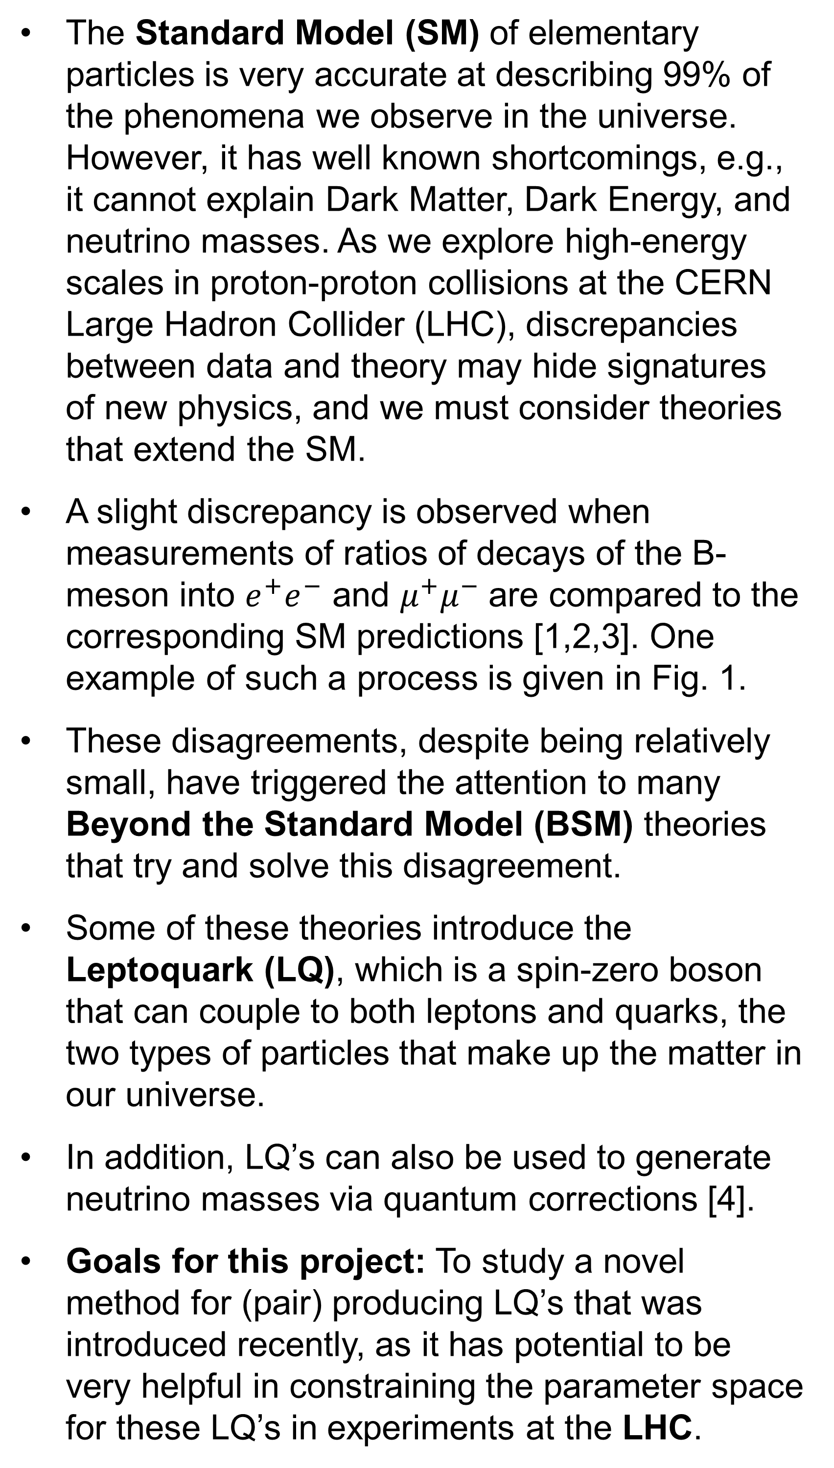
Novel Asymmetric Leptoquark Pair Production Mechanism
By: Casey Hampson
KSU Mentor: Dr. Marco Guzzi
REU @CERN Mentor: Dr. André Sopczak
BACKGROUND
METHODOLOGY
RESULTS/CONCLUSIONS
The Standard Model (SM) of elementary particles is very accurate at describing 99% of the phenomena we observe in the universe. However, it has well known shortcomings, e.g., it cannot explain Dark Matter, Dark Energy, and neutrino masses. As we explore high-energy scales in proton-proton collisions at the CERN Large Hadron Collider (LHC), discrepancies between data and theory may hide signatures of new physics, and we must consider theories that extend the SM.
A slight discrepancy is observed when measurements of ratios of decays of the B-meson into $e^{+}e^{−}$ and $μ^{+}μ^{−}$ are compared to the corresponding SM predictions [1,2,3]. One example of such a process is given in Fig. 1.
These disagreements, despite being relatively small, have triggered the attention to many Beyond the Standard Model (BSM) theories that try and solve this disagreement.
Some of these theories introduce the Leptoquark (LQ), which is a spin-zero boson that can couple to both leptons and quarks, the two types of particles that make up the matter in our universe.
In addition, LQ’s can also be used to generate neutrino masses via quantum corrections [4].
Goals for this project: To study a novel method for (pair) producing LQ’s that was introduced recently, as it has potential to be very helpful in constraining the parameter space for these LQ’s in experiments at the LHC.
The full production/decay of LQ’s and subsequent decay of the top/tau represents the signal, which must be distinguished from other processes that share the same final-state particles, which represent the background.
The background may include Higgs production, heavy boson production/decays, top quark pair production, and other processes.
We simulated these interactions using advanced event generators like MadGraph5 and to generate millions of events containing this signal and the associated final-state particles
CERN’s data format includes hundred of properties/parameters; we applied machine learning to our simulated dataset and previously simulated datasets from the backgrounds to see if the model could ``separate’’ our signal from background.
The analysis code that was used has been heavily modified and improved to take into consideration newer developments in CERN’s data format for simulation outputs
We tested our LQ signal chain based on previous Higgs production to ensure correctness before start making comparisons.
Fig. 4 shows the output of our machine learning model and its ability to classify events as either the ttH signal or one of the backgrounds. From Fig.4, the model does well at separating the signal from the background.
Fig. 3 shows the uncertainties associated with the model‘s prediction; we note that this is an improvement over the previous analysis of ref. [7]
In this project, we studied a promising novel mechanism for producing LQ‘s at the LHC.
We tested/compared newly updated analysis code on ttH to ensure validity and make it ready for the soon-to-be-finished LQ signal
Next Steps: At KSU, we study hadron collider phenomenology, QCD corrections, and delving into the structure of the proton. This knowledge is critical for a deeper understanding of LQ and, in general, for all BSM searches at the LHC. In addition, this knowledge will allow us to improve LQ predictions for novel LQ production mechanisms at the LHC.
Fig. 2: Main Feynman diagram contributing to $qq→R_{2}S_{1}$ at leading order.
NOVEL PAIR PRODUCTION MECHANISM
Many different LQ models have been proposed that involve both spin-0 LQ’s (like the Higgs boson), and spin-1 LQ’s (like the photon). An interesting model recently employed in LHC searches is given in Ref. [5] and considers two spin-0 LQ’s labelled by $S_{1}$ and $R_{2}$ respectively.
The LQ interactions with quarks and leptons in the model are included in the interaction Lagrangian:
The structure of the interaction Lagrangian is restricted by symmetries. If we consider two quarks in the initial state and require the two final state LQ’s to not have opposite charge, we obtain a novel ``asymmetric” mechanism for LQ production, depicted in Fig. 2.
This mechanism has been shown to have equal if not higher cross sections than other types of production methods.
Our analysis considers cases when the LQ’s decay into heavy leptons like the tau and heavy quarks like the top quark.
REFERENCES
LHCb collab.: arXiv.2406.03387
LHCb collab.; arXiv.2312.09115
ATLAS/CMS collabs.; 2405.11572
Babu and Julio; arXiv.1006.1092
Doršner, Lejlić, Saad; arXiv.2210.11004
Doršner, Fajfer, Lejlić; arXiv.2103.11702
Yazykov; CERN-CDS:2871484
Acknowledgements: I would like to thank Dr. Marco Guzzi and the NSF for supporting my physics research, as well as UMICH and CERN for organizing the summer REU at CERN.
Fig. 1: Example of a Feynman diagram with a LQ involved in a flavor-changing B-meson decay.
Fig. 3: Uncertainty with machine learning model predictions (statistics only)
Fig. 4: Machine learning output for ttH classification.

