Slide 1



Novel Mechanism for Asymmetric Leptoquark Pair Production at Hadron Colliders
Casey Hampson (Department of Physics, Kennesaw State University)
Dr. André Sopczak (CERN; ATLAS Collaboration)
Dr. Marco Guzzi (Department of Physics, Kennesaw State University)

Slide 2
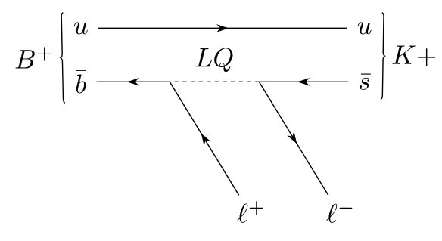
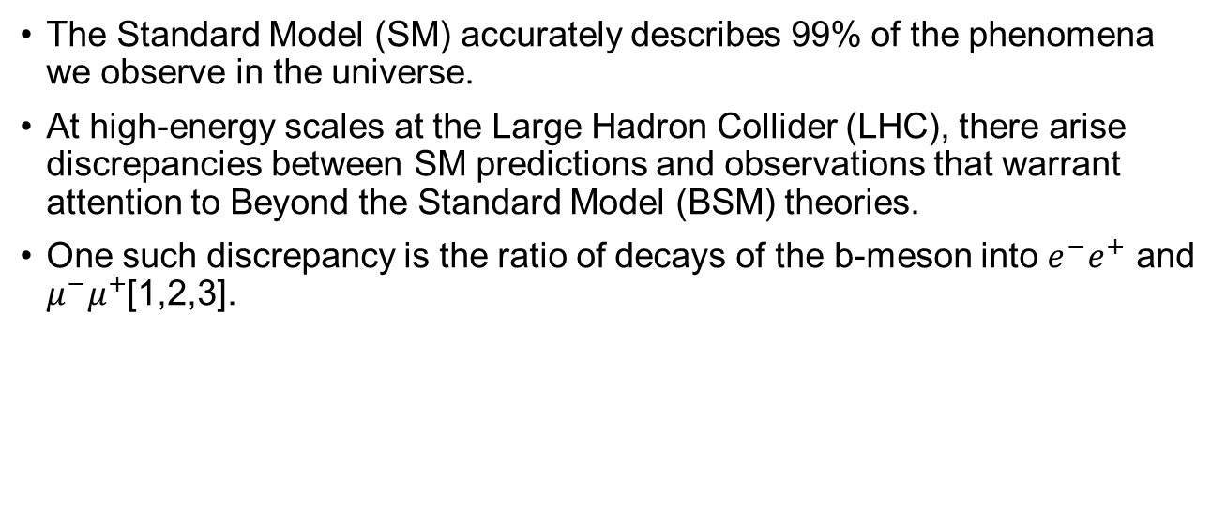
Introduction
The Standard Model (SM) accurately describes 99% of the phenomena we observe in the universe.
At high-energy scales at the Large Hadron Collider (LHC), there arise discrepancies between SM predictions and observations that warrant attention to Beyond the Standard Model (BSM) theories.
One such discrepancy is the ratio of decays of the b-meson into $e^{−}e^{+}$ and $μ^{−}μ^{+}$[1,2,3].

Slide 3
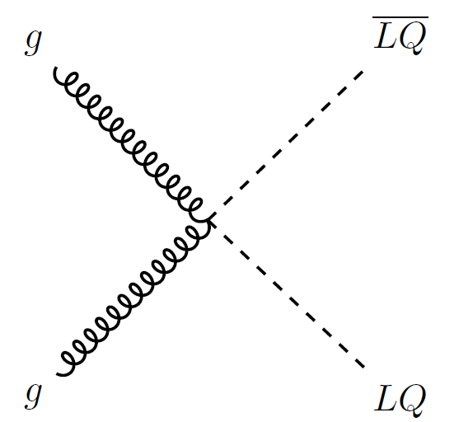
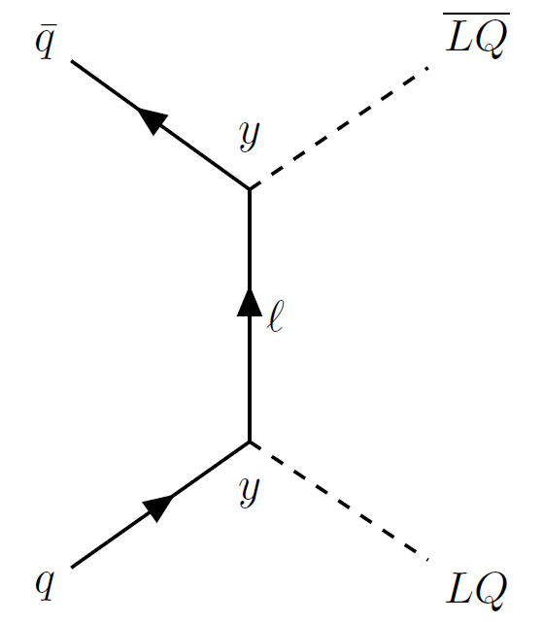
The Leptoquark
Some BSM theories introduce the Leptoquark (LQ), a boson that couples directly to both quarks and leptons.
The LQ can be used to explain the aforementioned discrepancy, as well as generate neutrino masses via quantum corrections [4].
Our goal for this project was to study a novel method for pair producing LQ’s at the LHC

Slide 4
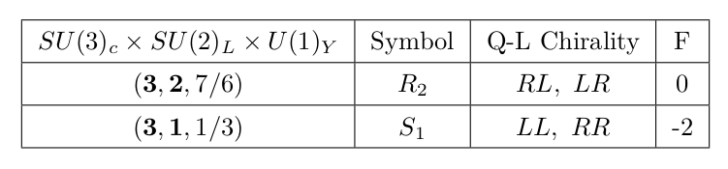
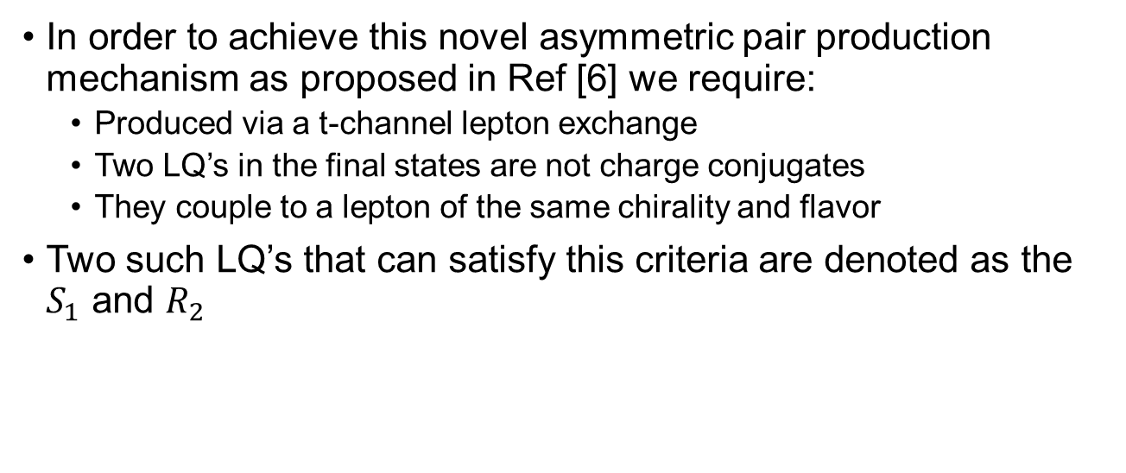
Asymmetric Pair Production
In order to achieve this novel asymmetric pair production mechanism as proposed in Ref [6] we require:
Produced via a t-channel lepton exchange
Two LQ’s in the final states are not charge conjugates
They couple to a lepton of the same chirality and flavor
Two such LQ’s that can satisfy this criteria are denoted as the $S_{1}$ and $R_{2}$

Slide 5
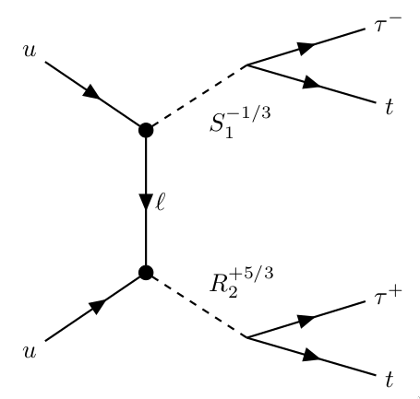
Asymmetric Pair Production
We worked in the 2lSS+1tau group which specializes in more massive decay products
Along with the symmetry constrains from the Lagrangian we specify Yukawa parameters that force decays into top quarks and taus

Slide 6
Analysis
We used advanced event generators and parton showering programs like MagGraph5 and Pythia8 to simulate this
The decays of these heavy particles gives a final state that is almost identical to that of other SM processes
Our goal is to differentiate our final state signature (the signal) from these others (background)
We use machine learning on the vast number of output variables produced by CERN's simulation (ntuples)

Slide 7
Analysis
The previous analysis code was tailored to top quark pair and Higgs production (ttH), and used an older version for data formatting
Lots of work involved updating the analysis code to prepare it for this LQ process and the improved ntuple models
Kept old machine learning model setups, number of layers, epochs, etc., only changed number of input parameters

Slide 8
Results
Our fully processed LQ signal samples that we requested were not finished in time; we only show results of the analysis on previous ttH data to compare performance
After the model was trained, we used a a program called TRExFitter to display some histograms of the model's output
It also generated some preliminary info on the statistical uncertainty, not considering systematics

Slide 9
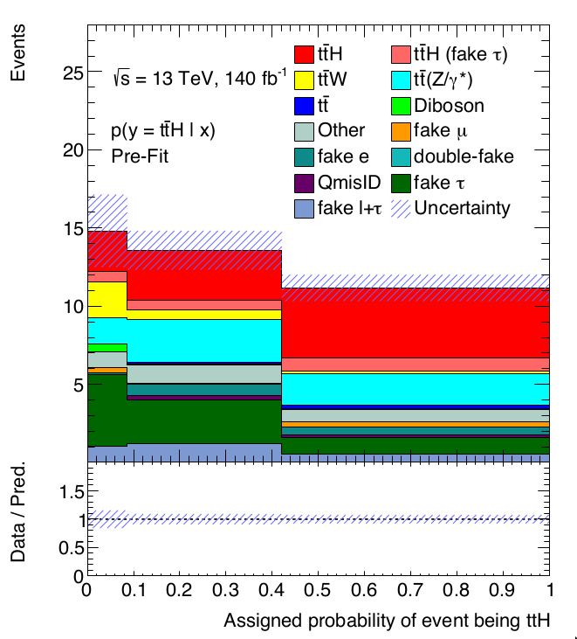
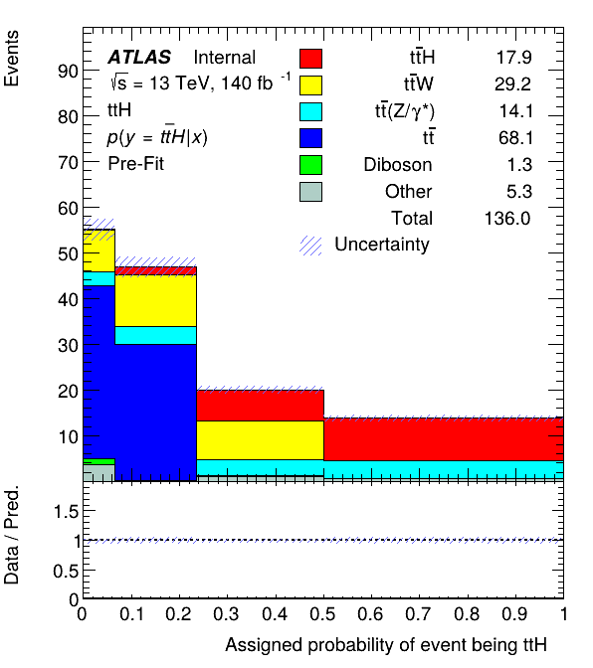
Results – Signal Separation

Slide 10
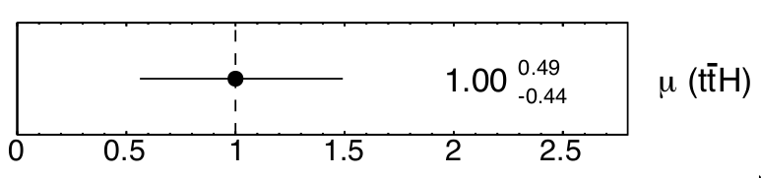
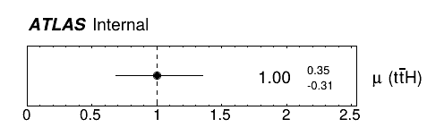
Results – Statistical Uncertainties

Slide 11
Conclusions/Next Steps
We have shown that the analysis code prepared for this novel LQ production method performs very well after preliminary testing
Obviously, inputting the LQ samples are next
Fine tune model parameters
Investigating systematics and things like fake-classification which are left out in the newest ntuple release

Slide 12
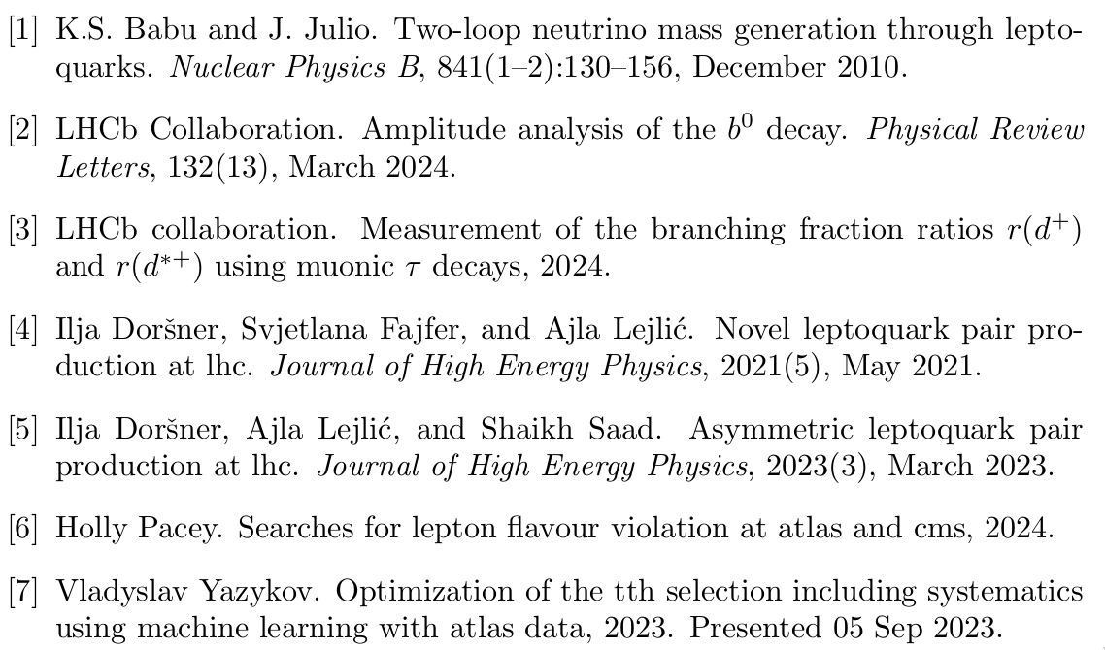
References

