Slide 1


New Mechanisms for Asymmetric Leptoquark Pair Production at Hadron Colliders
Casey Hampson, André Sopczak, Marco Guzzi

Slide 2
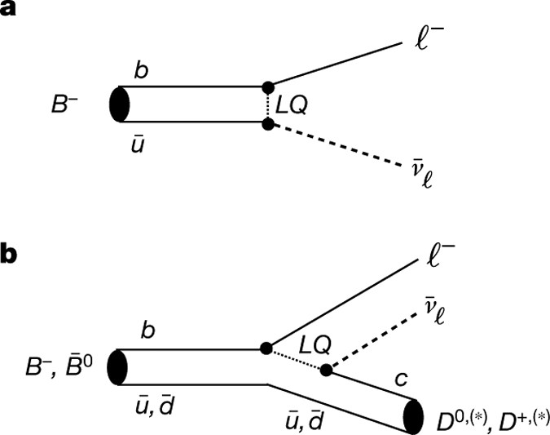
Introduction
Leptoquarks (LQ’s) are hypothesized BSM particles that have both baryon and lepton number, so they can couple to both quarks and leptons
The search for LQ’s have revived in recent years due to higher energy events at the LHC
Can help to explain strange behaviors with B-meson decays; main player being lepton flavour universality (LFU)
We don’t expect it to be violated in these processes, but it seems the case due to discrepancies between theory and experiment

Slide 3

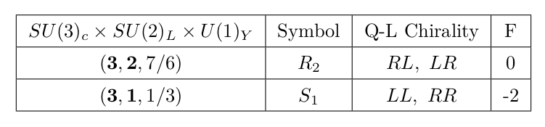
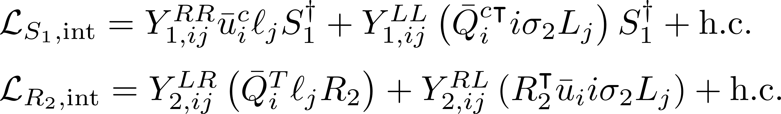
Scalar Leptoquarks
There are both scalar and vector leptoquarks proposed, but we focus on the scalar leptoquarks, specifically the R2 and S1 LQ’s

Slide 4
Scalar Leptoquarks
There are both scalar and vector leptoquarks proposed, but we focus on the scalar leptoquarks, specifically the R2 and S1 LQ’s

Slide 5
Scalar Leptoquarks
There are both scalar and vector leptoquarks proposed, but we focus on the scalar leptoquarks, specifically the R2 and S1 LQ’s

Slide 6
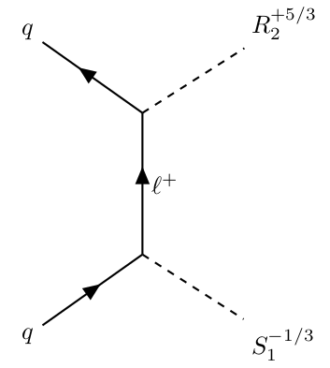
Novel Asymmetric Production Method
We will look at a new method that pair produces two different LQ’s, as opposed to ordinary charge-conjugate pair
Desirable qq initial state for LHC
Requires LQ’s to couple to lepton of same chirality and flavor
Yukawa couplings will determine what these quarks and leptons can/should be

Slide 7
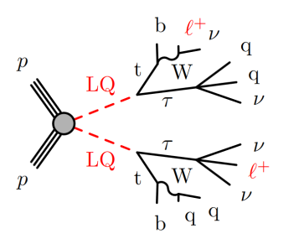
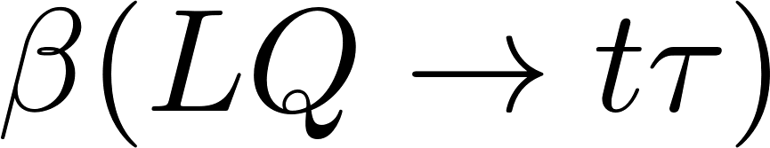
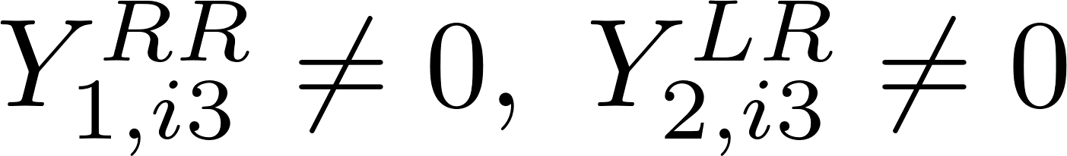
Analysis Channel
Our group focuses on the 2lSS+1tau channel/signature; we are in the Tau+X subgroup -> looking at heavy decay products
To achieve this, we must specify Yukawa couplings such that we have be a sufficient value:
Coupling to only right-chiral 3rd gen leptons -> only the tau
All quarks to avoid PDF suppression of heavy quark initial states

Slide 8
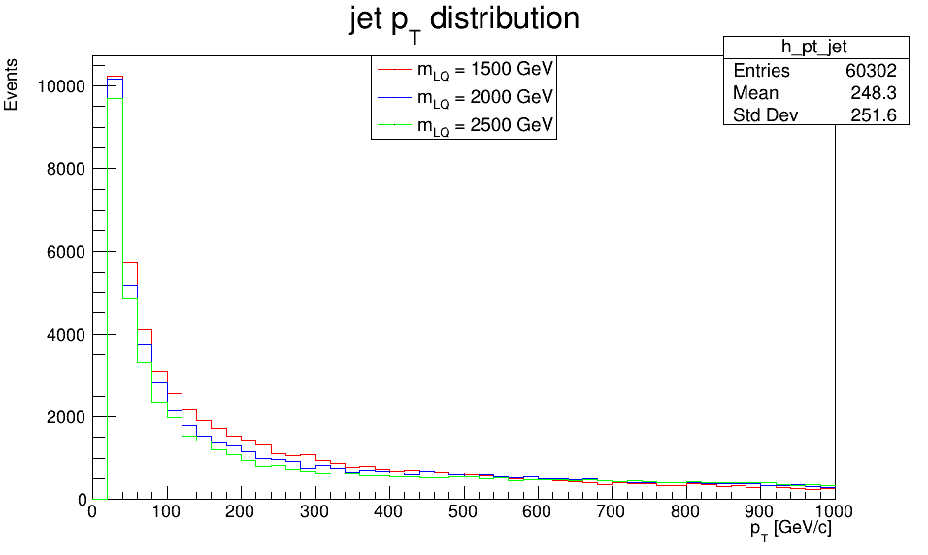
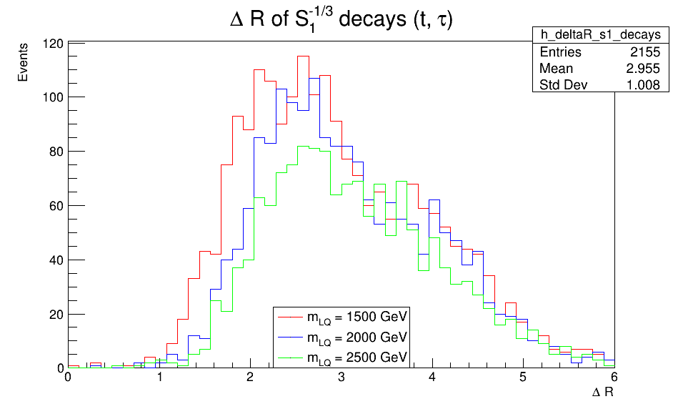
Test Event Generation and Official MC Request
Test our model by generating a small number of samples
Provide it all the necessary parameters, Yukawa couplings, mass points, kinematic cuts, etc.
Hard-scattering simulation with MG5_aMC@NLO, showering with Pythia8
Convert final state raw events into readable data
Can then make “validation” plots for the kinematics to ensure model works
Send off an official MC sample request
https://its.cern.ch/jira/browse/ATLMCPROD-11359
https://indico.cern.ch/event/1439002/#31-taux-pp-lq-mc-request-1010

Slide 9
2lSS+1tau Analysis with ttH as Signal

Slide 10
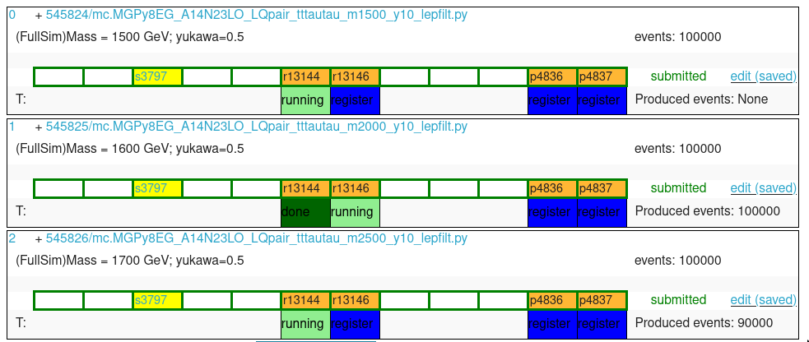
2lSS+1tau Analysis for Rel.22 with ttH as Signal
The full/official LQ samples that we requested were not produced in time
We still needed to port the previous 2lSS+1tau analysis from Rel.21 to Rel.22
Very involved! Many variables changed or were removed entirely; little documentation
Once we show it works and we get the LQ samples, we just move ttH to background and LQ to new signal

Slide 11
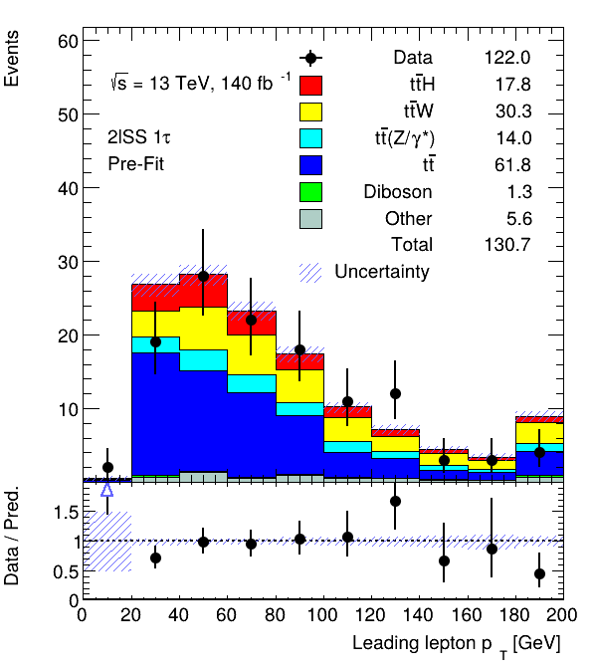
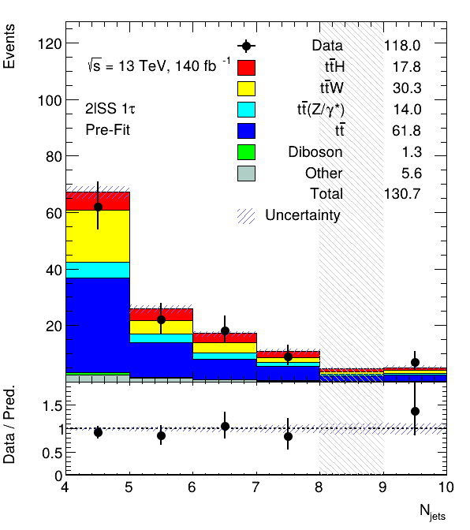
Pre-Fit Plots/Tables
There are a ton of other processes that can contribute to the 2lSS+1tau channel, such as various Higgs productions, boson production, top quark production, etc.
We apply weights to have the simulated processes more closely resemble the actual yields in experiment; selections for more kinematic cuts and other things
More “validation plots”

Slide 12
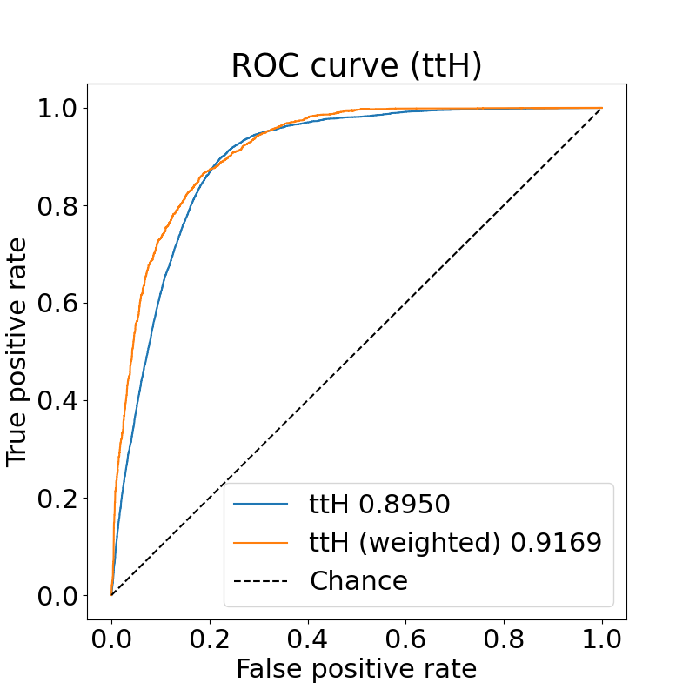
Machine Learning
Due to the huge number of features in the ntuples, and attractive model for separating signal from background is machine learning
Used a simple ResNet-6 for the training; a more complicated model could be trained for a future analysis
Produces probabilities for events being classified as signal

Slide 13
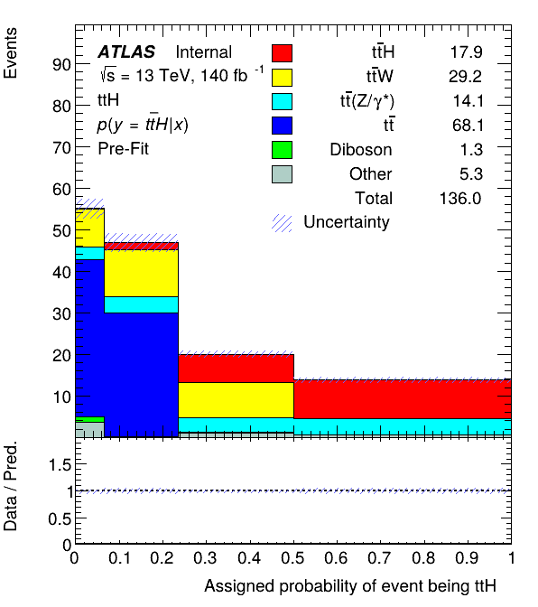
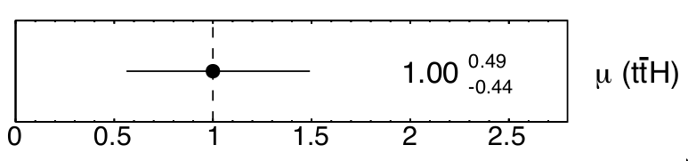
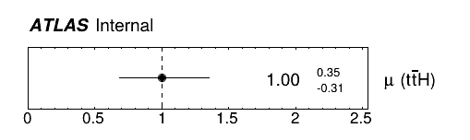
Previous Rel.21
New Rel.22

Slide 14
Conclusions/Next Steps
Look further into PLV and prompt variables to aid in classifying fakes; will help to reduce tt background, for instance, among many other things
Fine tune model parameters, perhaps train a better model like a transformer
Plug in the LQ samples as signal once they are done being produced
Look into non mass-degenerate LQ’s, as well as Yukawa coupling matrix elements that are not equal; we could prioritize the prevalent ones
Huge thanks to everyone at UMICH for doing this program, and thanks to all the summer students too for being cool and making the summer super fun!

Slide 15
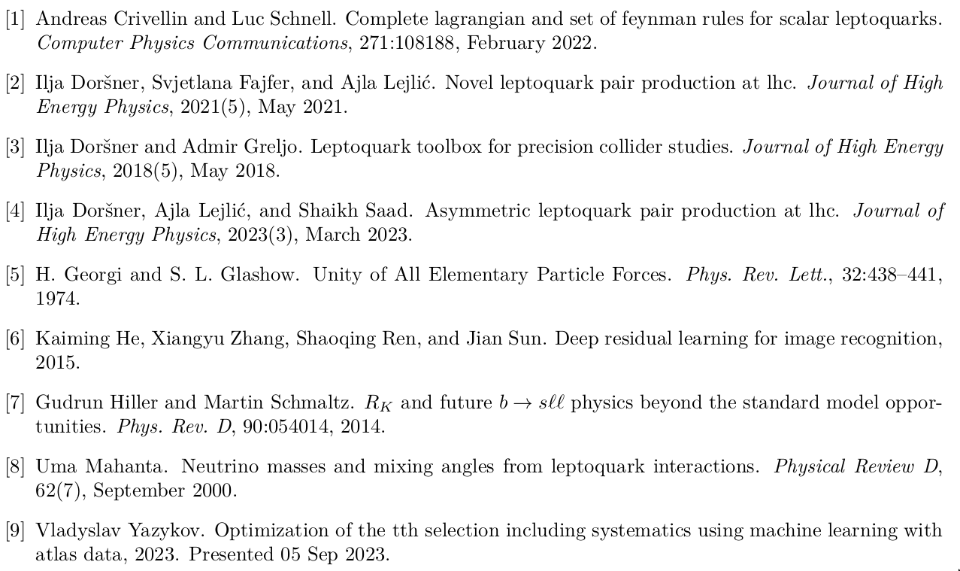
References

