Slide 1




Novel Mechanism for Asymmetric Leptoquark Pair Production at Hadron Colliders
Casey Hampson
(Department of Physics, Kennesaw State University)
Dr. André Sopczak (CERN; ATLAS Collaboration)
Dr. Marco Guzzi (Department of Physics, Kennesaw State University)
91st Annual Meeting of the Southeastern Section
of the American Physics Society
Oct 24–26, 2024 University of North Carolina
at Charlotte, Charlotte, NC, USA

Slide 2
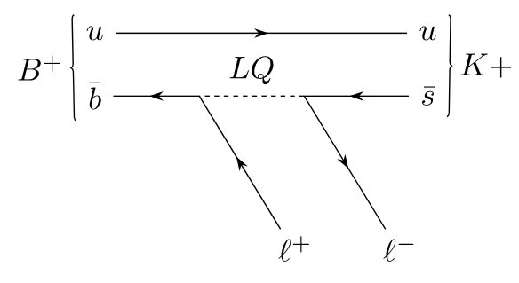
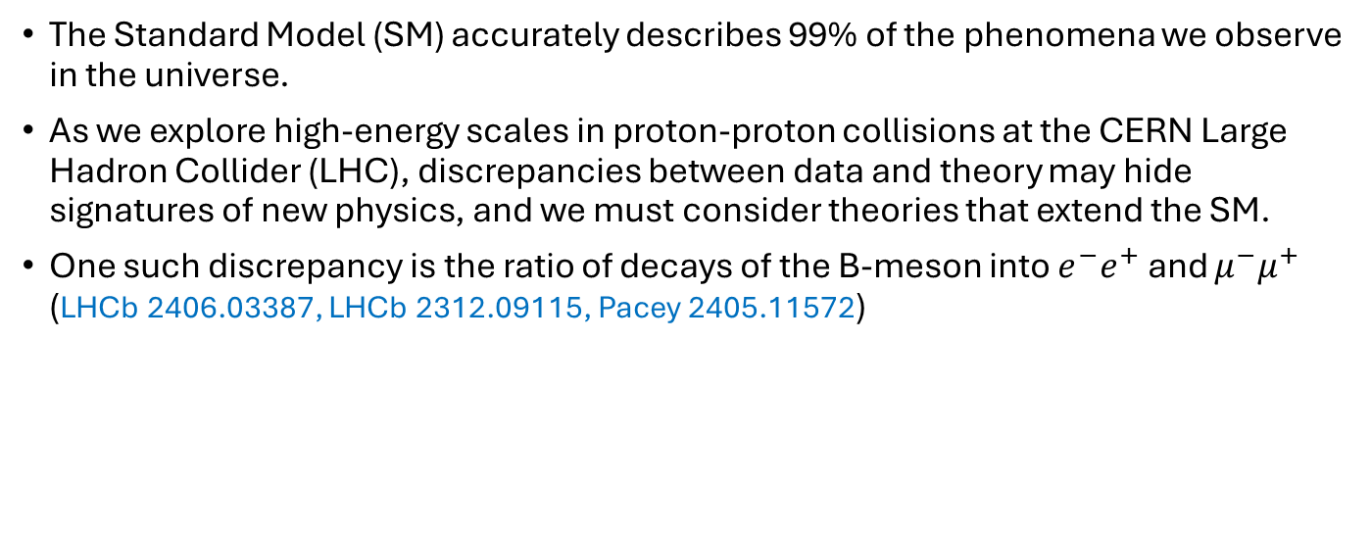
Introduction
The Standard Model (SM) accurately describes 99% of the phenomena we observe in the universe.
As we explore high-energy scales in proton-proton collisions at the CERN Large Hadron Collider (LHC), discrepancies between data and theory may hide signatures of new physics, and we must consider theories that extend the SM.
One such discrepancy is the ratio of decays of the B-meson into $e^{−}e^{+}$ and $μ^{−}μ^{+}$ (LHCb 2406.03387, LHCb 2312.09115, Pacey 2405.11572)

Slide 3
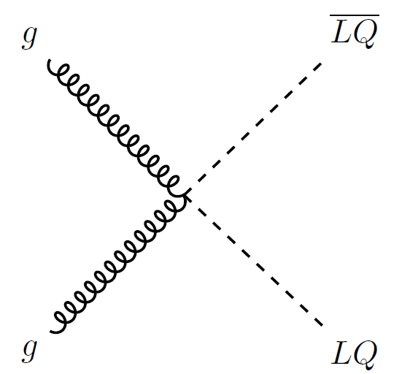
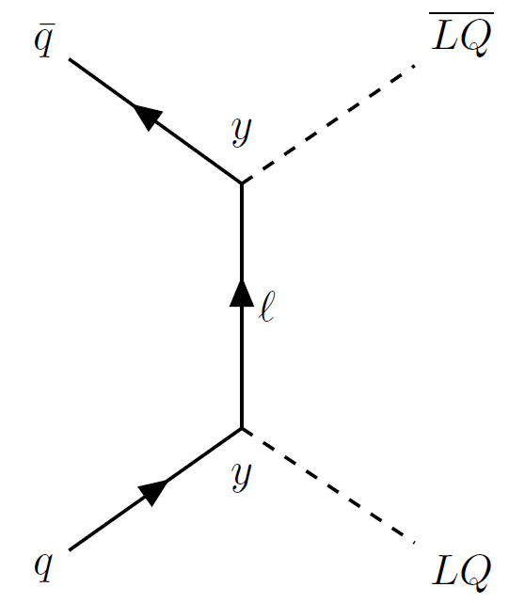
The Leptoquark
Some BSM theories introduce the Leptoquark (LQ), a (spin-0,1) boson that couples directly to both quarks and leptons.
The LQ can be used to explain the aforementioned discrepancy, as well as generate neutrino masses via quantum corrections. Babu, Julio, NPB841 (2010).
Our goal for this project was to study a novel method for pair producing LQ’s at the LHC

Slide 4
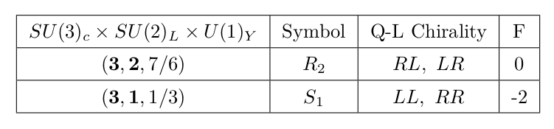
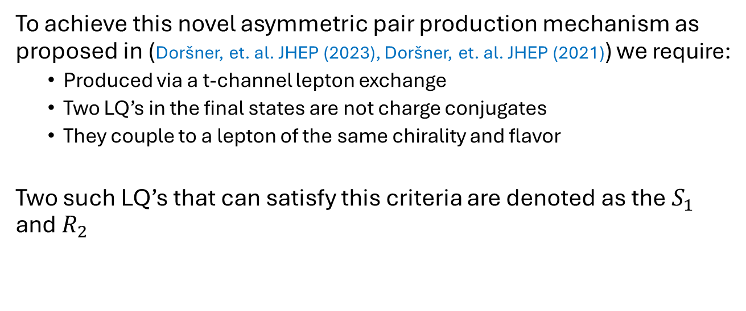
Asymmetric Pair Production
To achieve this novel asymmetric pair production mechanism as proposed in (Doršner, et. al. JHEP (2023), Doršner, et. al. JHEP (2021)) we require:
Produced via a t-channel lepton exchange
Two LQ’s in the final states are not charge conjugates
They couple to a lepton of the same chirality and flavor
Two such LQ’s that can satisfy this criteria are denoted as the $S_{1}$ and $R_{2}$

Slide 5
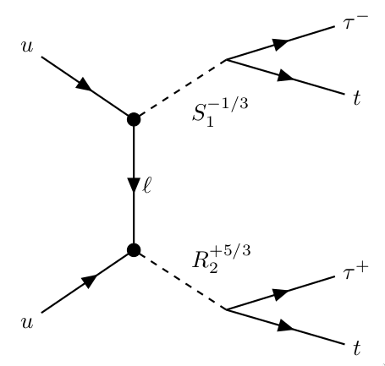
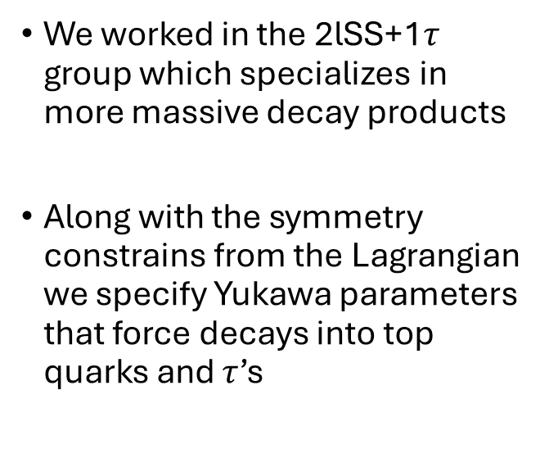
Asymmetric Pair Production
We worked in the 2lSS+1$τ$ group which specializes in more massive decay products
Along with the symmetry constrains from the Lagrangian we specify Yukawa parameters that force decays into top quarks and $τ$’s

Slide 6
Analysis
We used advanced event generators and parton showering programs like MadGraph5 and Pythia8 for the simulation
The decays of these heavy particles give a final state that is almost identical to that of other SM processes
Our goal is to differentiate our final-state signature (the signal) from these others (background)
We use Machine Learning (ML) on the vast number of output variables produced by the simulations (n-tuples)

Slide 7
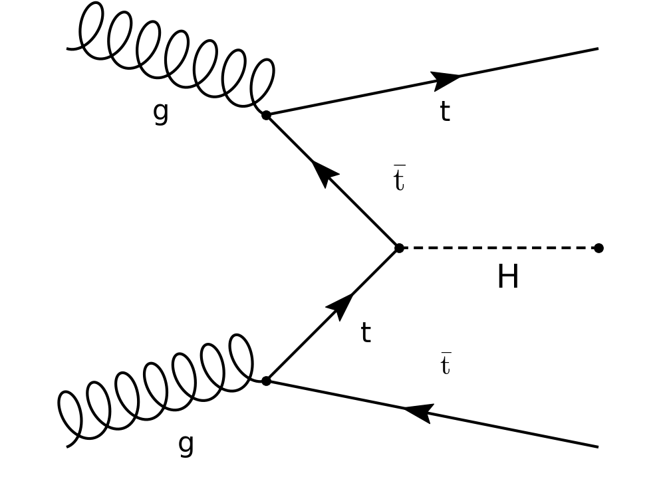
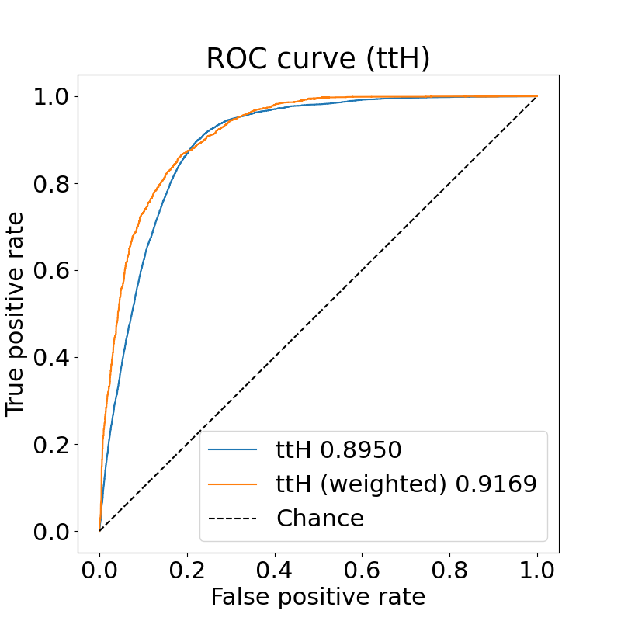
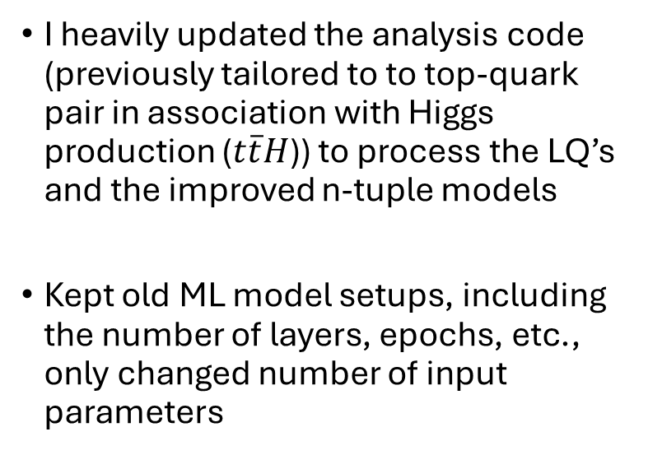
Analysis
I heavily updated the analysis code (previously tailored to to top-quark pair in association with Higgs production ($t\overline{t}H$)) to process the LQ’s and the improved n-tuple models
Kept old ML model setups, including the number of layers, epochs, etc., only changed number of input parameters

Slide 8
Results
We show results of the analysis code on the previous ttH data to compare the performance
Full LQ results are still a work in progress
After the model was trained, we used a program called TRExFitter to display some histograms of the model's output
It also generated some preliminary info on the statistical uncertainty

Slide 9
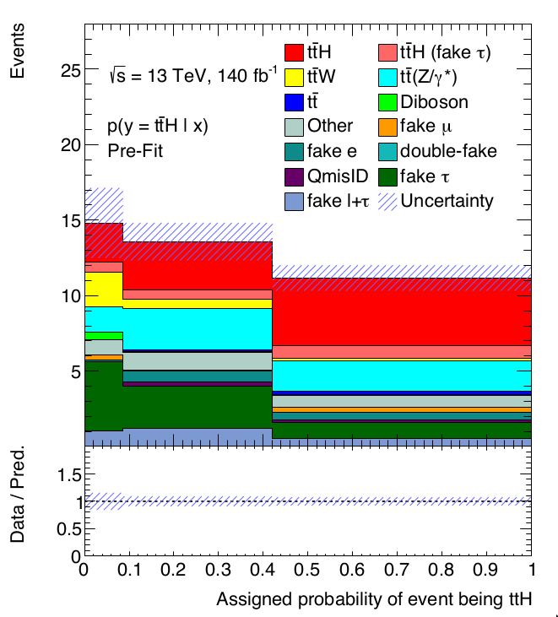
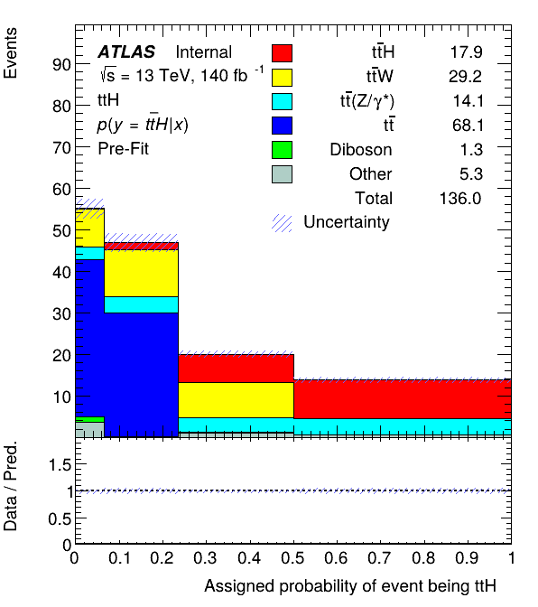
Results – Signal Separation

Slide 10
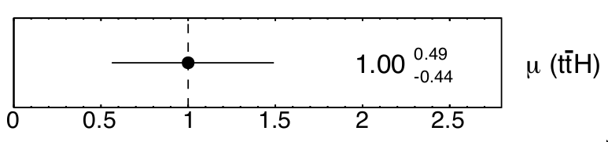
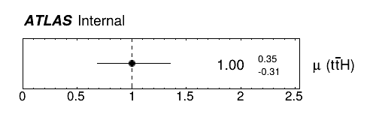
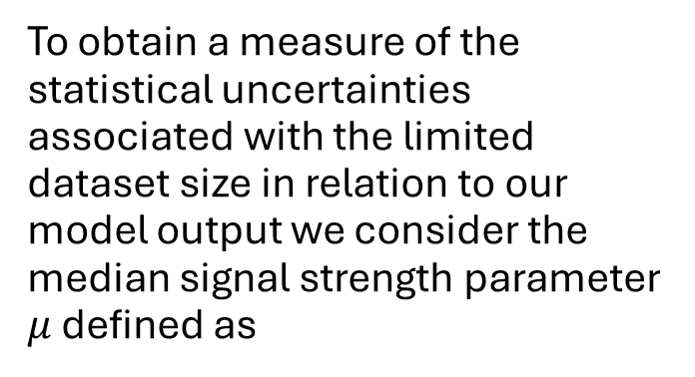
Results – Statistical Uncertainties
To obtain a measure of the statistical uncertainties associated with the limited dataset size in relation to our model output we consider the median signal strength parameter $μ$ defined as
$$\left(\text{background}\right) +μ⋅\left(\text{signal}\right)=\text{observed}$$

Slide 11
Conclusions and Future Plans
We have shown that the analysis code prepared for this novel LQ production method performs very well after preliminary testing
Inputting the LQ samples are next
Fine tune model parameters
Investigating systematics and things like fake-classification which are left out in the newest n-tuple model
This machinery will be used to explore the parameter space of a variety of BSM models

Slide 12
Backup

Slide 13
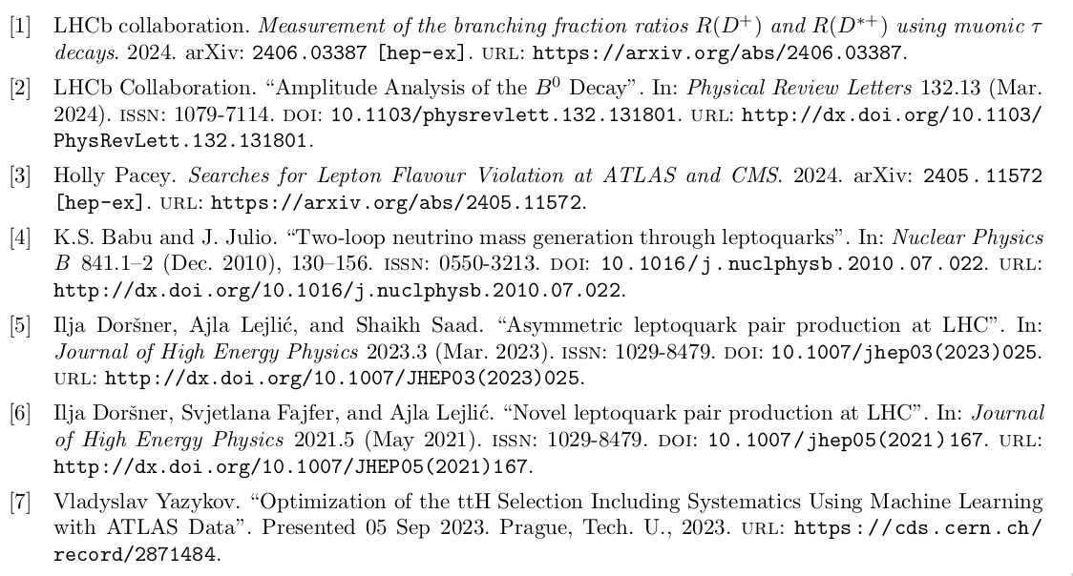
References

