Slide 1
PHYS4260 Quantum Mechanics II Spring 2025
Time Dependent Perturbation Theory

Slide 2
Outline
Final remarks on perturbation theory
Necessity of a field viewpoint

Slide 3


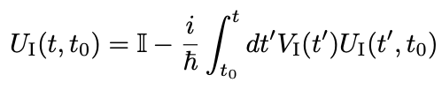
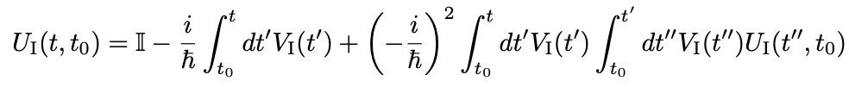
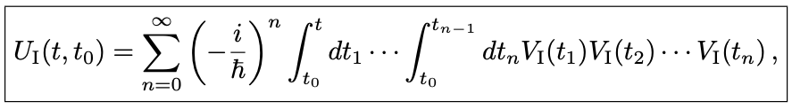
Re: Final remarks on Perturbation Series
Last week we have seen that, we can write
with the boundary condition
. Integrating this equation from $t_{0}$ to $t$, formally we obtain,
This result provides a self-consistent equation for $U_{I}\left(t,t_{0}\right),$ i.e. if we take this expression and substitute $U_{I}(t^{′},t_{0})$ under the integrand, we obtain
Iterating this procedure, we thus obtain
(1)

Slide 4

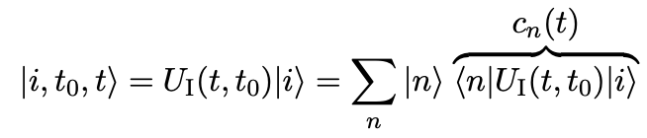
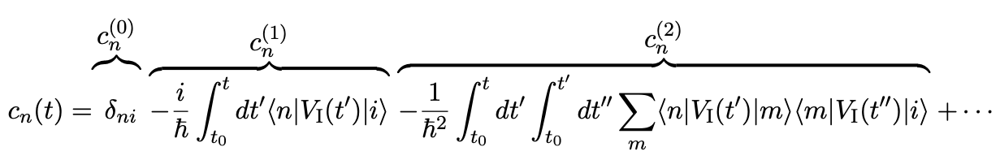

Re: Final remarks on Perturbation Series
The term $n = 0$translates to $𝕀$. Note that the operators $V_{I} (t)$ are organized in a time-ordered sequence, with
$t_{0}≤t_{n}≤t_{n−1}≤$… $≤t_{1}≤t$. With this understanding, we can write this expression more compactly as
where “T” denotes the time-ordering operator, and its action is understood by Eq. (1). If a system is prepared in an initial state, $|i⟩$ at time ${t=t}_{0}$, at a subsequent time, $t$, the system will be in a final state,
Making use of Eq. (1), and the resolution of identity, $\sum_{m}{|m⟩⟨m|}=𝕀$, we obtain

Slide 5

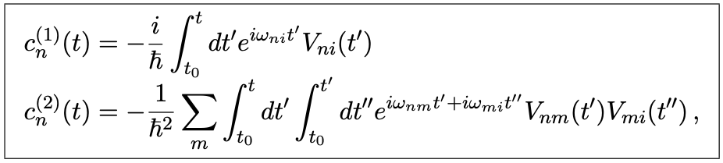


Re: Final remarks on Perturbation Series
Re calling that
we thus find the coefficients perturbatively
where
and
The probability of eﬀecting a transition from state $|i⟩$ to state $|n⟩$ for $n≠i$ is given

Slide 6


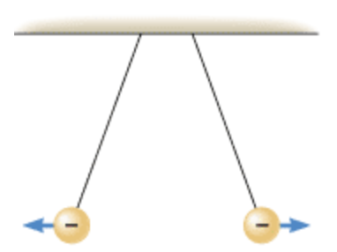


The question (or quest?) for convergence
In 1952 Freeman Dyson shocked the high energy physics community by declaring that, quite generally, the QED perturbation series cannot converge. The argument he used is explained as follows. Suppose we have the form of a physical quantity given as a power series in the charge coupling in QED
for some nonzero value of $e^{2}$. Then, $F(e^{2})$ analytic at $e = 0$ means that the physical quantity is an analytic function of $e$ for $e = 0$. Therefore, if $F(e^{2})$ is an analytic function, we can extend $e^{2}$ to the complex plane and the radius of convergence must be finite about $e^{2}=0$. So,
should also be convergent for sufficiently small values of $e^{2}$. We can interpret the physical quantity $F({−e}^{2})$ as arising
in a world where like charges attract each other.

Slide 7
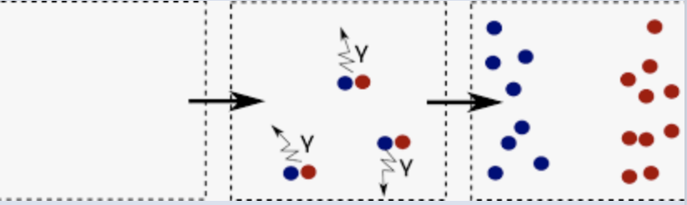
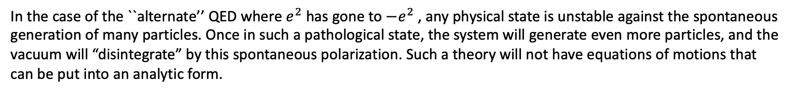
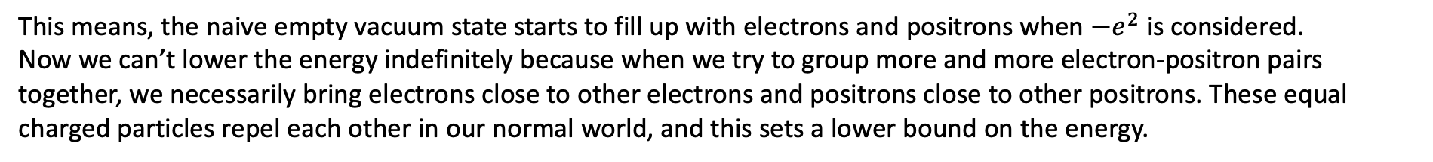
The question (or quest?) for convergence
In the classical limit of large particle number and large distances, the potential between charges is just the classical Coulomb potential with a sign reversal. One can imagine a “pathological” state with a large number of electron-positron pairs with the electrons separated from the positrons in different regions of space such that the negative Coulomb potential is larger than the rest energy and kinetic energy of the particles themselves.
In the case of the ``alternate’’ QED where $e^{2}$ has gone to $−e^{2}$ , any physical state is unstable against the spontaneous generation of many particles. Once in such a pathological state, the system will generate even more particles, and the vacuum will “disintegrate” by this spontaneous polarization. Such a theory will not have equations of motions that can be put into an analytic form.
This means, the naive empty vacuum state starts to fill up with electrons and positrons when $−e^{2}$ is considered.
Now we can’t lower the energy indefinitely because when we try to group more and more electron-positron pairs together, we necessarily bring electrons close to other electrons and positrons close to other positrons. These equal charged particles repel each other in our normal world, and this sets a lower bound on the energy.

Slide 8
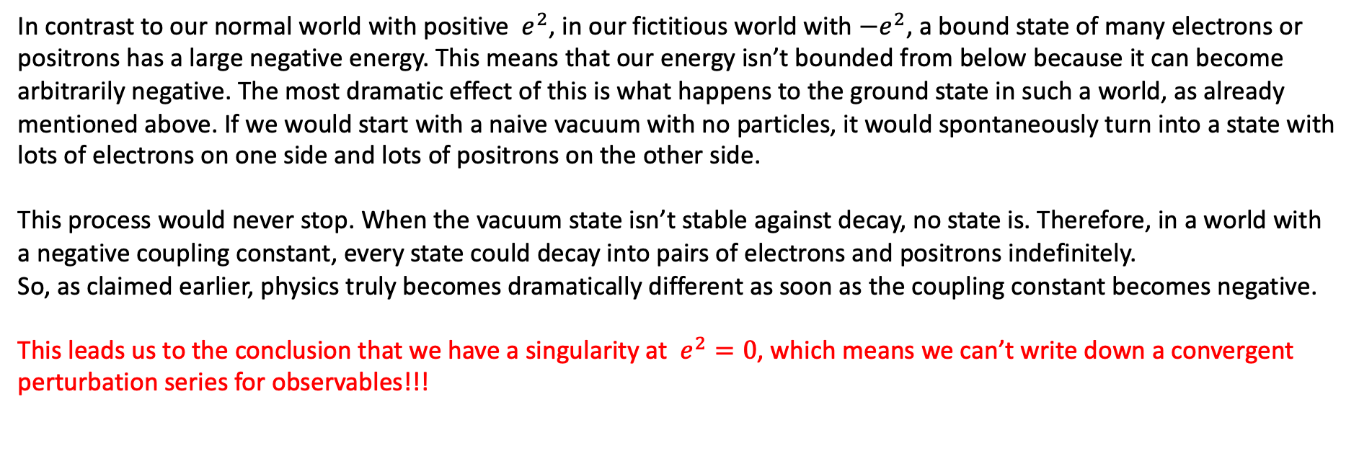
The question (or quest?) for convergence
In contrast to our normal world with positive $e^{2}$, in our fictitious world with $−e^{2}$, a bound state of many electrons or positrons has a large negative energy. This means that our energy isn’t bounded from below because it can become arbitrarily negative. The most dramatic effect of this is what happens to the ground state in such a world, as already mentioned above. If we would start with a naive vacuum with no particles, it would spontaneously turn into a state with lots of electrons on one side and lots of positrons on the other side.
This process would never stop. When the vacuum state isn’t stable against decay, no state is. Therefore, in a world with a negative coupling constant, every state could decay into pairs of electrons and positrons indefinitely.
So, as claimed earlier, physics truly becomes dramatically different as soon as the coupling constant becomes negative.
This leads us to the conclusion that we have a singularity at $e^{2}=0$, which means we can’t write down a convergent perturbation series for observables!!!

Slide 9
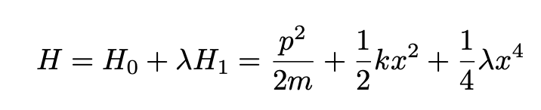
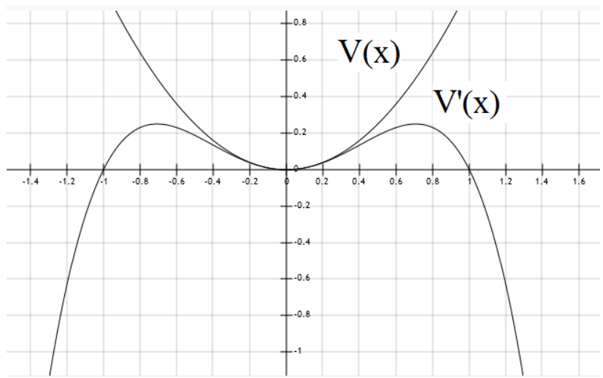
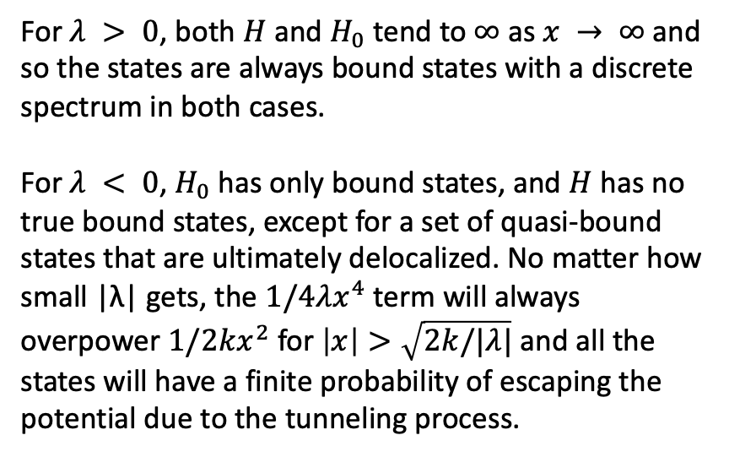
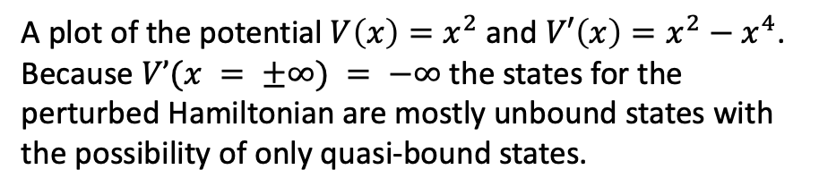
The question (or quest?) for convergence
The instability situation is similar to the case of the non-relativistic perturbed quantum harmonic oscillator
perturbation
For $λ > 0$, both $H$ and $H_{0}$ tend to $∞$ as $x → ∞$ and so the states are always bound states with a discrete spectrum in both cases.
For $λ < 0$, $H_{0}$ has only bound states, and $H$ has no true bound states, except for a set of quasi-bound states that are ultimately delocalized. No matter how small |λ| gets, the $1/4λx^{4}$ term will always overpower $1/2kx^{2}$ for $\left|x\right|>\sqrt{2k/|λ|}$ and all the states will have a finite probability of escaping the potential due to the tunneling process.
A plot of the potential ${V\left(x\right)=x}^{2}$ and ${V′\left(x\right)=x}^{2}−x^{4}$. Because $V’(x = ±∞) = −∞$ the states for the perturbed Hamiltonian are mostly unbound states with the possibility of only quasi-bound states.

Slide 10

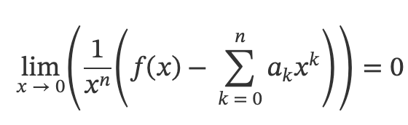
Why do we keep using perturbation theory?
The key point is that the expansion in perturbation theory is viewed as an asymptotic expansion.
An asymptotic expansion of a function is a formal power series that may not converge, but whose terms decrease fast enough such that the truncation of the series at any finite order still provides a controlled approximation to a given function.
Asymptotic expansion. Given a function $f:ℝ→ℝ$, a formal power series is an asymptotic expansion of $f$ at $x=0$ if for each $n∈ℕ$ the limit of the difference between $f$ and the sum of the first $n$ terms of the series divided by $x^{n}$ is zero as $x$tends to 0:
This definition makes no statement about the behavior as $n→∞$. In particular, an asymptotic expansion may have vanishing radius of convergence (and nevertheless provide useful approximate information).

Slide 11
Why do we keep using perturbation theory?
Nevertheless, for examples such as quantum electrodynamics and quantum chromodynamics as in the standard model of particles, the truncation of these series to the first handful of loop orders happens to agree with experiment (such as at the LHC collider) to high precision (for QED) or at least good precision (for QCD).
Therefore, one interprets the scattering matrix in perturbative quantum field theory as an asymptotic expansion of what should be the true non-perturbative result.

Slide 12
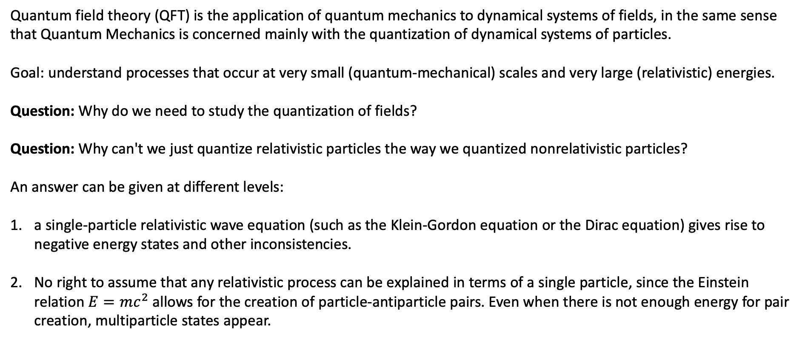
Necessity of a Field viewpoint
Quantum field theory (QFT) is the application of quantum mechanics to dynamical systems of fields, in the same sense that Quantum Mechanics is concerned mainly with the quantization of dynamical systems of particles.
Goal: understand processes that occur at very small (quantum-mechanical) scales and very large (relativistic) energies.
Question: Why do we need to study the quantization of fields?
Question: Why can't we just quantize relativistic particles the way we quantized nonrelativistic particles?
An answer can be given at different levels:
a single-particle relativistic wave equation (such as the Klein-Gordon equation or the Dirac equation) gives rise to negative energy states and other inconsistencies.
No right to assume that any relativistic process can be explained in terms of a single particle, since the Einstein relation $E=mc^{2}$ allows for the creation of particle-antiparticle pairs. Even when there is not enough energy for pair creation, multiparticle states appear.

Slide 13
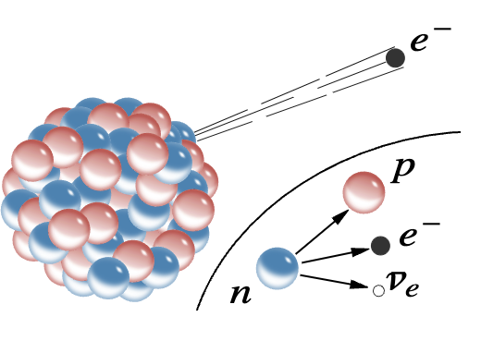
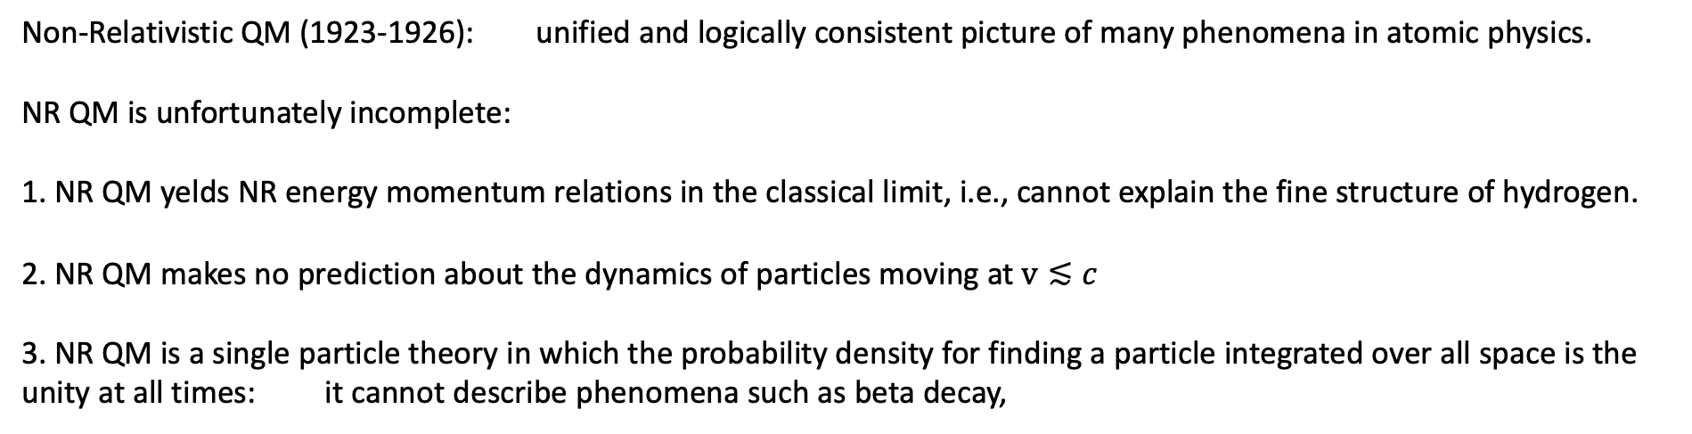
Issues with non-relativistic Quantum Mechanics
Non-Relativistic QM (1923-1926): unified and logically consistent picture of many phenomena in atomic physics.
NR QM is unfortunately incomplete:
1. NR QM yelds NR energy momentum relations in the classical limit, i.e., cannot explain the fine structure of hydrogen.
2. NR QM makes no prediction about the dynamics of particles moving at $v≲c$
3. NR QM is a single particle theory in which the probability density for finding a particle integrated over all space is the unity at all times: it cannot describe phenomena such as beta decay,
or it cannot describe excited atoms returning to their ground state by spontaneously emitting a single photon
in the absence of any external field

Slide 14
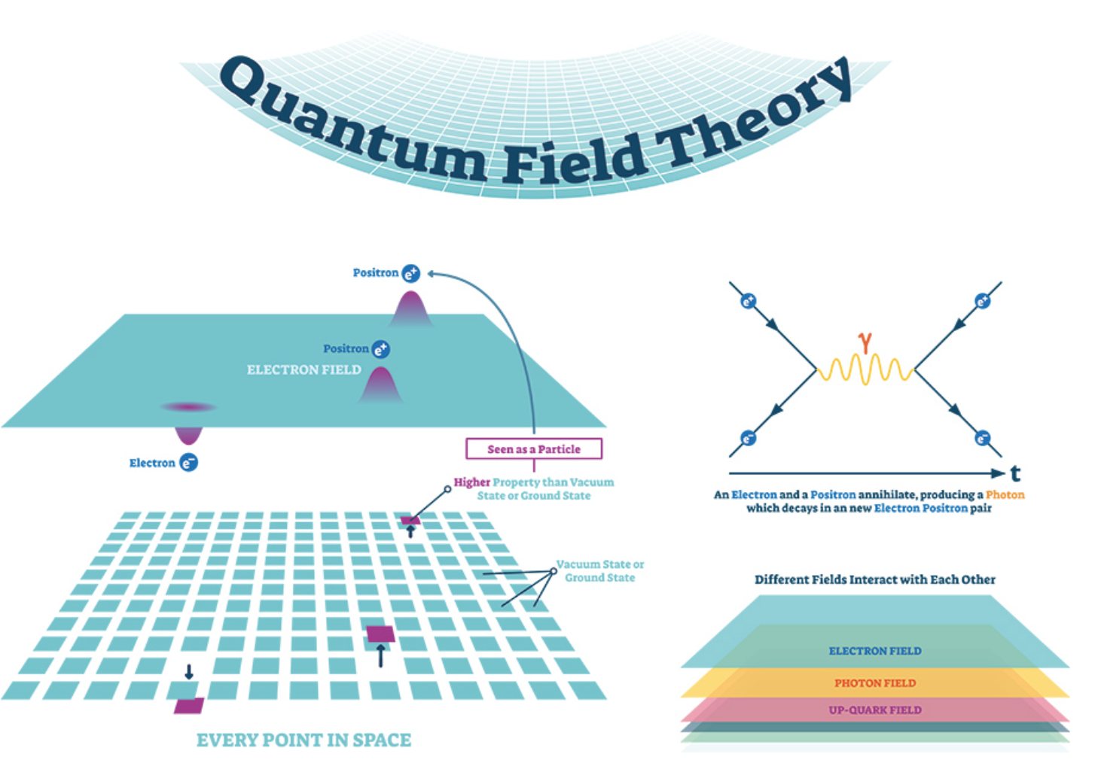
Issues with non-relativistic Quantum Mechanics
Essentially, NR QM cannot cope with the dynamics of multi-particle systems with creation and annihilation.
Dirac 1927: Quantum Theory of emission and absorption of radiation opened up a new subject called Quantum Fields.
Particles of definite mass and spin are interpreted as quantum mechanical excitation of a field.

Slide 15
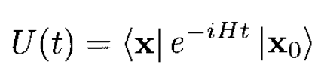
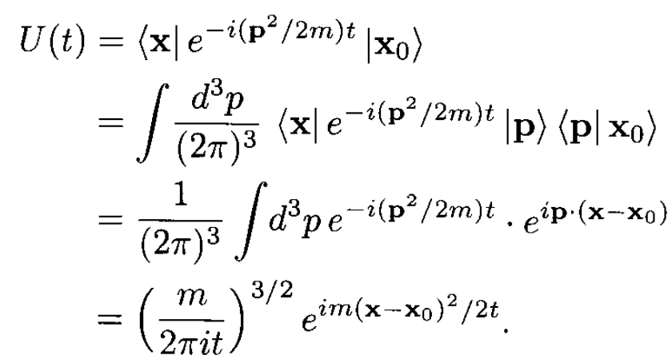
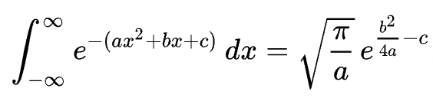
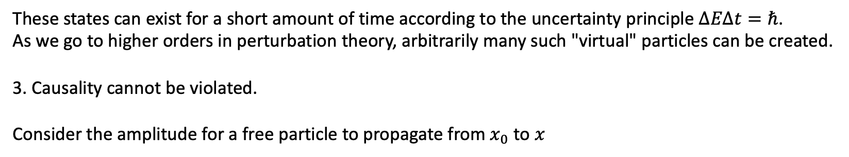
Issues with non-relativistic Quantum Mechanics
These states can exist for a short amount of time according to the uncertainty principle $ΔEΔt=ℏ$.
As we go to higher orders in perturbation theory, arbitrarily many such "virtual" particles can be created.
3. Causality cannot be violated.
Consider the amplitude for a free particle to propagate from $x_{0}$ to $x$
In nonrelativistic quantum mechanics we have $E=p^{2}/2m$, so
This expression is nonzero for all x and t, indicating that a particle can propagate between any two points in an arbitrarily short time.
Use the relation

Slide 16
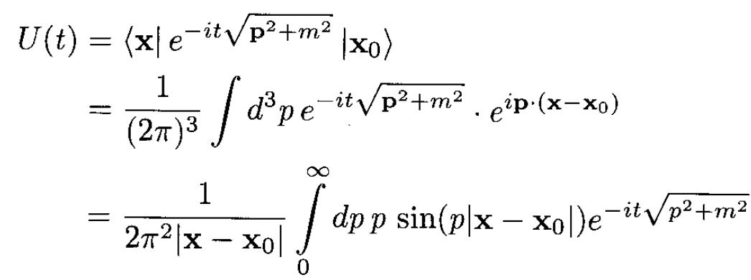
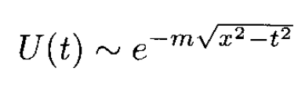
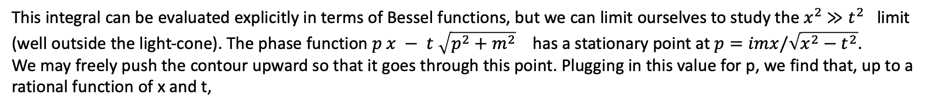
Issues with non-relativistic Quantum Mechanics
In a relativistic theory, this conclusion would signal a violation of causality. One might hope that using the relativistic expression $E=\sqrt{p^{2}c^{2}+m^{2}c^{4}}$ would help, but it does not. In analogy with the nonrelativistic case, we have
This integral can be evaluated explicitly in terms of Bessel functions, but we can limit ourselves to study the $x^{2}$ $≫t^{2}$ limit (well outside the light-cone). The phase function $p x − t \sqrt{p^{2}+m^{2}}$ has a stationary point at $p=imx/\sqrt{x^{2}−t^{2}}$.
We may freely push the contour upward so that it goes through this point. Plugging in this value for p, we find that, up to a rational function of x and t,
Thus, the propagation amplitude is small but nonzero outside the light-cone, and causality is still violated

